Slide 1
Topic – Airline Reservation
Domain – Transportation
Team -03

Slide 2
Team - 3
Team Members:
Kevin (Team Leader)
Muneeb (Member 1)
Piyush (Member 2)
Vidisha (Member 3)

Slide 3
Technologies Used
-
Client Side Scripting/Coding (Visual Studio Code IDE)
HTML (Hypertext Markup Language)
CSS (Cascading Style Sheets)
Angular
JavaScript , TypeScript
Server Side Scripting / Coding (Eclipse IDE)
Hibernate
Spring Boot

Slide 4
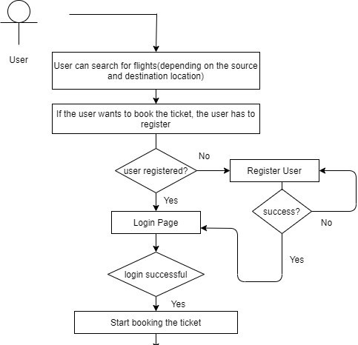
Design
-

Slide 5
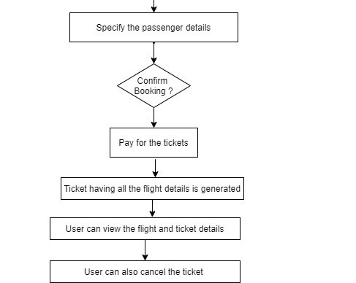
Design
-

Slide 6
Flow of project for User Module
The user searches for flights depending on source and destination location.
The user has to register for booking tickets.
The user has to login after registration
After successful login, the user can book the tickets.
User has to provide passenger details.
User can confirm the booking by paying the price of ticket.
The ticket is generated for the user and the user can view all the details

Slide 7
Flow of project for Admin Module
The admin can login using the admin credentials.
A dashboard is displayed with different options for admin.
Admin can add new flights along with all the flight details and this will be reflected on the user module.
Admin can delete any flight in case of failure/cancellation so that no false information is displayed.
Admin will be able to view all flights details available.

Slide 8
Implementation- Registration Module
-
Any visitor who visits the website for first time will be required to register to create user account.
Functionality | Operation
UserCreation | Write
Sign-Up Button : User details will be validated and then the details are stored in the Users table using UserCreation Api.
Login Link : If the user already has an account, it will redirect to login page.

Slide 9
Implementation-Login Module
-
After registration the user will be able to login using credentials and then the user will be able to get flight details.
Functionality | Operation
logincheck | read
register | write
Login Button: The user details will be verified and then if the details are proper it will redirect to Flight Search Page
Register : If the user does not have a account then they can register by clicking on the Sign Up link.

Slide 10
Implementation –Flight Search and Select Module
-
Any visitor of the website should be able to search for a flight, but booking can only be done after logging-in to the website.
Functionality | Operation
ViewFlight - on source and destination | Read

Slide 11
Implementation-Passenger Module
-
The passenger details are stored and can also be updated or deleted.
After selecting flight, user will be asked to enter passenger’s details and select seats before going for payment
Functionality | Operation
createPassenger | Write
GetPassengerById | Read
GetPassengerByUserId | Read
deletePassenger - cancellation of ticket | Write
UpdatePassenger | Read/Write

Slide 12
Implementation-Flight Ticket Details Module
-
User gets the ticket after the payment is done successfully and all details related to the user can be retrieved
Functionality | Operation
Fdetailticket - by ticket id | Read
Fdetail -by flight id | Read
fUid - get user id by ticket id | Read
fBookD – booking date | Read
fJType - get journey type | Read

Slide 13
Implementation-Payment Module
-
After Searching and selecting , user makes the payment
Functionality | Operation
newpayment | Write

Slide 14
Implementation – Admin Module
-
The admin can perform various tasks related to admin
Functionality | Operation
AddFlight | Write
DeleteFlight | Write
GetAllFlights | Read

