Slide 1

BOOK STORE MANAGEMENT SYSTEM
TEAM 18
NILRAJ MAYEKAR
ANIRUDH MAHESHWARI
KEVIN MOSES RODRIGUES
VISHNUVARDHAN CHENNAVARAM
FEI CAO

Slide 2
PURPOSE
Inventory Management: It keeps track of the number of books in stock.
Order Processing: It manages customer orders.
Sales Promotion Management: The system allows for the creation and management of promotional events, applying discounts to orders.
Supplier and Publisher Relations: It maintains information about publishers and authors, which is essential for ordering new inventory and managing the supply chain.
Customer Relationship Management (CRM): It records customer details for personalized marketing and service and maintains a history of customer purchases.
Employee Management: The system manages employee information, including their roles within the bookstore, which can help in scheduling and task assignment.
Reporting and Analysis: By tracking various entities and their interrelations, the system can generate reports for sales, inventory levels, popular books, and employee performance, aiding in strategic decision-making.
Review Management: It manages customer reviews for books and merchandise, which can be used to improve customer satisfaction and guide future inventory selections.

Slide 3
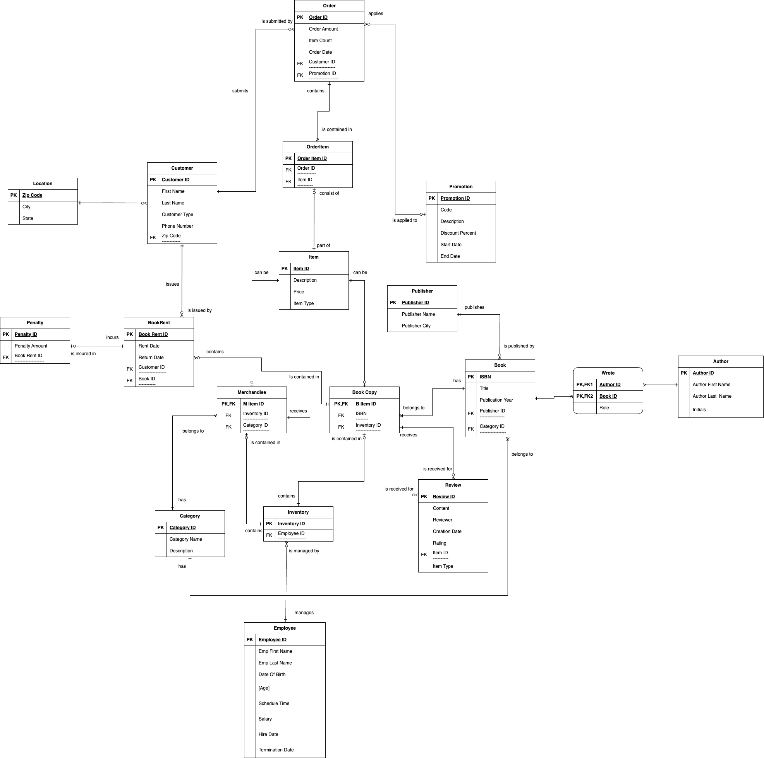
ER - DIAGRAM

Slide 4
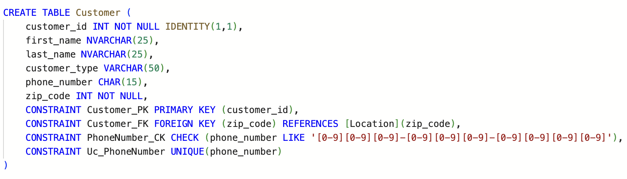
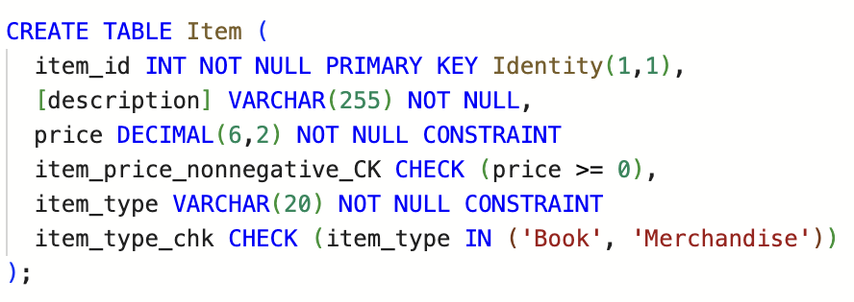
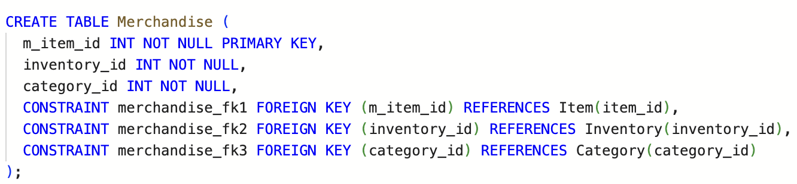
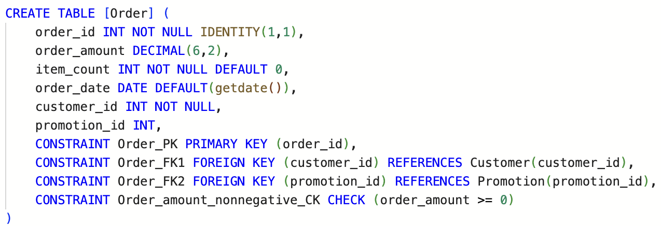
SQL DDL CREATE

Slide 5
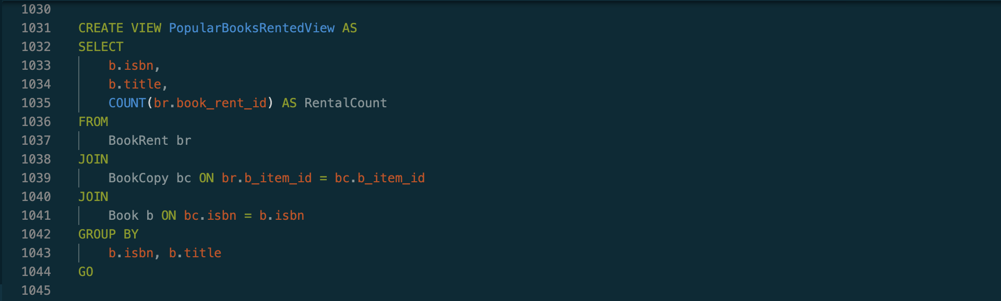
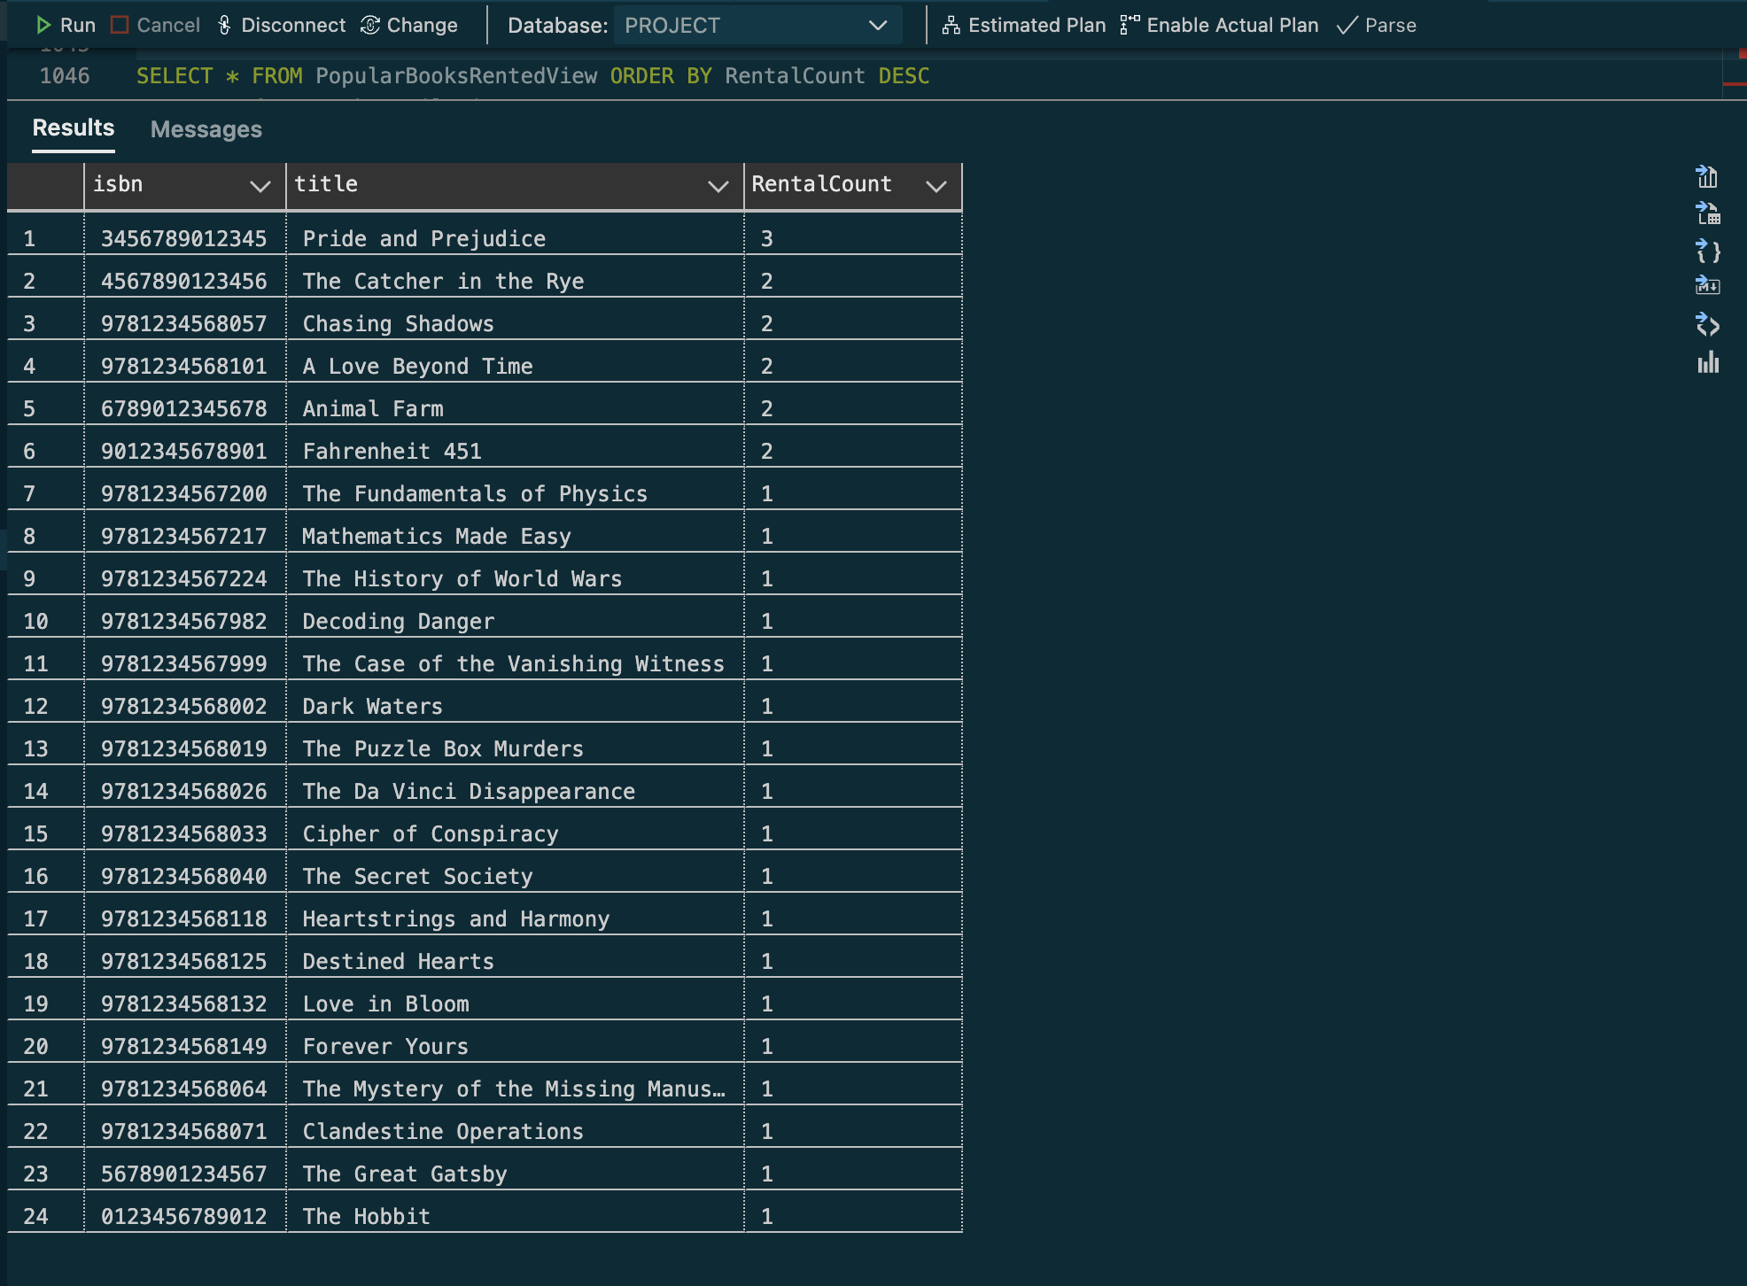
VIEWS
VIEW TO OBTAIN ALL THE POPULAR BOOKS RENTED
OUTPUT

Slide 6
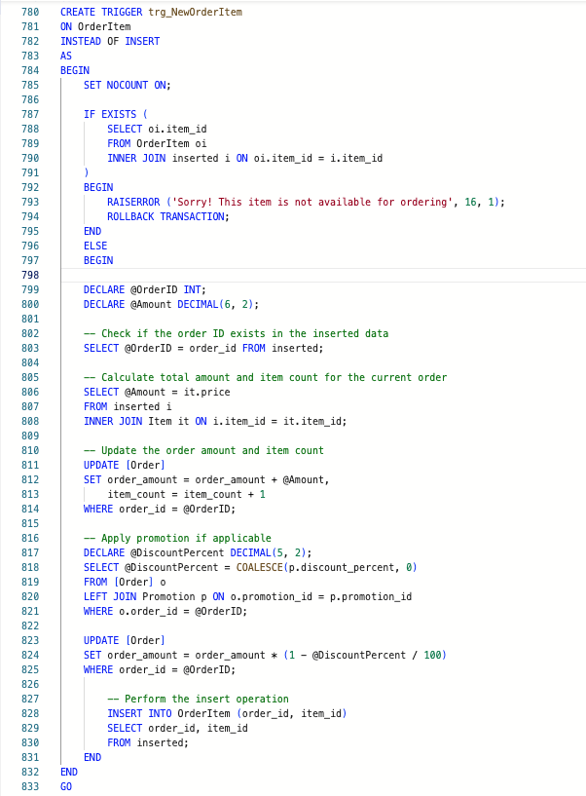
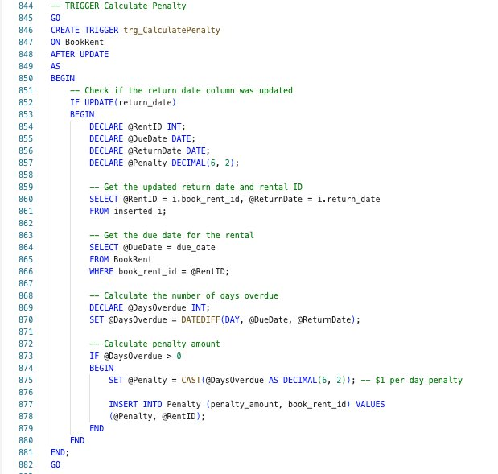
TRIGGERS
TRIGGER TO CHECK AND UPDATE NEW
ORDER ITEM
TRIGGER TO CALCULATE AND UPDATE
PENALTY
​

Slide 7
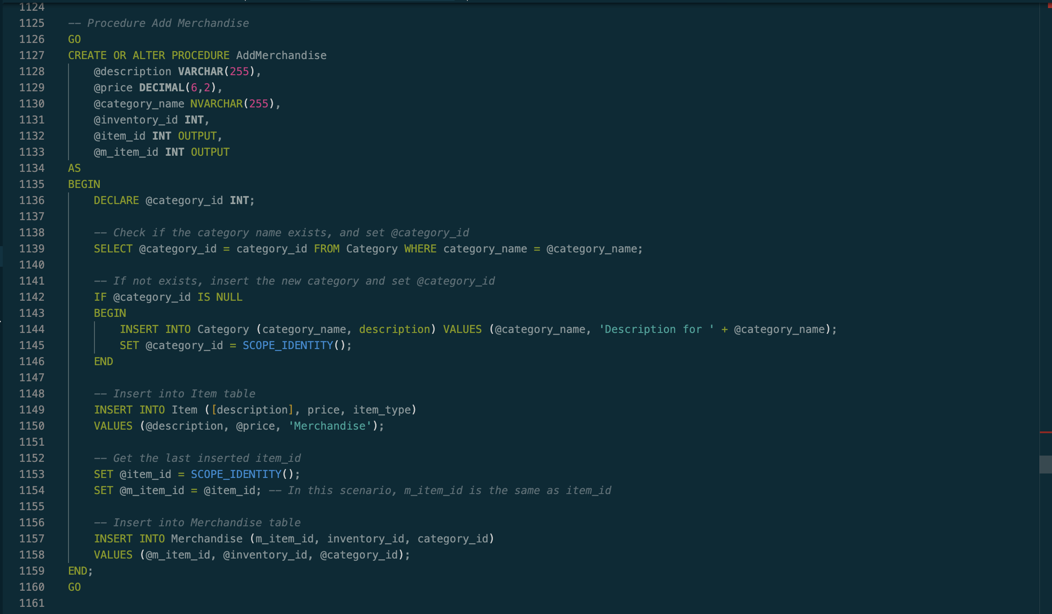
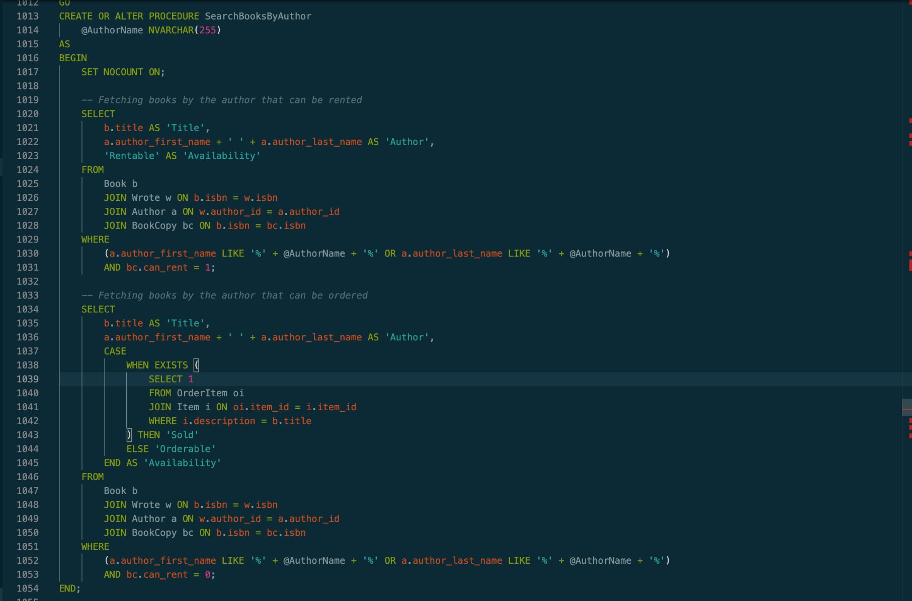
STORED PROCEDURES
STORED PROCEDURE FOR ADDING A MERCHANDISE
STORED PROCEDURE FOR SEARCHING BOOKS BY AUTHOR
​

Slide 8
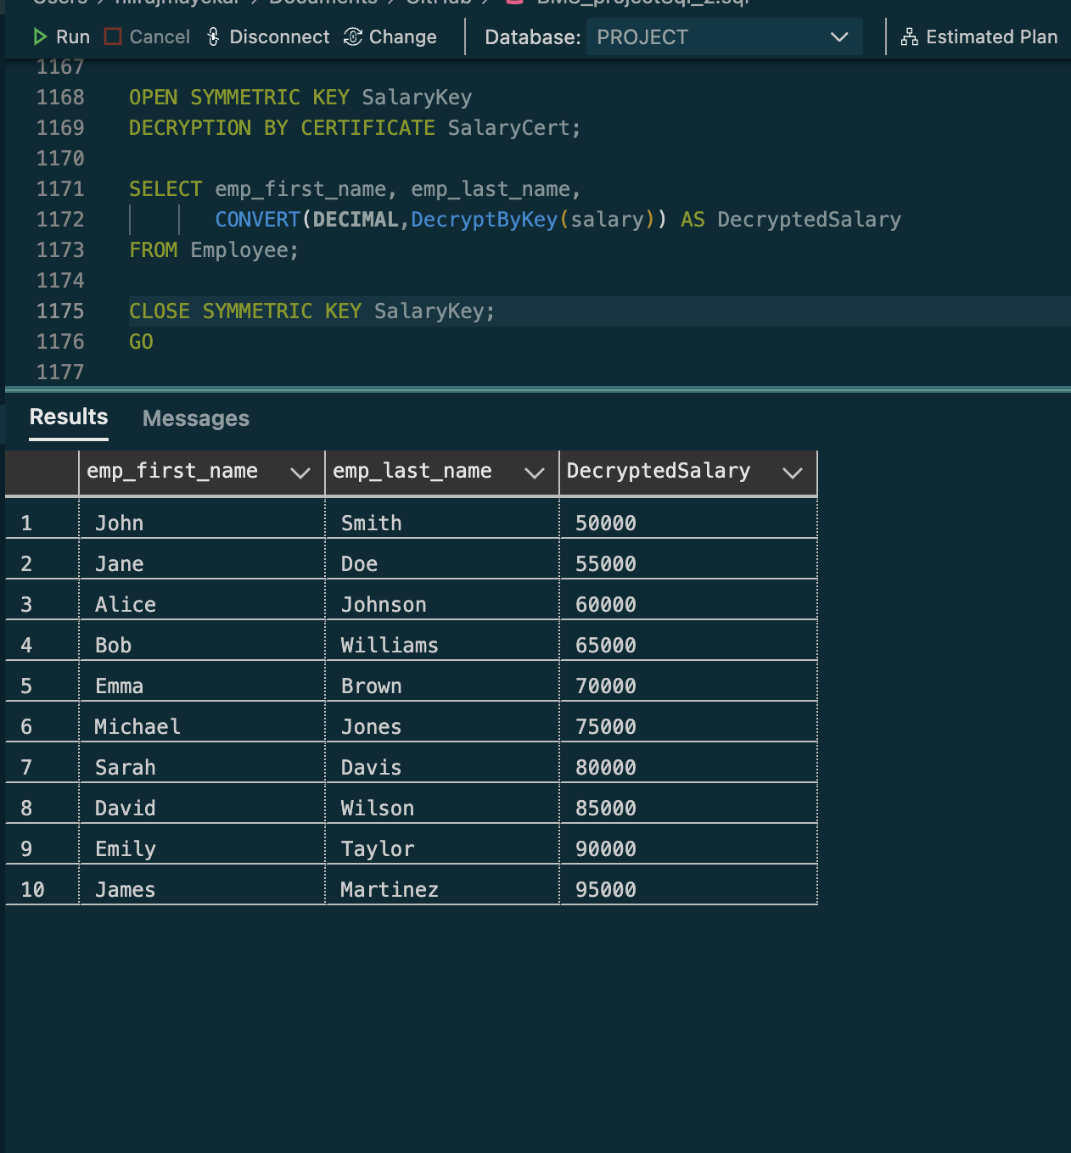
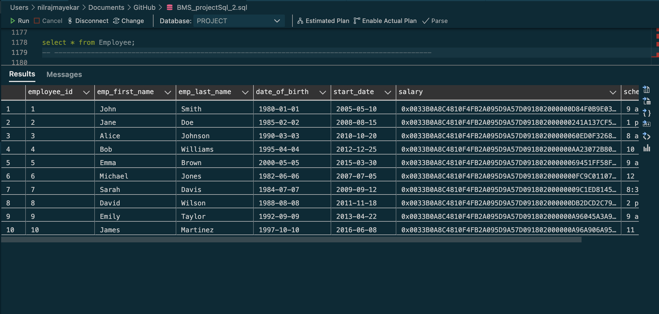
ENCRYPTION AND DECRYPTION
ENCRYPYTION FOR AN EMPLOYEE SALARY
OUTPUT
​

Slide 9
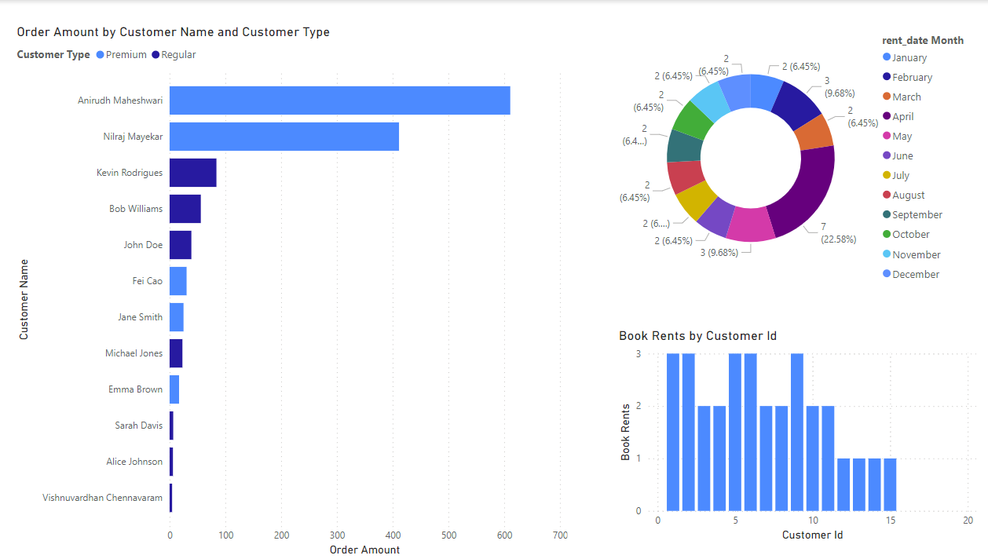
REPORTS
ANALYSIS
The stacked bar graph shows the order amount as per each customer name and type.
Donut chart shows the total number of books that were rented in each month.
Bar graph indicates the books rented by each customer through its customer id.
​

Slide 10
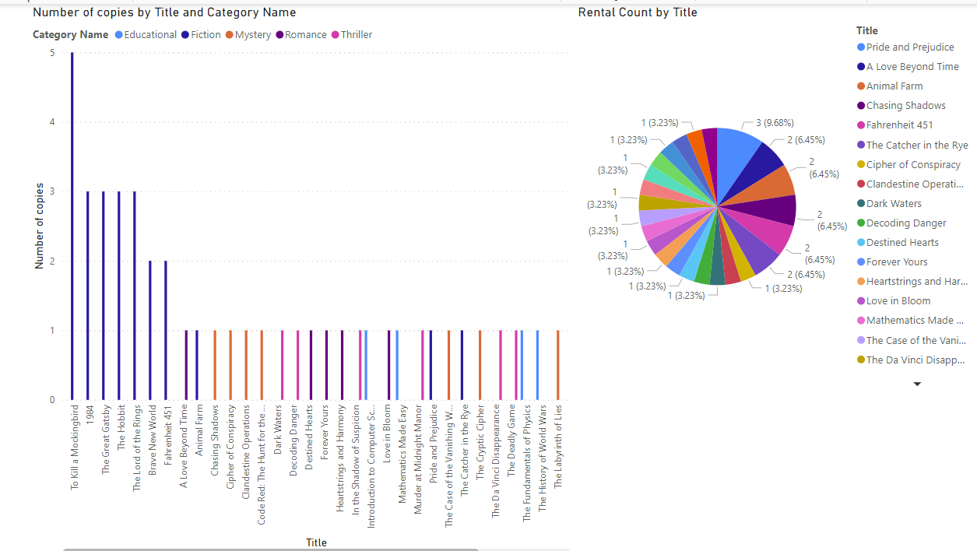
REPORTS CONTINUED....
ANALYSIS
Column chart shows the number of copies against its title and category name.
Pie chart indicates the rental count of books by its title.
​

Slide 11

THANK YOU

