Slide 1

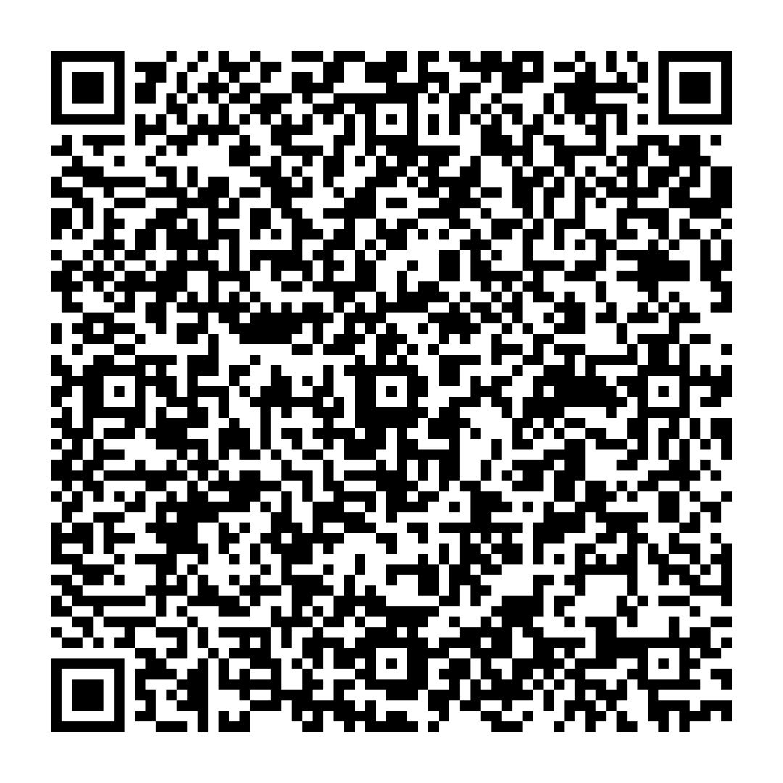
Beyond Tools and Resources: A Deep Dive into MCP Sampling for Agentic Features
Kevin Rohan Vaz
Senior Software Engineer @ SmartBear
Notes:
Hi Everyone
My name is Kevin Vaz, and i work at SmartBear as a senior software engineer on the API contract testing product and maintaining its SmartBear MCP integration, i won't go into detail on what API contract testing is, but if anyone is interested we can chat after the talk.
Sampling is an interesting feature which i came across while working on the smarbear mcp

Slide 2
AGENDA
Problem Statement
Introduction to Sampling
Walkthrough of Sampling Capabilities & Internals
Sampling Patterns Demo
Challenges in adopting Sampling
Q&A
Notes:
This is the agenda for this talk i will be talking about when do you use sampling, what is sampling, what are some of its capabilities, how does it work internally, some demos on different ways you can use sampling as well as how did i use it in smartbear mcp, some challenges that you can encounter while adopting it and future path forward for sampling.

Slide 3
Problem Statement
“Trying to build AI powered MCP tools?”
API key sprawl Every server needs its own LLM credentials, billing, and rate limit management - multiplied across every tool you build.
No user control LLM calls happen silently inside the server. Users can't see, edit, or reject what gets sent to the model.
"Every MCP server that needs AI has to solve the same problem - where does the LLM come from?"
“Sampling solves this by letting the server borrow the client's LLM — with the user always in control.”
Notes:
So you want to build ai powered mcp tools?
there are two challenges u will face, making integrations with specific llms
and users will not be able to control the flow in specific integrations

Slide 4
Introduction to Sampling
Client-side LLM access via MCP
No LLM needed on the server - Build AI features without server-side models.
Server-initiated requests - Server asks the client to call the LLM.
Multimodal input support - Works with text, images, and audio.
Notes:
sampling is when the server can access an LLM via a client without needing it at the server's end
now an important point to note here is generally in the mcp client and mcp server connections the client initiates requests to a server and the server responds back, in this case the flow is flipped and the server will now send requests to a client and the client responds back with llm responses

Slide 5
Sampling Capabilities
Capability priorities
Cost - How important is minimizing costs?
Speed - How important is low latency?
Intelligence - How important are advanced capabilities?
Model Selection – specify preferred models for the feature
Model Inference parameters – temperature & max tokens
Tool Use for building agents & parallel tool execution
{
"hints": [
{ "name": "claude-3-sonnet" }, // Prefer Sonnet-class models
{ "name": "claude" } // Fall back to any Claude model
],
"costPriority": 0.3, // Cost is less important
"speedPriority": 0.8, // Speed is very important
"intelligencePriority": 0.5 // Moderate capability needs
}

Slide 6
Sampling Internals – Client-Side flow
MCP Client declares sampling support – Sends sampling capability jsonrpc message on server initialization.
MCP Client bridges the server ↔ LLM – Forwards requests to accessible models.

Slide 7
Sampling Internals – Server-Side flow
Tool trigger sends jsonrpc to client – Client handles the sampling request.
Server owns tool execution – Manages tools and the agent loop.
{
…
"method": "sampling/createMessage",
"params": {
"messages": [
{
"role": "user",
"content": { "type": "text", "text": ”Is it going to rain in Bengaluru?" }
}
],
"tools": [ { "name": "get_weather", "description": ”…", "inputSchema": {…} ],
"systemPrompt": "You are a helpful weather assistant",
"modelPreferences": {
"hints": [{ "name": "claude-3-sonnet" }],
"speedPriority": 0.8,
"intelligencePriority": 0.5
},
"maxTokens": 300
}
}

Slide 8
Sampling Patterns - Demo
Workflow (Single Turn flow) – Example use cases:- - Summarizing a pdf. - Explaining errors in a screenshot. - Generating new data for missing inputs.
Agentic (Multi Turn flow) – Example use cases:- - Solving questions which requires using multiple tools like ”Who is the most recent Turing award winner in the field of AI?”. - Setting up contract testing in a new project till tests are passing and published.
Hybrid (Mix of Workflows and Agents)

Slide 9

Notes:
well see some of these use cases in action with a small tui that i have built which contains a host application as well as an mcp json rpc inspector
the json rpc inspector is divided into 3 parts a flow diagram which will keep changing based on whats happening in the host application
events recieved and sent by the mcp client
and events recieved and sent by the mcp server
now the first thing mcp client does it sends what does it support and u can see the sampling and tools nested jsons that we saw earlier and the server will also respond with what does it support, its then followed by a tools/list operation and we see the server send back those out sampling server tools
next lets test our sampling feature in the host app by getting it to sumarize a pdf and we can see that that the server sends a sampling/createMessage request to the mcp client
now the client has recieved the sampling request but hasnt executed it yet as we didnt give it permission to do so lets do that and we see very quickly that we got the result client and it sent it to the server and which then sent it back to the client and we can see the summary of the pdf
now lets try an agentic flow well do that. by using a question that used from a benchmark called general ai assistant which tests how well a model can reasoning through a problem and use tools in order to solve that problem

Slide 11
Challenges in adopting Sampling
Limited host app support - Not all clients implement sampling.
No access to host tools or agents - Must implement operations independently.
Human-in-the-loop adds latency - Approval steps slow down automated flows.
No guaranteed model availability - Client picks the model, not the server.
Capability gaps across clients - Tool support varies by implementation.
Complex multi-turn state management - Server must track full message history.
No standardised error handling - Rejection and failure behaviour differs.

Slide 12

Q&A
QR code to slides and code examples

