Slide 1

Object Oriented Programming
Class Diagrams
Q: What did the Java code say to the C code?
A: You've got no class.

Slide 2
Overview
Objective
  To learn about Object Orientation Concepts
Content
  Classes versus Objects
  Principles of Object Orientation
  Why do Modeling?
  Class Diagram
After this module, you should be able to
  Explain the basic principles of Object Orientation
  Explain the importance of modeling
  Read a class diagram and translate it to code
Object Oriented Application Development

Slide 3



The Object Technology
OO is a way of looking at a software system as a collection of interactive objects
Reality
House
Car
Tom
Model
:House
lives in
Tom:Person
drives
:Car
Object Oriented Application Development

Slide 4
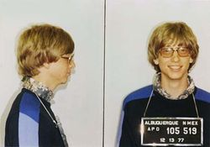
What is an Object?
Informally, an object represents an entity, either physical, conceptual, or software.
  Physical entity
  Conceptual entity
  Software entity
Car
US$100,000,000,000
Bill Gate’s bank account
Linked List
Object Oriented Application Development
Notes:
Picture of Bill Gates taken from http://en.wikipedia.org/wiki/Bill_gates.

Slide 5



Classes
A class is the blueprint from which individual objects are created.
An object is an instance of a class.
public class StudentTest {
public static void main(String[] args) {
Student s1 = new Student();
Student s2 = new Student();
}
}
Object factory
- class -
public class Student {
private String name;
// …
}
Cookie Cutter
Object Oriented Application Development

Slide 6


Classes & Objects
All the objects share the same attribute names and methods with other objects of the same class
Each object has its own value for each of the attribute
harry:Person
+ getAge()
name
Harry
Person
- name - dateOfBirth
+ getAge()
dateOfBirth
8/12/1975
mary:Person
+ getAge()
name
Mary
dateOfBirth
8/12/1980
Object Oriented Application Development

Slide 7

Basic Principles of Object Orientation
Object Orientation
Abstraction
Encapsulation
Modularity
Hierarchy
Object Oriented Application Development

Slide 8
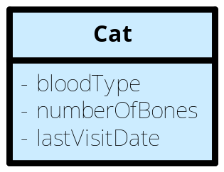
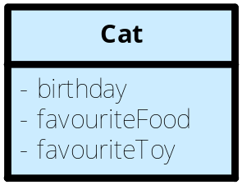





Abstraction
Determine the relevant properties and features while ignoring non-essential details
abstraction
Object Oriented Application Development

Slide 9

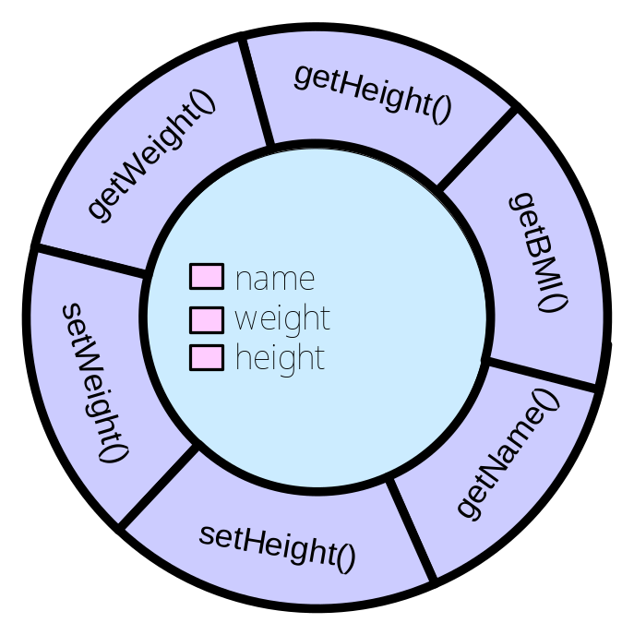
Encapsulation
Separate components into external
and internal aspects
setWeight(100)
Object Oriented Application Development
Notes:
Encapsulation is often referred to as “information hiding,” making it possible for the clients to operate without knowing how the implementation implements the interface. Some people make the distinction between abstraction and information hiding(http://www.javaworld.com/javaworld/jw-05-2001/jw-0518-encapsulation.html).

Slide 10
Modularity
Break something complex into manageable
pieces
  Functional Decomposition
  Object Decomposition
1
Step 1
Object
2
Step 2
Object
Object
Object
3
Step 3
Object Decomposition
Functional Decomposition
Object Oriented Application Development

Slide 11
Hierarchy
Ranking or ordering of objects
Asset
Increasing
abstraction
Bank Account
Stock
Saving Account
Current Account
Decreasing
abstraction
Object Oriented Application Development

Slide 12
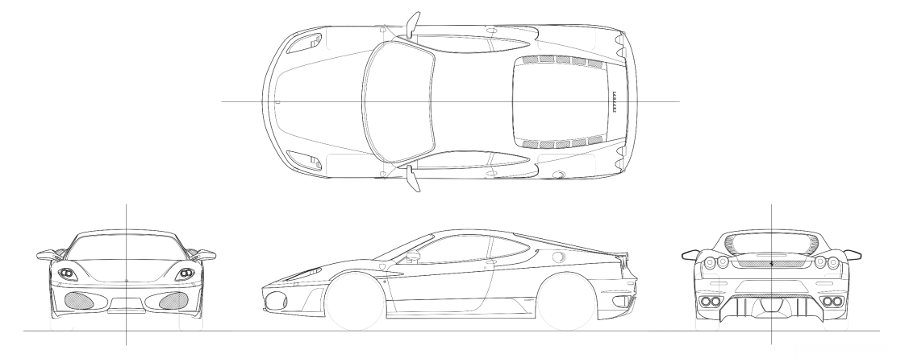

What is a model? https://www-computer-org.libproxy.smu.edu.sg/csdl/mags/so/2002/01/s1008.pdf
A simplification of reality.
Object Oriented Application Development

Slide 13
Why do we model? http://www.ibm.com/developerworks/rational/library/6007.html
Modeling achieves four aims:
  Helps you to visualize a system as you want it to be.
  Permits you to specify the structure or behavior of a system.
  Gives you a template that guides you in constructing a system.
  Documents the decisions you have made.
Object Oriented Application Development
Notes:
According to Booch in The Unified Modeling Language User Guide, modeling achieves four aims:
1. Models help you to visualize a system, as you want it to be. A model helps the software team communicate the vision for the system being developed. It is difficult for a software team to have a unified vision of a system that is described only in specification and requirement documents. Models bring about understanding of the system.
2. Models permit you to specify the structure of behavior of a system. A model allows how to document system behavior and structure before coding the system.
3. Models give a template that guide you in constructing a system. A model is an invaluable tool during construction. It serves as a road map for a developer. Have you experienced a situation where a developer coded incorrect behavior because he or she was confused over the wording in a requirements document? Modeling helps alleviate that situation.
4. Models document the decisions you’ve made. Models are valuable tools in the long term because they give “hard” information on design decisions. You don’t need to rely on someone’s memory.

Slide 14
Unified Modeling Language
A standard language for specifying, visualizing, constructing and documenting the artifacts of software systems
Advantages
  Facilitate communication
  manage the complexity of systems as they increase in scope and scale
Object Oriented Application Development
Notes:
We use the same language to communicate conceptual models to reduce the possibility of error.
If projects and organizations are to develop their own language for modeling systems, it will be difficult for outsiders and new members to understand what is going on without learning your lingo.

Slide 15
What is a Class Diagram?
Shows the static view of a system
  What are the classes?
  What are their relationships?
DVD
- id : int - title : String
+ getId() : int + getTitle() : String
Rental
- id : int - dueDate : FBDate
+ getId() : int + getDueDate() : FBDate + isDue() : boolean
Patron
- id : int - username : String - name : String
+ getId() : int + getUsername() : String + getName() :String
1
1
Object Oriented Application Development

Slide 16
Graphical Representation
Class
  We use a rectangle to represent a class with its name appearing inside the rectangle.
Example
Object
  We use a rectangle to represent an object and place the underlined name of the object inside the rectangle.
Example
<Class Name>
<Object Name>:<Class Name>
Person
Account
Tom:Person
Object Oriented Application Development

Slide 17
Class Diagrams
A class without attributes & methods
A class with attributes & methods
UML | Implementation
 | public class Person { }
Person
UML | Implementation
 | public class Person { private String name; private int age; public Person(String name) { ...} public double calculateBMI() { ... } public boolean isOlderThan(Person another) {...} }
Person
- name : String - age : int
+ Person(name : String) + calculateBMI() : double + isOlderThan(another : Person) : boolean
Object Oriented Application Development

Slide 18
Association
A structural relationship specifying that objects of one thing are connected to objects of another thing.
Team
*
Member
Player
1
Ship
*
Course
Object Oriented Application Development

Slide 19
Association
Associations between classes most often represent instance variables that hold references to other objects.
*
public class Team {
private ArrayList<Member> members;
}
Team
Member
1
public class Player {
private Ship ship;
}
Player
Ship
*
public class Course {
private ArrayList<Course> preRequisites;
}
Course
Object Oriented Application Development

Slide 20
Navigability
Indicates whether it is possible to navigate from a associating class to the target class using the relationship (association).
Examples
public class Team {
private ArrayList<Member> members;
}
Team
*
Member
public class Team {
private ArrayList<Member> members;
}
Team
1
*
Member
public class Member {
private Team team;
}
The association is assumed to be navigable in both directions when no arrowheads are shown.
Object Oriented Application Development

Slide 21
Multiplicity
Multiplicity is the number of instances of one class that can or must be related to ONE instance of another class.
For each association, there are two multiplicity decisions to make, one for each end of the association.
Example
  For ONE Course, it is taught by ONE or MORE instructors.
  For ONE instructor, he will teach only ONE course
Course
1
1..*
Instructor
Object Oriented Application Development

Slide 22

Multiplicity
Multiplicity indicators
Three basic "flavors" of multiplicity
  One-to-One
  One-to-Many
  Many-to-Many
Multiplicity | Description
 | Unspecified
1 | One
0..1 | Optional One
0..* | Zero or more
* | Zero or more
1..* | One or more
Object Oriented Application Development

Slide 23
Multiplicity: One-to-One
Example
  A Player has a Ship.
  A Ship belongs to a Player.
Player
1
1
Ship
tom:Player
patriotic:Ship
charles:Player
comeSinkMe:Ship
felicia:Player
sureWontSink:Ship
Class Diagram
Object Diagram
Object Oriented Application Development

Slide 24
Multiplicity: One-to-Many
Example
  A company hires many employees.
  An employee works for only one company.
starbug:Company
jimmy:Employee
Company
1
*
Employee
tomy:Employee
kopiNut:Company
jack:Employee
javaRocks:Company
mercy:Employee
jancy:Employee
Class Diagram
Object Diagram
randy:Employee
Object Oriented Application Development

Slide 25
Multiplicity: Many-to-Many
Example
  A course has many students enrolled in it.
  A student enrolls in many courses.
ooad:Course
benjamin:Student
Course
*
*
Student
dm:Course
andrew:Student
Class Diagram
ltb:course
alvin:Student
Object Diagram
Object Oriented Application Development

Slide 26
Reflexive Association
One instance of the class has associations to other instances of the same class
IS200:Course
prerequisites
*
IS201:Course
IS202:Course
course
IS203:Course
Class Diagram
Object Diagram
Object Oriented Application Development

Slide 27
Verb Phrase
Used to label an association so that the relationship can be used in a sentence.
The direction of the arrow has no meaning in terms of the model.
It is only an aid to the reader of the diagram.
  The instructor teaches a Course
Its use is optional.
Course
1
teaches
Instructor
*
Object Oriented Application Development

Slide 28
Association Roles
Alternative to using a verb phrase.
Roles on the end of the association can add clarity.
Employee
1
public class Employee {
private Employee manager;
}
manager
Object Oriented Application Development

Slide 29
Exercise
Draw the class diagram for the following scenario:
  An author writes one or more books.
  Each book is written by one or more authors.
Object Oriented Application Development

Slide 30
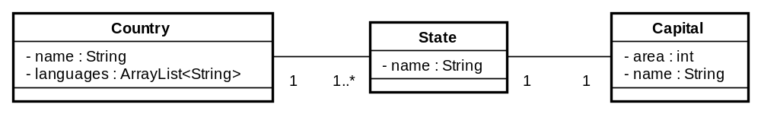
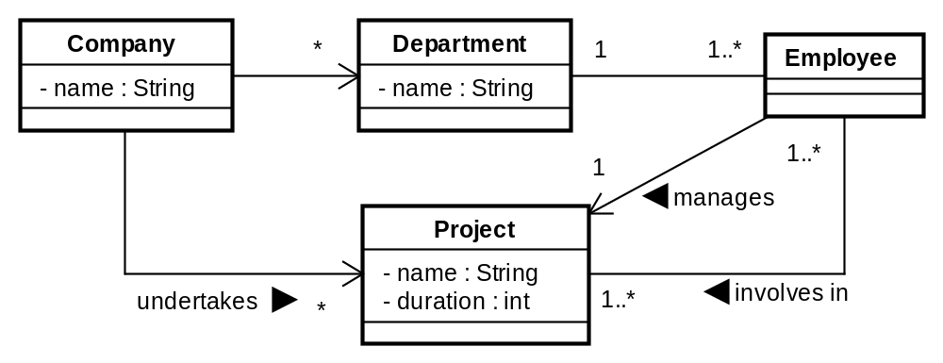
Exercise
Translate the following class diagram to Java code.
A.
B.
Object Oriented Application Development

Slide 31

Object Relationships: Composition
Composition
  "is-a-part-of" Relationship
  Models the notion of one object "owning" another and thus being responsible for the creation and destruction of another object.
Human
1
Heart
Object Oriented Application Development

Slide 32
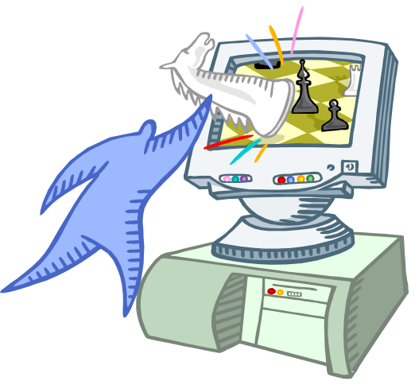
Object Relationships: Association
"has-a" relationship
public class Player {
private Item item;
// ...
}
public class Item {
// ...
}
Player
owns
1
Item
Object Oriented Application Development

Slide 33

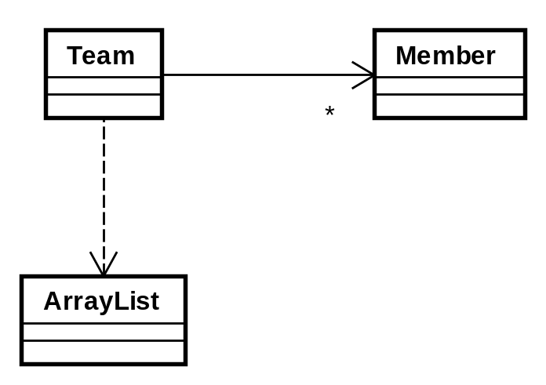
Object Relationships: Dependency
"uses" relationship
A change to the definition of one class may cause changes to the other class.
  One class sends a message to another
  One class has another as part of its data
  One class mentions another as a parameter
import java.util.*;
public class Team{
private ArrayList<Member> members;
}
Object Oriented Application Development

Slide 34
Summary
Class versus Object
  A class is the blueprint from which individual objects are created.
  An object is an instance of a class.
Principles of Object Orientation
  Abstraction
    determines the relevant properties and features while ignoring non-essential details.
  Encapsulation
    Separate components into external and internal aspects.
  Modularity
    Break something complex into manageable pieces.
  Hierarchy
    Ranking or ordering of objects
A model is a simplification of reality.
UML is a standard language used for modeling software
  Facilitates communication
  Manage complexity
Class diagrams shows the static view of a system
  An association is represented by a reference variable in the Java code.
Object Oriented Application Development

Slide 35

References
UML Distilled (http://blue.smu.edu.sg/distilled)
  Chapter 3. Class Diagrams: The Essentials
UML basics: The class diagram
  http://www.ibm.com/developerworks/rational/library/content/RationalEdge/sep04/bell/
Object Oriented Application Development

