Slide 1

Object Oriented Application Development
Inheritance and Packaging
- Part I -
Ability is what you are capable of doing.
Motivation determines what you do.
Attitude determines how well you do it.
Lou Holtz
Notes:
.

Slide 2
Overview
Objective
To be able to use inheritance in object oriented design and implementation
Content
Inheritance
Abstract class
Interface
Polymorphism
After this lecture, you should be able to
Apply inheritance & polymorphism in your coding

Slide 3
Inheritance
Organizes objects in a top-down fashion from the most general to the least general.
is-a relationship
superclass/base class
public class Mammal {
// ...
}
Mammal
A Human is a Mammal.
public class Human extends Mammal {
// ...
}
Human
All characteristics of Mammal are characteristics of a Human.
Keyword extends indicates that Human is a sub-class of Mammal
subclass/derived class

Slide 4
Benefit of Inheritance
Derived class inherits properties and methods from the base class
Primary benefit of inheritance is code reuse
Employee
Common characteristics are defined once at the base class
Look for common behaviours
Manager
Engineer

Slide 5
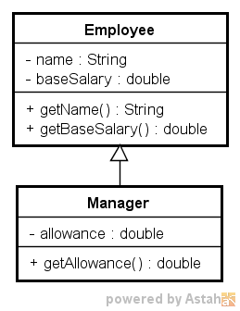
Reusing Code
public class Employee {
private String name;
private double baseSalary;
public String getName() { return name;
}
public double getBaseSalary(){
return baseSalary;
}
}
public class Manager extends Employee {
private double allowance;
public double getAllowance(){
return allowance;
}
}

Slide 6
Inheritance: Constructors
Constructors are not inherited by subclasses
The constructor of the superclass can be invoked from the subclass
public class Manager Test { public static void main(String[] args) { // not possible Manager m = new Manager("Amy", 1200);
}
}
public class Employee {
private String name;
private double baseSalary;
public Employee(String name,
double baseSalary) {
// …
}
}
public class Manager extends Employee {
private double allowance;
public Manager(String name,
double baseSalary,
double allowance) {
// ...
}
}

Slide 7


Using super in constructors
The super keyword is used to call a parent’s constructor
The super statement must be the first statement in the constructor
public class Manager extends Employee {
private double allowance;
public Manager(String name,
double baseSalary,
double allowance) {
super (name, baseSalary);
this.allowance = allowance;
}
}
public class Manager extends Employee {
private double allowance;
public Manager(String name,
double baseSalary,
double allowance) {
this.allowance = allowance; super (name, baseSalary);
}
}

Slide 8
Using super in constructors
If you did not provide the super statement, Java will insert a default call
It will invoke the no-arg constructor in the super class. In other words, super()
public class Cat extends Animal {
public Cat(String name) {
this.name = name;
}
}
// added in by Java during compilation super();

Slide 9
Exercise 1: Inheritance and Reuse
You are part of a team tasked to build a new system to manage electronic products in a large electronic center
At the moment the center only sells a few types of items:
Computers
Digital Cameras
Printers
Your job is to implement the entity classes
Implement the classes shown in the next slide

Slide 10
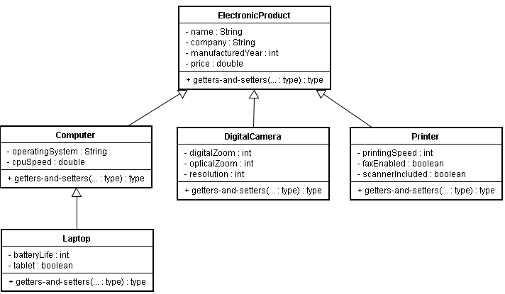
Exercise 1: Inheritance and Reuse
Note: At least implement Computer and Laptop classes. Implement appropriate constructors too.

Slide 11
Exercise 2: Inheritance and Reuse
Implement getNewWindowsBasedLongBatteryLifeTablet method of LaptopSearcher
Input: A list of laptops
Output: Laptops satisfying the following criteria:
Manufactured after 2008
Run on Windows operation system
Battery life more than 5 hours
Tablet PC
Main method is provided
- Output –
T1001 T1003
LaptopSearcher
+ getNewWindowsBasedLongBatteryLifeTablet(laptops:ArrayList<Laptop>):ArrayList<Laptop>

Slide 12
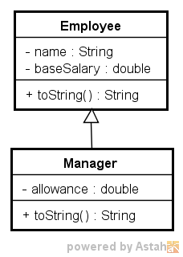
Overriding
An instance method in a subclass with the same signature (name, plus the number and the type of its parameters) and return type as an instance method in the subclass overrides the superclass's method.
public class Employee {
private String name;
private double baseSalary;
public String toString() {
return "name=" + name
+ ",baseSalary="
+ baseSalary;
}
}
public class Manager extends Employee {
private double allowance;
public String toString() {
return super.toString()
+ ",allowance=" + allowance;
}
}
The method toString overrides the method in Employee

Slide 13
Overriding
public class ManagerTest {
public static void main(String[] args) {
Manager m = new Manager("Lily", 1000, 100);
String desc = m.toString();
System.out.println(desc);
}
}
- Output –
name=Lily,baseSalary=1000.0,allowance=100.0
The method toString in Manager overrides the method in Employee

Slide 14
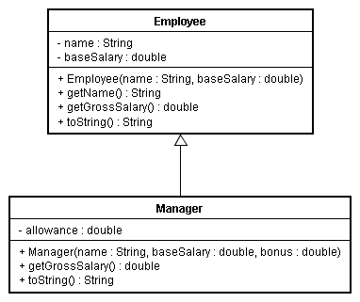
Which method to invoke
The lowest one wins!
Manager m = new Manager("Lily", 1000,500);
System.out.println(m.getName());
System.out.println(m.tostring());

Slide 15
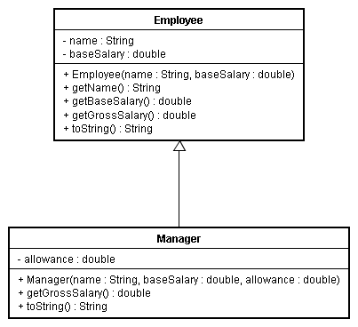
Exercise 3: Method Overriding
Implement the getGrossSalary method in both the Employee and Manager classes.
The formula to calculate the Manager's gross salary is baseSalary + allowance
public class EmployeeTest {
public static void main(String[] args) {
Manager m = new Manager("Peter", 5000, 2000);
Employee e = new Employee("John", 3000);
System.out.println("Manager's salary : "
+ m.getGrossSalary());
System.out.println("Employee's salary : "
+ e.getGrossSalary());
}
}
- Output –
Manager's salary : 7000.0
Employee's salary : 3000.0

Slide 16
Abstract Class
A generic base class
Provides a partial implementation, leaving it to subclasses to complete the implementation
public abstract class Mammal {
private String name;
public Mammal(String name) {
this.name = name;
}
public String getName() {
return name;
}
public abstract void makeNoise();
}
Mammal
Classes with abstract method must be declared abstract
Cow
Cat
Abstract method has no implementation(body). It is overridden by subclasses.

Slide 17
How to Create a Subclass?
Use the extends keyword followed by the superclass's name
public class Cow extends Mammal {
public Cow(String name) {
super(name);
}
public void makeNoise() {
System.out.println("Moo!");
}
}
public class Cat extends Mammal {
public Cat(String name) {
super(name);
}
public void makeNoise() {
System.out.println("Meow!");
}
}
All abstract methods must be implemented in the subclass
Moo!
makeNoise()
Meow!

Slide 18
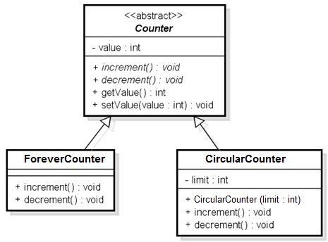
Exercise 4: Abstract Class
Implement the following classes:
Counter is an abstract class (increment, decrement are abstract methods)
ForeverCounter will count from 0,1,2 ….
CircularCounter will count from 0,1,2, …limit,0,1,2 ..limit
CounterTest.java is provided

Slide 19
Exercise 4: Abstract Class
Output –
Forever: 0, Circular: 0
Incrementing ...
Forever: 1, Circular: 1
Forever: 2, Circular: 2
Forever: 3, Circular: 3
Forever: 4, Circular: 4
Forever: 5, Circular: 5
Forever: 6, Circular: 0
Forever: 7, Circular: 1
Forever: 8, Circular: 2
Forever: 9, Circular: 3
Forever: 10, Circular: 4
Decrementing ...
Forever: 9, Circular: 3
Forever: 8, Circular: 2
Forever: 7, Circular: 1
Forever: 6, Circular: 0
Forever: 5, Circular: 5
Forever: 4, Circular: 4
Forever: 3, Circular: 3
Forever: 2, Circular: 2
Forever: 1, Circular: 1
Forever: 0, Circular: 0

Slide 20


Interfaces
An interface is a group of related methods with empty bodies.
A template is specified using the interface keyword.
public interface Pet {
public void tame();
}
class
abstract
class
Interface
Complete Implementation
Partial Implementation (Some methods have no body)
No implementation (All methods have no body)

Slide 21
Interfaces
The subclass must provide implementations of the methods specified in the interface.
public class Cat extends Mammal implements Pet {
public Cat(String name) {
super(name);
}
public void makeNoise() {
System.out.println("Meow!");
}
public void tame() {
System.out.println("Scratch behind the ear!");
}
}
Use the keyword implements followed by the interface name.
The tame() method is defined.

Slide 22
Exercise 5a: Interfaces
Create an interface TaxableProduct
Modify the classes in Exercise 1 so that we can compute the taxes (tax rate = 7%) for computers, digital cameras, laptops, and printers:
Find the best class to implement the interface
Implement the interface
TaxTest.java is provided.
<<interface>> TaxableProduct
+ computeTax():double
Output –
The tax for a $2500.0 laptop is $175.0

Slide 23
Exercise 5b: Using Interfaces
Create a class TaxCalculator with the static method calculateTotalPayableTax.
The method accepts a list of TaxableProducts and output the total amount of tax that is to be paid for the products
TaxCalculatorTest.java is provided to test your application.
TaxCalculator
+ calculateTotalPayableTax(products:ArrayList<TaxableProduct>):double
Output –
The total tax is $525.0

Slide 24
Inherited Methods & Overriding Java 5.0 Program Design P334
All Java class is automatically an extension of the standard class Object.
The class Object specifies some basic behaviors common to all objects.
Examples
toString()
equals()
Object
String
Point2D
Scanner
Point

Slide 25
The toString() Method
Provides a meaningful textual representation of the object.
Can be useful when debugging a program.
public class MyPoint {
private int x;
private int y;
public MyPoint(int x, int y) {
this.x = x;
this.y = y;
}
public String toString() {
return “MyPoint[" + x + "," + y + "]";
}
public static void main(String[] args) {
MyPoint p = new MyPoint(1,2);
System.out.println(p);
}
}
- With toString() method –
MyPoint[1,2]
- Without toString() method –
MyPoint@7d772e

Slide 26
The instanceof Operator
The instanceof operator is use to check the type of object that the "reference" points to.
public class InstanceOfDemo {
public static void main(String[] args) {
Manager m = new Manager("Peter", 5000, 2000);
Employee e = new Employee("John", 3000);
System.out.println(e instanceof Manager);
System.out.println(m instanceof Manager);
}
}
- Output –
false
true

Slide 27
Exercise 6: instanceof
Complete the calManagerAvgGrossSalary method in the EmployeeTest class.
import java.util.ArrayList;
public class EmployeeTest {
public static double calManagerAvgGrossSalary(ArrayList<Employee> empList) {
// complete the code
}
public static void main(String[] args) {
ArrayList<Employee> empList = new ArrayList<Employee>();
empList.add(new Manager("Albert", 5000, 2000));
empList.add(new Manager("Benny", 7000, 1500));
empList.add(new Manager("Charles", 9000, 1000));
empList.add(new Employee("Danny", 1500));
empList.add(new Employee("Edward", 4000));
empList.add(new Employee("Fred", 3500));
empList.add(new Employee("George", 3500));
System.out.println(calManagerAvgGrossSalary(empList));
}
}
Output –
8500

Slide 28
The equals() method
Determines whether its parameter is a object that is equivalent to the invoking object.
public class MyPoint {
// ...
public boolean equals(Object obj) {
if (obj instanceof MyPoint) {
MyPoint another = (MyPoint)obj;
if (another.x == x && another.y == y) {
return true;
}
}
return false;
}
public static void main(String[] args) {
MyPoint p1 = new MyPoint(1,2);
MyPoint p2 = new MyPoint(1,2);
System.out.println(p1.equals(p2));
}
}
An instance of MyPoint object is an instance of Object. An instance of Object might not be an instance of MyPoint. Thus, we need to do a cast to tell the compiler than we know indeed it is a MyPoint object.
Returns false unless the object is an object created using the MyPoint class

Slide 29
The equals() Method: Guidelines
Reflexivity
x.equals(x) should always be true.
Symmetry
If x.equals(y) is true, then y.equals(x) should be true.
Transitivity
If x.equals(y) and y.equals(z) are true, then x.equals(z) should be true
Consistency
While the objects to which x and y refer are unchanged, repeated evaluations of x.equals(y) should return the same value.
Physicality
x.equals(null) should return false

Slide 30
Exercise 7: Inherited Methods
Write a Box class that represents the sides of a rectangle.
Implements a specific constructor that takes in 3 parameters
Overrides the equals() and toString() methods in Object.
BoxTest.java is provided
height
Output –
b1 == b2
b1 is Length=10.0,Breadth=9.0,Height=8.0
b2 is Length=10.0,Breadth=9.0,Height=8.0
breadth
length

Slide 31
Syntactic Polymorphism
Java can determine which method to invoke at compile time.
Example
Function overloading like method Math.min().
The method invoked depends on the types of the actual arguments.
int a, b, c;
double x, y, z;
c = Math.min(a, b); // invokes integer min()
z = Math.min(x, y); // invokes double min()

Slide 32
Pure Polymorphism Java 5.0 Program Design P485
Pure Polymorphism
The method to invoke can only be determined at execution time (Late binding).
Moo!
makeNoise()
Meow!

Slide 33
Exercise 8: Polymorphism
Create toString() methods for the following classes:
ElectronicProduct
Computer
Laptop
DigitalCamera
Printer
The toString() methods should output useful information

Slide 34
Exercise 8: Polymorphism
Implement createReport method of ProductReportCreator
Input: A list of electronic products
Output: Information of each product to the console
You should make use of the toString() methods
Create a main method to test the functionality
Running “java ProductReportCreator > report.txt” should produce the report in report.txt file
ProductReportCreator
+ createReport(products:ArrayList<ElectronicProduct>):void

Slide 35
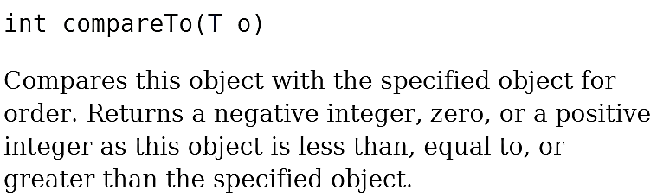
Useful Interfaces: Comparable https://docs.oracle.com/javase/8/docs/api/java/lang/Comparable.html https://docs.oracle.com/javase/tutorial/collections/interfaces/order.html
Comparable interface is used to sort a collection of objects of a particular class.
Step 1: Make target class implements Comparable
Step 2: Write the method compareTo
public class Student implements Comparable<Student> { private String name; private int age; // … public int compareTo(Student another) { return name.compareTo(another.name); } public String toString() { return "( name=" + name + ", age=" + age + " )"; } }
compareTo method of String class: compares two strings lexicographically

Slide 36
Useful Interfaces: Comparable
Step 3: Use Collections.sort
import java.util.ArrayList; import java.util.Collections; public class StudentTest { public static void main(String[] args) { ArrayList<Student> sList = new ArrayList<Student>(); sList.add(new Student("Charlie", 12)); sList.add(new Student("Amy", 13)); sList.add(new Student("Billy", 11)); Collections.sort(sList); System.out.println(sList); } }
- output -
[( name=Amy, age=13 ), ( name=Billy, age=11 ), ( name=Charlie, age=12 )]

Slide 37
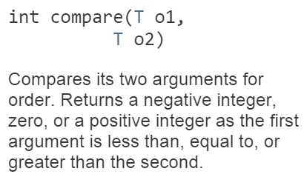
Useful Interfaces: Comparator https://docs.oracle.com/javase/8/docs/api/java/util/Comparator.html https://docs.oracle.com/javase/tutorial/collections/interfaces/order.html
Comparator interface is used to sort a collection of objects of a particular class.
Step 1: Create a new class that implements Comparator
Step 2: Implement the method compare
import java.util.*; public class AgeComparator implements Comparator<Student> { public int compare(Student s1, Student s2) { return s1.getAge()-s2.getAge(); } }

Slide 38
Useful Interfaces: Comparator
Step 3: Use Collections.sort
import java.util.ArrayList; import java.util.Collections; public class StudentTest { public static void main(String[] args) { ArrayList<Student> sList = new ArrayList<Student>(); sList.add(new Student("Charlie", 12)); sList.add(new Student("Amy", 13)); sList.add(new Student("Billy", 11)); Collections.sort(sList, new AgeComparator()); System.out.println(sList); } }
- output -
[( name=Billy, age=11 ), ( name=Charlie, age=12 ), ( name=Amy, age=13 )]

Slide 39
Comparable versus Comparator
Comparable
Pros: The comparison can leverage private fields
Cons: Only 1 ordering behavior is possible
Comparator
Pros: Allow us to specify different sorting order
Cons: Cannot directly leverage on private fields

Slide 40
Exercise 9: Comparable
Use the Employee class created for Exercise 3.
Modify the Employee class such that the following code produces the right output:
import java.util.*;
public class EmployeeSortingTest {
public static void main(String[] args) {
ArrayList<Employee> empList = new ArrayList<Employee>();
empList.add(new Employee ("Peter", 5000));
empList.add(new Employee("Zack", 3000));
Collections.sort(empList);
for (int i=0;i<empList.size();i++){
System.out.println(empList.get(i));
}
}
}
- Output –
name=Zack,baseSalary=3000.0
name=Peter,baseSalary=5000.0

Slide 41
Exercise 10: Comparator - I
Use the Employee class created for Exercise 3.
Create BaseSalaryComparator class such that the following code produces the right output:
import java.util.*;
public class EmployeeSortingTest {
public static void main(String[] args) {
ArrayList<Employee> empList = new ArrayList<Employee>();
empList.add(new Employee ("Peter", 5000));
empList.add(new Employee("Zack", 3000));
Collections.sort(empList,new BaseSalaryComparator());
for (int i=0;i<empList.size();i++){
System.out.println(empList.get(i));
}
}
}
- Output –
name=Zack,baseSalary=3000.0
name=Peter,baseSalary=5000.0

Slide 42
Exercise 11: Comparator - II
Use the Employee class created for Exercise 3.
Create NameComparator class such that the following code produces the right output:
import java.util.*;
public class EmployeeSortingTest {
public static void main(String[] args) {
empList.add(new Employee ("Peter", 5000));
empList.add(new Employee("Zack", 3000));
Collections.sort(empList,new NameComparator());
for (int i=0;i<empList.size();i++){
System.out.println(empList.get(i));
}
}
}
- Output –
name=Zack,baseSalary=3000.0
name=Peter,baseSalary=5000.0

Slide 43
Summary
Inheritance
IS-A relationship
Code re-use
Prefix call with super
Abstract class
Provides a partial implementation, leaving it to subclasses to complete the implementation.
Interface
An interface is a group of related methods with empty bodies.
Polymorphism
Syntatic
The method to invoke is determined at compile time.
Pure polymorphism
The method to invoke can only be determined at execution time.
Comparable and Comparator

