Slide 1

Object Oriented Application Development
Inheritance and Packaging
-Part 2-
I do not know anyone who has gotten to the top without hard work. That is the recipe. It will not always get you to the top, but it will get you pretty near.
Margaret Thatcher
Notes:
.

Slide 2
Overview
Objective
To be able to use packages and various access modifiers
Content
Environment variables
Packages
Access Modifier
After this module, you should be able to
Understand environment variables
Organize your classes into packages
Use the appropriate modifier for access control

Slide 3
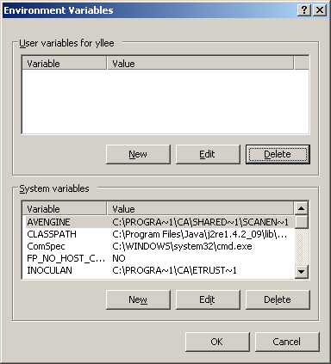
Environment Variables http://support.microsoft.com/kb/310519
String that contain information about the environment for the system, and the currently logged on user.
Method 1: Command Prompt
Display
Modify
Method 2: Control Panel > System & Security > System
Click Advanced System Settings
Click Environment Variables
C:\>echo %path%
C:\>set path=%path%;c:\is201
Notes:
Using method 1, the change is valid only for the current command prompt and not for any other command prompts.
Using method 2, the changes are written to the registry, and are usually effective immediately. However, after a change to user environment variables is made, any open software programs should be restarted to force them to read the new registry values.

Slide 4
Environment Variables
PATH
A string containing folder locations where executables will be searched for by the Operating System
Executables are searched for in the folders specified in the PATH variable in order (left-to-right) for the first occurrence
- hello.bat -
echo Welcome to IS201
ROOT
is201
hello.bat
is202
hello.bat
Search order
C:\>set path=c:\is201;c:\is202 C:\>hello
C:\>echo Welcome to IS201
Welcome to IS201
- hello.bat -
echo Welcome to IS202

Slide 5
Environment Variables
- Welcome.java -
public class Welcome { public static void main(String[] args) { System.out.println("Welcome to IS201"); } }
CLASSPATH
A string containing folder locations where class files will be searched for by the Java virtual machine (java.exe)
Executables are searched for in the folders specified in the CLASSPATH variable in order (left-to-right) for the first occurrence
ROOT
compile from
is201
Welcome.class
is202
Search order
Welcome.class
C:\>set CLASSPATH=c:\is201;c:\is202 C:\>java Welcome
Welcome to IS201
- Welcome.java -
public class Welcome { public static void main(String[] args) { System.out.println("Welcome to IS202"); } }

Slide 6
Exercise 12: Path
Locate the folder where your notepad++ executable is stored
Usually somewhere in C:\Program Files
Add a reference in your path to the folder where notepad++ is stored
Start notepad++ directly from the command prompt

Slide 7
Exercise 13: Classpath
Create two Greetings.java classes
The first one prints “Good Morning !”
The second one prints “Good Afternoon !”
Create two folders: morning and afternoon
Open a command prompt
Set the classpath so that “Good Morning !” is printed whenever one types: java Greetings

Slide 8
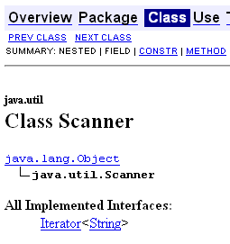
Packages Java 5.0 Program Design P74
To logically group classes.
To access a class in another group, we use the import keyword.
The character * refers to all classes in the package.
java
import java.util.*; public class ScannerDemo { public static void main(String[] args) { Scanner sc = new Scanner(System.in); System.out.println("Enter your name: "); String name = sc.next(); System.out.println("Your name is " + name); } }
lang
util
Scanner
…
Java Documentation

Slide 9
Packages
Allow classes to be collected together into a single grouping
package entity;
public class Employee {
// ...
}
Employee will be added to the entity package
Import it to use it.
import entity.*;
public class EmployeeTest {
public static void main(String[] args) {
Employee e = new Employee("Lily");
}
}

Slide 10
Creating a Package - 1
Step 1: Include the package statement as the first statement
Step 2: Create a folder named entity, the same name as the package name.
package entity;
public class Employee {
}

Slide 11
Creating a Package - 2
Step 3: Compile the java file
D:\is201>javac -d classes src/entity/*.java
Note: The classes folder need to be created first

Slide 12
Creating a Package - 3
Step 4: Import the package in your class and use it.
import entity.*;
public class EmployeeTest {
public static void main(String[] args) {
Employee e = new Employee("Lily");
System.out.println(e.getName());
}
}

Slide 13
Creating a Package - 4
Step 5: Save the file in the right directory.
Step 6: Compile and run it.
D:\is201>javac –cp classes -d classes src\EmployeeTest.java
D:\is201>java –cp classes EmployeeTest

Slide 14
Exercise 14: Packages
Implement the Employee class.
The class has two attributes
name (of type String)
salary (of type double)
Implement getters and setters
Implement the toString method
Place the Employee class in the ooad package.
Implement the EmployeeTest class in the default package (i.e., no package is declared).
Declares and creates an instance of Employee
Displays the textual representation of the Employee object to the screen.

Slide 15
Controlling Access Java 5.0 Program Design P477
Modifier | Same Class | Same Package | Subclass | Universe
private | Yes
( default ) | Yes | Yes
protected | Yes | Yes | Yes
public | Yes | Yes | Yes | Yes

Slide 16
Public Access Modifier
Package X
Package Y
public class R
extends P {
}
public class P {
}
public int a;
Method m3
Method m1
public class S {
}
Method m4
public class Q {
}
Method m2

Slide 17
Protected Access Modifier
Package X
Package Y
public class R
extends P {
}
public class P {
}
protected int a;
Method m3
Method m1
public class S {
}
Method m4
public class Q {
}
Method m2

Slide 18
Default Access Modifier
No keyword needs to be specified.
Package X
Package Y
public class R
extends P {
}
public class P {
}
int a;
Method m3
Method m1
public class S {
}
Method m4
public class Q {
}
Method m2

Slide 19
Private Access Modifier
Package X
Package Y
public class R
extends P {
}
public class P {
}
private int a;
Method m3
Method m1
public class S {
}
Method m4
public class Q {
}
Method m2

Slide 20
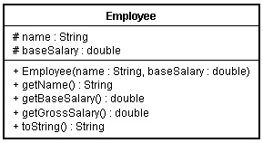
Exercise 15: Access Modifiers
Change the Employee class in Exercise 3 to follow the following class diagram. Note: # symbol represents protected access modifier
Simplify the getGrossSalary() method of the Manager class.

Slide 21
Summary
Environment variable
Path
Classpath
Package allows classes to be collected together into a single grouping.
Access Modifiers
public
protected
default
private

