Slide 1
What are the best laptops in terms of implicit and qualitative factors (such as speed, sound , screen-resolution etc.) based on Amazon product reviews.
A Modern Recommender System using Aspect Based Sentiment Analysis
By:
Kevin Joseph Scaria
Notes:
Sampath

Slide 2
Task
A user U₁ who is interested in good battery life or screen resolution.
We develop a recommender system to query the top N laptops in terms of screen resolution and battery life from the database.
Notes:
Sampath

Slide 3
Problem
Recommender systems often recommend products/content based on the user's interaction with historical content and similarity of interaction with other users in the system.
It often ignores textual content and feedback in the form of reviews which has rich sentiments embedded in them in the form of implicit and explicit aspects pertaining to the product/content.
We aim to leverage this rich content present in the form of reviews to recommend products desired by the user based on these implicit and explicit aspects.
Notes:
Harsha

Slide 4
Pipeline
Aspect Based Sentiment Analysis
Recommender Systems
Reviews
Aspect extraction
Aspect oriented Opinion word mining
Sentiment Analysis
Query Products based on required aspects
Reweighting candidate items
Top N Recommendations
Notes:
Harsha

Slide 5
ABSA Task – Aspect Extraction (ATE model)
We use large language models such as BERT and formulate the aspect extraction problem as a Sequence Tagging task.
Every text will have a corresponding tag associated with the tokens.
The language model will understand syntactic patterns from the labelled tags to extract the aspect terms.
The laptop’s performance was amazing
ATE Model
[0, 0, 1, 0, 0]
“performance”
Notes:
Nikitha

Slide 6
ABSA Task – Aspect Oriented Opinion Word mining (TOWE model)
Similarly, BERT model is used, and aspect-oriented opinion word mining problem is also formulated as a Sequence Tagging task.
The language model will understand syntactic patterns from the labelled tags to extract the opinion words for each extracted aspect term.
The laptop’s performance was amazing. The aspect is performance.
TOWE Model
[0, 0, 0, 0, 1, 0, 0, 0, 0]
“amazing”
Notes:
Nikitha

Slide 7
ABSA Task – Sentiment Analysis
Once the aspect term and opinion word is extracted, we use the opinion word to extract the sentiment associated with each aspect term.
The laptop’s performance was amazing.
Aspect Opinion Pair = {“performance” : “amazing”}
Opinion word: amazing
VADER Sentiment Analysis
Positive
Notes:
Rajesh

Slide 8
Recommender System – Extract Candidates Items
The next step is to develop a query system that will extract all candidate items given an aspect.
DeviceID | Review | ReviewID | Upvotes | Downvotes
1 | R1 | a | 35 | 12
1 | R2 | b | 23 | 3
2 | R1 | a | 12 | 1
2 | R2 | c | 5 | 8
User Query: ‘screen-resolution’
Filter Queries
Notes:
Kevin

Slide 9
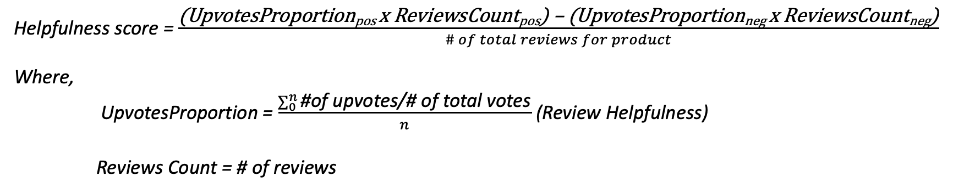
Recommender System – Weighted Confidence
Finally, to bring to the top, reviews with most helpfulness and a positive score, we reweight the candidate terms using a weighted confidence mechanism.
Helpfulness score = $\frac{\text{(}\text{UpvotesProportionpos} \text{x} \text{ReviewsCountpos}\text{) – (}\text{UpvotesProportionneg} \text{x} \text{ReviewsCountneg}\text{)}}{\# of total reviews for product}$
Where,
UpvotesProportion = $\frac{\sum_{0}^{n}{\text{\#}\text{of} \text{upvotes}\text{/\# }\text{of} \text{total} \text{votes}}}{n}$ (Review Helpfulness)
Reviews Count = # of reviews

Slide 10
Recommender System – Weighted Confidence
This formula can be intuitively thought of as follows:
Let A be the product of high positive reviews count and a high number of upvotes for each product review. This captures the review helpfulness that is positive.
This value A is subtracted by the influence from negative reviews B.
Thus A – B, gives a weighted score which considers the effect of positive reviews and negative reviews for a product and the review helpfulness for each review as well.

Slide 11
Recommender System – Extract Candidates Items
Once the products are reweighted based on the confidence scores, the top N recommendations can be quickly extracted using a sorting algorithm.
DeviceID | Review | ReviewID | Upvotes | Downvotes
1 | R1 | a | 35 | 12
1 | R2 | b | 23 | 3
2 | R1 | a | 12 | 1
2 | R2 | c | 5 | 8
DeviceID | Confidence Score
3 | 0.91
2 | 0.45
1 | 0.01
4 | -0.32

Slide 12
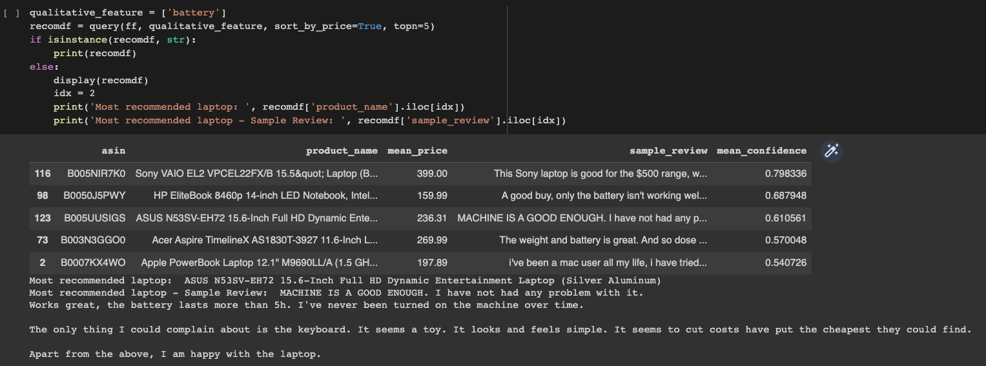
System Output –> Query : “battery”

Slide 13
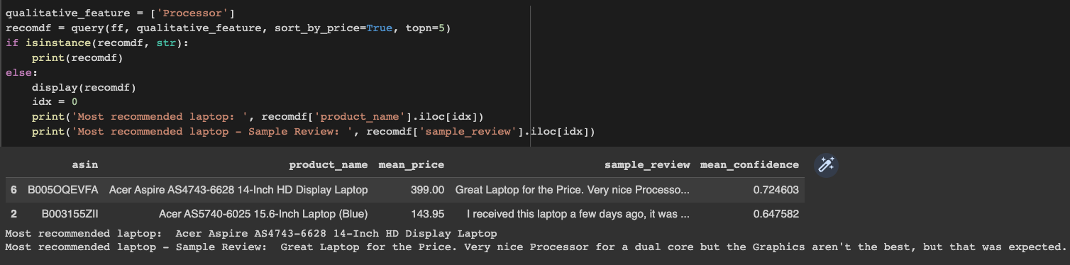
System Output –> Query : “Processor”

