Slide 1

Bibliothouris

Slide 2
Architecture
Presentation Layer
Application Layer
BookService
Domain Layer
Book
BookRepository

Slide 3
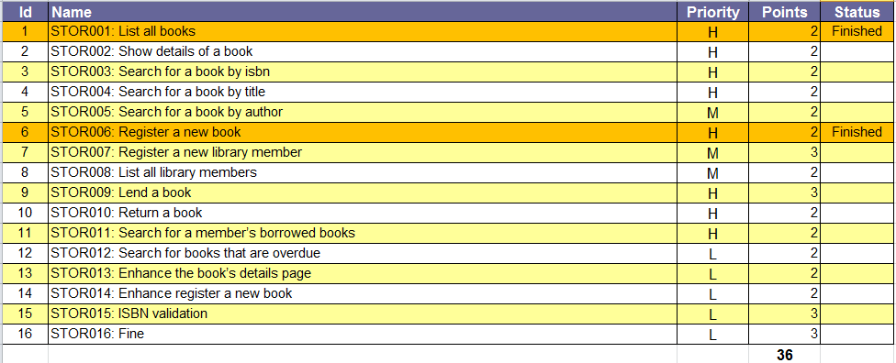
Backlog

Slide 4
Story 1: List All Books
The user can navigate to a page showing a list of all books registered in the system.
Attributes shown: unique number (isbn), title, author’s last and first name

Slide 5
Story 2: Show details of book
The user can navigate to the details of a book.
This page shows all of the book’s attributes:
ISBN
Title
Depends on story 1

Slide 6
Story 3: Search for a book by isbn
The user can search books.
On this search page, provide an input text field to enter (part of) a unique book number (isbn). -> the use of wildcards is supported
The return values contains following columns: ISBN number, title, author last name, author first name.
If no books were found, a corresponding message is shown.

Slide 7
Story 4: Search for a book by title
The user can search books.
On this search page, provide an input text field to enter (part of) a book’s title -> the use of wildcards is supported
The return value contains following columns: ISBN number, title, author last name, author first name.
If no books were found, a corresponding message is shown.

Slide 8
Story 5: Search for a book by author
The user can search books.
On this search page, provide an input text field to enter (part of) an author name. -> the use of wildcards is supported
The return values contains following columns following columns: ISBN number, title, author last name, author first name.
If no books were found, a corresponding message is shown.

Slide 9
Story 6: Register a new book
The user can add a new book to the system.
Provide a page to enter the details for a new book: ISBN and title
No validation is done

Slide 10
Story 7: Register a new library member
provide a link to add a new library member to the system.
In the new page, the user should be able to register following member’s data: unique number (INSS), last name, first name, street, number, postal code, city
At confirmation, next validations should take place:
INSZ number should be unique
INSZ, last name and city should be filled in
Out of scope: validation of postal code and city

Slide 11
Story 8: List all library members
The user should be able to navigate to a list of all members registered in the system.
Attributes shown: unique number (insz), last name, first name, city
A Message should be displayed when no users are found

Slide 12
Story 9: Lend a book
The user can lend a book.
This page provides following input text fields:
Member’s unique number
ISBN number
Due date –> default today() + 3 weeks
Validate the input fields:
ISBN number should exist
INSZ number should exist
Show a message when validation fails.

Slide 13
Story 10: Return a book
From the start page of the library application, provide a link to ‘return a book’
The user enters an ISBN number and confirms
At confirmation check whether the book was returned late. In that case, show a corresponding message.

Slide 14
Story 11: Search for a member’s borrowed books
The user can navigate to a page to search for all the books borrowed by a registered member.
Provide an input text field to enter the member’s unique number.
At confirmation show a list of all borrowed books: ISBN, title, author’s last and first name.

Slide 15
Story 12: Search for books that are overdue
The user can view all books that are overdue.
This page contains following data:
Member’s unique number, last and first name
Book’s isbn and title

Slide 16
Story 13: Enhance the book’s details page
Enhance the existing book’s details page with more data:
- Lend y/n
- If lend: member’s unique number and name
Extends story 2

Slide 17
Story 14: Enhance register a new book
The user can add a new book to the system
Provide a page to enter the details for a new book: ISBN, title, author’s last name, author’s first name
At confirmation, validate the new book:
ISBN, title and author’s last name are mandatory fields, author’s first name is optional.

Slide 18
Story 15: ISBN validation
ISBN number is 13 digits long
Last digit is a check digit
Every number on an odd position in this ISBN are summed.
Every number on an even position are summed up and multiplied by three.
Two sums are summed up.
Difference with next number ten (or 0) => check digit
Example: 978-90-274-3964-?
9 + 8 + 0 + 7 + 3 + 6 = 33
7 + 9 + 2 + 4 + 9 + 4 = 35 x 3 = 105
33 + 105 = 138
Next 10 = 140, so: 140 – 138 = 2
Format: 978-90-274-3964-2 (dashes)

Slide 19
Story 16: Fine
A member has to pay a fine if he returns a book too late.
Max loan period = 3 weeks.
If you bring it back later
5 € fine
For each extra week later: 2 € extra
Eg.
1 – 3 weeks: no fine
3 – 4 weeks: 5€ fine
4-5 weeks: 7 € fine
....
Show this fine on:
Return a book screen
List members: add column that shows total of his fines
Search books overdue: add column with fine

