Slide 1


DATA ANALYTICS (ONLINE)
QUESTIONS
DATA SUMMARY
World Happiness Report
Project 4
CODE/DATA APPROACH
VISUALS
RESULTS
Team Members:
Natalie Shaw
Eric Weber
Kevin Smith
IMPLICATIONS
GROUP 4: PROJECT 3

Slide 2
DATA ANALYTICS (ONLINE)
QUESTIONS
DATA SUMMARY
1)Is there a geographic region in the world where we can find the top ranked and bottom ranked countries?
2)Is there a strong correlation between the world happiness final score and the variables that feed that result?
3)How are the world happiness scores derived.
CODE/DATA APPROACH
VISUALS
RESULTS
IMPLICATIONS
GROUP 4: PROJECT 3

Slide 3
DATA ANALYTICS (ONLINE)
QUESTIONS
Kaggle World Happiness Report
1) https://www.kaggle.com/unsdsn/world-happiness
DATA SUMMARY
CODE/DATA APPROACH
VISUALS
RESULTS
IMPLICATIONS
GROUP 4: PROJECT 3

Slide 4

DYSTOPIA
DATA ANALYTICS (ONLINE)
QUESTIONS
The answer to question 3
THE ANSWER LIES IN…
DATA SUMMARY
DYSTOPIA
“Dystopia is an imaginary country that has the world’s least-happy people. The purpose in establishing Dystopia is to have a benchmark against which all countries can be favorably compared (no country performs more poorly than Dystopia) in terms of each of the six key variables, thus allowing each sub-bar to be of positive (or zero, in six instances) width. The lowest scores observed for the six key variables, therefore, characterize Dystopia. Since life would be very unpleasant in a country with the world’s lowest incomes, lowest life expectancy, lowest generosity, most corruption, least freedom, and least social support, it is referred to as “Dystopia,” in contrast to Utopia.”
CODE/DATA APPROACH
VISUALS
RESULTS
IMPLICATIONS
GROUP 4: PROJECT 3

Slide 5
DATA ANALYTICS (ONLINE)
QUESTIONS
DATA SUMMARY
SKLEARN
LEAFLET/ GEOJSON
JAVA
CODE/DATA APPROACH
csv
POSTGRESS
PYTHON
MAT PLOTLIB
HTML
GIT HUB PAGES
DATA TABLE
TABLEAU
CSS
VISUALS
JUPTER NOTEBOOK
(PANDAS)
RESULTS
IMPLICATIONS
GROUP 4: PROJECT 3

Slide 6

DATA ANALYTICS (ONLINE)
QUESTIONS
CHOROPLETH MAP
Leaflet
DATA TABLE
Python htm (DT)
INDEX (HTML)
DATA SUMMARY
CODE/DATA APPROACH
Embedded
Python (SKLearn)
VISUALS
TABLEAU
MACHINE LEARNING (LINK)
RESULTS
IMPLICATIONS
GROUP 4: PROJECT 3

Slide 7
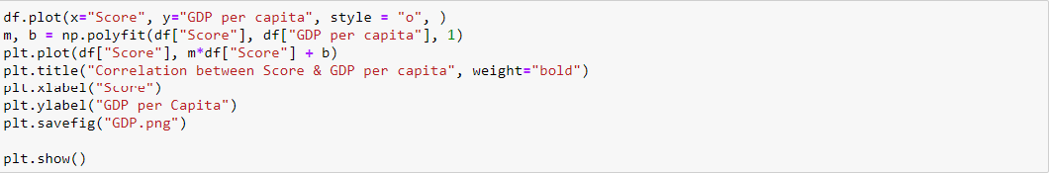
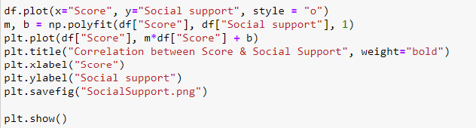


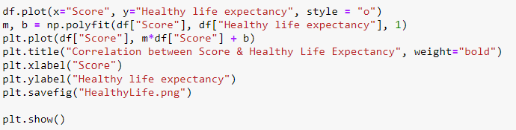


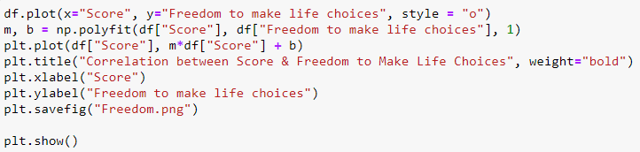


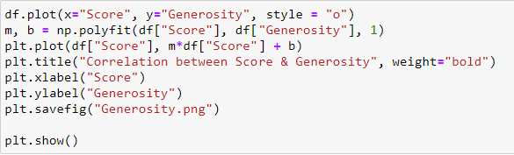
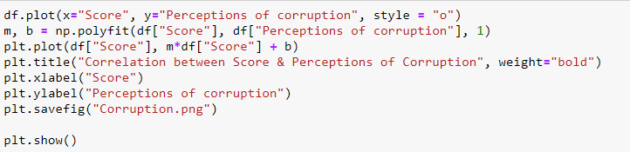
DATA ANALYTICS (ONLINE)
GDP
QUESTIONS
SOCIAL
SUPPORT
DATA SUMMARY
LIFE
EXPECTANCY
CODE/DATA APPROACH
FREEDOM
VISUALS
GENEROSITY
RESULTS
CORUPTION
IMPLICATIONS
GROUP 4: PROJECT 3 (EW)

Slide 8
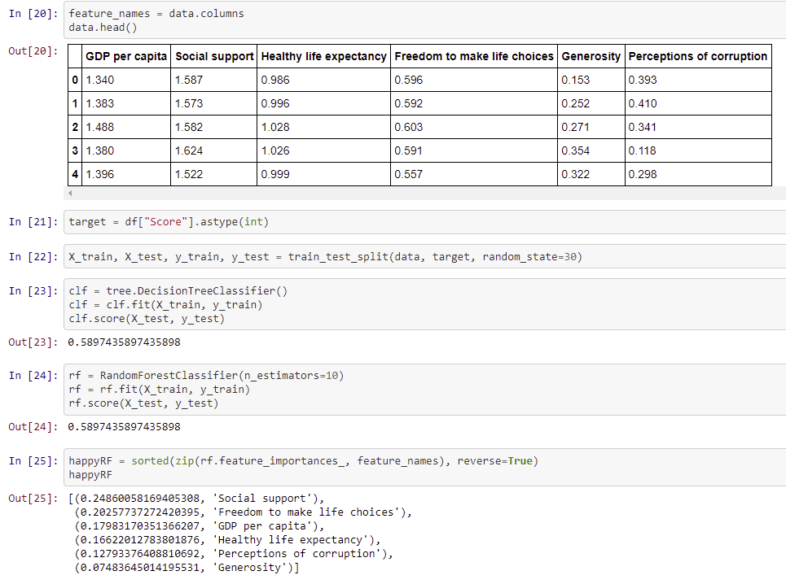
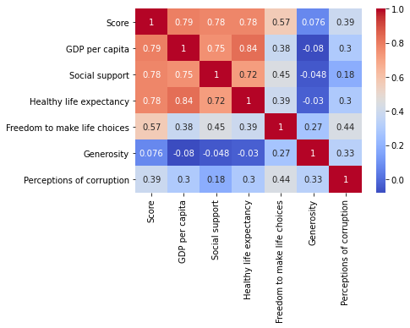
DATA ANALYTICS (ONLINE)
MACHINE LEARNING
QUESTIONS
DATA SUMMARY
CODE/DATA APPROACH
VISUALS
RESULTS
IMPLICATIONS
GROUP 4: PROJECT 3 (EW)

Slide 9
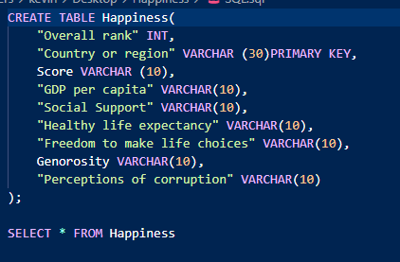
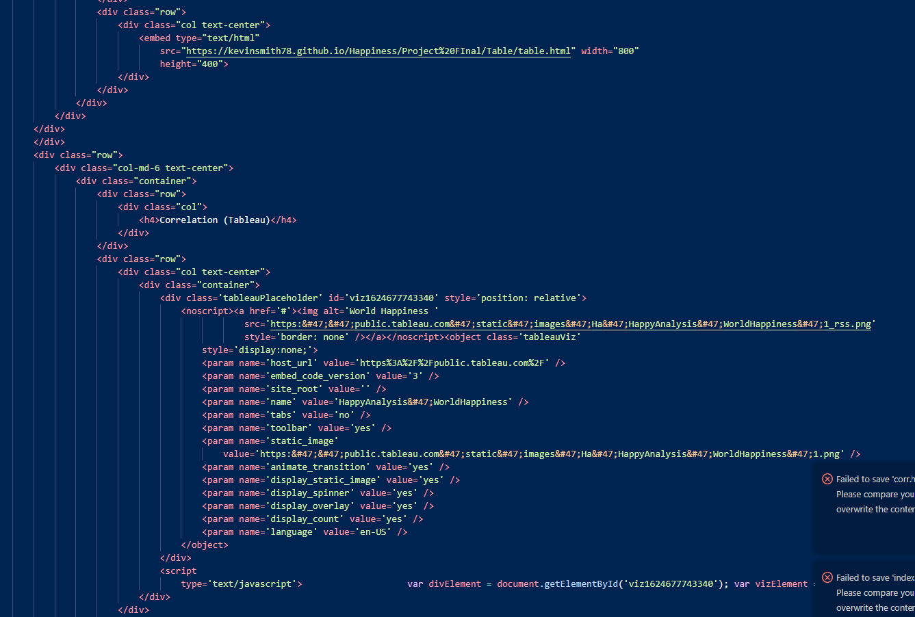
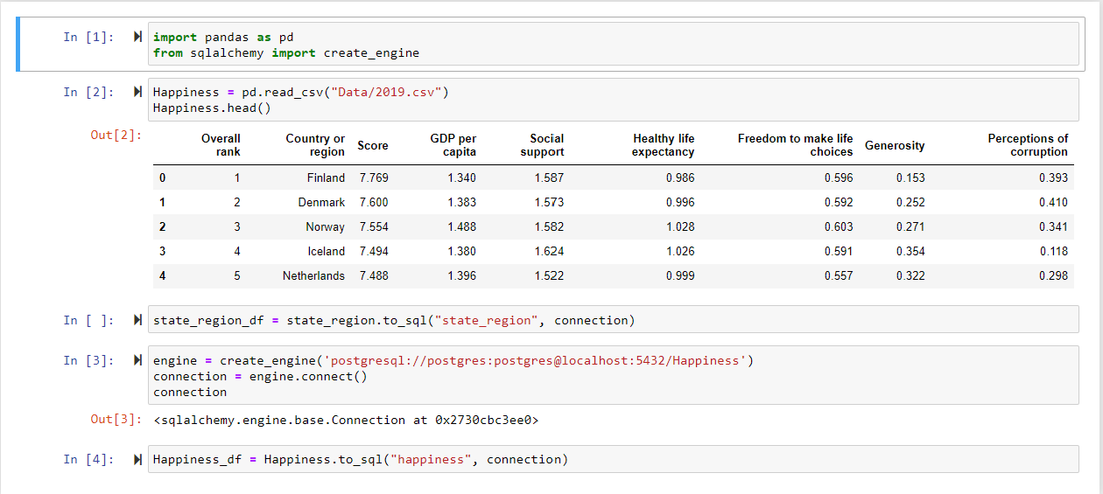
DATA ANALYTICS (ONLINE)
DATA VISUALS
QUESTIONS
DATA SUMMARY
CODE/DATA APPROACH
VISUALS
RESULTS
IMPLICATIONS
GROUP 4: PROJECT 3

Slide 10
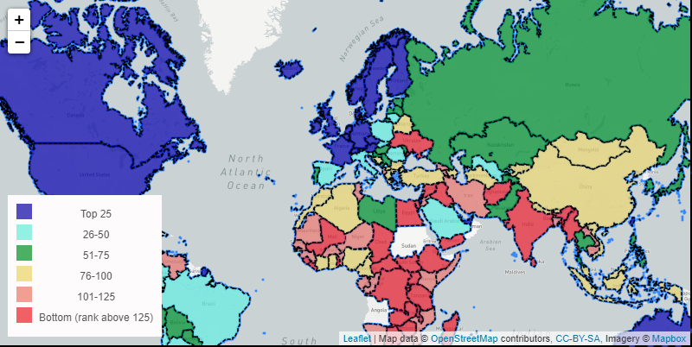
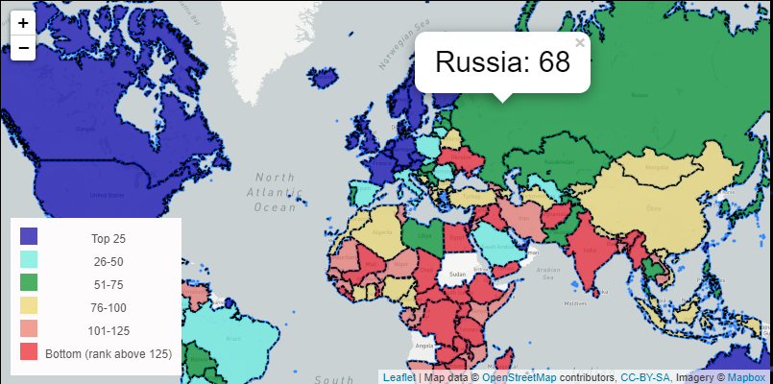
DATA ANALYTICS (ONLINE)
VISUALS
QUESTIONS
CHOROPLETH MAP
DATA SUMMARY
This map shows that most of the higher ranked countries are in the Northern Hemispheres, while the lower ranked countries are in the Southern Hemispheres.
CODE/DATA APPROACH
VISUALS
RESULTS
IMPLICATIONS
GROUP 4: PROJECT 3 (NS)

Slide 11
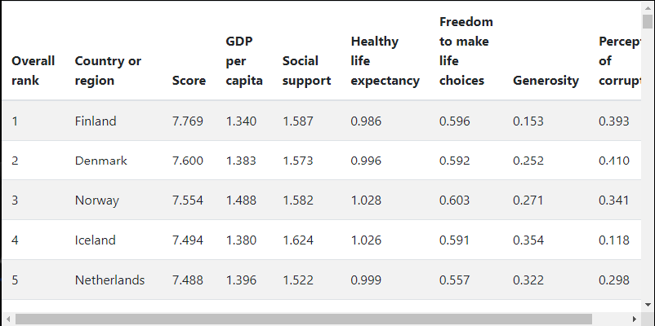
DATA ANALYTICS (ONLINE)
VISUALS
QUESTIONS
DATA TABLE
DATA SUMMARY
A quick Data Table to show the countries ranked in order
CODE/DATA APPROACH
VISUALS
RESULTS
IMPLICATIONS
GROUP 4: PROJECT 3 (NS)

Slide 12




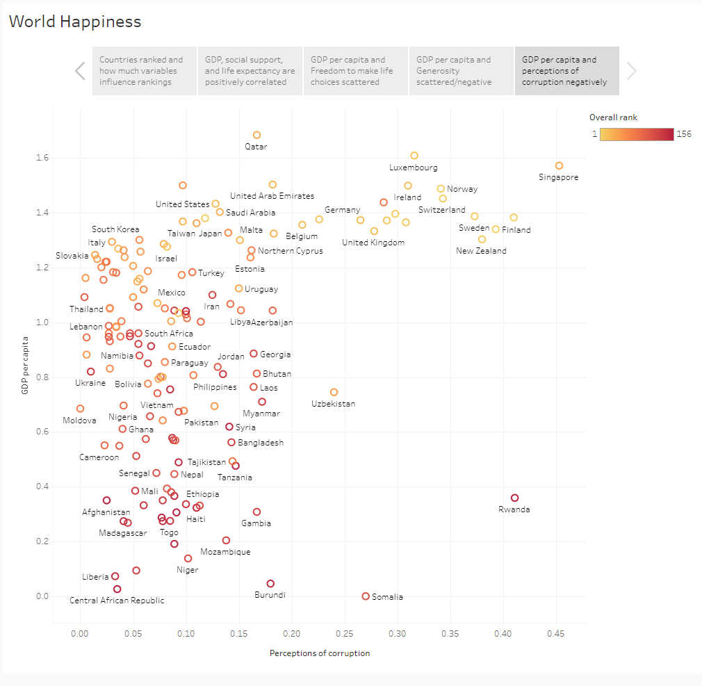
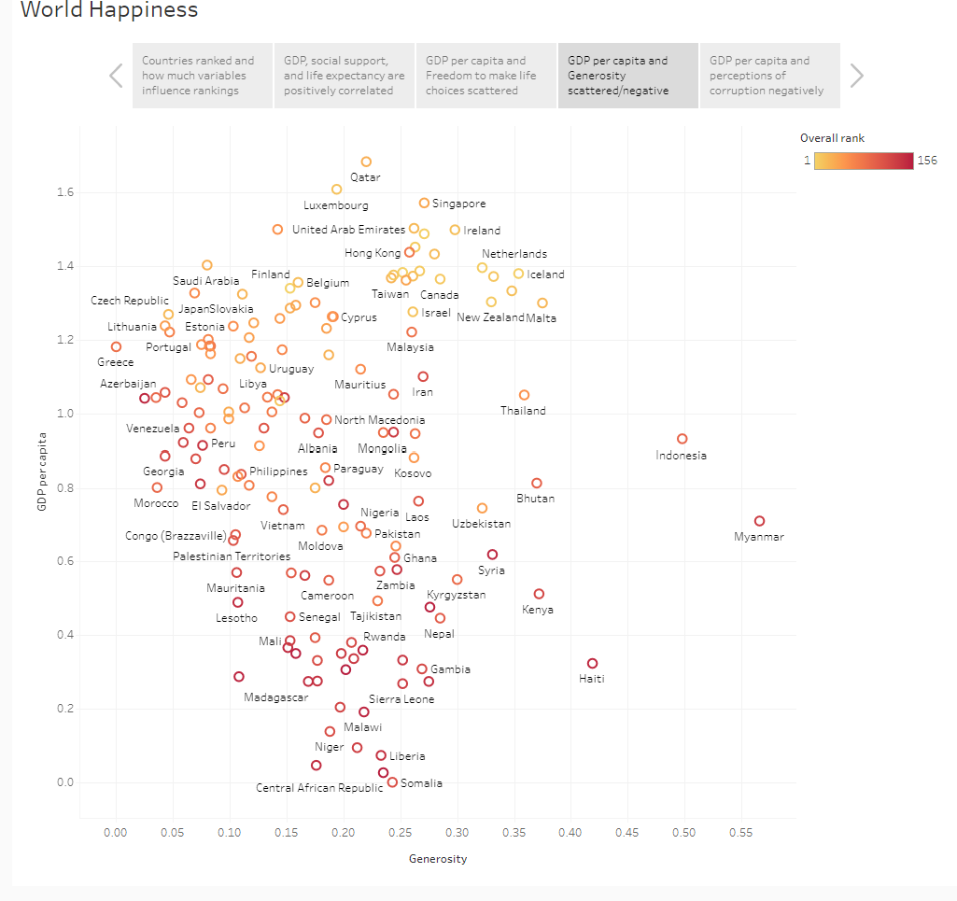
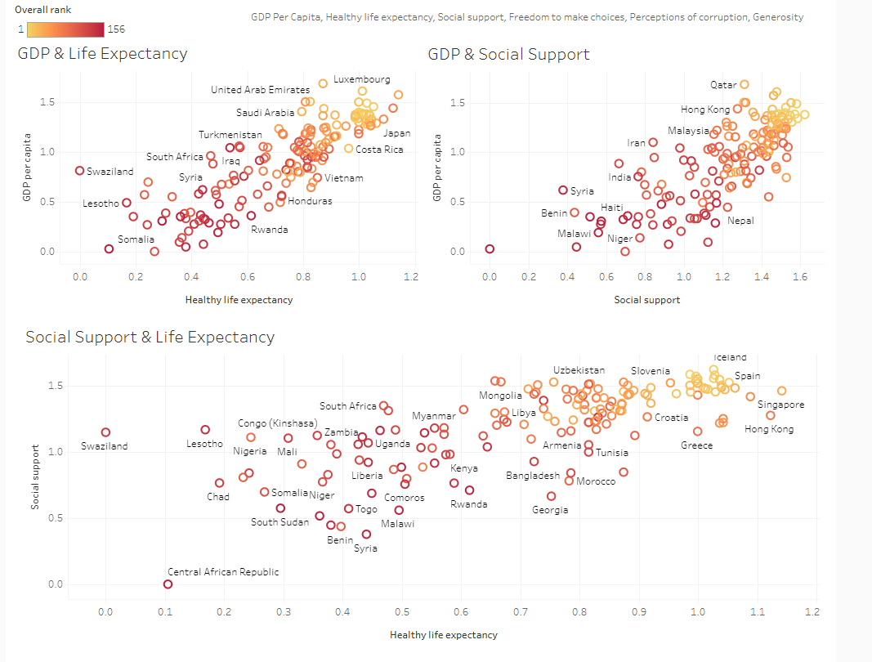
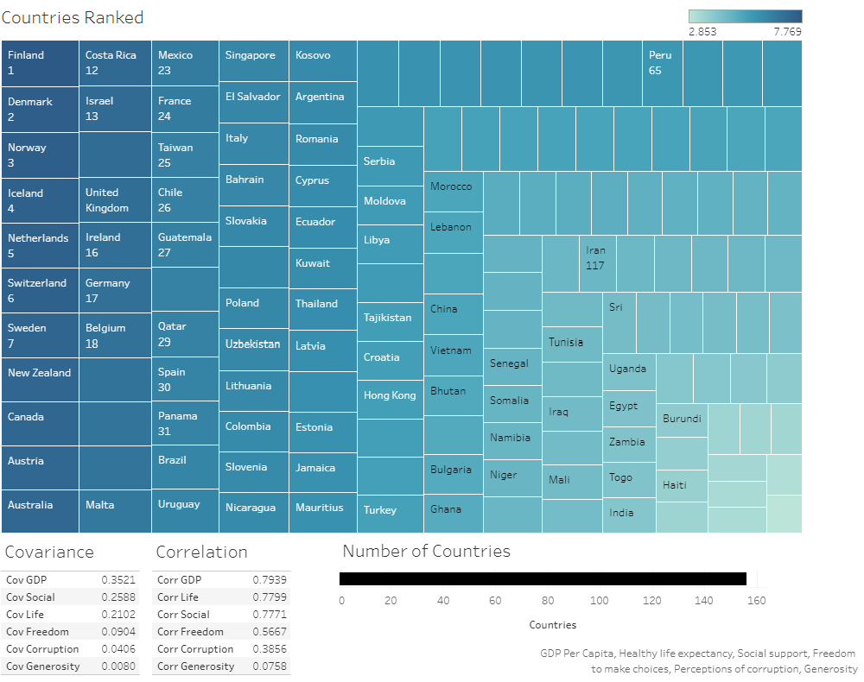

DATA ANALYTICS (ONLINE)
VISUALS - TABLEAU
QUESTIONS
DATA SUMMARY
CODE/DATA APPROACH
VISUALS
RESULTS
IMPLICATIONS
GROUP 4: PROJECT 3 (NS)

Slide 13
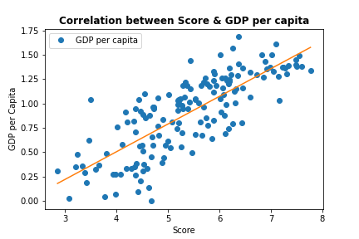
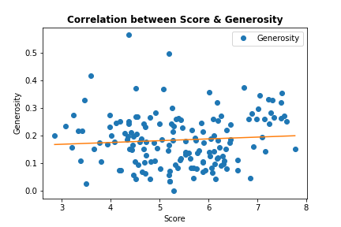
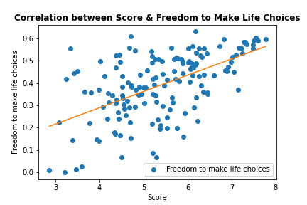
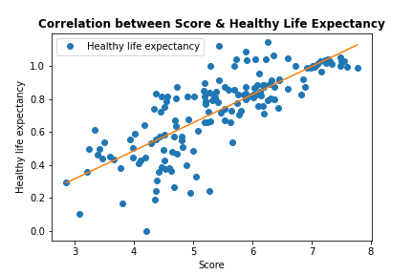
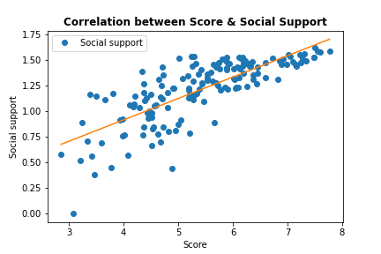
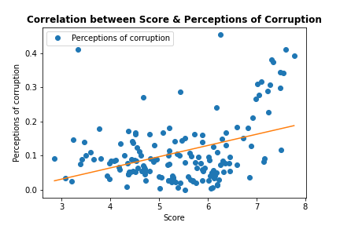
DATA ANALYTICS (ONLINE)
VISUALS
QUESTIONS
MACHINE LEARNING / CORRELATION
DATA SUMMARY
CODE/DATA APPROACH
VISUALS
RESULTS
IMPLICATIONS
GROUP 4: PROJECT 3

Slide 14
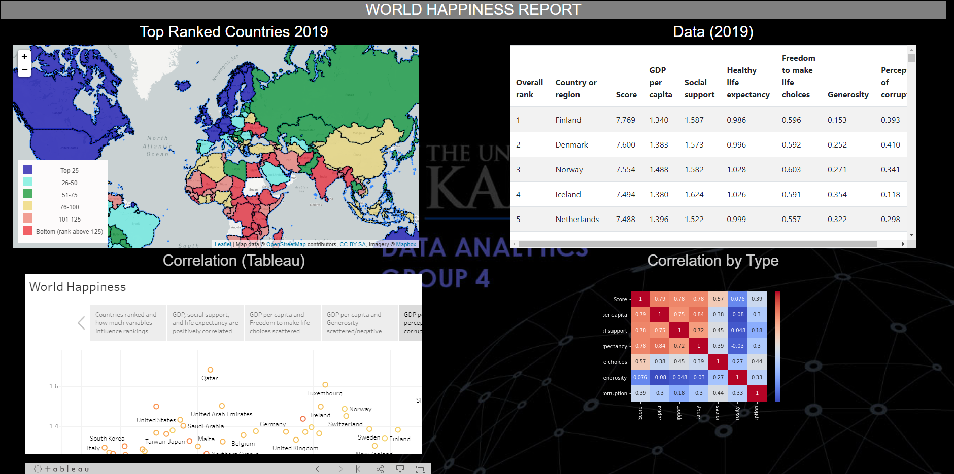
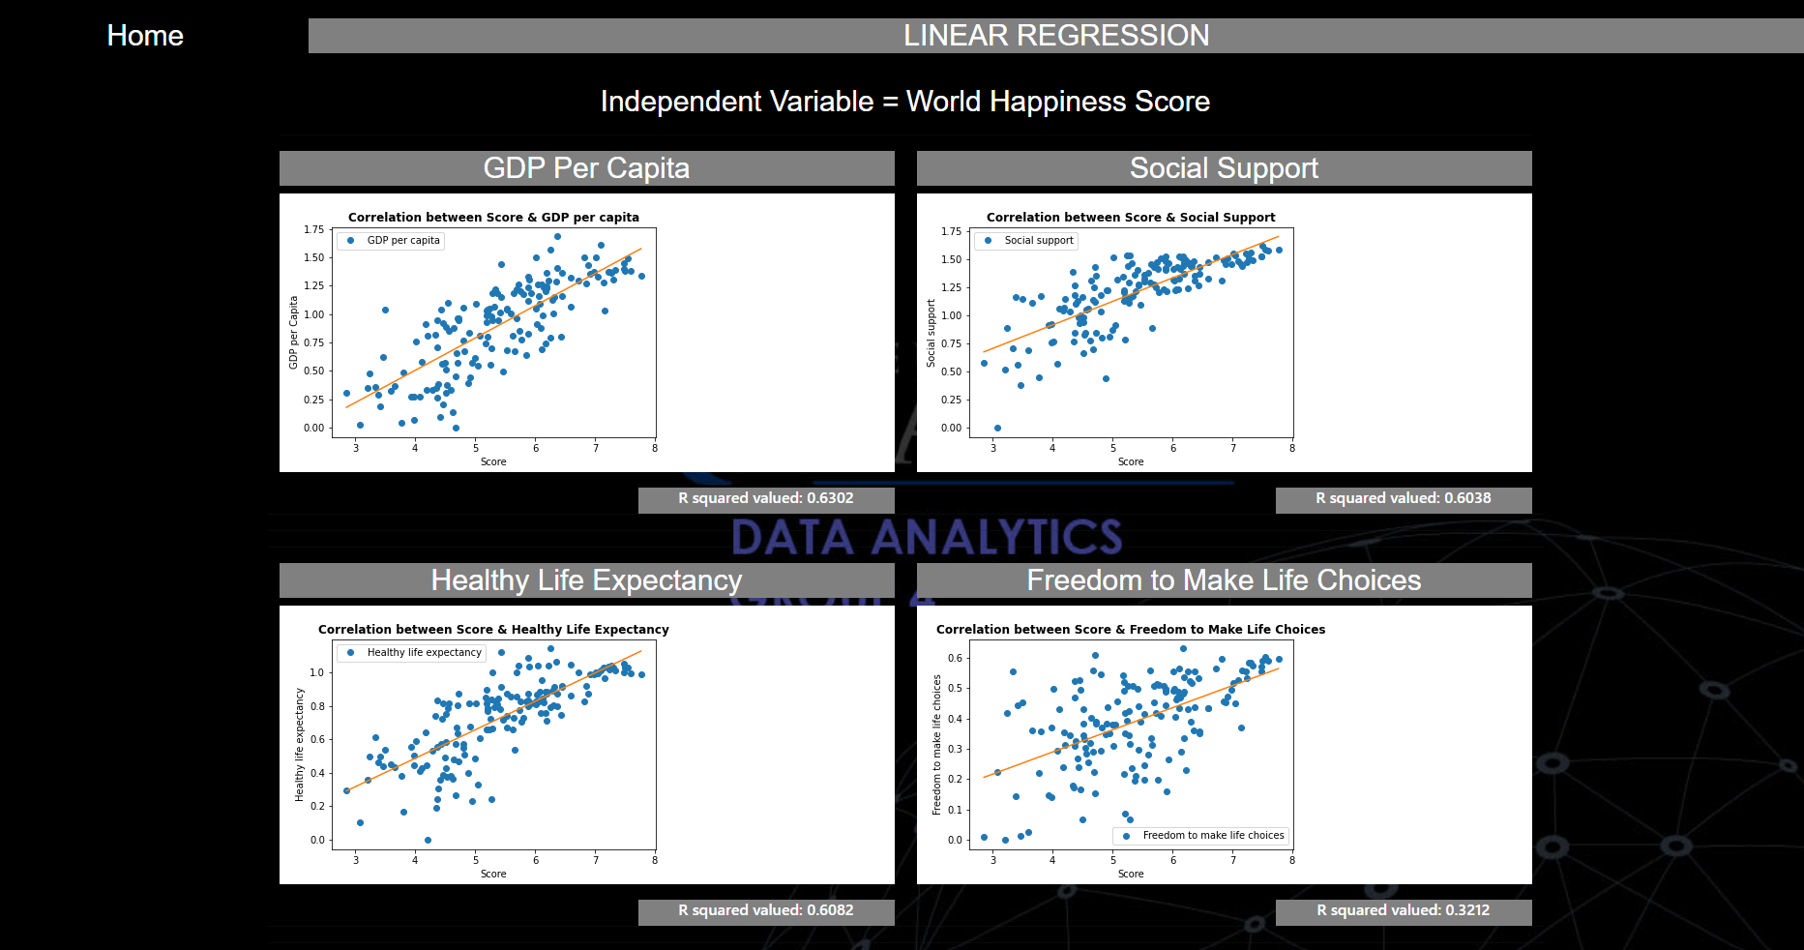
DATA ANALYTICS (ONLINE)
QUESTIONS
MACHINE LEARNING / CORRELATION
DATA SUMMARY
CODE/DATA APPROACH
VISUALS
RESULTS
IMPLICATIONS
GROUP 4: PROJECT 3

Slide 15
DATA ANALYTICS (ONLINE)
QUESTIONS
IMPLICATIONS / FURTHER REVIEW
DATA SUMMARY
MERGE AND USE ALL MULTIPLE YEARS TO PERFORM PREDICTION FOR NEXT YEAR
USE GROUPING TO ESTABLISH IF CERTAIN CONTINENTS HAVE STRONG SCORES THEN OTHERS
VERY INTRESTING TO SEE HOW COVID-19 IMPACTS THIS YEARS RESULTS
CODE/DATA APPROACH
VISUALS
RESULTS
IMPLICATIONS
GROUP 4: PROJECT 3

Slide 16
DATA ANALYTICS (ONLINE)
QUESTIONS
DATA SUMMARY
CODE/DATA APPROACH
QUESTIONS?
VISUALS
RESULTS
IMPLICATIONS
GROUP 4: PROJECT 2

