Slide 1
Blackjack
CSC 460/660
Kevin Stanley
Carson Mullins
Zach Fondal

Slide 2
Outline
Team Roles
Technologies Used in Project
Architecture Diagram
Prototype
Final Blackjack Demo
Questions?

Slide 3
Team Roles
Kevin Stanley
Developer
Scrum Master
Create initial seed application for GIT repository including Card, Player, Hand, Suit, Value classes.
Implemented Split, Double Down, Blackjack check and Add Money functionality
Implemented JSON storage/retrieval of Bank amount.
Added application audio.
How to Document

Slide 4
Team Roles
Carson Mullins
Developer
Found images for cards
UI
Implemented Hit, Stay functionality.
Implemented hand value (to determine if win or bust).

Slide 5
Team Roles
Zach Fondal
Developer
Created Bank class
Architecture Diagram

Slide 6






Technologies Used in Project
Jira - https://csc660.atlassian.net/secure/Dashboard.jspa
Slack - https://csc660.slack.com/messages/CDR7XG1R9/
GitHub - https://github.com/kevinstanley8/Blackjack
Sourcetree
C#/Visual Studio

Slide 7
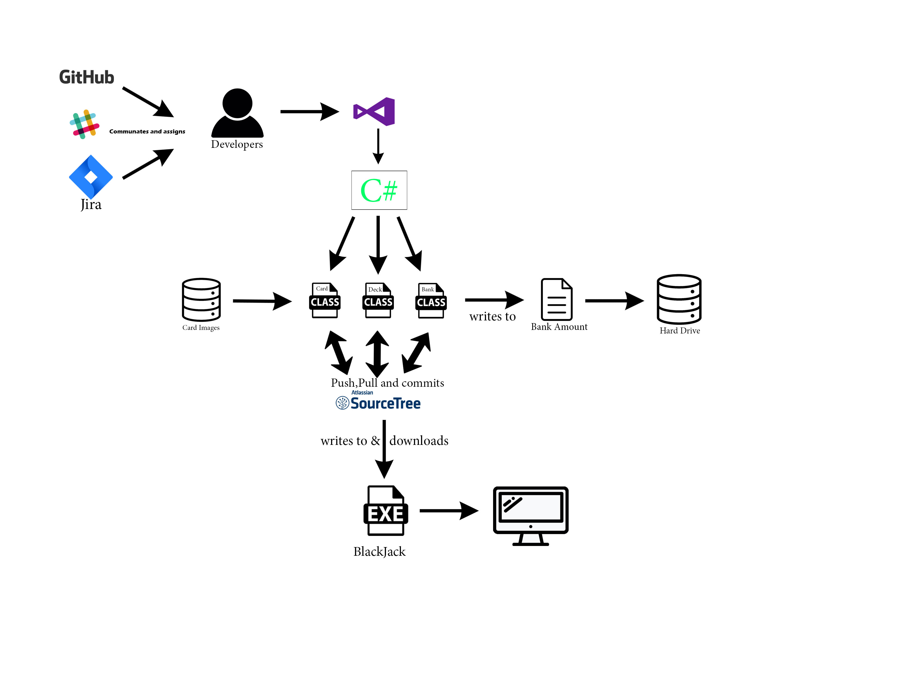
Architecture Diagram

Slide 8
Prototype
https://www.figma.com/proto/Zp89SG2A8BgGW99WedlCEdxl/Blackjack?node-id=0%3A1&scaling=min-zoom&redirected=1

Slide 9
Final Blackjack Demo

Slide 10
Questions?

