Slide 1

Recursion

Slide 2
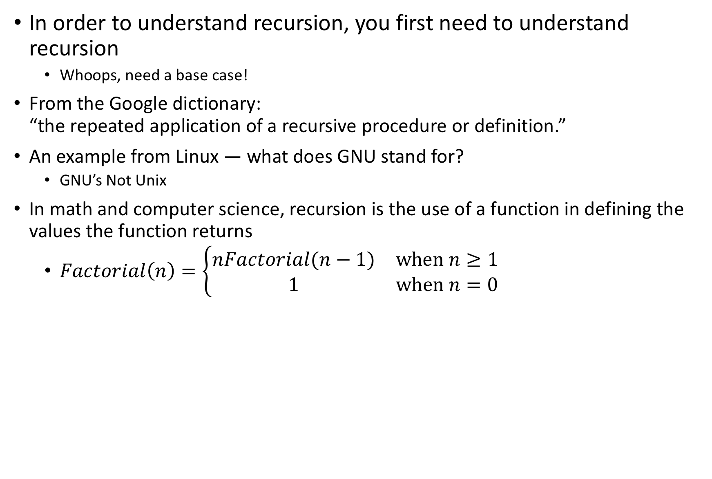
What is recursion?
In order to understand recursion, you first need to understand recursion
Whoops, need a base case!
From the Google dictionary: “the repeated application of a recursive procedure or definition.”
An example from Linux — what does GNU stand for?
GNU’s Not Unix
In math and computer science, recursion is the use of a function in defining the values the function returns
$Factorial\left(n\right)=\left\{\begin{matrix}nFactorial(n−1) & \text{when} n≥1 \\ 1 & \text{when} n=0\end{matrix}\right.$

Slide 3
https://www.smbc-comics.com/comic/2011-08-02

Slide 4
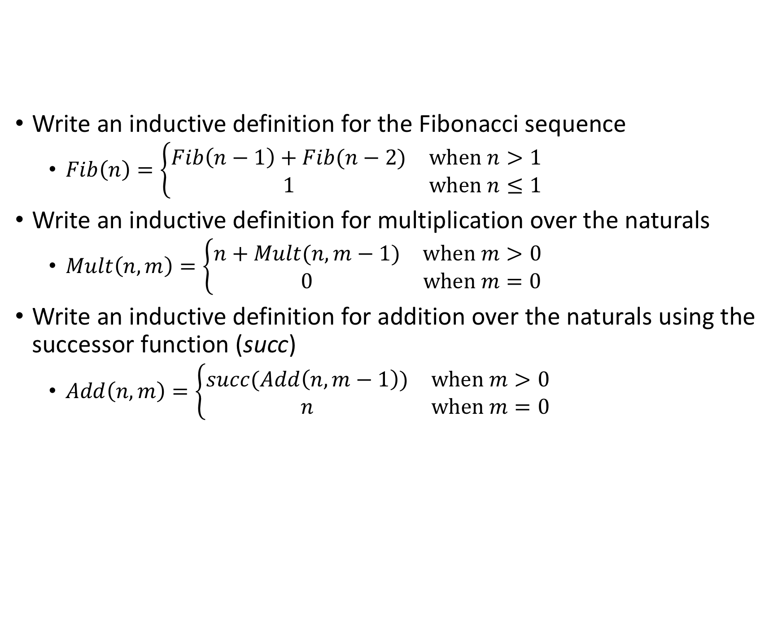
Exercise
Write an inductive definition for the Fibonacci sequence
$Fib\left(n\right)=\left\{\begin{matrix}Fib\left(n−1\right)+Fib(n−2) & \text{when} n>1 \\ 1 & \text{when} n≤1\end{matrix}\right.$
Write an inductive definition for multiplication over the naturals
$Mult\left(n, m\right)=\left\{\begin{matrix}n+Mult(n,m−1) & \text{when} m>0 \\ 0 & \text{when} m=0\end{matrix}\right.$
Write an inductive definition for addition over the naturals using the successor function (succ)
$Add\left(n,m\right)=\left\{\begin{matrix}succ(Add\left(n,m−1\right)) & \text{when} m>0 \\ n & \text{when} m=0\end{matrix}\right.$

Slide 5
Booleans
Definition of the booleans

Slide 6
Naturals
An inductive definition of the natural numbers

Slide 7

Fin

