Slide 1

Relations

Slide 2
What is a relation?
A relation is proposition about two values
= is the proposition that two values are equal
< is the proposition that the first value is less than the second value
Let β be an arbitrary type, and r be a binary relation on elements of type, β.
In Lean: variable {β : Type} variable (r : β → β → Prop) variables x y : β #check r x y
This is prefix notation

Slide 3
Infix notation
Infix notation is when the relation can be used between the two values instead of before them
local infix `R`:50 := r
local infix `≺`:50 := r
The number 50 defines the precedence
#check x R y
#check x ≺ y
See equality example

Slide 4
Possible properties that relations can have
Reflexive (e.g., x = x)
Symmetric (e.g., x = y → y = x)
Transitive (e.g., x = y ∧ y = z → x = z)
See Lean proofs for equality
Any relation that has all 3 of the above is an equivalence relation

Slide 5
Does equivalence mean equal?
Are there relations that are equivalent besides equal?
Consider mod 12 equivalence:
def mod_12_equiv : ℕ → ℕ → Prop :=
λ x y, x % 12 = y % 12
See proofs of that it is an equivalence

Slide 6
Other possible relation properties
Total (e.g., x ≤ y ∨ y ≤ x)
Irreflexive (e.g., ¬(x < x))
Anti-symmetric (e.g., x ≤ y ∧ y ≤ x → x = y)
Connected (e.g., x ≠ y → x < y ∨ y < x)
Empty relation (e.g., x ∞ y, where ∞ is the relation that the first argument is both less than and greater than the second argument)

Slide 7
Relation properties summary
Reflexive: ∀x, x R x
Symmetric: ∀ x y, x R y → y R x
Transitive: ∀ x y z, x R y ∧ y R z → x R z
Total: ∀ x y, x R y ∨ y R x
Irreflexive: ∀x, x R x → false
Anti-symmetric: ∀ x y, x R y ∧ y R x → x = y
Connected: ∀ x y, x ≠ y → x R y ∨ y R x
Empty: ∀ x y, x R y → false

Slide 8
Exercises
Which properties do the following relations hold of: (a) reflexive, (b) symmetric, (c) transitive, (d) total, (e) irreflexive, (f) anti-symmetric, (g) connected, (h) empty
=
a, b, c
<
c, e, f*, g (* indicates a proof from false elimination, AKA a “vacuous” proof)
≤
a, c, d, f, g
≠
b, e, g
“left-hand side (LHS) equals 0 * right-hand side (RHS)”
c, f
“LHS equals 1 + RHS”
e, f*
“LHS < RHS and RHS < LHS”
b*, c*, e*, f*, h

Slide 9
Subrelation
Subrelation is a property between two relations
For example, < is a subrelation of ≤, because x < y → x ≤ y
def subrelation (q r : β → β → Prop) := ∀ ⦃x y⦄, q x y → r x y
Is < a subrelation of <?
Yes!
All relations are subrelations of themselves
All empty relations are subrelations of any relation

Slide 10
Relations as sets of 2-tuples
Conceptually, we can also think of a relation as a set of 2-tuples
Why does this make sense?
What is a set?
A set is a proposition about a value
Conceptually, the proposition is about whether that value is in the set
What is a relation?
A relation is a proposition about two values
Conceptually, whether the relation holds for those two values
Note, however, that the syntax is different

Slide 11
Successor Relation
Let us define a relation R as R¹
For example imagine the relation “is one or two less than” as defined over the naturals
It contains the 2-tuples {(0, 1), (0, 2), (1, 2), (1, 3), (2, 3), (2, 4), (3, 4), (3, 5), etc.}
Now let us define R² (or R ◦ R) as the relation having left-hand elements equal to the left-hand elements of the tuples in R¹, and right-hand elements equal to the corresponding right-hand elements of the right-hand elements in R¹
E.g., from above this would be “is two, three, or four less than”
It contains the 2-tuples {(0, 2), (0, 3), (0, 4), (1, 3), (1, 4), (1, 5), etc.}
R³ (or R ◦ R²) is the relation having left-hand elements having left-hand elements equal to the left-hand elements of the tuples in R¹, and right-hand elements equal to the corresponding right-hand elements of the right-hand elements in R²
E.g., from the above this would be “is three, four, five, or six less than”
It contains the 2-tuples {(0, 3), (0, 4), (0, 5), (0, 6), (1, 4), (1, 5), (1, 6), (1, 7), etc.}

Slide 12
Successor Relation in Lean
def successor: (β → β → Prop) → (β → β → Prop) :=
begin
assume r,
exact λ(x y: β), ∃(b: β), (r x b) ∧ (r b y)
end

Slide 13
Exercises
Provide R² given the following R¹ definitions
R¹ = “LHS is one less than RHS”
R² = “LHS is two less than RHS”
R¹ = “LHS is twice the RHS”
R² = “LHS is four times RHS”
R¹ = “LHS is two or three times the RHS”
R² = “LHS is four, six, or nine times the RHS”
Provide R³ given the following R¹ definitions
R¹ = “LHS is one less than RHS”
R³ = “LHS is three less than RHS”
R¹ = “LHS is two or three times the RHS”
R³ = “LHS is 8, 12, 18, or 27 times the RHS”

Slide 14
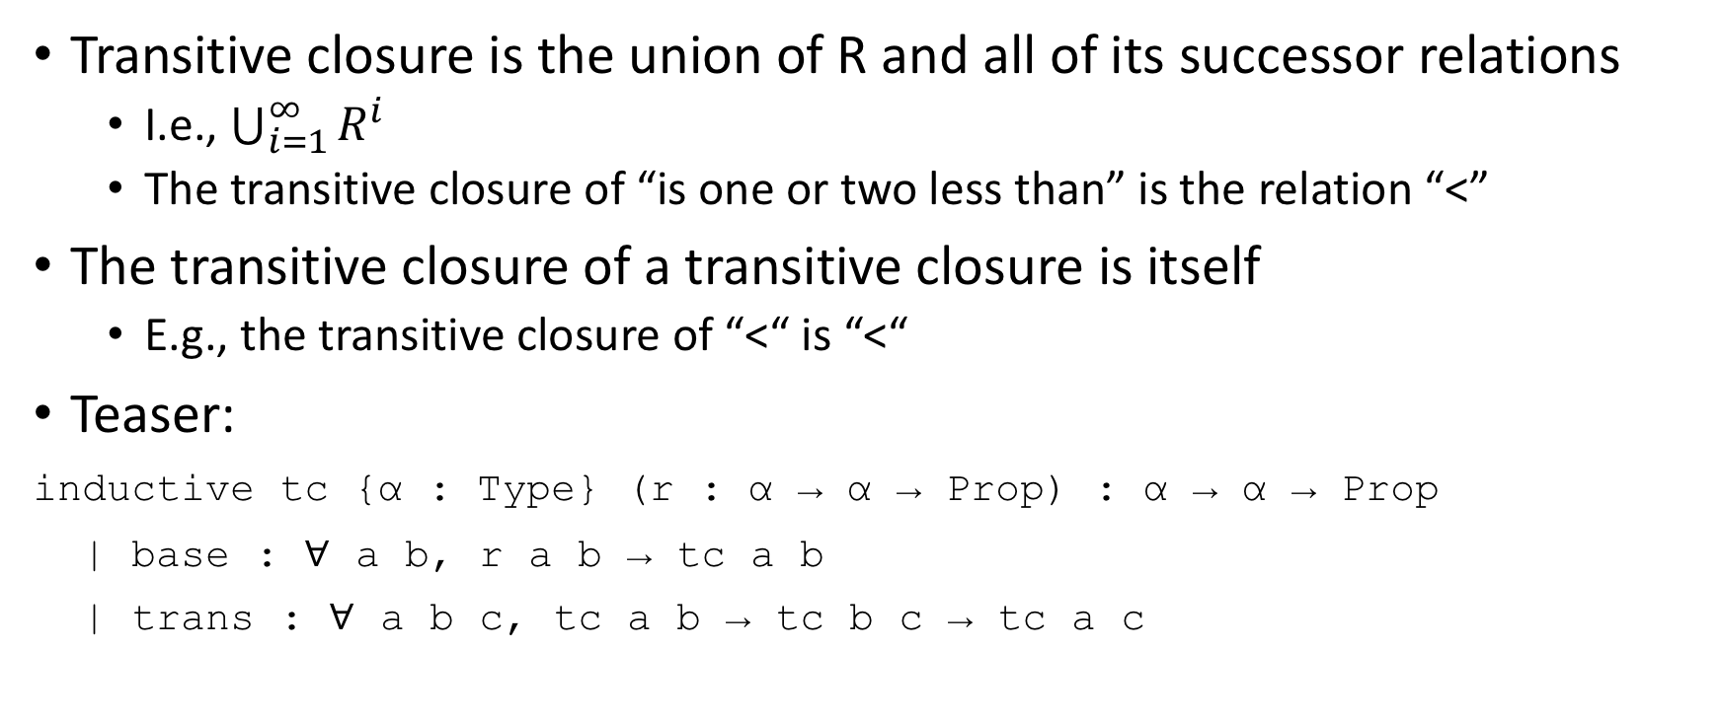
Transitive Closure
Transitive closure is the union of R and all of its successor relations
I.e., $\bigcup_{i=1}^{∞}{R^{i}}$
The transitive closure of “is one or two less than” is the relation “<”
The transitive closure of a transitive closure is itself
E.g., the transitive closure of “<“ is “<“
Teaser:
inductive tc {α : Type} (r : α → α → Prop) : α → α → Prop
| base : ∀ a b, r a b → tc a b
| trans : ∀ a b c, tc a b → tc b c → tc a c

Slide 15
Exercises
What is the transitive closure of the following:
R¹ = “LHS is one less than RHS”
TC = <
R¹ = “LHS is zero or one less than RHS”
TC = ≤
R¹ = “LHS is two more than RHS”
TC = ∃n: ℕ, n > 0 ∧ LHS = 2n + RHS
R¹ = “LHS is two more or two less than RHS”
TC = “LHS has same parity as RHS” AKA “LHS is even iff RHS is even and LHS is odd iff RHS is odd AKA ∃n: ℤ, LHS = 2i + RHS

Slide 16

Fin

