Slide 1

What’S kicking in
?
ISSS616 Applied Statistical Analysis with R
Group 6
Archie Quiambao DOLIT
MIN Xiaoqi
Kevin Magic Rialubin SUNGA
WANG Zhifei
Lynette WONG Yik Lynn
WONG Sook Xian Sophia
1
Notes:
Good evening everyone! We are group 6. Before we start, lemme ask “How many of you supported a project in Kickstarter, Indiegogo, GoFundMe or other crowdfunding website?”
Today, let's kickstart the presentation and discover what's kicking in the kickstarter scene‘’

Slide 2
0 1
What DO we know about kickstarter?
02
What are the problems faced by creators and backers?
AGENDA
03
How can our R shiny App help creators and backers?
04
What is our Analytical Process?
05
Let’s walk you through our shiny app!
06
CONCLUSION
Notes:
We will firstly go through what is kickstarter, followed by the problems faced by creators and backers and how our Rshiny app will help them. Then we will explain our analytical process, walk you through our shinny app before we conclude our presentation.

Slide 3





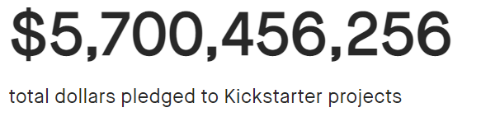
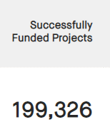
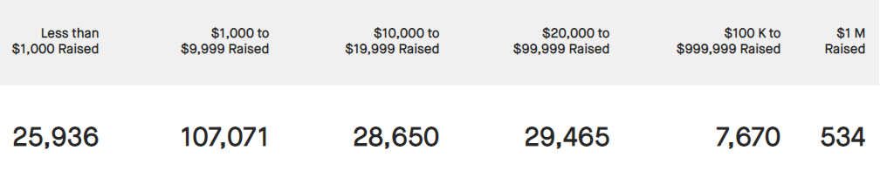
kickstarter
Online platform for creative ideas
Funders/start-ups present ideas → supported by people worldwide (Crowd funding)
Since its launch on 28 April 2009,
19.4
million
$5.7
billion
Backers
Pledged
Source: Kickstarter - Data as of 5 April 2021
Notes:
Kickstarter is an online platform for creative ideas, ranging from film, music, games to design and technology. This is where funders and startups will present their ideas and be supported by people worldwide, which is called crowd funding. Since its launch on 2009, kickstarter has gathered 19.4 million backers and raised 5.7 billion dollars pledged amount.

Slide 4
FLOW OF KICK STARTER
STAGE 1
STAGE 2
STAGE 3
Creators set monetary goal & deadline
Backers pledge money if they like the project
Campaign status (All-or Nothing) :
Success: when goal amount met by set deadline
Failed: does not meet funding goal, creators receives no money
Notes:
Here is how kickstarter works. At stage 1, the creator will post a project, set monetary goal and deadline to be met. Then the bakders will pledge money if they like a certain project. Finally, kickstarter follows a all or nothing model which the campaign status depends on the pledge amount. The project is successful only when the goal amount is met by the deadline, if not, the project is failed and the creators will receive no money.

Slide 5
PROBLEMS FACED by CREATORS and BACKERS?
Dispersed info & limited resources
Accessed from different websites
Limited data analysis
Past project performance
Too many factors to consider in project planning
One-man show or a very small team of creators → difficult to make decisions
?
!
?
Making the choice
Range of variables to quantify
Backer: successful project, historical data
Creator: What’s the optimal amount, date, topic, success rate etc.
5
Notes:
So if you were a creator or backer, what are the problems you may face? Here we have summarized the potential problems. Firstly, there is dispersed information and limited resources. Statistics on Kickstarter projects need to be accessed from different websites with limited data analysis for project creators to have a holistic view of the past projects’ performances. Secondly, there are too many factors for creators to consider in project planning stage, many of the creators are one man show or very small team which may be difficult for them to make wise decisions. Lastly, backers and creators face a range of variables they need to quantify. For backers, they would want to know what are the past successful projects so that they will make the right choice; for creators, they need to know what’s the optimal goal amount, when to launch the project, what topics they should choose to work on and how to increase their project success.

Slide 6
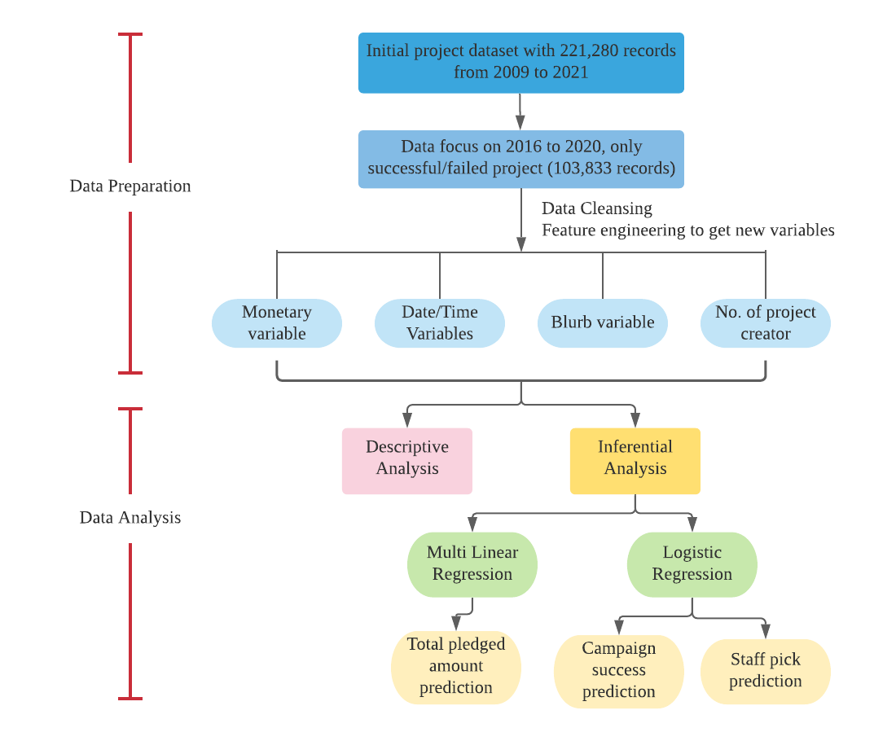
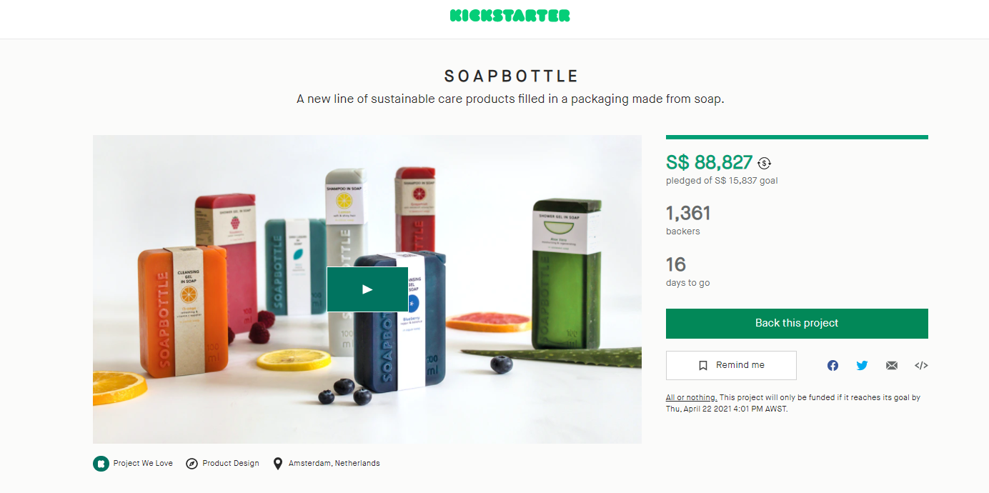
Analytical Approach
Data crawling from Kickstarter website
6
Notes:
Celia
Before we jump into the solutions, lets look at the analytical approach we have adopted to tackle the problem faced.
Here is a brief work flow of our approach. In our project, we took 5 year worth of monthly kickstart data and focusing on completed campaigns that are either successful or failed.
From there, we performed cleansing, feature engineering to derive additional variables, and conducted descriptive analysis and statistical tests to determine the useful variable that were eventually used in our solution.
Lets look at some interesting findings we have on success rate (%)

Slide 7
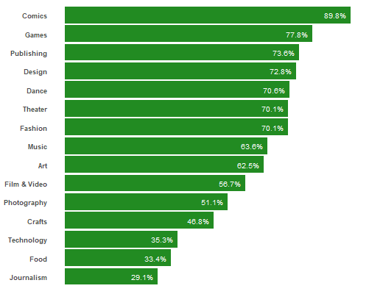
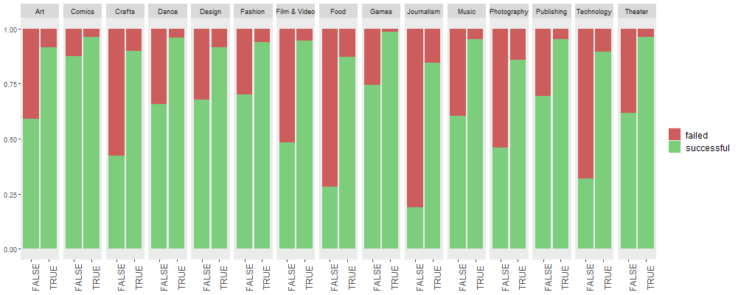
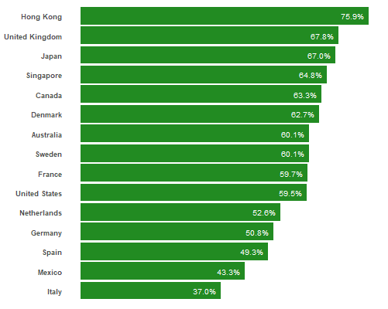
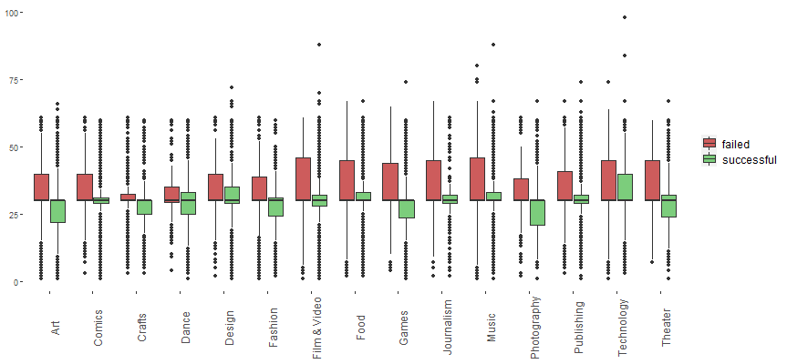
Trends and insights
Success Rate (%)
Staff Pick: higher success rate across all categories
Top 3
Category
Campaign Duration: optimal duration <= 30 days
Top 3
Location
7
Notes:
Celia
-Firstly, staff pick. As shown by the percentage bar chart, higher success rate is observed across all categories. This drive us to dive deeper at subsequent stage to help creators to get their project featured by staff.
-Campaign Duration: intuitively, one would think the longer the campaign period, the more time we have to collect funds, hence the better it is. However it is not the case, from our findings, optimal duration is actually one month
-Success rate also vary across category and location where the project is launched at.

Slide 8
FINAL DATASET and MODEL
Creators
Backers
Total Pledged Amount (Set Goal)
Staff Pick
Campaign State
Final Dataset
Multiple linear regression
Logistic Regression
Logistic Regression
Total Pledged Amount ~
number of backers
+ main category
+ staff pick
+ campaign duration
+ title word length
+ description word length
+ country of origin
+ number of project created
+ launch day
+ launch month
Staff Pick ~
(by main category)
campaign duration
+ title word length
+ description word length
+ country of origin
+ number of project created
+ launch day
+ launch month
+ goal ($USD)
Campaign State ~
(by main category)
staff pick
+ campaign duration
+ title word length
+ description word length
+ country of origin
+ number of project created
+ launch day
+ launch month
+ goal ($USD)
Monetary
Project Info
Date/Time
Creators’ past projects
Location
8
Notes:
Celia
-After studying on the trend and conducting test to verify our hypothesis, we arrive at the list of variables that will go into modelling stage
-These variables can be broadly classified into 5 area. Monetary, Data/Time variable, location, project info and number of past projects a creator has.
-As creator and backers have different needs, we have 3 models set up to cater to the different requirement.
-
-For creators, two concerns they are how much to set as goal, and how to get their campaign featured by staff – to help them that, we have adopted multiple linear regression to predict the pledged amount the project is likely to collect, creator can use this to proxy the goal amount
-Staff pick, logistic regression is used, so creators can fine tune the variables to make their project more favorable by staff
-For backers. In general, backers wants to support a project of interest that can be successful, so that they can enjoy the product and services , or even the rewards creators are providing

Slide 9
HOW CAN OUR R SHINY APP HELP CREATORS & BACKERs?
DECISION MAKING
RESOURCE PLANNING
Creators can understand contributing factors of a staff-picked project and determine suitable goal . Backers can decide whether to pledge based on proability of success.
Insights gained from dashboard and predictions based on historical data can help in resource planning
TRACKING PROGRESS
Once project has been launched, predict pledged amount based on moving indicators.
9
Notes:
Celia
With the help of Shiny, decision making, resource planning, and tracking progress can be obtained at ease
Next, I’ll invite my team make, Archie, Kevin, Sook Xian and Lynnett to demonstrate how this can be done thru our shiny app

Slide 10
APP DEMO VIA ROLE PLAY
APP Developers
CREATOR
BACKER
10
Notes:
App Developer
> Dashboard & EDA – Kevin
> MLR and Logit – Archie
Creator – Sook (MLR, Staff Pick)
Backer – Lynette (Success Rate)
What variables used
How to used
Discuss about Food and Technology

Slide 11
CONCLUSION
11
Notes:
Kevin

Slide 12
PROBLEMS AND SOLUTIONS
PROBLEMS
SOLUTIONS
Dispersed info & limited resources
A comprehensive dashboard
Accessed from different websites
Limited data analysis
Backer: successful project, historical data
One stop shop
Rich exploratory data analysis
Useful to creators and backers
ISOLATE the variables that matter
Too many factors to consider in project planning
Through exploratory data analysis and modelling, creators can narrow down the factors that have the greatest impact on their project’s success.
Different factors to consider
Making the choice
DATA-DRIVEN DECISION making
Backer: successful project, historical data
Creator: What’s the optimal amount, date, topic, success rate etc.
Backers can use our logit models to determine a project’s likelihood of success
Creators can use our MLR and logit models to help set goals and other aspects of their campaign
12
Notes:
Now that we’ve completed our demo. I’d like to just summarize some of the key points that we’d like for you to take away from our discussion today.
First. Kickstarter is a platform that does a lot of good for society and the world by connecting creators and backers. But creators and backers face some problems, and that’s where we hope to come in.
The first problem is the information creators and backers need is dispersed, can be hard to find. Our app solves this by consolidating the most important information into one easy to use tool.
The second problem is there’s a lot for a creator to consider in designing their project’s campaign. We hope to make the design process simpler for creators by analyzing historical projects, specifically what factors led to those campaigns being successful.
The third and last problem is creators and backers currently rely on intuition and a gut feeling to determine their goal amount or whether a campaign is worth backing. We hope to add some objectivity and clarity into this decision making process using our prediction models.

Slide 13
WHAT DIFFERENTIATEs us?
DATA
Exploratory data visualization
Our study and app is based on 5 years worth of data and insights (2016-2020).
Our app is the most comprehensive out in the market, and it makes it easy for users to visualize and explore historical data.
ANALYTICAL APPROACH
Robust and flexible models
Our approach is unique: we predict pledge amount, staff pick, and success rate using variables like project locations.
Our models are flexible and allow creators and backers to change variables over the lifetime of a project to get more up to date predictions.
Notes:
Kickstarter is a popular project on Kaggle, github, and other websites. This space may be saturated, but we believe we still have something of value to add to the conversation. There are 4 things that we think set us apart:
Our data is relatively big compared to some other studies. In one study we found, they only used 6 months whereas we use 5 years worth of data.
Our dashboard is comprehensive and allows users to get macro and micro level insights from the data.
Our analytical approach. One of our models focuses on staff pick. We believe focusing on this variable (as opposed to just success rate) better empowers creators because this is something they can proactively strive for as an early indicator.
Lastly, our tool and model are flexible enough to adapt. We recognize that projects evolve. If key factors about your project change, you can use our model to get updated predictions to see if you’re on track or if you need to course correct.

Slide 14
IMPROVE THE PREDICTION ACCURACY and FUTURE WORK
Future Work
Additional information
Text analytics or text data mining to derive additional information from project name and blurb
Variable on “Number of Projects by the creator” would need to be calibrated as it currently takes into account the total number of projects launched by a creator during the 5-year period.
Further analysis can be performed to determine how creators of certain project category (e.g. games) with a succession of successful projects could have an impact on the outcome.
Consider partitioning the data into training, validation and testing
Social analytics – impact of online ads (in particular targeted and hyper personalized marketing campaigns)
Backers’ demographics
Results of search engine optimization
14
Notes:
Lynette:
How can you improve the accuracy of your model and what are future enhancements?

Slide 15

THANK YOU
VERY MUCH!
SCAN THE QR CODE TO VIEW THE APP
ANY QUESTIONS?
https://adolit.shinyapps.io/Kickstarter-ASAR-G2-Group6/
Slides template from Slidesgo
15
Notes:
Archie

Slide 16
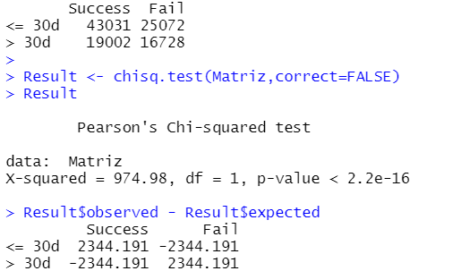
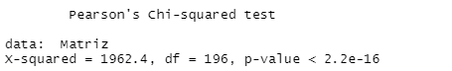
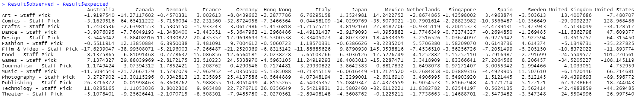
Statistical tests Chi-Square Test of Association
$H_{0}$: No association exists between Campaign Duration by Project Success State
$H_{1}$: Association exists between Campaign Duration by Project Success State
Chi-Square Test Result of Campaign Duration by Project Success State
$H_{0}$: No association exists between Main Category and Country of Origin for Staff Picked Projects
$H_{1}$: Association exists between Main Category and Country of Origin for Staff Picked Projects
Chi-Square Test Result of Main Category by Country of Origin for Staff Picked Projects
16
Notes:
Sook
You mentioned about the significance of staff pick and campaign duration, did you perform statistical tests?

Slide 17
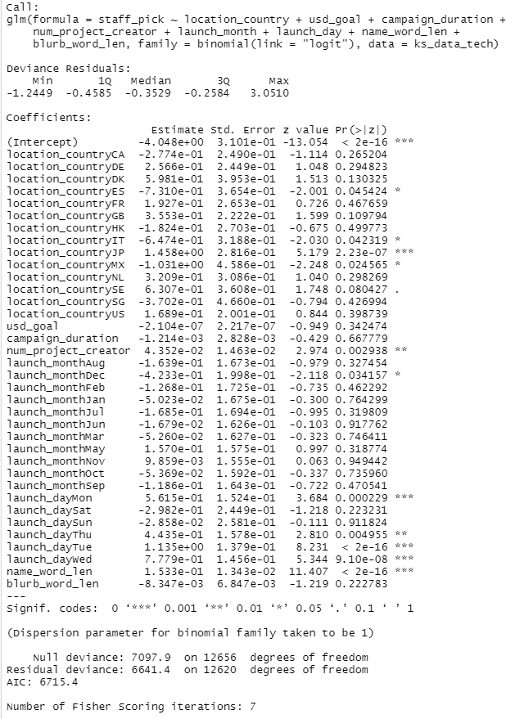
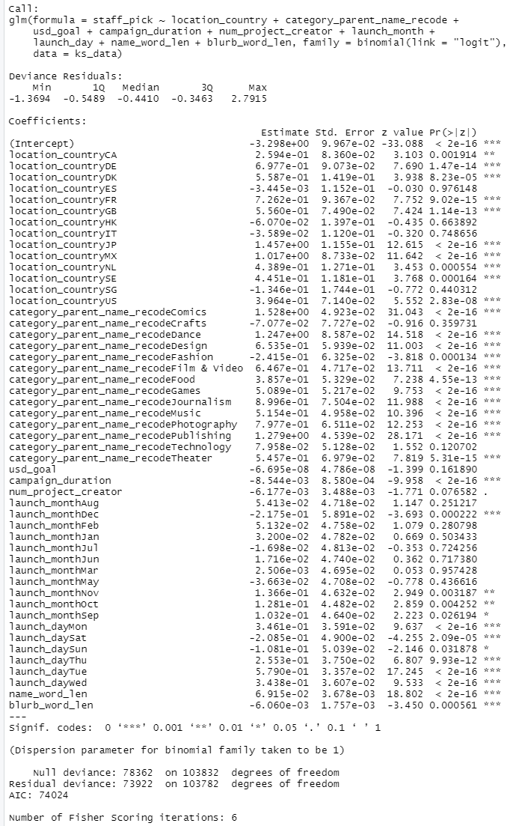
WHY PER CATEGORY?
TECH ONLY
ALL ONLY
Lower AIC Value (6715.4 vs 74024)
Better model fit
17
Notes:
Archie:
Can you elaborate why did you choose to build models per main category for staff pick and success rate?
Thanks for the question, we actually tried to build a model for all category but building a model per category is better because it yields a lower AIC Value.

