Slide 1
Global Illumination
May 7, 2007

Slide 2
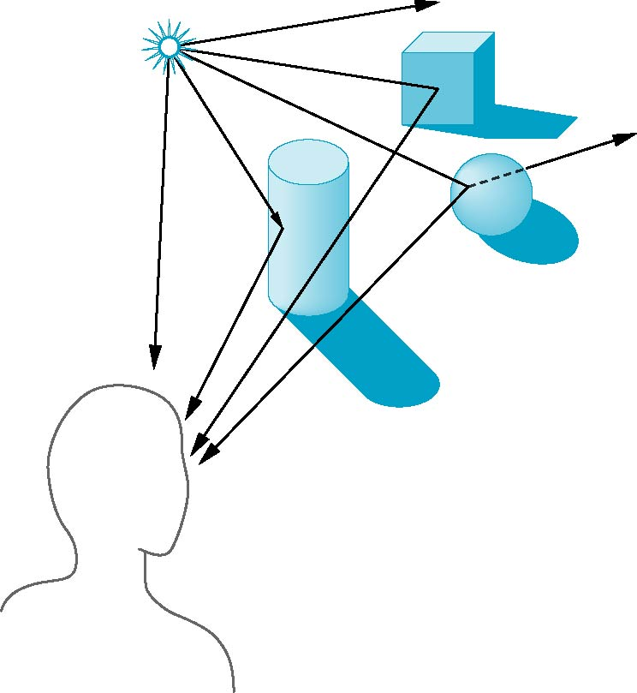
Global Effects
shadow
multiple reflection
translucent surface

Slide 3

Local vs. Global

Slide 4
Local vs Global Rendering
Correct shading requires a global calculation involving all objects and light sources
  Incompatible with pipeline model which shades each polygon independently (local rendering)
However, in computer graphics, especially real time graphics, we are happy if things “look right”
  Exist many techniques for approximating global effects

Slide 5
Local Reflection Models

Slide 6
Phong Reflection Model
I = Ka*Ia + kd*Id + Ks*Is
Not completely correct, but good enough.
specular
diffuse
ambient

Slide 7
Ambient Component
Accounting for light scatter around.
Ia is constant.

Slide 8
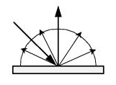
Diffuse Component
Ia = Ii * N·L
Not affected by viewing direction.
  i.e., incoming light is reflected
  to all directions.
L
N

Slide 9
Specular Component
(Phong Reflection Model)
To model imperfect reflection.
Is = Ii(N · H)^{n}
L
H
N
V

Slide 10
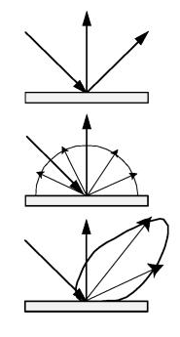
Specular Component
(Cook & Torrance Model)
Consider specular reflection as perfect reflection of micro-facets.
Specular=DGF/(N·V)
  D: Distribution term
  G: Geometry (shadowing and masking) term
  F: Fresnel term

Slide 11
D Term (Cook & Torrance)
Modeling the distribution of micro-geometry.
Gaussian distribution can be used:
D = k e^{-(α/m)2}

Slide 12
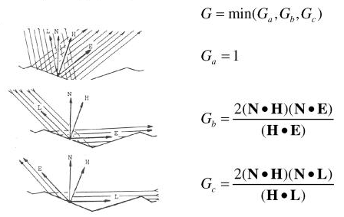
G Term (Cook & Torrance)

Slide 13
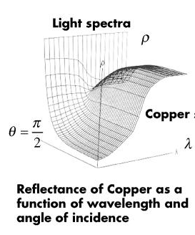
The Fresnel Term
Color of reflected light varies with viewing angle.

Slide 14
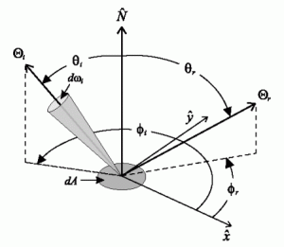
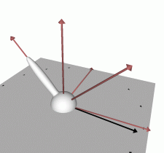
BRDF
BRDF=f(θ_{in}, φ_{in}, θ_{ref}, φ_{ref})=f(Light,View)

Slide 15
Why Not Always Using BRDF?
Difficult to find a “closed form” representation of BRDF.
The Phong model and Cook & Torrance model are approximation of BRDF.
  They are not 100% matche of BRDF, but they are easy to compute.

Slide 16
Exercise
Q1: Those reflectance models give us local illumination only. Why?
Q2: What typical effects are missing?
  Hint: What are the parameters? Do they include the other objects?
  Shadow, reflection, and refraction…

Slide 17
Object-Order vs. Screen-Order Rendering

Slide 18
How Do You Draw a Picture (Without a Computer)?
What is your subject?
Viewing Parameters:
  Camera, Picture Frames, Resolutions
Many ways to specify it:
  eye, focus length, image plane
  eye, direction, FOV, up vector

Slide 20
Method A: Object Order Algorithm
(Process one polygon at a time.)

Slide 21
3D to 2D Projection
OK, so we can map a 3D point (or vertex) to 2D image.
But what about a 3D surface?
Polygons are made from points.
Actually, we only need triangles!

Slide 22
Scan Conversion
Also called rasterization.
The 3D to 2D Projection gives us 2D vertices (points).
We need to fill in the interior.

Slide 23
Shading
Interpolation between any two vertices:
  Vertex colors (lit or unlit?)
  Normal vectors
  Z
  w (or 1/w) for perspective correction
  Texture coordinates

Slide 24
Note that we usually apply only local illumination in object order algorithm (because you have to go beyond the current object to obtain the global effect.)
Method B: Screen Order Algorithm
(Process one pixel at a time.)

Slide 25
Ray Tracing Algorithm
More detail in Watt’s 10.3.1 (pp.284-286) and 12.2-12.4 (pp.342-354)
Transmitted
Reflected

Slide 26
Creating a Ray
Parameters:
  Image Plane (position, size, and resolution)
  Viewpoint
  Which ray (x, y)?

Slide 27
Ray-Object Intersection
For example: sphere
  (x-x₀)²+(y-y₀)²+(z-z₀)²=r²
Ray: (x,y)=(x₁,y₁)+t(x_{d},y_{d})
Find t that satisfy
  (x-x₀)²+(y-y₀)²+(z-z₀)²=r²
Normal vector?
Also easy for planes, cones, …etc.

Slide 28
Shading Models
Pixel color = ambient + diffuse + specular + reflected + transmitted
The weight of each is determined by the surface properties.

Slide 29
Reflection and Refraction
Reflected ray is determined by:
  incoming ray and normal vector.
Refracted ray is determined by:
  Incoming ray
  Normal vector
  And density

Slide 30
Recursive Algorithm
The reflected ray and refracted ray are traced recursively.
Termination condition:
  Depth of trace
  Weight (to the final pixel color) of ray
Pseudo code in Watt’s page 349.

Slide 31
Advantage
We get all the following automatically:
  Hidden surface removal
  Shadow
  Reflection
  Transparency and refraction

Slide 32
Disadvantage
Slow. Many rays are spawned.
Slow. Ray-object intersection for every ray and every object. (Space partition helps a lot!).
The lighting is still not completely right!

Slide 33
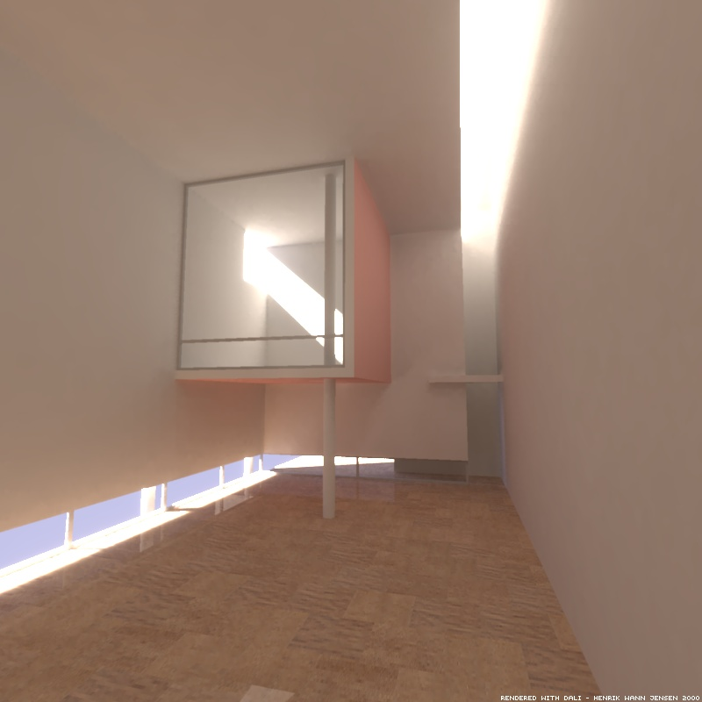
Can you get this with ray tracing?

Slide 34
Other Global Illumination Techniques
Radiosity
Monte Carlo path tracing, for examples:
  Distributed ray tracing
  Metropolis light transport
  Photon map…etc.
Want to know more? Read my Digital Image Synthesis course slides.

Slide 35
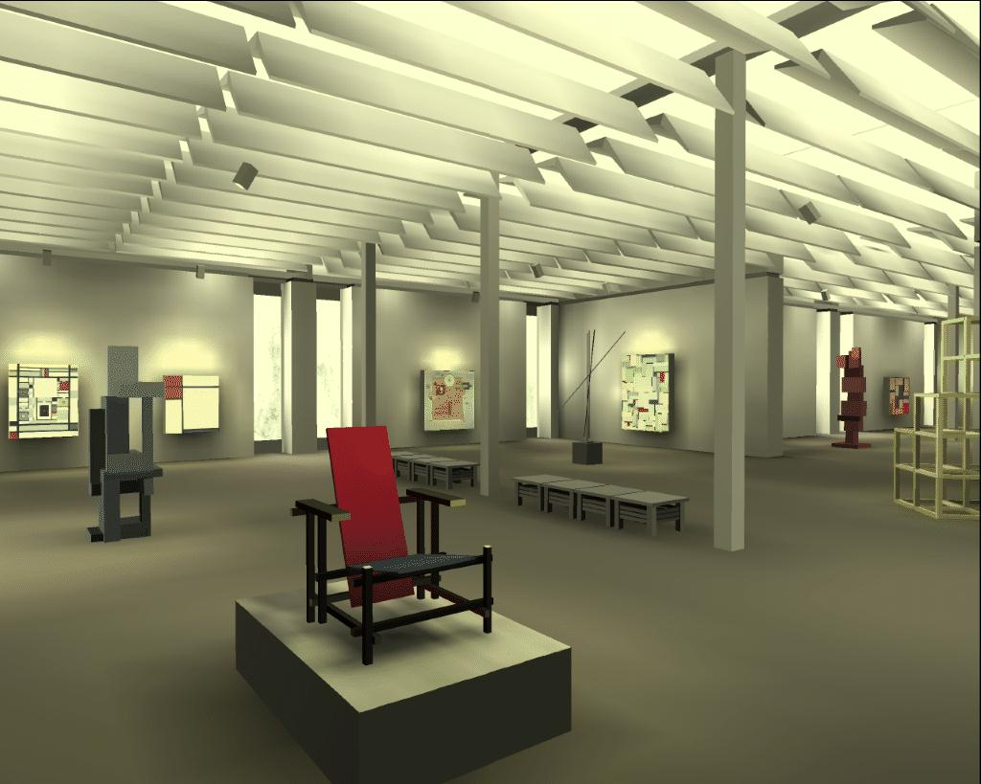
What is Radiosity
Borrowed from radiative heat transfer.
Assuming diffuse reflectance.
View independent solution.

Slide 36
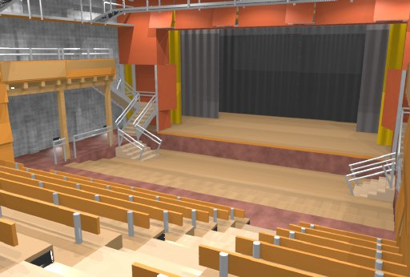
RADIANCE
© 1994 by Charles Ehrlich, Mark Mack

Slide 37
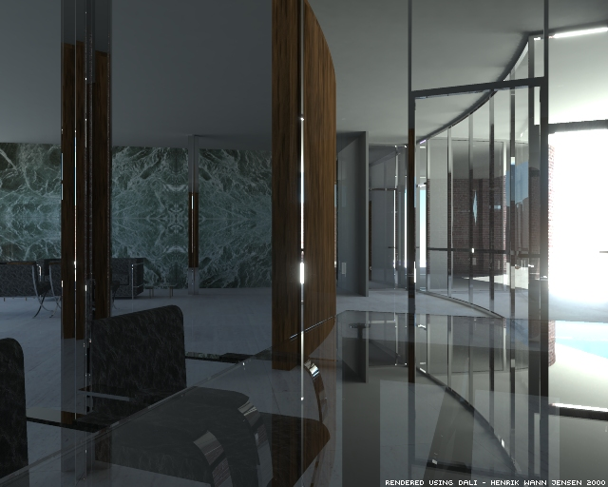
Photon Map

Slide 38
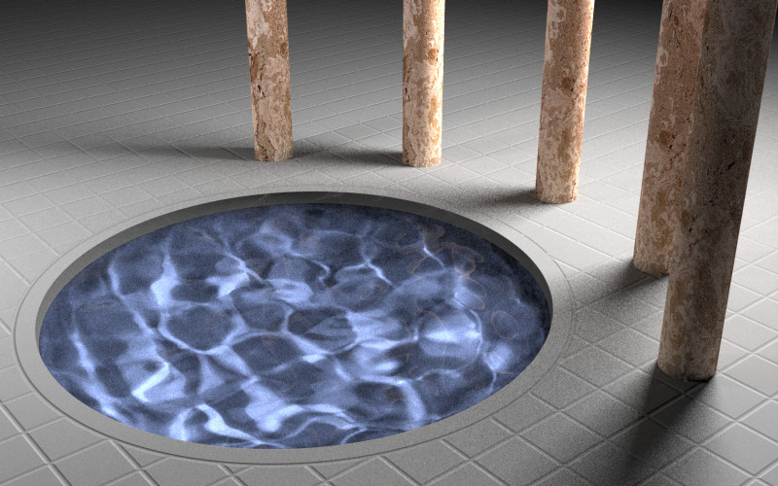
Metropolis Light Transport
Image by Eric Veach and Leonidas J. Guibas

