Slide 1
Global Illumination
Introduction to Computer Graphics
CSE 470/598
Arizona State University
Dianne Hansford

Slide 2
Overview
Global Illumination
Raytracing
Radiosity
Photon Mapping
Commercial Applications
Free Applications
Resources

Slide 3
Global Illumination
Lighting based on the full scene
Lighting based on physics
Traditionally represented by two algorithms
  Raytracing – 1980
  Radiosity – 1984
More modern techniques include photon mapping and many variations of raytracing and radiosity ideas

Slide 4
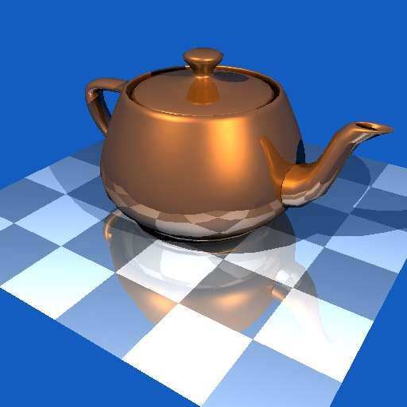
Raytracing
From: http://jedi.ks.uiuc.edu/~johns/raytracer/raygallery/stills.html

Slide 5
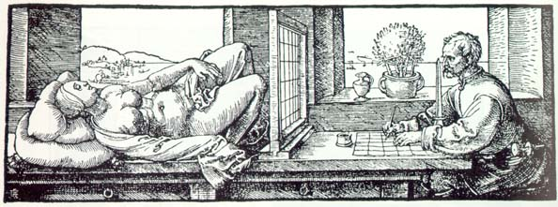
Raytracing
Albrecht Duerer,
Underweysung der Messung mit dem Zirkel und Richtscheyt
(Nurenberg, 1525), Book 3, figure 67.

Slide 6
Raytracing - Basics
Demo -- http://home.tiscali.be/slinline/trezebees.html
Represent specular global lighting
Trace light backward (usually) from the eye, through the pixel, and into the scene
Recursively bounce off objects in the scene, accumulating a color for that pixel
Final output is a single image of the scene

Slide 7
More RayTracing Links
from Robert S. in CSE470 ....
While digging around, I not only found that Quake 3 Ray Traced project, but I found a graphic rendering API called OpenRT! They even have a GPU that calculates ray traced graphics! How neat is that?!
Q3RT (video on Downloads section) - http://graphics.cs.uni-sb.de/~sidapohl/egoshooter/
OpenRT API - http://www.openrt.de/
RT GPU - http://www.saarcor.de/
You really have to watch the videos to appreciate how cool these projects are.
The funny thing is that honestly, modern video game graphics have kinda surpassed this with all the tricks they have.
Far Cry - http://media.pc.gamespy.com/media/482/482383/imgs_1.html?ui=gamefinder
Riddick - http://media.pc.gamespy.com/media/691/691009/imgs_1.html?ui=gamefinder
Again, those are really meant to be seen in motion to appreciate their glory. Have fun looking at the stuff.

Slide 8
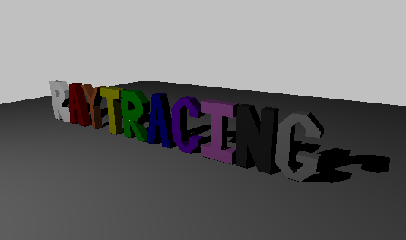
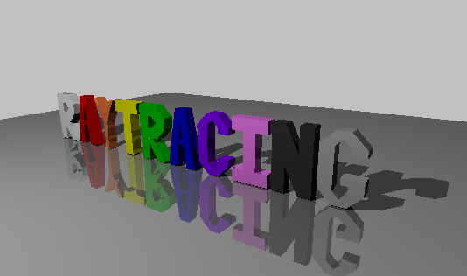
Raycasting vs. Raytracing

Slide 9
Raytracing - Pros
Simple idea and nice results
Inter-object interaction possible
  Shadows
  Reflections
  Refractions (light through glass, etc.)
Based on real-world lighting

Slide 10
Raytracing - Cons
Takes a long time
Computation speed-ups are often highly scene-dependent
Lighting effects tend to be abnormally sharp, without soft edges, unless more advanced techniques are used
Hard to put into hardware

Slide 11
Supersampling I
Problem: Each pixel of the display represents one single ray
  Aliasing
  Unnaturally sharp images
Solution: Send multiple rays through each “pixel” and average the returned colors together

Slide 12
Supersampling II
Direct supersampling
  Split each pixel into a grid and send rays through each grid point
Adaptive supersampling
  Split each pixel only if it’s significantly different from its neighbors
Jittering
  Send rays through randomly selected points within the pixel

Slide 13
Soft Shadows
Basic shadow generation was an on/off choice per point
“Real” shadows do not usually have sharp edges
Instead of using a point light, use an object with area
Shoot jittered shadow rays toward the light and count only those that hit it

Slide 14
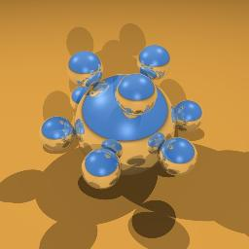
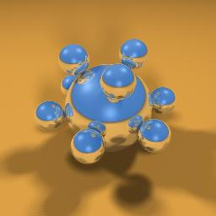
Soft Shadow Example
Hard shadow
Soft shadow
From: http://www.cs.unc.edu/~andrewz/comp238/hw2/

Slide 15
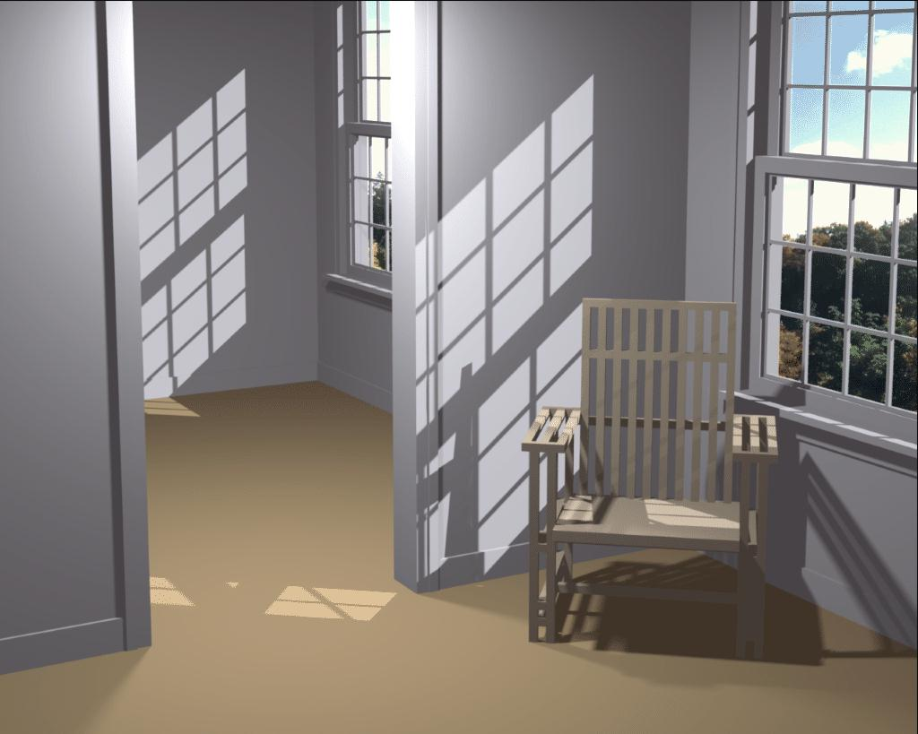
Radiosity
From Cornell University

Slide 16
Radiosity - Basics
Radiosity of a surface: rate at which energy leaves a surface
  emitted by surface and reflected from other surfaces
Represent diffuse global lighting
Create closed energy system where every polygon emits and/or bounces some light at every other polygon
Calculate how light energy spreads through the system
Solve a linear system for radiosity of each “surface”
  Dependent on emissive property of surface
  Dependent on relation to other surfaces (form factors)
Final output is a polygon mesh with pre-calculated colors for each vertex

Slide 17
Radiosity - Pros
Viewpoint independence means fast real-time display after initial calculation
Inter-object interaction possible
  Soft shadows
  Indirect lighting
  Color bleeding
Accurate simulation of energy transfer

Slide 18
Radiosity - Cons
Form factors need to be re-computed if anything moves
Large computational and storage costs
Non-diffuse light not represented
  Mirrors and shiny objects hard to include
Lighting effects tend to be “blurry”, not sharp without good subdivision
Not applicable to procedurally defined surfaces

Slide 19
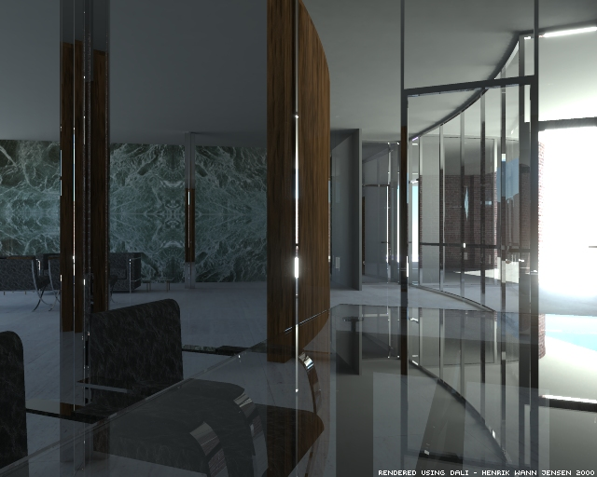
Photon Mapping
From http://graphics.ucsd.edu/~henrik/images/global.html

Slide 20
Photon Mapping Basics
Enhancement to raytracing
Can simulate caustics
(focused light, like shimmering waves at the bottom of a swimming pool)
Can simulate diffuse inter-reflections
(e.g., the "bleeding" of colored light from a red wall onto a white floor, giving the floor a reddish tint)
Can simulate clouds or smoke

Slide 21
Photon Mapping
“Photons” are emitted (raytraced) from light sources
Photons either bounce or are absorbed
Photons are stored in a photon map, with both position and incoming direction
Photon map is decoupled from the geometry

Slide 22
Photon Mapping
Raytracing step uses the closest N photons to each ray intersection and estimates the outgoing radiance
Specular can be done using “usual” raytracing to reduce the number of photons needed
Numerous extensions to the idea to add more complex effects

Slide 23
Photon Mapping - Pros
Preprocessing step is view independent, so only needs to be re-done if the lighting or positions of objects change
Inter-object interaction includes:
  Shadows
  Indirect lighting
  Color bleeding
  Highlights and reflections
  Caustics – current method of choice
Works for procedurally defined surfaces

Slide 24
Photon Mapping - Cons
Still time-consuming, although not as bad as comparable results from pure raytracing
Photon map not easy to update if small changes are made to the scene

Slide 25
Commercial Applications
mental ray - http://www.mentalimages.com/
Maya - http://www.alias.com/eng/index.shtml
3ds max - http://www.discreet.com/
Lightwave 3D - http://www.newtek.com/
RenderMan Repository - http://www.renderman.org/
RenderMan - https://renderman.pixar.com/

Slide 26
Free Applications
3Delight - http://www.3delight.com/
Lucille - http://web.sfc.keio.ac.jp/~syoyo/lucille/
OpenRT - http://www.openrt.de/index.html
Radiance - http://radsite.lbl.gov/radiance/HOME.html
RenderPark - http://www.cs.kuleuven.ac.be/cwis/research/graphics/RENDERPARK/
SunFlow - http://sunflow.sourceforge.net/

Slide 27
Resources - Raytracing
3D Rendering History Part 2 http://www.cgnetworks.com/story_custom.php?story_id=1724&page=1
POV-Ray – The Persistence of Vision Raytracer http://www.povray.org/
Numerous books on the subject (Check Noble Library)
CSE 570 for full treatment

Slide 28
Resources - radiosity
Radiosity and Realistic Image Synthesis by Michael F. Cohen, John R. Wallace (1993)
The Global Illumination Compendium http://www.cs.kuleuven.ac.be/~phil/GI/
SIGGRAPH education slides
http://www.siggraph.org/education/materials/HyperGraph/radiosity/overview_1.htm
Overview:
http://glasnost.itcarlow.ie/~powerk/Graphics/Notes/node13.html
CSE 570 for full treatment

Slide 29
Resources – photon mapping
Henrik Wann Jensen’s homepage – photon mapping, subsurface scattering and beautiful pictures http://graphics.ucsd.edu/~henrik/
http://www.ypoart.com/tutorials/Photon-Intro.htm
http://www.ypoart.com/tutorials/Photon-Fundamentals.htm

