Slide 1
Global Illumination
CS 319
Advanced Topics in Computer Graphics
John C. Hart

Slide 2
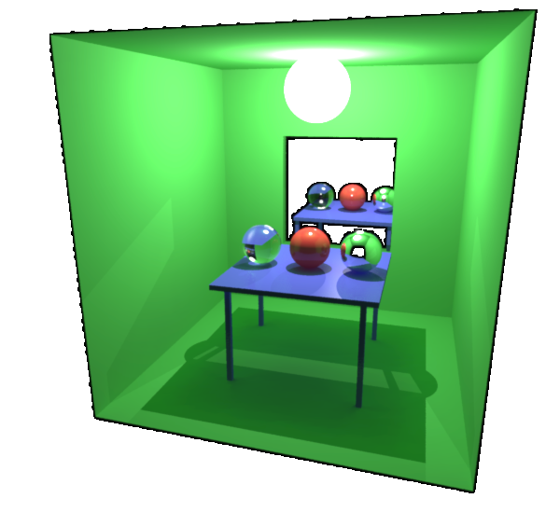
Global Illumination
Accounts for all light in a scene
Techniques
The Rendering Equation
  theoretical basis for
  light transport
Path Tracing
  attempts to trace
  “all rays” in a scene
Photon Mapping
  deposits light energy on surfaces for later collection
Radiosity
  balances diffuse interreflection

Slide 3
The Rendering Equation
I(x,x’) – intensity at x from x’
g(x,x’) – geometry term (g)
% of light from x’ that reaches x
e.g. shadows, occlusion
e(x,x’) – emissive term (e)
light emitted by x’ toward x
e.g. light sources
ρ(x,x’,x’’) – reflectivity
% of intensity incident at x’ from x’’ reflected in the x direction
x”
x
I(x,x’)
I(x’,x”)
g(x,x’)
x’

Slide 4
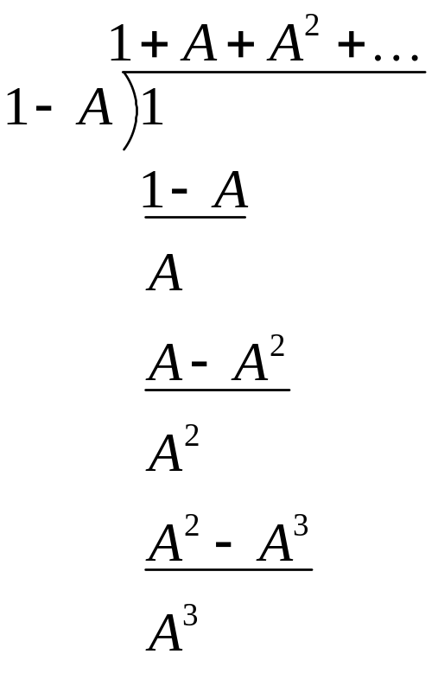

Describing Paths
I = ge + gR(I)
R(⋅) – linear integral “reflection” operator
  Reflected intensity is twice the power if the incident intensity is twice the power
  R(cI) = cR(I)
  Reflected intensity from two light sources is equal to the sum of the intensities reflected from each
  R(I₁ + I₂) = R(I₁) + R(I₂)
Solve for intensity I
  (1 – gR)I = ge
  I = (1 – gR)⁻¹ ge
  I = ge + gRge + gRgRge + gRgRgRge + ...

Slide 5
Reflectance Categories
L – emitter (light source)
E – receiver (eye)
D – diffuse
  Ideal
  ρ(x,x’,x”) = ρ( ⋅,x’,x”)
  In general, any interaction where light is scattered across hemisphere
S – specular
  Ideal (e.g. mirror, refraction)
  ρ(x,x’,x”) = δ(arg(x,x’) – arg(x’,x’’))
  In general, any interaction where light is reflected in a single direction
D
S

Slide 6
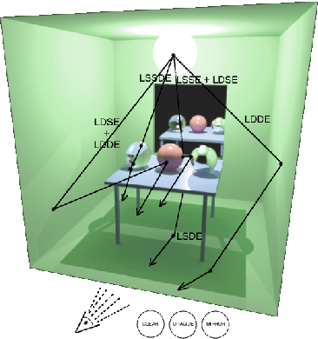
Paths
OpenGL
  LDE
  LDSE (w/mirror or env. map)
  I = ge + gDe (no shadows)
  I = ge + gDge (shadow buffer)
Ray tracing
  LDS*E
  I = ge + g(Sg)*Dge
Radiosity
  LD*E
  I = g(Dg)*e

Slide 7
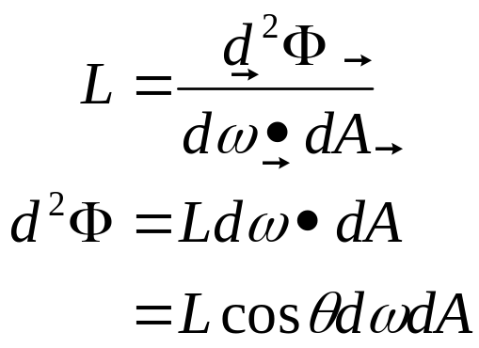
Energy Transport
dω
dω
Radiance – power per unit projected area perpendicular to the ray, per unit solid angle in the direction of the ray
  Fundamental unit of light transport
  Invariant along ray
dA
dA
dA₁
dA₂
L₁
L₂
dω₂
dω₁
d²Φ₁ = L₁dω₁dA₁ = L₂dω₂dA₂ = d²Φ₂
dω₁ = dA₂/r², dω₂ = dA₁/r²
dω₁ dA₁ = dA₁ dA₂/r² = dω₂ dA₂
L₁ = L₂

Slide 8
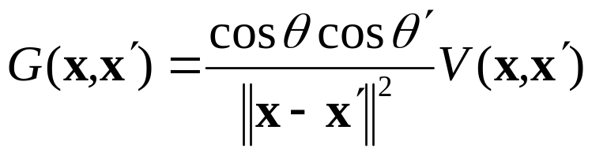
Radiance Form of Rendering Equation
x’
ω
θ’
ω’
V(x,x’) – visibility term
1 if visible
0 if occluded
θ
x

Slide 9
Energy Conservation
Energy remains contant
  Out – In = Emitted – Absorbed
Global conservation
  Total energy input must equal total energy output
  Where does it go? Mostly heat
  Closed environment
Local conservation
  Incident energy must be reflected or absorbed
  Ratio controlled by Fresnel

