Slide 1
Last Time
Subdivision techniques for modeling
We are now all done with modeling, the standard hardware pipeline and image manipulation
Two weeks to go for project 3

Slide 2
This Week and Next
Some graphics topics that we will cover at a higher level
  Other ways of rendering
  Other ways of calculating lighting
  Animation
Today: Global illumination and raytracing

Slide 3
Shading Revisited
Some applications are intended to produce pictures that look photorealistic, or close to it
  The image should look like a photograph
  A better metric is perceptual: the image should generate a target set of perceptions
  Applications include: Film special effects, Training simulations, Computer games, Architectural visualizations, Psychology experiments, …
To achieve the goal of photorealism, we must think carefully about light and how it interacts with surfaces
What you should take away: The various aspects of light interaction and how algorithms capture or ignore them

Slide 4
Light Transport
Light transport problems are concerned with how much light arrives at any surface, and from what direction
The physical quantity of interest is radiance: How much light (power) is traveling along a line in space per unit foreshortened area per unit solid angle
  We will not go into the theory - it takes 3 hours just to give the definitions and equations
  CS779 will cover this material in detail
Similar problems arise in radiated heat transport (i.e. satellites), where some of the technology was originally developed

Slide 5
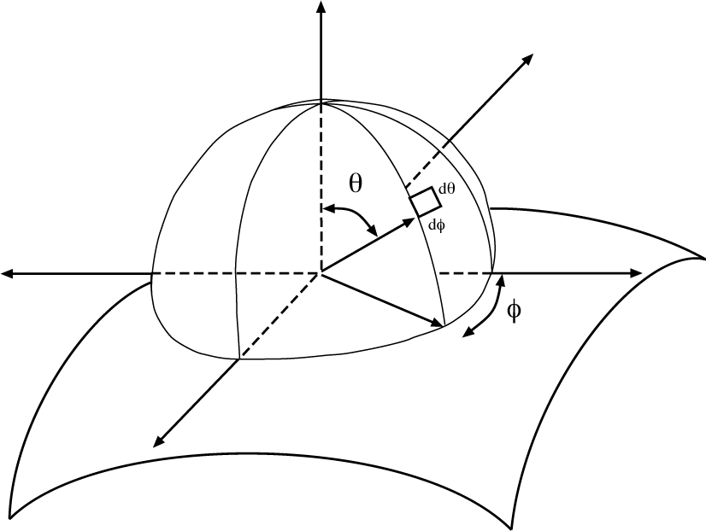
Radiometry
Radiometry: The study of light distribution:
  how “bright” will surfaces be?
  what is “brightness”?
    measuring light
    interactions between light and surfaces
Core idea - think about light arriving at a surface
Around any point is a hemisphere of directions
Simplest problems can be dealt with by reasoning about this hemisphere

Slide 6
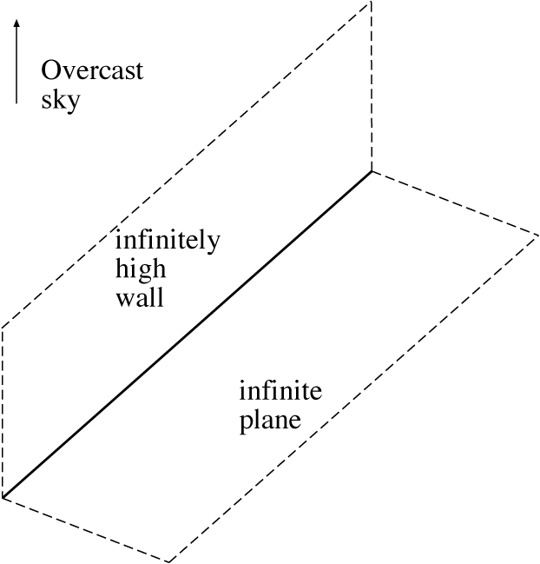
Lambert’s wall
How bright are various locations on the plane?

Slide 7
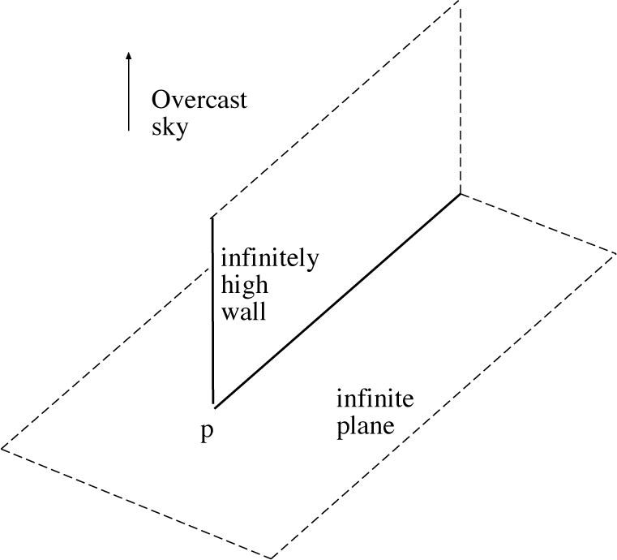
More complex wall
Which points on the plane are brightest?

Slide 8
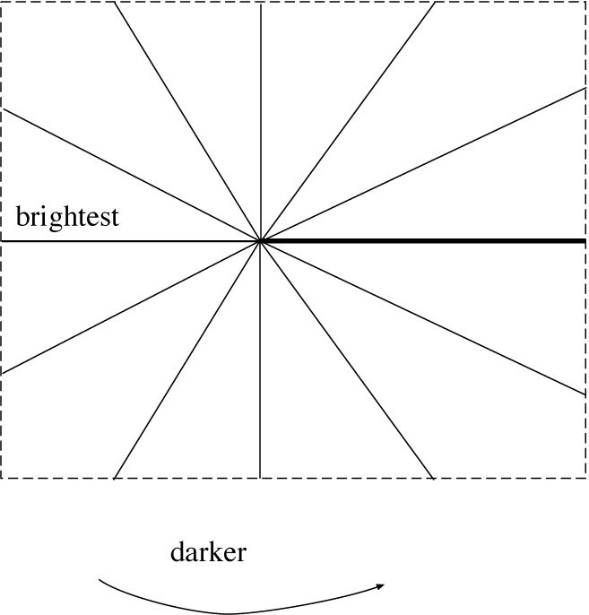
More complex wall

Slide 9
Light Transport
Which surface gets more light? Why?
How much light reaches point “a”?
If the walls are black?
If the walls are mirrors?
a
a
b

Slide 10
Reflectance Modeling
Reflectance modeling is concerned with the way in which light reflects off surfaces
  Clearly important to deciding what surfaces look like
  Also important in solving the light transport problem
Physical quantity is BRDF: Bidirectional Reflectance Distribution Function
  A function of a point on the surface, an incoming light direction, and an outgoing light direction
  Tells you how much of the light that comes in from one direction goes out in another direction
  General BRDFs are difficult to work with, so simplifications are made

Slide 11
Simple BRDFs
Diffuse surfaces:
  Uniformly reflect all the light they receive
    Sum up all the light that is arriving: Irradiance
    Send it back out in all directions
  A reasonable approximation for matte paints, soot, carpet
Perfectly specular surfaces:
  Reflect incoming light only in the mirror direction
Rough specular surfaces:
  Reflect incoming light around the mirror direction
Diffuse + Specular:
  A diffuse component and a specular component

Slide 12
Light Sources
Sources emit light: exitance
Different light sources are defined by how they emit light:
  How much they emit in each direction from each point on their surface
  For some algorithms, “point” lights cannot exist
  For other algorithms, only “point” light can exist

Slide 13
Global Illumination Equation
The total light leaving a point is given by the sum of two major terms:
  Exitance from the point
  Incoming light from other sources reflected at the point
Light leaving
Exitance
Sum
BRDF
Incoming
light
Incoming light reflected at the point

Slide 14
Photorealistic Lighting
Photorealistic lighting requires solving the equation!
  Not possible in the general case with today’s technology
Light transport is concerned with the “incoming light” part of the equation
  Notice the chicken and egg problem
    To know how much light leaves a point, you need to know how much light reaches it
    To know how much light reaches a point, you need to know light leaves every other point
Reflectance modeling is concerned with the BRDF
  Hard because BRDFs are high dimensional functions that tend to change as surfaces change over time

Slide 15
Classifying Rendering Algorithms
One way to classify rendering algorithms is according to the type of light interactions they capture
For example: The OpenGL lighting model captures:
  Direct light to surface to eye light transport
  Diffuse and rough specular surface reflectance
  It actually doesn’t do light to surface transport correctly, because it doesn’t do shadows
We would like a way of classifying interactions: light paths

Slide 16
Classifying Light Paths
Classify light paths according to where they come from, where they go to, and what they do along the way
Assume only two types of surface interactions:
  Pure diffuse, D
  Pure specular, S
Assume all paths of interest:
  Start at a light source, L
  End at the eye, E
Use regular expressions on the letters D, S, L and E to describe light paths
  Valid paths are L(D|S)*E

Slide 17
Simple Light Path Examples
LE
  The light goes straight from the source to the viewer
LDE
  The light goes from the light to a diffuse surface that the viewer can see
LSE
  The light is reflected off a mirror into the viewer’s eyes
L(S|D)E
  The light is reflected off either a diffuse surface or a specular surface toward the viewer
Which do OpenGL (approximately) support?

Slide 18
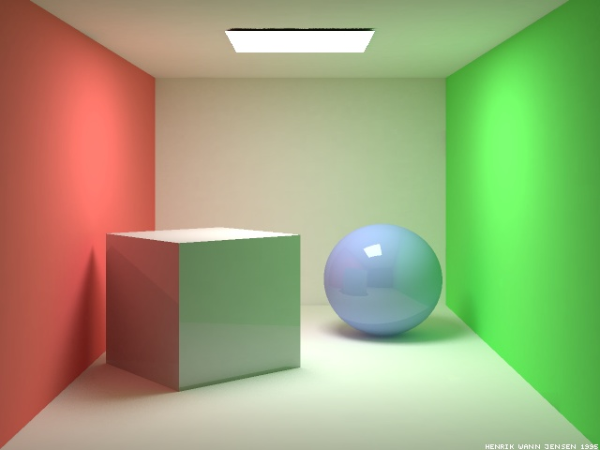
More Complex Light Paths
Find the following:
  LE
  LDE
  LSE
  LDDE
  LDSE
  LSDE
Radiosity Cornell box, due to Henrik wann Jensen,
http://www.gk.dtu.dk/~hwj, rendered with ray tracer

Slide 19
More Complex Light Paths
LE
LDDE
LSDE
LSE
LDSE
LDE

Slide 20
The OpenGL Model
The “standard” graphics lighting model captures only L(D|S)E
It is missing:
  Light taking more than one diffuse bounce: LD*E
    Should produce an effect called color bleeding, among other things
    Approximated, grossly, by ambient light
  Light refracted through curved glass
    Consider the refraction as a “mirror” bounce: LDSE
  Light bouncing off a mirror to illuminate a diffuse surface: LS+D+E
  Many others

Slide 21
Raytracing
Cast rays out from the eye, through each pixel, and determine what they hit first
  Builds the image pixel by pixel, one at a time
Cast additional rays from the hit point to determine the pixel color
  Shadow rays toward each light. If they hit something, then the object is shadowed from that light, otherwise use “standard” model for the light
  Reflection rays for mirror surfaces, to see what should be reflected in the mirror
  Transmission rays to see what can be seen through transparent objects
  Sum all the contributions to get the pixel color

Slide 22
Raytracing
Shadow rays
Reflection ray
Transmitted ray

Slide 23
Recursive Ray Tracing
When a reflected or refracted ray hits a surface, repeat the whole process from that point
  Send out more shadow rays
  Send out new reflected ray (if required)
  Send out a new refracted ray (if required)
  Generally, reduce the weight of each additional ray when computing the contributions to surface color
  Stop when the contribution from a ray is too small to notice
What light paths does recursive ray tracing capture?

Slide 24

PCKTWTCH by Kevin Odhner, POV-Ray

Slide 25
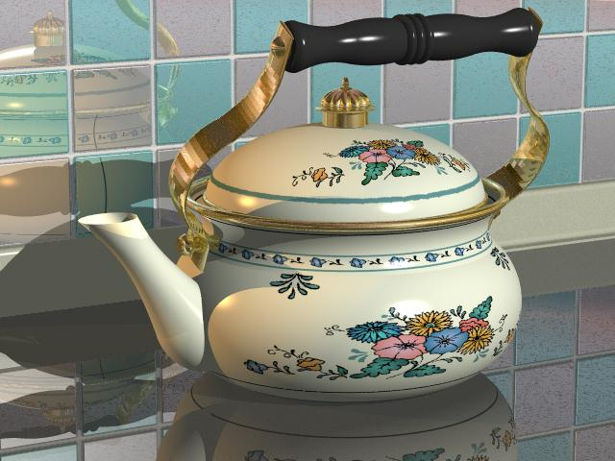
Kettle, Mike Miller, POV-Ray

Slide 26
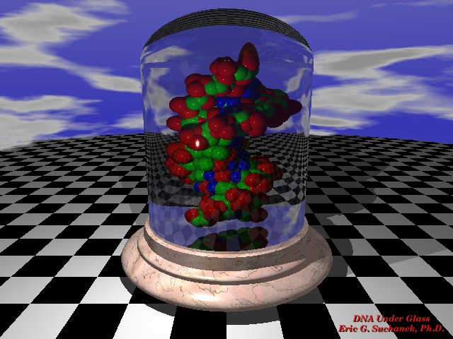

Slide 27
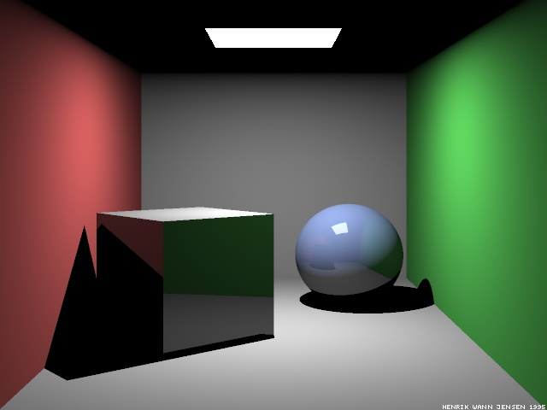
Which paths are missing?
Ray-traced Cornell box, due to Henrik Jensen,
http://www.gk.dtu.dk/~hwj

Slide 29
Next time…
Implementing a ray-tracer
Radiosity basics

