Slide 1
Computer Graphics (Fall 2008)
COMS 4160, Lecture 22: Global Illumination
http://www.cs.columbia.edu/~cs4160

Slide 2
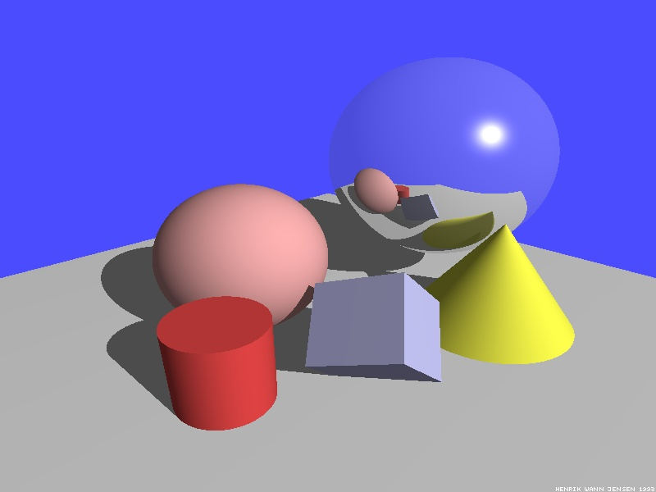
Illumination Models
So far considered mainly local illumination
  Light directly from light sources to surface
Global Illumination: multiple bounces
  Already ray tracing: reflections/refractions
Some images courtesy Henrik Wann Jensen

Slide 3

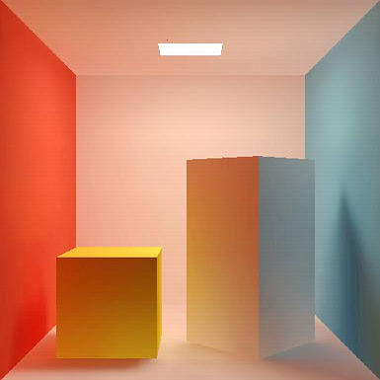
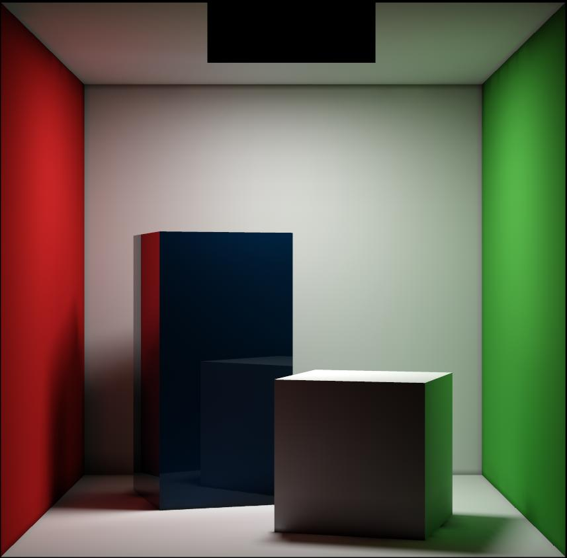
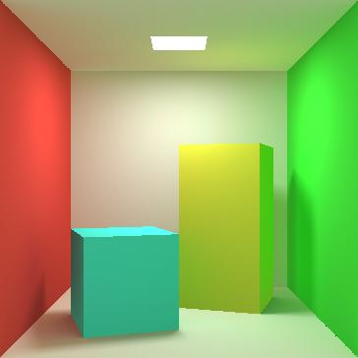
Global Illumination
Diffuse interreflection, color bleeding [Cornell Box]

Slide 4

Global Illumination
Caustics: Focusing through specular surface
Major research effort in 80s, 90s till today

Slide 5
Overview of lecture
Theory for all methods (ray trace, radiosity)
We derive Rendering Equation [Kajiya 86]
  Major theoretical development in field
  Unifying framework for all global illumination
Discuss existing approaches as special cases
Fairly theoretical lecture (but important). Not well covered in any of the textbooks. Closest are 2.6.2 in Cohen and Wallace handout (but uses slightly different notation, argument [swaps x, x’ among other things]) and 19.2 in Shirley (different notation, omits emission, but has a reasonably good intuitive discussion that we somewhat follow).

Slide 6
Outline
Reflectance Equation (review)
Global Illumination
Rendering Equation
As a general Integral Equation and Operator
Approximations (Ray Tracing, Radiosity)
Surface Parameterization (Standard Form)

Slide 7

Reflectance Equation (review)
Reflected Light
(Output Image)
Emission
Incident
Light (from
light source)
BRDF
Cosine of
Incident angle

Slide 8
Reflectance Equation (review)
Sum over all light sources
Reflected Light
(Output Image)
Emission
Incident
Light (from
light source)
BRDF
Cosine of
Incident angle

Slide 9


Reflectance Equation (review)
Replace sum with integral
Reflected Light
(Output Image)
Emission
Incident
Light (from
light source)
BRDF
Cosine of
Incident angle

Slide 10


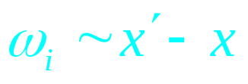

Global Illumination
Surfaces (interreflection)
Reflected Light
(Output Image)
Emission
Reflected
Light (from
surface)
BRDF
Cosine of
Incident angle

Slide 11
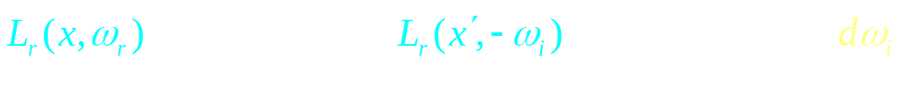
Rendering Equation
Surfaces (interreflection)
Reflected Light
(Output Image)
Emission
Reflected
Light
BRDF
Cosine of
Incident angle
UNKNOWN
KNOWN
UNKNOWN
KNOWN
KNOWN

Slide 12
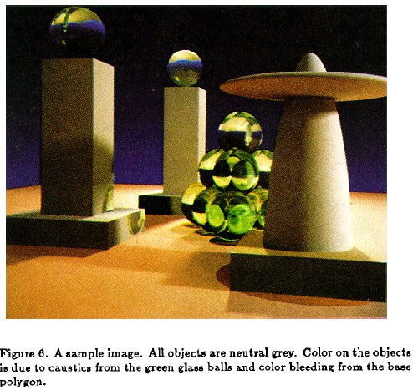
Rendering Equation (Kajiya 86)

Slide 13
Outline
Reflectance Equation (review)
Global Illumination
Rendering Equation
As a general Integral Equation and Operator
Approximations (Ray Tracing, Radiosity)
Surface Parameterization (Standard Form)
The material in this part of the lecture is fairly advanced and
not covered in any of the texts. The slides should be fairly
complete. This section is fairly short, and I hope some of you
will get some insight into solutions for general global illumination

Slide 14
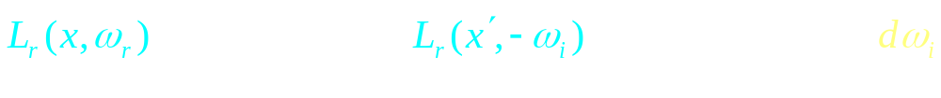
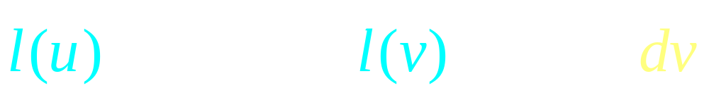
Rendering Equation as Integral Equation
Reflected Light
(Output Image)
Emission
Reflected
Light
BRDF
Cosine of
Incident angle
UNKNOWN
KNOWN
UNKNOWN
KNOWN
KNOWN
Is a Fredholm Integral Equation of second kind
[extensively studied numerically] with canonical form
Kernel of equation

Slide 15

Linear Operator Equation
Kernel of equation
Light Transport Operator
Can be discretized to a simple matrix equation
[or system of simultaneous linear equations]
(L, E are vectors, K is the light transport matrix)

Slide 16
Solution Techniques
All global illumination methods try to solve (approximations of) the rendering equation
  Too hard for analytic solution: numerical General theory of solving integral equations
Radiosity (next lecture; usually diffuse surfaces)
  General class numerical finite element methods (divide surfaces in scene into a finite set elements or patches)
  Set up linear system (matrix) of simultaneous equations
  Solve iteratively

Slide 17





Ray Tracing and extensions
  General class numerical Monte Carlo methods
  Approximate set of all paths of light in scene
Binomial Theorem

Slide 18
Ray Tracing
Emission directly
From light sources
Direct Illumination
on surfaces
Global Illumination
(One bounce indirect)
[Mirrors, Refraction]
(Two bounce indirect)
[Caustics etc]

Slide 19

Ray Tracing
Emission directly
From light sources
Direct Illumination
on surfaces
Global Illumination
(One bounce indirect)
[Mirrors, Refraction]
OpenGL Shading
(Two bounce indirect)
[Caustics etc]

Slide 20
Outline
Reflectance Equation (review)
Global Illumination
Rendering Equation
As a general Integral Equation and Operator
Approximations (Ray Tracing, Radiosity)
Surface Parameterization (Standard Form)
Page 461 of Shirley is reasonably close to this part of lecture,
although it uses different notation. See also pages 38 and 39
in handout, which may have a clearer explanation of the ideas.

Slide 21
Rendering Equation
Surfaces (interreflection)
Reflected Light
(Output Image)
Emission
Reflected
Light
BRDF
Cosine of
Incident angle
UNKNOWN
KNOWN
UNKNOWN
KNOWN
KNOWN

Slide 22


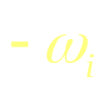
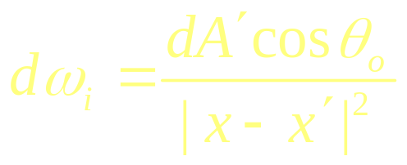


Change of Variables
Integral over angles sometimes insufficient. Write integral in terms of surface radiance only (change of variables)

Slide 23

Change of Variables
Integral over angles sometimes insufficient. Write integral in terms of surface radiance only (change of variables)

Slide 24
Rendering Equation: Standard Form
Integral over angles sometimes insufficient. Write integral in terms of surface radiance only (change of variables)
Domain integral awkward. Introduce binary visibility fn V
Same as equation 2.52 Cohen Wallace. It swaps primed
And unprimed, omits angular args of BRDF, - sign.
Same as equation above 19.3 in Shirley, except he has
no emission, slightly diff. notation

Slide 25
Overview
Theory for all methods (ray trace, radiosity)
We derive Rendering Equation [Kajiya 86]
  Major theoretical development in field
  Unifying framework for all global illumination
Discuss existing approaches as special cases

