Slide 1
Light, Reflectance, and Global Illumination
TOPICS:
Survey of Representations for Light and Visibility
Color, Perception, and Light
Reflectance
Cost of Ray Tracing
Global Illumination Overview
Radiosity
Yu’s Inverse Global Illumination paper
15-869, Image-Based Modeling and Rendering
Paul Heckbert, 18 Oct. 1999

Slide 2
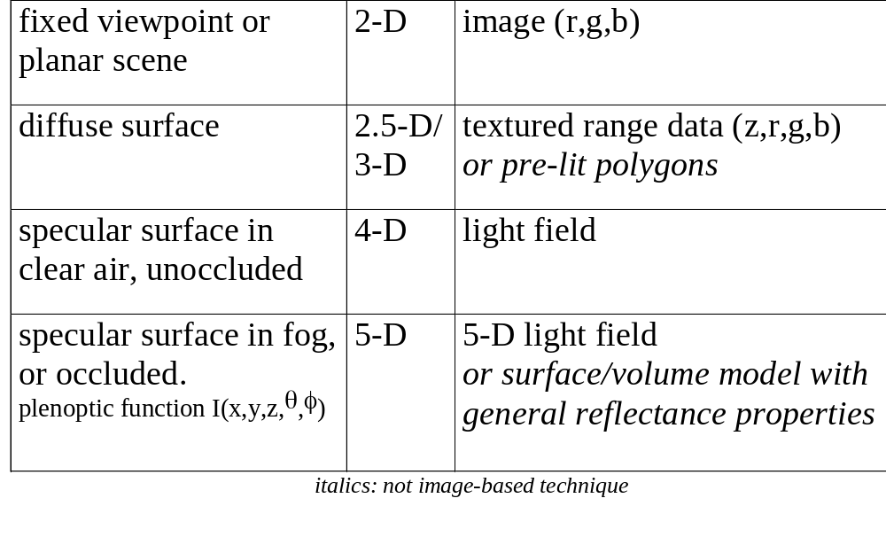
Representations for Light and Visibility

Slide 3
Physics of Light and Color
Light comes from electromagnetic radiation.
The amplitude of radiation is a function of wavelength λ.
Any quantity related to wavelength is called “spectral”.
Frequency ν = 2 π / λ
EM spectrum:
radio, infrared, visible, ultraviolet, x-ray, gamma-ray
long wavelength short wavelength
low frequency high frequency
Don’t confuse EM ``spectrum’’ with ``spectrum’’ of signal in signal/image processing; they’re usually conceptually distinct.
Likewise, don’t confuse spectral wavelength & frequency of EM spectrum with spatial wavelength & frequency in image processing.

Slide 4
Perception of Light and Color
Light is electromagnetic radiation visible to the human eye.
Humans have evolved to sense the dominant wavelengths emitted by the sun; space aliens have presumably evolved differently.
In low light, we perceive primarily with rods in the retina, which have broad spectral sensitivity (“at night, you can’t see color”).
In bright light, we perceive primarily with the three sets of cones in the retina, which have narrower spectral sensitivity roughly corresponding to red, yellow, and blue wavelengths.
We’re most sensitive to greens & yellows; not very sens. to blue.
The eye has a huge dynamic range: 10 orders of magnitude.
In the brain, neurons combine cone signals into spot, edge, and line receptive fields (point spread functions). And each comes at a range of scales, orientations, and color channels.

Slide 5
What is Color?
Color is human perception of light.
Our perception is imperfect; we don’t see spectral power P(λ), instead we see three scalars:
at long wavelength (≈ red): L = ∫P(λ)s_{L}(λ)dλ
at middle wavelength (≈ yellow): M = ∫P(λ)s_{M}(λ)dλ
at short wavelength (≈ blue): S = ∫P(λ)s_{S}(λ)dλ
where s_{L}(λ), s_{M}(λ), and s_{S}(λ) are the sensitivity curves of our three sets of cones.
Color is three dimensional because any light we see is indistinguishable to our eyes from some mixture of three spectral (monochromatic, single-wavelength) primaries.

Slide 6
Color Spaces
Color can be described in various color spaces:
spectrum - allows non-visible radiation to be described, but usually impractical/unnecessary.
RGB - CRT-oriented color space
good for computer storage.
HSV - a more intuitive color space; good for user interfaces
H=hue -- the color wheel, the spectral colors
S=saturation (purity) -- how gray?
V=value (related to brightness, luminance) -- how bright?
a non-linear transform of RGB, since H is cyclic.
CIE XYZ - used by color scientists, a linear transform of RGB.
other color spaces, less commonly used...
For extremely realistic image synthesis, use of four or more samples of the spectrum may be necessary, but for most purposes, the three samples used by RGB color space is just fine.

Slide 7
Light is a Function of Many Variables
Light is a function of
position x,y,z
direction θ,φ
wavelength λ
time t
polarization
phase
In computer graphics, we typically ignore the last three by assuming static scenes, unpolarized, incoherent light, and assume that the speed of light is infinite.
But light is still a complicated function of many variables.
How do we measure light, what are the units?

Slide 8
Units of Light
quantity dimension units
solid angle solid angle [steradian]
power energy/time [watt]=[joule/sec]
radiance L power/(area*solid angle) [watt/(m²*steradian)]
a.k.a. intensity I
In vacuum or as an approximation for air, radiance is constant along a ray.
A picture is an array of incoming radiance values at imaginary projection plane; because of radiance-constancy, these are equal to outgoing radiances at intersection of ray with first surface hit
In general, light is absorbed and scattered along a ray.

Slide 9
General Reflection & Transmission
At a surface, reflectance is the fraction of incident (incoming) light that is reflected, transmittance is the fraction that is transmitted into the material. Opaque materials have zero transmittance.
In some books, reflectance is denoted ρ, and transmittance τ. Other books use k_{dr} and k_{sr} for diffuse and specular reflectance, and k_{dt} and k_{st} for transmittance.
A general reflectance function has the form of a bidirectional reflectance distribution function (BRDF): ρ(θ_{i},φ_{i},θ_{o},φ_{o}), where the direction of incoming light is (θ_{i},φ_{i}) and the direction of outgoing light is (θ_{o},φ_{o}), θ is the polar angle measured from perpendicular, and φ is the azimuth.
There is a similar function for bidirectional transmittance, τ(θ_{i},φ_{i},θ_{o},φ_{o}).
Light is absorbed and scattered by some media (e.g. fog).
Phong’s Illumination model is an approximation to general reflectance.

Slide 10
Phong Illumination Model
A point light source with radiance I_{l}, illuminating an opaque surface, reflects light of the following radiance:
If surface is perfectly diffuse (Lambertian). It is independent of viewing direction!
I = I_{l} k_{dr} max{N.L,0}/r²
where k_{dr} = coefficient of diffuse reflection [1/steradian]
N = unit normal vector
L = unit direction vector to light, r is distance to light
If surface is perfectly specular. It is not independent of viewing direction.
I = I_{l} k_{sr} max{N.H,0}^{e}/r²
where k_{sr} = coefficient of specular reflection [1/steradian]
H = unit “halfway vector” = (V+L)/||V+L||
V = unit direction vector to viewer
e = exponent, controlling apparent roughness: small=rough, big=smooth
There are more realistic reflection models than Phong’s.
Don’t confuse Phong Illumination with Phong Shading.

Slide 11
Cost of Basic Rendering Algorithms
s = #surfaces (e.g. polygons) t_{s} = time per surface (transforming, ...)
p = #pixels t_{p} = time per pixel (writing, incrementing, ...)
● = #lights t = time to light surface point w.r.t. one light
a = Σ screen areas of surfs t_{i} = time for one ray/surface intersection test
Painter’s or Z-buffer algorithm, with flat shading
(assuming no sorting in painter’s algorithm)
worst case cost = s(t_{s} + t) + at_{p} ≈ at_{p} if polygons big
Painter’s or Z-buffer algorithm, with per pixel shading (e.g. Phong)
worst case cost = st_{s} + a(t + t_{p}) ≈ at if polygons big
Ray casting with no shadows, no spatial data structures
worst case cost = p(st_{i} + t + t_{p}) ≈ pst_{i} if many surfaces
Ray tracing to max depth d with shadows, refl&tran, no spat. DS, no supersampling
2^{d}−1 intersections/pixel, for each of which there are  shadow rays
worst case cost = p(2^{d}−1)[( +1)st_{i} + t] ≈ 2^{d}pst_{i} if many surfaces
Note: time constants vary, e.g. t_{p} is larger for z-buffer than for painter’s.

Slide 12
Interreflection
We typically simulate just direct illumination: light traveling on a straight, unoccluded line from light source to surface, reflected there, then traveling in a straight, unoccluded line into eye.
Light travels by a variety of paths:
light source → eye (0 bounces: looking at light source)
light source → surface1 → eye (1 bounce: direct illumination)
light source → surf1 → surf2 → eye (2 bounces)
light source → surf1 → surf2 → surf3 → eye (3 bounces)
...
Illumination via a path of 2 or more bounces is called indirect illumination or interreflection. It also happens with transmission.

Slide 13
Global Illumination
Observation: light comes from other surfaces, not just designated light sources.
Goal: simulate interreflection of light in 3-D scenes.
Difficulty: you can no longer shade surfaces one at a time, since they’re now interrelated!
Two general classes of algorithms:
1. ray tracing methods: simulate motion of photons one by one, tracing photon paths either backwards (“eye ray tracing”) or forwards (“light ray tracing”) -- good for specular scenes
2. radiosity methods: set up a system of linear equations whose solution is the light distribution -- good for diffuse scenes

Slide 14
The Unit of Radiosity
Radiance (a.k.a. intensity) is power from/to an area in a given direction.
  units: power / (area × solid angle)
Radiosity is outgoing power per unit area due to emission or reflection over a hemisphere of directions.
  units: power / area
  radiosity = radiance × integral of [cos(polar angle) × d(solid angle)] over a hemisphere = π × radiance
  So radiosity and radiance are linearly interrelated.
Thus, “radiosity” is both a unit of light and an algorithm.
Radiant emitted flux density is the unit for light emission.
  units: power / area

Slide 15
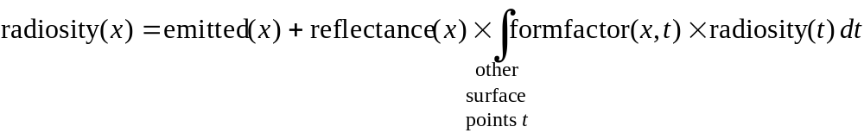
Radiosity as an Integral Equation
This is called an integral equation because the unknown function “radiosity(x)” appears inside an integral.
Can be solved by radiosity methods or randomized “Monte Carlo” techniques also, by simulating millions of photon paths.
Radiosity methods are a discrete way to think about and simulate global illumination.
where x and t are
surface points

Slide 16
Classical Radiosity Method
Definitions:
  surfaces are divided into elements
  radiosity = integral of emitted radiance plus reflected radiance over a hemisphere. units: [power/area]
Assumptions:
  no participating media (no fog) → shade surfaces only, not vols.
  opaque surfaces (no transmission)
  reflection and emission are diffuse → radiance is direction-indep., radiance is a function of 2-D surface parameters and λ
  reflection and emission are independent of λ within each of several wavelength bands; typically use 3 bands: R,G,B → solve 3 linear systems of equations
  radiosity is constant across each element → one RGB radiosity per element
Typically (but not exclusively):
  surfaces are polygons, elements are quadrilaterals or triangles

Slide 17
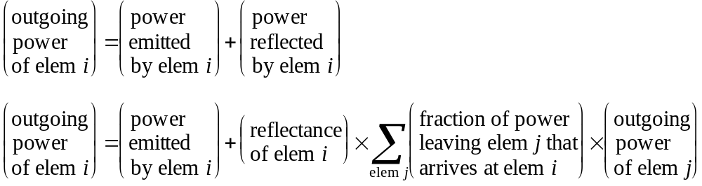
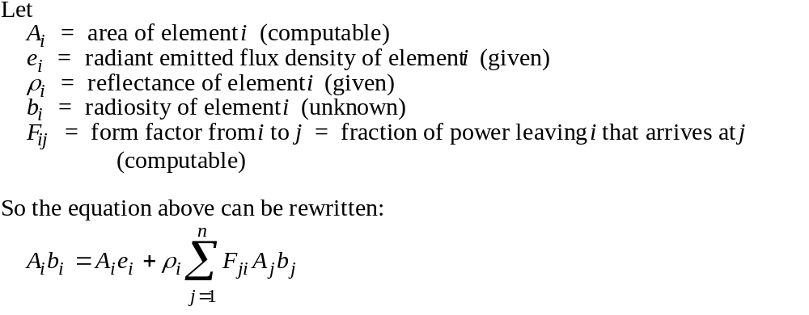
Deriving Radiosity Equations, 1

Slide 18
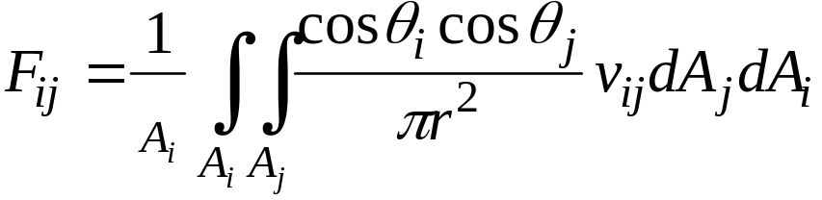
Form Factors
Define the form factor F_{ij} to be the fraction of light leaving element i that arrives at element j
Where
  v_{ij} is a boolean visibility function: 0 if point on i is occluded with respect to point on j, 1 if unoccluded.
  This is a double area integral. Difficult! We end up approximating it.
  dA_{i} and dA_{j} are infinitesimal areas on elements i and j, respectively
  θ_{i} and θ_{j} are polar angles: the angles between ray and normals on elements i and j, respectively
  Projected area of dA_{i} from j is cos θ_{i} dA_{i}, hence the cosines
  r is distance from point on i to point on j
Reciprocity law: A_{i}F_{ij} = A_{j}F_{ji}.

Slide 19
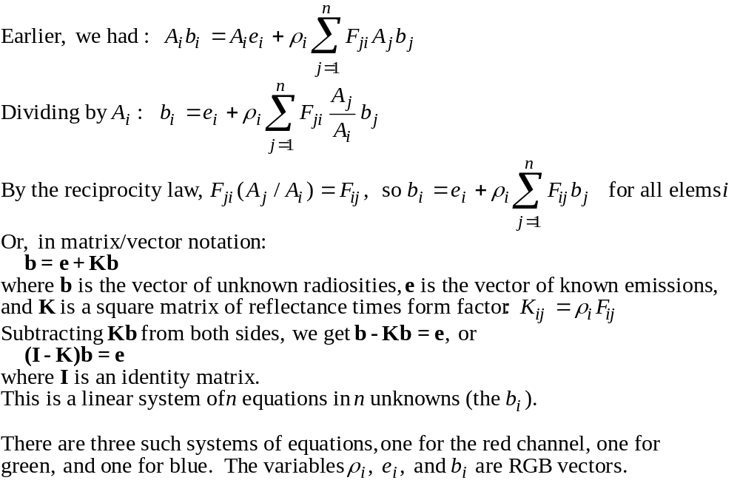
Deriving Radiosity Equations, 2

Slide 20
Computing Visibility for Form Factors
Computing visibility in the form factor integral is like solving a hidden surface problem from the point of view of each surface in the scene.
Two methods:
  ray tracing: easy to implement, but can be slow without spatial subdivision methods (grids, octrees, hierarchical bounding volumes) to speed up ray-surface intersection testing
  hemicube: exploit speed of z-buffer algorithm, compute visibility between one element and all other elements. Good when you have z-buffer hardware, but some tricky issues regarding hemicube resolution
You end up approximating the double area integral with a double summation, just like numerical methods for approximating integrals.
When two elements are known to be inter-visible (no occluders), you can use analytic form factor formulas and skip all this.

Slide 21
Radiosity Systems Issues
All algorithms require the following operations:
  1. Input scene (geometry, emissions, reflectances).
  2. Choose mesh (important!), subdividing polygons into elements.
  3. Compute form factors using ray tracing or hemicube for visibility (expensive).
  4. Solve system of equations (indirectly, if progressive radiosity).
  5. Display picture.
If mesh is chosen too coarse, approximation is poor, you get blocky shadows.
If mesh is chosen too fine, algorithm is slow. A good mesh is critical!
In radiosity simulations, because scene is assumed diffuse, surfaces’ radiance will be view-independent.
Changes in viewpoint require only visibility computations, not shading. Do with z-buffer hardware for speed. This is commonly used for “architectural walkthroughs” and virtual reality.
Changes in scene geometry or reflectance require a new radiosity simulation.

Slide 22
Summary of Radiosity Algorithms
Radiosity algorithms allow indirect lighting to be simulated.
Classical radiosity algorithms:
Generality: limited to diffuse, polygonal scenes.
Realism: acceptable for simple scenes; blocky shadows on complex scenes. Trial and error is used to find the right mesh.
Speed: good for simple scenes. If all form factors are computed, O(n²), but if progressive radiosity or newer “hierarchical radiosity” algorithms are used, sometimes O(n).
Generalizations:
curved surfaces: easy - radiosity samples are like a surface texture.
non-diffuse (specular or general) reflectance: much harder; radiosity is now a function of not just 2-D position on surface, but 2-D position and 2-D direction. Lots of memory required, but it can be done.

Slide 23
Inverse Global Illumination: Recovering Reflectance Models of Real Scenes from Photographs
Yizhou Yu, Paul Debevec, Jitendra Malik, and Tim Hawkins
SIGGRAPH ‘99
15-869, Image-Based Modeling and Rendering
Paul Heckbert, 20 Oct. 1999

Slide 24
Yu: Motivation
Most IBMR methods permit novel viewpoints but not novel lighting; they assume surfaces are diffuse.
Want to permit changes in lighting.
Would like to to recover (non-diffuse) reflectance maps:
  specularity and roughness at each surface point

Slide 25
Yu: Simplifying Assumptions
static scene of opaque surfaces
known shape
known light source positions
calibrated cameras, known camera positions
high dynamic range photographs
specular reflection parameters (specular reflection coefficient and roughness) constant over large surface regions
each surface point captured in at least one image
each light source captured in at least one image
image of a highlight in each specular surface region in at least one photograph

Slide 26
Yu Algorithm Overview
1. Solve for shape (use FAÇADE or similar system)
2. Solve for coarse diffuse reflectances
  coarsely mesh the surfaces into triangles
  inverse radiosity problem: known form factors and radiosities (from image radiances), solve for diffuse reflectances (linear system)
3. Solve for coarse specular reflectance
  find highlights for each surface from known surface geometry & lights
    check that highlight unoccluded
  sample image at points around the highlight center
  repeat until convergence
    solve for diffuse and specular reflectances (linear system) for each region
    solve for roughness of each region (nonlinear)
    update estimates of interreflection between surfaces
4. Solve for detailed diffuse reflectance (albedo maps)
  look at all images of a given surface point, subtract specular component
  throw out outlier (highlight-tainted values), average the rest

Slide 27
Yu: Acquisition Details
spherical, frosted light bulbs
180 volt DC power to avoid 60Hz light flicker
black strips of tape on walls for digitization
shot 150 images with digital camera, merged to create 40 high dynamic range images (represent with floating point pixel values)
block light source to camera in some of the images
correct for radial distortion and vignetting

