Slide 1
DesignPattern

Slide 2
Creational design patterns

Slide 3
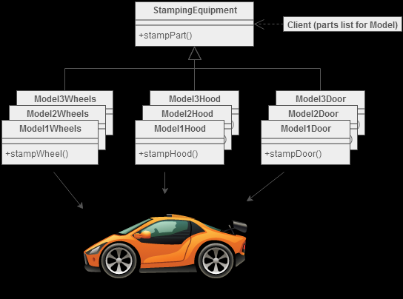
Abstract Factory
Intent
1.Provide an interface for creating families of related or dependent objects
without specifying their concrete classes.
2.A hierarchy that encapsulates: many possible "platforms",
and the construction of a suite of "products".
3.The new operator considered harmful.

Slide 4
class Factory {
public:
virtual Shape* createCurvedInstance() = 0;
virtual Shape* createStraightInstance() = 0;
};
class SimpleShapeFactory : public Factory {
public:
Shape* createCurvedInstance() {
return new Circle;
}
Shape* createStraightInstance() {
return new Square;
}
};
class RobustShapeFactory : public Factory {
public:
Shape* createCurvedInstance() {
return new Ellipse;
}
Shape* createStraightInstance() {
return new Rectangle;
}
};
#include <iostream.h>
class Shape {
public:
Shape() {
id_ = total_++;
}
virtual void draw() = 0;
protected:
int id_;
static int total_;
};
int Shape::total_ = 0;
class Circle : public Shape {
public:
void draw() {
cout << "circle " << id_ << ": draw" << endl;
}
};
class Square : public Shape {
public:
void draw() {
cout << "square " << id_ << ": draw" << endl;
}
};
class Ellipse : public Shape {
public:
void draw() {
cout << "ellipse " << id_ << ": draw" << endl;
}
};
class Rectangle : public Shape {
public:
void draw() {
cout << "rectangle " << id_ << ": draw" << endl;
}
};
int main() {
#ifdef SIMPLE
Factory* factory = new SimpleShapeFactory;
#elif ROBUST
Factory* factory = new RobustShapeFactory;
#endif
Shape* shapes[3];
shapes[0] = factory->createCurvedInstance(); // shapes[0] = new Ellipse;
shapes[1] = factory->createStraightInstance(); // shapes[1] = new Rectangle;
shapes[2] = factory->createCurvedInstance(); // shapes[2] = new Ellipse;
for (int i=0; i < 3; i++) {
shapes[i]->draw();
}
}

Slide 5
In Maya
already been
can be

Slide 6
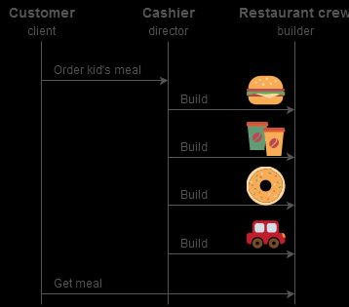
Builder
Intent
1.Separate the construction of a complex object from its representation
so that the same construction process can create different representations.
2.Parse a complex representation, create one of several targets.

Slide 7
#include <iostream.h>
#include <stdio.h>
#include <string.h>
enum PersistenceType
{
File, Queue, Pathway
};
struct PersistenceAttribute
{
PersistenceType type;
char value[30];
};
class DistrWorkPackage
{
public:
DistrWorkPackage(char *type)
{
sprintf(_desc, "Distributed Work Package for: %s", type);
}
void setFile(char *f, char *v)
{
sprintf(_temp, "\n File(%s): %s", f, v);
strcat(_desc, _temp);
}
void setQueue(char *q, char *v)
{
sprintf(_temp, "\n Queue(%s): %s", q, v);
strcat(_desc, _temp);
}
void setPathway(char *p, char *v)
{
sprintf(_temp, "\n Pathway(%s): %s", p, v);
strcat(_desc, _temp);
}
const char *getState()
{
return _desc;
}
private:
char _desc[200], _temp[80];
};
class Builder
{
public:
virtual void configureFile(char*) = 0;
virtual void configureQueue(char*) = 0;
virtual void configurePathway(char*) = 0;
DistrWorkPackage *getResult()
{
return _result;
}
protected:
DistrWorkPackage *_result;
};
class UnixBuilder: public Builder
{
public:
UnixBuilder()
{
_result = new DistrWorkPackage("Unix");
}
void configureFile(char *name)
{
_result->setFile("flatFile", name);
}
void configureQueue(char *queue)
{
_result->setQueue("FIFO", queue);
}
void configurePathway(char *type)
{
_result->setPathway("thread", type);
}
};
class VmsBuilder: public Builder
{
public:
VmsBuilder()
{
_result = new DistrWorkPackage("Vms");
}
void configureFile(char *name)
{
_result->setFile("ISAM", name);
}
void configureQueue(char *queue)
{
_result->setQueue("priority", queue);
}
void configurePathway(char *type)
{
_result->setPathway("LWP", type);
}
};
class Reader
{
public:
void setBuilder(Builder *b)
{
_builder = b;
}
void construct(PersistenceAttribute[], int);
private:
Builder *_builder;
};
void Reader::construct(PersistenceAttribute list[], int num)
{
for (int i = 0; i < num; i++)
if (list[i].type == File)
_builder->configureFile(list[i].value);
else if (list[i].type == Queue)
_builder->configureQueue(list[i].value);
else if (list[i].type == Pathway)
_builder->configurePathway(list[i].value);
}
const int NUM_ENTRIES = 6;
PersistenceAttribute input[NUM_ENTRIES] =
{
{
File, "state.dat"
}
,
{
File, "config.sys"
}
,
{
Queue, "compute"
}
,
{
Queue, "log"
}
,
{
Pathway, "authentication"
}
,
{
Pathway, "error processing"
}
};
int main()
{
UnixBuilder unixBuilder;
VmsBuilder vmsBuilder;
Reader reader;
reader.setBuilder(&unixBuilder);
reader.construct(input, NUM_ENTRIES);
cout << unixBuilder.getResult()->getState() << endl;
reader.setBuilder(&vmsBuilder);
reader.construct(input, NUM_ENTRIES);
cout << vmsBuilder.getResult()->getState() << endl;
}

Slide 8
In Maya
Evaluator

Slide 9
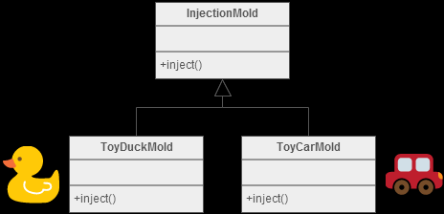
Factory Method
Intent
1.Define an interface for creating an object, but let subclasses decide which class to instantiate.
Factory Method lets a class defer instantiation to subclasses.
2.Defining a "virtual" constructor.
3.The new operator considered harmful.

Slide 10
/* Framework declaration */
class Application
{
public:
Application(): _index(0)
{
cout << "Application: ctor" << endl;
}
/* The client will call this "entry point" of the framework */
NewDocument(char *name)
{
cout << "Application: NewDocument()" << endl;
/* Framework calls the "hole" reserved for client customization */
_docs[_index] = CreateDocument(name);
_docs[_index++]->Open();
}
void OpenDocument(){}
void ReportDocs();
/* Framework declares a "hole" for the client to customize */
virtual Document *CreateDocument(char*) = 0;
private:
int _index;
/* Framework uses Document's base class */
Document *_docs[10];
};
void Application::ReportDocs()
{
cout << "Application: ReportDocs()" << endl;
for (int i = 0; i < _index; i++)
cout << " " << _docs[i]->GetName() << endl;
}
/* Customization of framework defined by client */
class MyApplication: public Application
{
public:
MyApplication()
{
cout << "MyApplication: ctor" << endl;
}
/* Client defines Framework's "hole" */
Document *CreateDocument(char *fn)
{
cout << " MyApplication: CreateDocument()" << endl;
return new MyDocument(fn);
}
};
#include <iostream.h>
/* Abstract base class declared by framework */
class Document
{
public:
Document(char *fn)
{
strcpy(name, fn);
}
virtual void Open() = 0;
virtual void Close() = 0;
char *GetName()
{
return name;
}
private:
char name[20];
};
/* Concrete derived class defined by client */
class MyDocument: public Document
{
public:
MyDocument(char *fn): Document(fn){}
void Open()
{
cout << " MyDocument: Open()" << endl;
}
void Close()
{
cout << " MyDocument: Close()" << endl;
}
};
int main()
{
/* Client's customization of the Framework */
MyApplication myApp;
myApp.NewDocument("foo");
myApp.NewDocument("bar");
myApp.ReportDocs();
}

Slide 11
In Maya
OGS::Fragment::Factory

Slide 12
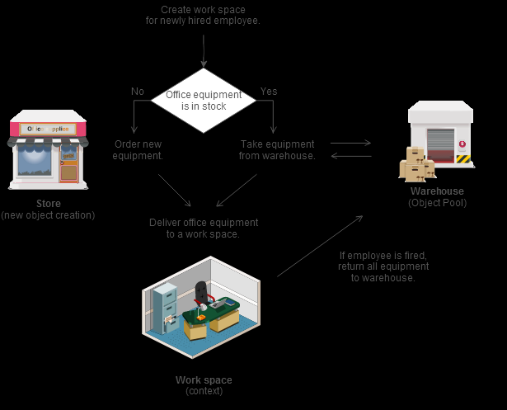
Object Pool
Intent
Object pooling can offer a significant performance boost;
it is most effective in situations where the cost of initializing a class instance is high,
the rate of instantiation of a class is high, and the number of instantiations in use at any one time is low.

Slide 13
public abstract class ObjectPool<T> {
private long expirationTime;
private Hashtable<T, Long> locked, unlocked;
public ObjectPool() {
expirationTime = 30000; // 30 seconds
locked = new Hashtable<T, Long>();
unlocked = new Hashtable<T, Long>();
}
protected abstract T create();
public abstract boolean validate(T o);
public abstract void expire(T o);
public synchronized T checkOut() {
long now = System.currentTimeMillis();
T t;
if (unlocked.size() > 0) {
Enumeration<T> e = unlocked.keys();
while (e.hasMoreElements()) {
t = e.nextElement();
if ((now - unlocked.get(t)) > expirationTime) {
// object has expired
unlocked.remove(t);
expire(t);
t = null;
} else {
if (validate(t)) {
unlocked.remove(t);
locked.put(t, now);
return (t);
} else {
// object failed validation
unlocked.remove(t);
expire(t);
t = null;
}
}
}
}
// no objects available, create a new one
t = create();
locked.put(t, now);
return (t);
}
public synchronized void checkIn(T t) {
locked.remove(t);
unlocked.put(t, System.currentTimeMillis());
}
}
//The three remaining methods are abstract
//and therefore must be implemented by the subclass
public class JDBCConnectionPool extends ObjectPool<Connection> {
private String dsn, usr, pwd;
public JDBCConnectionPool(String driver, String dsn, String usr, String pwd) {
super();
try {
Class.forName(driver).newInstance();
} catch (Exception e) {
e.printStackTrace();
}
this.dsn = dsn;
this.usr = usr;
this.pwd = pwd;
}
@Override
protected Connection create() {
try {
return (DriverManager.getConnection(dsn, usr, pwd));
} catch (SQLException e) {
e.printStackTrace();
return (null);
}
}
@Override
public void expire(Connection o) {
try {
((Connection) o).close();
} catch (SQLException e) {
e.printStackTrace();
}
}
@Override
public boolean validate(Connection o) {
try {
return (!((Connection) o).isClosed());
} catch (SQLException e) {
e.printStackTrace();
return (false);
}
}
}
public class Main {
public static void main(String args[]) {
// Do something...
...
// Create the ConnectionPool:
JDBCConnectionPool pool = new JDBCConnectionPool(
"org.hsqldb.jdbcDriver", "jdbc:hsqldb://localhost/mydb",
"sa", "secret");
// Get a connection:
Connection con = pool.checkOut();
// Use the connection
...
// Return the connection:
pool.checkIn(con);
}
}

Slide 14
In Maya
already been
can be

Slide 15
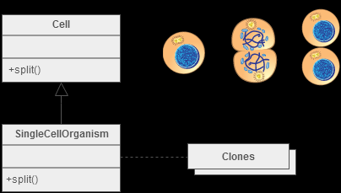
Prototype
Intent
1.Specify the kinds of objects to create using a prototypical instance,
and create new objects by copying this prototype.
2.Co-opt one instance of a class for use as a breeder of all future instances.
3.The new operator considered harmful.

Slide 16
class LandSatImage: public Image
{
public:
imageType returnType()
{
return LSAT;
}
void draw()
{
cout << "LandSatImage::draw " << _id << endl;
}
// When clone() is called, call the one-argument ctor with a dummy arg
Image *clone()
{
return new LandSatImage(1);
}
protected:
// This is only called from clone()
LandSatImage(int dummy)
{
_id = _count++;
}
private:
// Mechanism for initializing an Image subclass - this causes the
// default ctor to be called, which registers the subclass's prototype
static LandSatImage _landSatImage;
// This is only called when the private static data member is inited
LandSatImage()
{
addPrototype(this);
}
// Nominal "state" per instance mechanism
int _id;
static int _count;
};
// Register the subclass's prototype
LandSatImage LandSatImage::_landSatImage;
// Initialize the "state" per instance mechanism
int LandSatImage::_count = 1;
class SpotImage: public Image
{
public:
imageType returnType()
{
return SPOT;
}
void draw()
{
cout << "SpotImage::draw " << _id << endl;
}
Image *clone()
{
return new SpotImage(1);
}
protected:
SpotImage(int dummy)
{
_id = _count++;
}
private:
SpotImage()
{
addPrototype(this);
}
static SpotImage _spotImage;
int _id;
static int _count;
};
SpotImage SpotImage::_spotImage;
int SpotImage::_count = 1;
// Simulated stream of creation requests
const int NUM_IMAGES = 8;
imageType input[NUM_IMAGES] =
{
LSAT, LSAT, LSAT, SPOT, LSAT, SPOT, SPOT, LSAT
};
#include <iostream.h>
enum imageType
{
LSAT, SPOT
};
class Image
{
public:
virtual void draw() = 0;
static Image *findAndClone(imageType);
protected:
virtual imageType returnType() = 0;
virtual Image *clone() = 0;
// As each subclass of Image is declared, it registers its prototype
static void addPrototype(Image *image)
{
_prototypes[_nextSlot++] = image;
}
private:
// addPrototype() saves each registered prototype here
static Image *_prototypes[10];
static int _nextSlot;
};
Image *Image::_prototypes[];
int Image::_nextSlot;
// Client calls this public static member function when it needs an instance
// of an Image subclass
Image *Image::findAndClone(imageType type)
{
for (int i = 0; i < _nextSlot; i++)
if (_prototypes[i]->returnType() == type)
return _prototypes[i]->clone();
}
int main()
{
Image *images[NUM_IMAGES];
// Given an image type, find the right prototype, and return a clone
for (int i = 0; i < NUM_IMAGES; i++)
images[i] = Image::findAndClone(input[i]);
// Demonstrate that correct image objects have been cloned
for (i = 0; i < NUM_IMAGES; i++)
images[i]->draw();
// Free the dynamic memory
for (i = 0; i < NUM_IMAGES; i++)
delete images[i];
}

Slide 17
In Maya
already been
can be

Slide 18
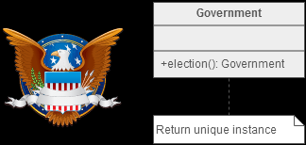
Singleton
Intent
Ensure a class has only one instance, and provide a global point of access to it.
Encapsulated "just-in-time initialization" or "initialization on first use".

Slide 19
Structural design patterns

Slide 20
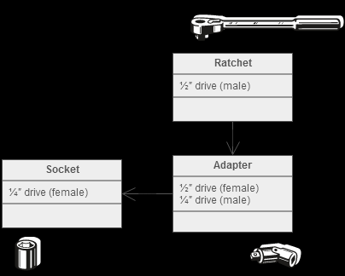
Adapter
Intent
1.Convert the interface of a class into another interface clients expect.
Adapter lets classes work together that couldn't otherwise because of incompatible interfaces.
2.Wrap an existing class with a new interface.
3.Impedance match an old component to a new system

Slide 21
#include "stdafx.h"
#include <iostream>
using namespace std;
class ExecuteInterface {
public:
// 1. Specify the new interface
virtual ~ExecuteInterface(){}
virtual void execute() = 0;
};
// 2. Design a "wrapper" or "adapter" class
template <class TYPE>
class ExecuteAdapter: public ExecuteInterface {
public:
ExecuteAdapter(TYPE *o, void(TYPE:: *m)()) {
object = o;
method = m;
}
~ExecuteAdapter() {
delete object;
}
// 4. The adapter/wrapper "maps" the new to the legacy implementation
void execute() { /* the new */
(object->*method)();
}
private:
TYPE *object; // ptr-to-object attribute
void(TYPE:: *method)(); /* the old */ // ptr-to-member-function attribute
};
// The old: three totally incompatible classes
// no common base class,
class Fea {
public:
// no hope of polymorphism
~Fea() {
cout << "Fea::dtor" << endl;
}
void doThis() {
cout << "Fea::doThis()" << endl;
}
};
class Feye {
public:~Feye() {
cout << "Feye::dtor" << endl;
}
void doThat() {
cout << "Feye::doThat()" << endl;
}
};
class Pheau {
public:
~Pheau() {
cout << "Pheau::dtor" << endl;
}
void doTheOther() {
cout << "Pheau::doTheOther()" << endl;
}
};
/* the new is returned */
ExecuteInterface **initialize() {
ExecuteInterface **array = new ExecuteInterface *[3];
/* the old is below */
array[0] = new ExecuteAdapter < Fea > (new Fea(), &Fea::doThis);
array[1] = new ExecuteAdapter < Feye > (new Feye(), &Feye::doThat);
array[2] = new ExecuteAdapter < Pheau > (new Pheau(), &Pheau::doTheOther);
return array;
}
int main() {
ExecuteInterface **objects = initialize();
for (int i = 0; i < 3; i++) {
objects[i]->execute();
}
// 3. Client uses the new (polymporphism)
for (i = 0; i < 3; i++) {
delete objects[i];
}
delete objects;
return 0;
}
Fea::doThis()
Feye::doThat()
Pheau::doTheOther()
Fea::dtor
Feye::dtor
Pheau::dtor

Slide 22
In Maya
already been
can be

Slide 23
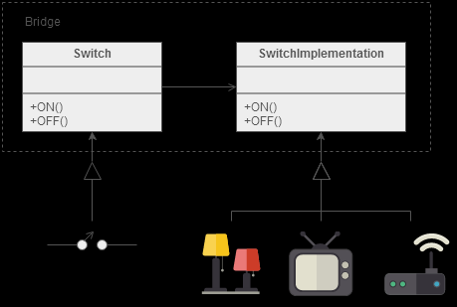
Bridge
Intent
1.Decouple an abstraction from its implementation so that the two can vary independently.
2.Publish interface in an inheritance hierarchy, and bury implementation in its own inheritance hierarchy.
3.Beyond encapsulation, to insulation

Slide 24
#include <iostream.h>
#include <iomanip.h>
#include <string.h>
class TimeImp {
public:
TimeImp(int hr, int min) {
hr_ = hr;
min_ = min;
}
virtual void tell() {
cout << "time is " << setw(2) << setfill(48) << hr_ << min_ << endl;
}
protected:
int hr_, min_;
};
class CivilianTimeImp: public TimeImp {
public:
CivilianTimeImp(int hr, int min, int pm): TimeImp(hr, min) {
if (pm)
strcpy(whichM_, " PM");
else
strcpy(whichM_, " AM");
}
/* virtual */
void tell() {
cout << "time is " << hr_ << ":" << min_ << whichM_ << endl;
}
protected:
char whichM_[4];
};
class ZuluTimeImp: public TimeImp {
public:
ZuluTimeImp(int hr, int min, int zone): TimeImp(hr, min) {
if (zone == 5)
strcpy(zone_, " Eastern Standard Time");
else if (zone == 6)
strcpy(zone_, " Central Standard Time");
}
/* virtual */
void tell() {
cout << "time is " << setw(2) << setfill(48) << hr_ << min_ << zone_ <<
endl;
}
protected:
char zone_[30];
};
class Time {
public:
Time(){}
Time(int hr, int min) {
imp_ = new TimeImp(hr, min);
}
virtual void tell() {
imp_->tell();
}
protected:
TimeImp *imp_;
};
class CivilianTime: public Time {
public:
CivilianTime(int hr, int min, int pm) {
imp_ = new CivilianTimeImp(hr, min, pm);
}
};
class ZuluTime: public Time {
public:
ZuluTime(int hr, int min, int zone) {
imp_ = new ZuluTimeImp(hr, min, zone);
}
};
int main() {
Time *times[3];
times[0] = new Time(14, 30);
times[1] = new CivilianTime(2, 30, 1);
times[2] = new ZuluTime(14, 30, 6);
for (int i = 0; i < 3; i++)
times[i]->tell();
}
time is 1430
time is 2:30 PM
time is 1430 Central Standard Time

Slide 25
In Maya
already been
can be

Slide 26
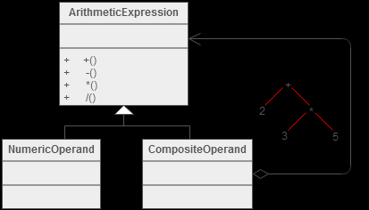
Composite
Intent
1.Compose objects into tree structures to represent whole-part hierarchies.
Composite lets clients treat individual objects and compositions of objects uniformly.
2.Recursive composition
3."Directories contain entries, each of which could be a directory."
4.1-to-many "has a" up the "is a" hierarchy

Slide 27
#include <iostream>
#include <vector>
using namespace std;
class Component
{
public:
virtual void traverse() = 0;
};
class Primitive: public Component
{
int value;
public:
Primitive(int val)
{
value = val;
}
void traverse()
{
cout << value << " ";
}
};
class Composite: public Component
{
vector < Component * > children;
int value;
public:
Composite(int val)
{
value = val;
}
void add(Component *c)
{
children.push_back(c);
}
void traverse()
{
cout << value << " ";
for (int i = 0; i < children.size(); i++)
children[i]->traverse();
}
};
class Row: public Composite
{
public:
// Two different kinds of "con-
Row(int val): Composite(val){}
// tainer" classes. Most of the
void traverse()
{
// "meat" is in the Composite
cout << "Row"; // base class.
Composite::traverse();
}
};
class Column: public Composite
{
public:
Column(int val): Composite(val){}
void traverse()
{
cout << "Col";
Composite::traverse();
}
};
int main()
{
Row first(1); // Row1
Column second(2); // |
Column third(3); // +-- Col2
Row fourth(4); // | |
Row fifth(5); // | +-- 7
first.add(&second); // +-- Col3
first.add(&third); // | |
third.add(&fourth); // | +-- Row4
third.add(&fifth); // | | |
first.add(&Primitive(6)); // | | +-- 9
second.add(&Primitive(7)); // | +-- Row5
third.add(&Primitive(8)); // | | |
fourth.add(&Primitive(9)); // | | +-- 10
fifth.add(&Primitive(10)); // | +-- 8
first.traverse(); // +-- 6
cout << '\n';
}
Row1 Col2 7 Col3 Row4 9 Row5 10 8 6

Slide 28
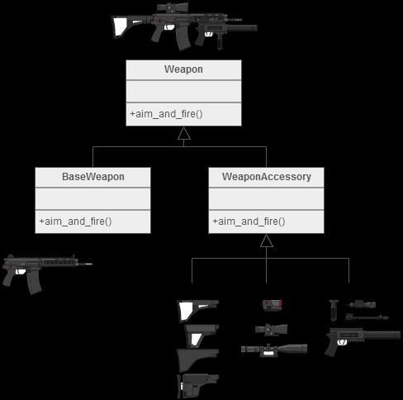
Decorator
Intent
1.Attach additional responsibilities to an object dynamically.
Decorators provide a flexible alternative to subclassing for extending functionality.
2.Client-specified embellishment of a core object by recursively wrapping it.
3.Wrapping a gift, putting it in a box, and wrapping the box.

Slide 29
class BorderDecorator: public Decorator
{
public:
// 6. Optional embellishment
BorderDecorator(Widget *w): Decorator(w){}
/*virtual*/
void draw()
{
// 7. Delegate to base class and add extra stuff
Decorator::draw();
cout << " BorderDecorator" << '\n';
}
};
class ScrollDecorator: public Decorator
{
public:
// 6. Optional embellishment
ScrollDecorator(Widget *w): Decorator(w){}
/*virtual*/
void draw()
{
// 7. Delegate to base class and add extra stuff
Decorator::draw();
cout << " ScrollDecorator" << '\n';
}
};
#include <iostream>
using namespace std;
// 1. "lowest common denom"
class Widget
{
public:
virtual void draw() = 0;
};
class TextField: public Widget
{
// 3. "Core" class & "is a"
int width, height;
public:
TextField(int w, int h)
{
width = w;
height = h;
}
/*virtual*/
void draw()
{
cout << "TextField: " << width << ", " << height << '\n';
}
};
// 2. 2nd level base class
class Decorator: public Widget // 4. "is a" relationship
{
Widget *wid; // 4. "has a" relationship
public:
Decorator(Widget *w)
{
wid = w;
}
/*virtual*/
void draw()
{
wid->draw(); // 5. Delegation
}
};
int main()
{
// 8. Client has the responsibility to compose desired configurations
Widget *aWidget = new BorderDecorator(new BorderDecorator(new ScrollDecorator
(new TextField(80, 24))));
aWidget->draw();
}
TextField: 80, 24
ScrollDecorator
BorderDecorator
BorderDecorator

Slide 30
In Maya
already been
can be

Slide 31
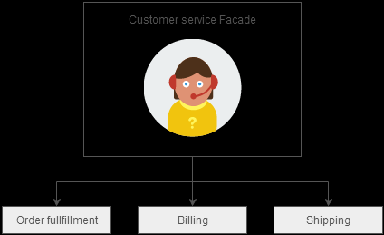
Facade
Intent
1.Provide a unified interface to a set of interfaces in a subsystem.
Facade defines a higher-level interface that makes the subsystem easier to use.
2.Wrap a complicated subsystem with a simpler interface.

Slide 32
#include <iostream.h>
class MisDepartment
{
public:
void submitNetworkRequest()
{
_state = 0;
}
bool checkOnStatus()
{
_state++;
if (_state == Complete)
return 1;
return 0;
}
private:
enum States
{
Received, DenyAllKnowledge, ReferClientToFacilities,
FacilitiesHasNotSentPaperwork, ElectricianIsNotDone,
ElectricianDidItWrong, DispatchTechnician, SignedOff, DoesNotWork,
FixElectriciansWiring, Complete
};
int _state;
};
class ElectricianUnion
{
public:
void submitNetworkRequest()
{
_state = 0;
}
bool checkOnStatus()
{
_state++;
if (_state == Complete)
return 1;
return 0;
}
private:
enum States
{
Received, RejectTheForm, SizeTheJob, SmokeAndJokeBreak,
WaitForAuthorization, DoTheWrongJob, BlameTheEngineer, WaitToPunchOut,
DoHalfAJob, ComplainToEngineer, GetClarification, CompleteTheJob,
TurnInThePaperwork, Complete
};
int _state;
};
class FacilitiesDepartment
{
public:
void submitNetworkRequest()
{
_state = 0;
}
bool checkOnStatus()
{
_state++;
if (_state == Complete)
return 1;
return 0;
}
private:
enum States
{
Received, AssignToEngineer, EngineerResearches, RequestIsNotPossible,
EngineerLeavesCompany, AssignToNewEngineer, NewEngineerResearches,
ReassignEngineer, EngineerReturns, EngineerResearchesAgain,
EngineerFillsOutPaperWork, Complete
};
int _state;
};
class FacilitiesFacade
{
public:
FacilitiesFacade()
{
_count = 0;
}
void submitNetworkRequest()
{
_state = 0;
}
bool checkOnStatus()
{
_count++;
/* Job request has just been received */
if (_state == Received)
{
_state++;
/* Forward the job request to the engineer */
_engineer.submitNetworkRequest();
cout << "submitted to Facilities - " << _count <<
" phone calls so far" << endl;
}
else if (_state == SubmitToEngineer)
{
/* If engineer is complete, forward to electrician */
if (_engineer.checkOnStatus())
{
_state++;
_electrician.submitNetworkRequest();
cout << "submitted to Electrician - " << _count <<
" phone calls so far" << endl;
}
}
else if (_state == SubmitToElectrician)
{
/* If electrician is complete, forward to technician */
if (_electrician.checkOnStatus())
{
_state++;
_technician.submitNetworkRequest();
cout << "submitted to MIS - " << _count <<
" phone calls so far" << endl;
}
}
else if (_state == SubmitToTechnician)
{
/* If technician is complete, job is done */
if (_technician.checkOnStatus())
return 1;
}
/* The job is not entirely complete */
return 0;
}
int getNumberOfCalls()
{
return _count;
}
private:
enum States
{
Received, SubmitToEngineer, SubmitToElectrician, SubmitToTechnician
};
int _state;
int _count;
FacilitiesDepartment _engineer;
ElectricianUnion _electrician;
MisDepartment _technician;
};
int main()
{
FacilitiesFacade facilities;
facilities.submitNetworkRequest();
/* Keep checking until job is complete */
while (!facilities.checkOnStatus())
;
cout << "job completed after only " << facilities.getNumberOfCalls() <<
" phone calls" << endl;
}
submitted to Facilities - 1 phone calls so far
submitted to Electrician - 12 phone calls so far
submitted to MIS - 25 phone calls so far
job completed after only 35 phone calls

Slide 33
In Maya
already been
can be

Slide 34
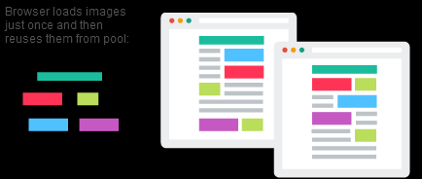
Flyweight
Intent
Use sharing to support large numbers of fine-grained objects efficiently.
The Motif GUI strategy of replacing heavy-weight widgets with light-weight gadgets.

Slide 35
#include <iostream.h>
#include <string.h>
class Icon
{
public:
Icon(char *fileName)
{
strcpy(_name, fileName);
if (!strcmp(fileName, "go"))
{
_width = 20;
_height = 20;
}
if (!strcmp(fileName, "stop"))
{
_width = 40;
_height = 40;
}
if (!strcmp(fileName, "select"))
{
_width = 60;
_height = 60;
}
if (!strcmp(fileName, "undo"))
{
_width = 30;
_height = 30;
}
}
const char *getName()
{
return _name;
}
draw(int x, int y)
{
cout << " drawing " << _name << ": upper left (" << x << "," << y <<
") - lower right (" << x + _width << "," << y + _height << ")" <<
endl;
}
private:
char _name[20];
int _width;
int _height;
};
class DialogBox
{
public:
DialogBox(int x, int y, int incr): _iconsOriginX(x), _iconsOriginY(y),
_iconsXIncrement(incr){}
virtual void draw() = 0;
protected:
Icon *_icons[3];
int _iconsOriginX;
int _iconsOriginY;
int _iconsXIncrement;
};
class FileSelection: public DialogBox
{
public:
FileSelection(Icon *first, Icon *second, Icon *third): DialogBox(100, 100,
100)
{
_icons[0] = first;
_icons[1] = second;
_icons[2] = third;
}
void draw()
{
cout << "drawing FileSelection:" << endl;
for (int i = 0; i < 3; i++)
_icons[i]->draw(_iconsOriginX + (i *_iconsXIncrement), _iconsOriginY);
}
};
class CommitTransaction: public DialogBox
{
public:
CommitTransaction(Icon *first, Icon *second, Icon *third): DialogBox(150,
150, 150)
{
_icons[0] = first;
_icons[1] = second;
_icons[2] = third;
}
void draw()
{
cout << "drawing CommitTransaction:" << endl;
for (int i = 0; i < 3; i++)
_icons[i]->draw(_iconsOriginX + (i *_iconsXIncrement), _iconsOriginY);
}
};
class FlyweightFactory
{
public:
static Icon *getIcon(char *name)
{
for (int i = 0; i < _numIcons; i++)
if (!strcmp(name, _icons[i]->getName()))
return _icons[i];
_icons[_numIcons] = new Icon(name);
return _icons[_numIcons++];
}
static void reportTheIcons()
{
cout << "Active Flyweights: ";
for (int i = 0; i < _numIcons; i++)
cout << _icons[i]->getName() << " ";
cout << endl;
}
private:
enum
{
MAX_ICONS = 5
};
static int _numIcons;
static Icon *_icons[MAX_ICONS];
};
int FlyweightFactory::_numIcons = 0;
Icon *FlyweightFactory::_icons[];
int main()
{
DialogBox *dialogs[2];
dialogs[0] = new FileSelection(FlyweightFactory::getIcon("go"),
FlyweightFactory::getIcon("stop"), FlyweightFactory::getIcon("select"));
dialogs[1] = new CommitTransaction(FlyweightFactory::getIcon("select"),
FlyweightFactory::getIcon("stop"), FlyweightFactory::getIcon("undo"));
for (int i = 0; i < 2; i++)
dialogs[i]->draw();
FlyweightFactory::reportTheIcons();
}
drawing FileSelection:
drawing go: upper left (100,100) - lower right (120,120)
drawing stop: upper left (200,100) - lower right (240,140)
drawing select: upper left (300,100) - lower right (360,160)
drawing CommitTransaction:
drawing select: upper left (150,150) - lower right (210,210)
drawing stop: upper left (300,150) - lower right (340,190)
drawing undo: upper left (450,150) - lower right (480,180)
Active Flyweights: go stop select undo

Slide 36
In Maya
already been
  cache
can be

Slide 37
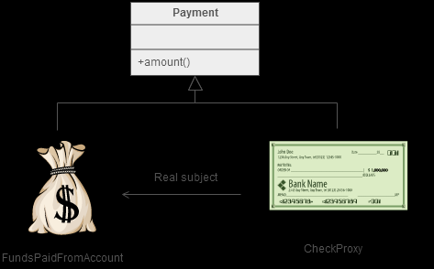
Proxy
Intent
Provide a surrogate or placeholder for another object to control access to it.
Use an extra level of indirection to support distributed, controlled, or intelligent access.
Add a wrapper and delegation to protect the real component from undue complexity.

Slide 38
class Subject
{
public:
virtual void execute() = 0;
};
class RealSubject: public Subject
{
string str;
public:
RealSubject(string s)
{
str = s;
}
/*virtual*/void execute()
{
cout << str << '\n';
}
};
class ProxySubject: public Subject
{
string first, second, third;
RealSubject *ptr;
public:
ProxySubject(string s)
{
int num = s.find_first_of(' ');
first = s.substr(0, num);
s = s.substr(num + 1);
num = s.find_first_of(' ');
second = s.substr(0, num);
s = s.substr(num + 1);
num = s.find_first_of(' ');
third = s.substr(0, num);
s = s.substr(num + 1);
ptr = new RealSubject(s);
}
~ProxySubject()
{
delete ptr;
}
RealSubject *operator->()
{
cout << first << ' ' << second << ' ';
return ptr;
}
/*virtual*/void execute()
{
cout << first << ' ' << third << ' ';
ptr->execute();
}
};
int main()
{
ProxySubject obj(string("the quick brown fox jumped over the dog"));
obj->execute();
obj.execute();
}
the quick fox jumped over the dog
the brown fox jumped over the dog

Slide 39
In Maya
already been
can be

Slide 40
Behavioral design patterns

Slide 41
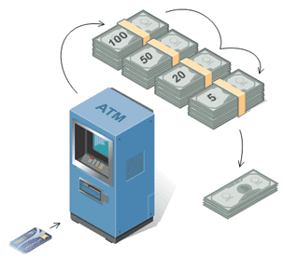
Chain of Responsibility
Intent
1.Avoid coupling the sender of a request to its receiver by giving more than one object a chance to handle the request.
Chain the receiving objects and pass the request along the chain until an object handles it.
2.Launch-and-leave requests with a single processing pipeline that contains many possible handlers.
3.An object-oriented linked list with recursive traversal.

Slide 42
#include <iostream>
#include <vector>
#include <ctime>
using namespace std;
class Component
{
int value;
Component *next; // 1. "next" pointer in the base class
public:
Component(int v, Component *n)
{
value = v;
next = n;
}
void setNext(Component *n)
{
next = n;
}
virtual void traverse()
{
cout << value << ' ';
}
// 2. The "chain" method in the base class always delegates to the next obj
virtual void volunteer()
{
next->volunteer();
}
};
int main()
{
srand(time(0)); // 1
Primitive seven(7); // |
Primitive six(6, &seven); // +-- 2
Composite three(3, &six); // | |
three.add(&six);
three.add(&seven); // | +-- 4 5
Primitive five(5, &three); // |
Primitive four(4, &five); // +-- 3
Composite two(2, &four); // | |
two.add(&four);
two.add(&five); // | +-- 6 7
Composite one(1, &two); // |
Primitive nine(9, &one); // +-- 8 9
Primitive eight(8, &nine);
one.add(&two);
one.add(&three);
one.add(&eight);
one.add(&nine);
seven.setNext(&eight);
cout << "traverse: ";
one.traverse();
cout << '\n';
for (int i = 0; i < 8; i++)
{
one.volunteer();
cout << '\n';
}
}
class Primitive: public Component
{
public:
Primitive(int val, Component *n = 0): Component(val, n){}
/*virtual*/void volunteer()
{
Component::traverse();
// 3. Primitive objects don't handle volunteer requests 5 times out of 6
if (rand() *100 % 6 != 0)
// 3. Delegate to the base class
Component::volunteer();
}
};
class Composite: public Component
{
vector < Component * > children;
public:
Composite(int val, Component *n = 0): Component(val, n){}
void add(Component *c)
{
children.push_back(c);
}
/*virtual*/void traverse()
{
Component::traverse();
for (int i = 0; i < children.size(); i++)
children[i]->traverse();
}
// 3. Composite objects never handle volunteer requests
/*virtual*/void volunteer()
{
Component::volunteer();
}
};
traverse: 1 2 4 5 3 6 7 8 9
4
4 5 6 7
4 5 6 7 8 9 4 5 6 7 8 9 4
4
4 5 6
4 5
4 5
4 5 6 7 8 9 4 5 6 7 8 9 4 5 6

Slide 43
In Maya
already been
  APipeline
can be

Slide 44
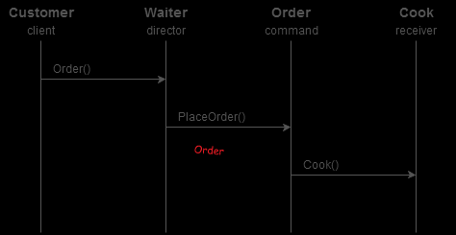
Command
Intent
1.Encapsulate a request as an object, thereby letting you parameterize clients with different requests,
queue or log requests, and support undoable operations.
2.Promote "invocation of a method on an object" to full object status
3.An object-oriented callback

Slide 45
#include <iostream> #include <string> using namespace std;
class Person;
class Command
{
// 1. Create a class that encapsulates an object and a member function
// a pointer to a member function (the attribute's name is "method")
Person *object; //
void(Person:: *method)();
public:
Command(Person *obj = 0, void(Person:: *meth)() = 0)
{
object = obj; // the argument's name is "meth"
method = meth;
}
void execute()
{
(object-> *method)(); // invoke the method on the object
}
};
class Person
{
string name;
// cmd is a "black box", it is a method invocation
// promoted to "full object status"
Command cmd;
public:
Person(string n, Command c): cmd(c)
{
name = n;
}
void talk()
{
// "this" is the sender, cmd has the receiver
cout << name << " is talking" << endl;
cmd.execute(); // ask the "black box" to callback the receiver
}
void passOn()
{
cout << name << " is passing on" << endl;
// 4. When the sender is ready to callback to the receiver,
// it calls execute()
cmd.execute();
}
void gossip()
{
cout << name << " is gossiping" << endl;
cmd.execute();
}
void listen()
{
cout << name << " is listening" << endl;
}
};
int main()
{
// Fred will "execute" Barney which will result in a call to passOn()
// Barney will "execute" Betty which will result in a call to gossip()
// Betty will "execute" Wilma which will result in a call to listen()
Person wilma("Wilma", Command());
// 2. Instantiate an object for each "callback"
// 3. Pass each object to its future "sender"
Person betty("Betty", Command(&wilma, &Person::listen));
Person barney("Barney", Command(&betty, &Person::gossip));
Person fred("Fred", Command(&barney, &Person::passOn));
fred.talk();
}
Fred is talking
Barney is passing on
Betty is gossiping
Wilma is listening

Slide 46
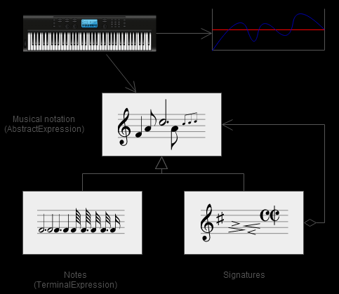
Interpreter
Intent
1.Given a language, define a representation for its grammar along with an interpreter that
uses the representation to interpret sentences in the language.
2.Map a domain to a language, the language to a grammar, and the grammar to a hierarchical object-oriented design.

Slide 47
#include <iostream.h>
#include <string.h>
class Thousand;
class Hundred;
class Ten;
class One;
class RNInterpreter
{
public:
RNInterpreter(); // ctor for client
RNInterpreter(int){}
// ctor for subclasses, avoids infinite loop
int interpret(char*); // interpret() for client
virtual void interpret(char *input, int &total)
{
// for internal use
int index;
index = 0;
if (!strncmp(input, nine(), 2))
{
total += 9 * multiplier();
index += 2;
}
else if (!strncmp(input, four(), 2))
{
total += 4 * multiplier();
index += 2;
}
else
{
if (input[0] == five())
{
total += 5 * multiplier();
index = 1;
}
else
index = 0;
for (int end = index + 3; index < end; index++)
if (input[index] == one())
total += 1 * multiplier();
else
break;
}
strcpy(input, &(input[index]));
} // remove leading chars processed
protected:
// cannot be pure virtual because client asks for instance
virtual char one(){}
virtual char *four(){}
virtual char five(){}
virtual char *nine(){}
virtual int multiplier(){}
private:
RNInterpreter *thousands;
RNInterpreter *hundreds;
RNInterpreter *tens;
RNInterpreter *ones;
};
int RNInterpreter::interpret(char *input)
{
int total;
total = 0;
thousands->interpret(input, total);
hundreds->interpret(input, total);
tens->interpret(input, total);
ones->interpret(input, total);
if (strcmp(input, ""))
// if input was invalid, return 0
return 0;
return total;
}
class Thousand: public RNInterpreter
{
public:
// provide 1-arg ctor to avoid infinite loop in base class ctor
Thousand(int): RNInterpreter(1){}
protected:
char one()
{
return 'M';
}
char *four()
{
return "";
}
char five()
{
return '\0';
}
char *nine()
{
return "";
}
int multiplier()
{
return 1000;
}
};
class Hundred: public RNInterpreter
{
public:
Hundred(int): RNInterpreter(1){}
protected:
char one()
{
return 'C';
}
char *four()
{
return "CD";
}
char five()
{
return 'D';
}
char *nine()
{
return "CM";
}
int multiplier()
{
return 100;
}
};
class Ten: public RNInterpreter
{
public:
Ten(int): RNInterpreter(1){}
protected:
char one()
{
return 'X';
}
char *four()
{
return "XL";
}
char five()
{
return 'L';
}
char *nine()
{
return "XC";
}
int multiplier()
{
return 10;
}
};
class One: public RNInterpreter
{
public:
One(int): RNInterpreter(1){}
protected:
char one()
{
return 'I';
}
char *four()
{
return "IV";
}
char five()
{
return 'V';
}
char *nine()
{
return "IX";
}
int multiplier()
{
return 1;
}
};
RNInterpreter::RNInterpreter()
{
// use 1-arg ctor to avoid infinite loop
thousands = new Thousand(1);
hundreds = new Hundred(1);
tens = new Ten(1);
ones = new One(1);
}
int main()
{
RNInterpreter interpreter;
char input[20];
cout << "Enter Roman Numeral: ";
while (cin >> input)
{
cout << " interpretation is " << interpreter.interpret(input) << endl;
cout << "Enter Roman Numeral: ";
}
}
Enter Roman Numeral: MCMXCVI
interpretation is 1996
Enter Roman Numeral: MMMCMXCIX
interpretation is 3999
Enter Roman Numeral: MMMM
interpretation is 0
Enter Roman Numeral: MDCLXVIIII
interpretation is 0
Enter Roman Numeral: CXCX
interpretation is 0
Enter Roman Numeral: MDCLXVI
interpretation is 1666
Enter Roman Numeral: DCCCLXXXVIII
interpretation is 888

Slide 48
In Maya
already been
can be

Slide 49
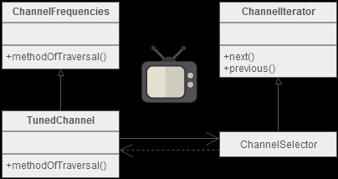
Iterator
Intent
1.Provide a way to access the elements of an aggregate object sequentially without exposing its underlying representation.
2.The C++ and Java standard library abstraction that makes it possible to decouple collection classes and algorithms.
3.Promote to "full object status" the traversal of a collection.
4.Polymorphic traversal

Slide 50
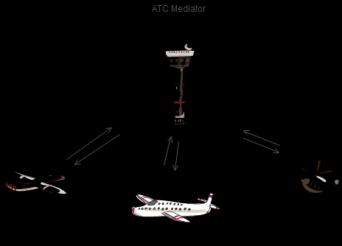
Mediator
Intent
1.Define an object that encapsulates how a set of objects interact.
Mediator promotes loose coupling by keeping objects from referring to each other explicitly, and it lets you vary their interaction independently.
2.Design an intermediary to decouple many peers.
3.Promote the many-to-many relationships between interacting peers to "full object status".

Slide 51
#include <iostream.h>
class FileSelectionDialog;
class Widget
{
public:
Widget(FileSelectionDialog *mediator, char *name)
{
_mediator = mediator;
strcpy(_name, name);
}
virtual void changed();
virtual void updateWidget() = 0;
virtual void queryWidget() = 0;
protected:
char _name[20];
private:
FileSelectionDialog *_mediator;
};
class List: public Widget
{
public:
List(FileSelectionDialog *dir, char *name): Widget(dir, name){}
void queryWidget()
{
cout << " " << _name << " list queried" << endl;
}
void updateWidget()
{
cout << " " << _name << " list updated" << endl;
}
};
class Edit: public Widget
{
public:
Edit(FileSelectionDialog *dir, char *name): Widget(dir, name){}
void queryWidget()
{
cout << " " << _name << " edit queried" << endl;
}
void updateWidget()
{
cout << " " << _name << " edit updated" << endl;
}
};
class FileSelectionDialog
{
public:
enum Widgets
{
FilterEdit, DirList, FileList, SelectionEdit
};
FileSelectionDialog()
{
_components[FilterEdit] = new Edit(this, "filter");
_components[DirList] = new List(this, "dir");
_components[FileList] = new List(this, "file");
_components[SelectionEdit] = new Edit(this, "selection");
}
virtual ~FileSelectionDialog();
void handleEvent(int which)
{
_components[which]->changed();
}
virtual void widgetChanged(Widget *theChangedWidget)
{
if (theChangedWidget == _components[FilterEdit])
{
_components[FilterEdit]->queryWidget();
_components[DirList]->updateWidget();
_components[FileList]->updateWidget();
_components[SelectionEdit]->updateWidget();
}
else if (theChangedWidget == _components[DirList])
{
_components[DirList]->queryWidget();
_components[FileList]->updateWidget();
_components[FilterEdit]->updateWidget();
_components[SelectionEdit]->updateWidget();
}
else if (theChangedWidget == _components[FileList])
{
_components[FileList]->queryWidget();
_components[SelectionEdit]->updateWidget();
}
else if (theChangedWidget == _components[SelectionEdit])
{
_components[SelectionEdit]->queryWidget();
cout << " file opened" << endl;
}
}
private:
Widget *_components[4];
};
FileSelectionDialog::~FileSelectionDialog()
{
for (int i = 0; i < 3; i++)
delete _components[i];
}
void Widget::changed()
{
_mediator->widgetChanged(this);
}
int main()
{
FileSelectionDialog fileDialog;
int i;
cout << "Exit[0], Filter[1], Dir[2], File[3], Selection[4]: ";
cin >> i;
while (i)
{
fileDialog.handleEvent(i - 1);
cout << "Exit[0], Filter[1], Dir[2], File[3], Selection[4]: ";
cin >> i;
}
}
Exit[0], Filter[1], Dir[2], File[3], Selection[4]: 1
filter edit queried
dir list updated
file list updated
selection edit updated
Exit[0], Filter[1], Dir[2], File[3], Selection[4]: 2
dir list queried
file list updated
filter edit updated
selection edit updated
Exit[0], Filter[1], Dir[2], File[3], Selection[4]: 3
file list queried
selection edit updated
Exit[0], Filter[1], Dir[2], File[3], Selection[4]: 4
selection edit queried
file opened
Exit[0], Filter[1], Dir[2], File[3], Selection[4]: 3
file list queried
selection edit updated

Slide 52
In Maya
already been
can be

Slide 53
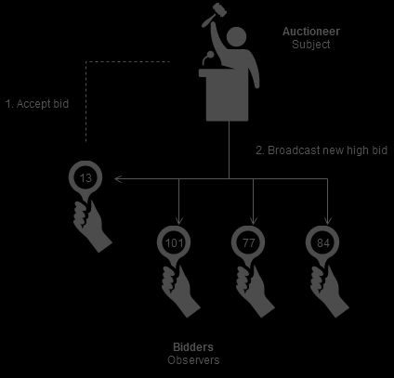
Observer
Intent
1.Define a one-to-many dependency between objects so that when one object changes state,
all its dependents are notified and updated automatically.
2.Encapsulate the core (or common or engine) components in a Subject abstraction,
and the variable (or optional or user interface) components in an Observer hierarchy.
3.The "View" part of Model-View-Controller.

Slide 54
void Subject::notify() {
// 5. Publisher broadcasts
for (int i = 0; i < views.size(); i++)
views[i]->update();
}
class DivObserver: public Observer {
public:
DivObserver(Subject *mod, int div): Observer(mod, div){}
void update() {
// 6. "Pull" information of interest
int v = getSubject()->getVal(), d = getDivisor();
cout << v << " div " << d << " is " << v / d << '\n';
}
};
class ModObserver: public Observer {
public:
ModObserver(Subject *mod, int div): Observer(mod, div){}
void update() {
int v = getSubject()->getVal(), d = getDivisor();
cout << v << " mod " << d << " is " << v % d << '\n';
}
};
#include <iostream>
#include <vector>
using namespace std;
class Subject {
// 1. "independent" functionality
vector < class Observer * > views; // 3. Coupled only to "interface"
int value;
public:
void attach(Observer *obs) {
views.push_back(obs);
}
void setVal(int val) {
value = val;
notify();
}
int getVal() {
return value;
}
void notify();
};
class Observer {
// 2. "dependent" functionality
Subject *model;
int denom;
public:
Observer(Subject *mod, int div) {
model = mod;
denom = div;
// 4. Observers register themselves with the Subject
model->attach(this);
}
virtual void update() = 0;
protected:
Subject *getSubject() {
return model;
}
int getDivisor() {
return denom;
}
};
int main() {
Subject subj;
DivObserver divObs1(&subj, 4); // 7. Client configures the number and
DivObserver divObs2(&subj, 3); // type of Observers
ModObserver modObs3(&subj, 3);
subj.setVal(14);
}
14 div 4 is 3
14 div 3 is 4
14 mod 3 is 2

Slide 55
In Maya
already been
can be

Slide 56
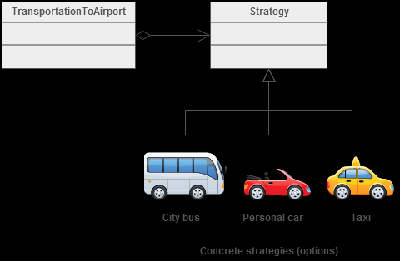
Strategy
Intent
Define a family of algorithms, encapsulate each one, and make them interchangeable.
Strategy lets the algorithm vary independently from the clients that use it.
Capture the abstraction in an interface, bury implementation details in derived classes.

Slide 57
#include <iostream.h>
#include <fstream.h>
#include <string.h>
class Strategy;
class TestBed
{
public:
enum StrategyType
{
Dummy, Left, Right, Center
};
TestBed()
{
strategy_ = NULL;
}
void setStrategy(int type, int width);
void doIt();
private:
Strategy *strategy_;
};
class Strategy
{
public:
Strategy(int width): width_(width){}
void format()
{
char line[80], word[30];
ifstream inFile("quote.txt", ios::in);
line[0] = '\0';
inFile >> word;
strcat(line, word);
while (inFile >> word)
{
if (strlen(line) + strlen(word) + 1 > width_)
justify(line);
else
strcat(line, " ");
strcat(line, word);
}
justify(line);
}
protected:
int width_;
private:
virtual void justify(char *line) = 0;
};
void TestBed::setStrategy(int type, int width)
{
delete strategy_;
if (type == Left)
strategy_ = new LeftStrategy(width);
else if (type == Right)
strategy_ = new RightStrategy(width);
else if (type == Center)
strategy_ = new CenterStrategy(width);
}
void TestBed::doIt()
{
strategy_->format();
}
int main()
{
TestBed test;
int answer, width;
cout << "Exit(0) Left(1) Right(2) Center(3): ";
cin >> answer;
while (answer)
{
cout << "Width: ";
cin >> width;
test.setStrategy(answer, width);
test.doIt();
cout << "Exit(0) Left(1) Right(2) Center(3): ";
cin >> answer;
}
return 0;
}
class LeftStrategy: public Strategy
{
public:
LeftStrategy(int width): Strategy(width){}
private:
/* virtual */void justify(char *line)
{
cout << line << endl;
line[0] = '\0';
}
};
class RightStrategy: public Strategy
{
public:
RightStrategy(int width): Strategy(width){}
private:
/* virtual */void justify(char *line)
{
char buf[80];
int offset = width_ - strlen(line);
memset(buf, ' ', 80);
strcpy(&(buf[offset]), line);
cout << buf << endl;
line[0] = '\0';
}
};
class CenterStrategy: public Strategy
{
public:
CenterStrategy(int width): Strategy(width){}
private:
/* virtual */void justify(char *line)
{
char buf[80];
int offset = (width_ - strlen(line)) / 2;
memset(buf, ' ', 80);
strcpy(&(buf[offset]), line);
cout << buf << endl;
line[0] = '\0';
}
};
Exit(0) Left(1) Right(2) Center(3): 2
Width: 75
Exit(0) Left(1) Right(2) Center(3): 3
Width: 75

Slide 58
In Maya
already been
can be

Slide 59
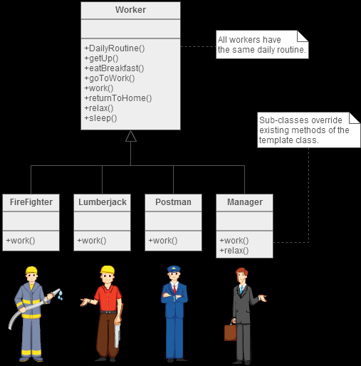
Template Method
Intent
1.Define the skeleton of an algorithm in an operation, deferring some steps to client subclasses.
Template Method lets subclasses redefine certain steps of an algorithm without changing the algorithm's structure.
2.Base class declares algorithm 'placeholders', and derived classes implement the placeholders.

Slide 60
#include <iostream>
using namespace std;
class Base
{
void a()
{
cout << "a ";
}
void c()
{
cout << "c ";
}
void e()
{
cout << "e ";
}
// 2. Steps requiring peculiar implementations are "placeholders" in base class
virtual void ph1() = 0;
virtual void ph2() = 0;
public:
// 1. Standardize the skeleton of an algorithm in a base class "template method"
void execute()
{
a();
ph1();
c();
ph2();
e();
}
};
class One: public Base
{
// 3. Derived classes implement placeholder methods
/*virtual*/void ph1()
{
cout << "b ";
}
/*virtual*/void ph2()
{
cout << "d ";
}
};
class Two: public Base
{
/*virtual*/void ph1()
{
cout << "2 ";
}
/*virtual*/void ph2()
{
cout << "4 ";
}
};
int main()
{
Base *array[] =
{
&One(), &Two()
};
for (int i = 0; i < 2; i++)
{
array[i]->execute();
cout << '\n';
}
}
a b c d e
a 2 c 4 e

Slide 61
In Maya
already been
can be

Slide 62
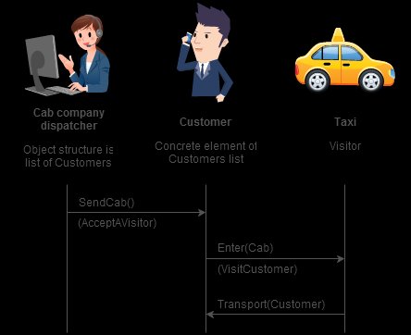
Visitor
Intent
1.Represent an operation to be performed on the elements of an object structure.
Visitor lets you define a new operation without changing the classes of the elements on which it operates.
2.The classic technique for recovering lost type information.
3.Do the right thing based on the type of two objects.
4.Double dispatch

Slide 63
// 2. Create a "visitor" base class w/ a visit() method for every "element" type
class Visitor
{
public:
virtual void visit(This *e) = 0;
virtual void visit(That *e) = 0;
virtual void visit(TheOther *e) = 0;
};
/*virtual*/void This::accept(Visitor &v)
{
v.visit(this);
}
/*virtual*/void That::accept(Visitor &v)
{
v.visit(this);
}
/*virtual*/void TheOther::accept(Visitor &v)
{
v.visit(this);
}
// 3. Create a "visitor" derived class for each "operation" to do on "elements"
class UpVisitor: public Visitor
{
/*virtual*/void visit(This *e)
{
cout << "do Up on " + e->thiss() << '\n';
}
/*virtual*/void visit(That *e)
{
cout << "do Up on " + e->that() << '\n';
}
/*virtual*/void visit(TheOther *e)
{
cout << "do Up on " + e->theOther() << '\n';
}
};
class DownVisitor: public Visitor
{
/*virtual*/void visit(This *e)
{
cout << "do Down on " + e->thiss() << '\n';
}
/*virtual*/void visit(That *e)
{
cout << "do Down on " + e->that() << '\n';
}
/*virtual*/void visit(TheOther *e)
{
cout << "do Down on " + e->theOther() << '\n';
}
};
#include <iostream>
#include <string>
using namespace std;
// 1. Add an accept(Visitor) method to the "element" hierarchy
class Element
{
public:
virtual void accept(class Visitor &v) = 0;
};
class This: public Element
{
public:
/*virtual*/void accept(Visitor &v);
string thiss()
{
return "This";
}
};
class That: public Element
{
public:
/*virtual*/void accept(Visitor &v);
string that()
{
return "That";
}
};
class TheOther: public Element
{
public:
/*virtual*/void accept(Visitor &v);
string theOther()
{
return "TheOther";
}
};
int main()
{
Element *list[] =
{
new This(), new That(), new TheOther()
};
UpVisitor up; // 4. Client creates
DownVisitor down; // "visitor" objects
for (int i = 0; i < 3; i++)
// and passes each
list[i]->accept(up);
// to accept() calls
for (i = 0; i < 3; i++)
list[i]->accept(down);
}
do Up on This do Down on This
do Up on That do Down on That
do Up on TheOther do Down on TheOther

Slide 64
In Maya
already been
can be

Slide 65
Open Close Principle | OPC is a generic principle. You can consider it when writing your classes to make sure that when you need to extend their behavior you don�t have to change the class but to extend it.
 | Software entities like classes, modules and functions should be open for extension but closed for modifications.
Dependency Inversion Principle | Dependency Inversion Principle states that we should decouple high level modules from low level modules, introducing an abstraction layer between the high level classes and low level classes.
 | High-level modules should not depend on low-level modules. Both should depend on abstractions.
 | Abstractions should not depend on details. Details should depend on abstractions.
Interface Segregation Principle | This principle teaches us to take care how we write our interfaces. When we write our interfaces we should take care to add only methods that should be there.
 | Clients should not be forced to depend upon interfaces that they don't use.

Slide 66
Principle
Open Close Principle | OPC is a generic principle. You can consider it when writing your classes to make sure that when you need to extend their behavior you don�t have to change the class but to extend it.
 | Software entities like classes, modules and functions should be open for extension but closed for modifications.
Dependency Inversion Principle | Dependency Inversion Principle states that we should decouple high level modules from low level modules, introducing an abstraction layer between the high level classes and low level classes.
 | High-level modules should not depend on low-level modules. Both should depend on abstractions.
 | Abstractions should not depend on details. Details should depend on abstractions.

Slide 67
Principle
Interface Segregation Principle | This principle teaches us to take care how we write our interfaces. When we write our interfaces we should take care to add only methods that should be there.
 | Clients should not be forced to depend upon interfaces that they don't use.
Single Responsibility Principle | In this context a responsibility is considered to be one reason to change. This principle states that if we have 2 reasons to change for a class, we have to split the functionality in two classes.
 | A class should have only one reason to change.
Liskov's Substitution Principle | This principle is just an extension of the Open Close Principle in terms of behavior meaning that we must make sure that new derived classes are extending the base classes without changing their behavior.
 | Derived types must be completely substitutable for their base types.

Slide 68
Thank you~~!!

