Slide 1
CS5070 Mathematical Structures for Computer Science
Sequence
Kun Suo
Department of Computer Science College of Computing and Software Engineering
Kennesaw State University
ksuo@kennesaw.edu

Slide 2
Sequences (Chapter 2)
A sequence is an ordered list of numbers: ⟨a₀, a₁, a₂, a₃, . . .⟩.
A sequence is a type of function. The sequence (a_{n})_{n≥0} is a function with domain N where a_{n} is the image of the natural number n.
A closed formula for a sequence (a_{n})_{n∈N} is a formula for a_{n} using a fixed finite number of operations on n.
An example of a closed formula is: a_{n} = n² + 3
A recursive definition (or inductive definition) for a sequence (a_{n})_{n∈N} consists of a recurrence relation and an initial condition.
An example of a recursive definition is:
a_{n} = 2a_{n−1} with a₀ = 27

Slide 3
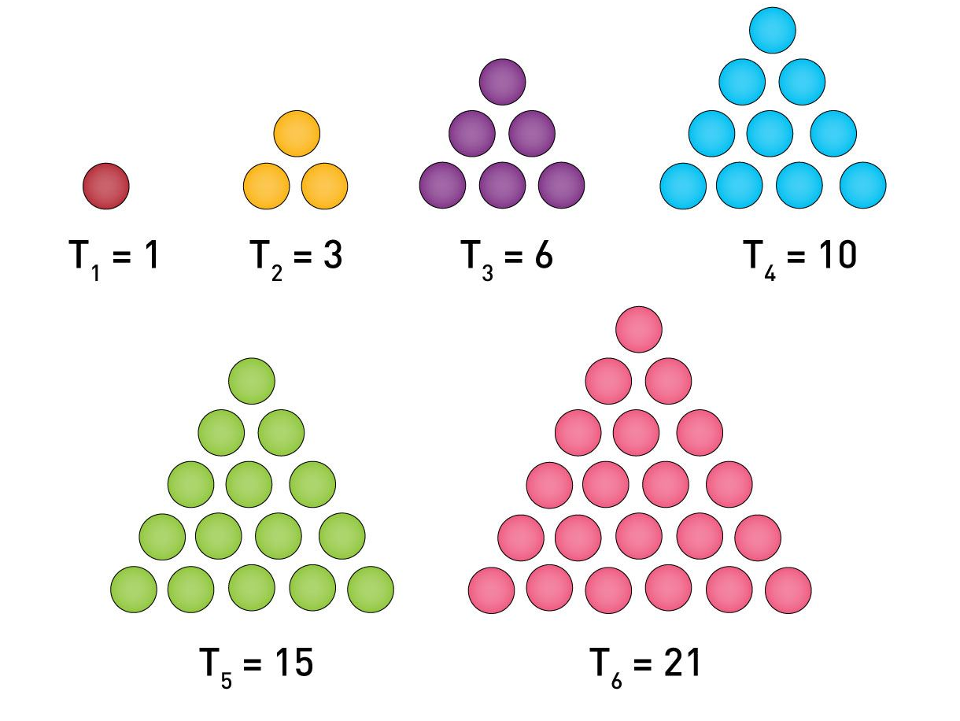
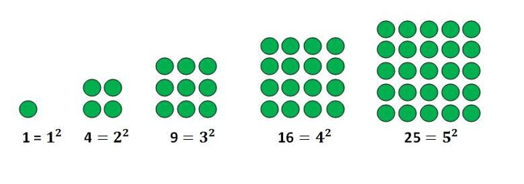
Known Sequences
The square numbers sequence 1, 4, 9, 16, 25, . . . ; this sequence (s_{n})_{n≥1} has a closed formula
s_{n} = n²
The triangular numbers sequence 1, 3, 6, 10, 15, 21, . . .; this sequence (T_{n})_{n≥1} has closed formula
n(n + 1)
T_{n} =
2

Slide 4
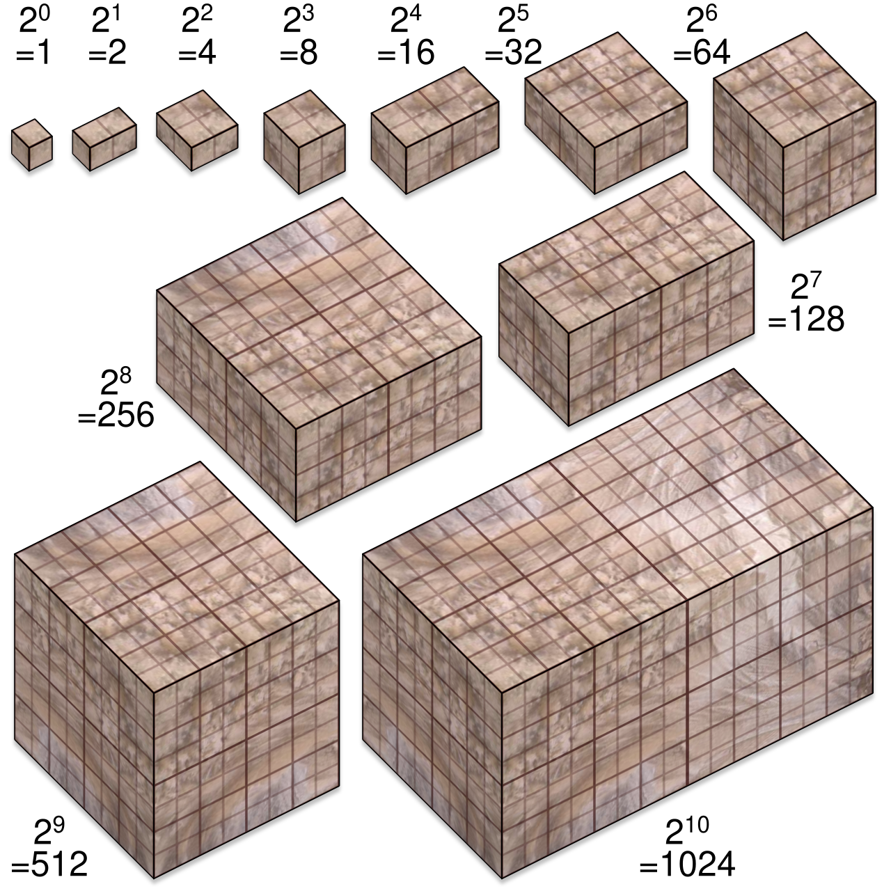
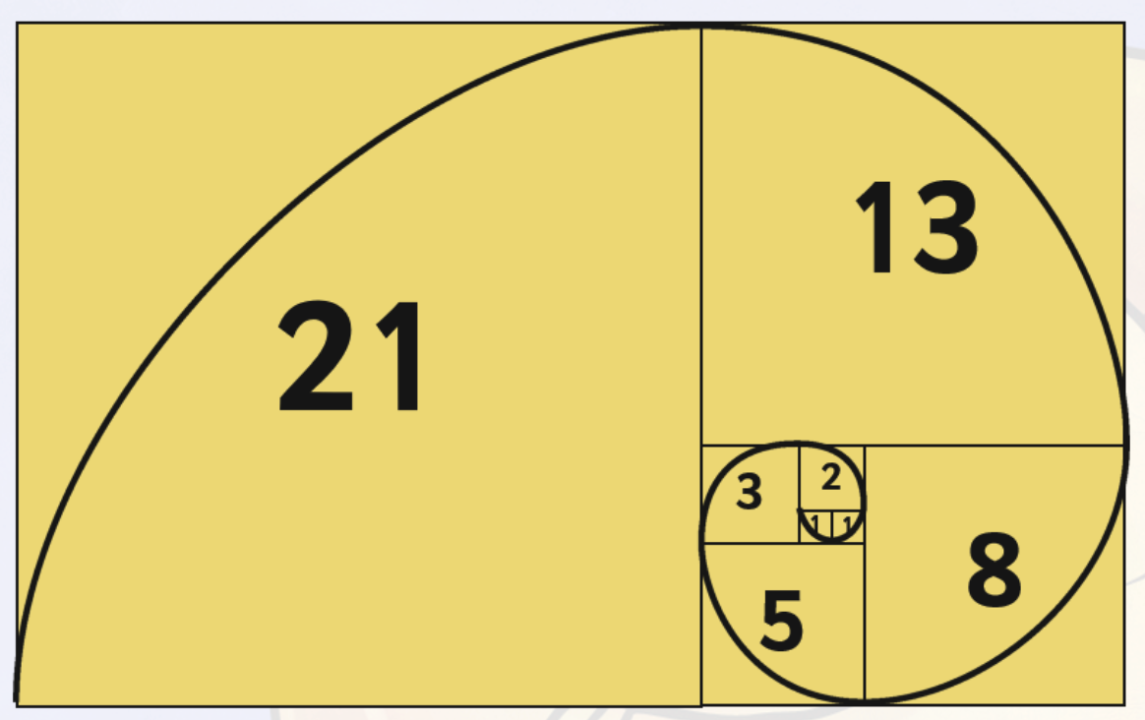
Known Sequences
The powers of 2 sequence 1, 2, 4, 8, 16, 32, . . .; this sequence (a_{n})_{n≥0} has closed formula
a_{n} = 2^{n}
The Fibonacci numbers sequence 1, 1, 2, 3, 5, 8, 13, . . . is defined recursively by
Fn = Fn−1 + Fn−2
with F₁ = F₂ = 1

Slide 5
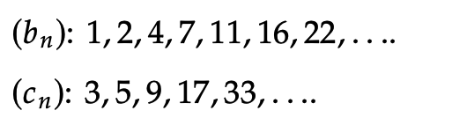
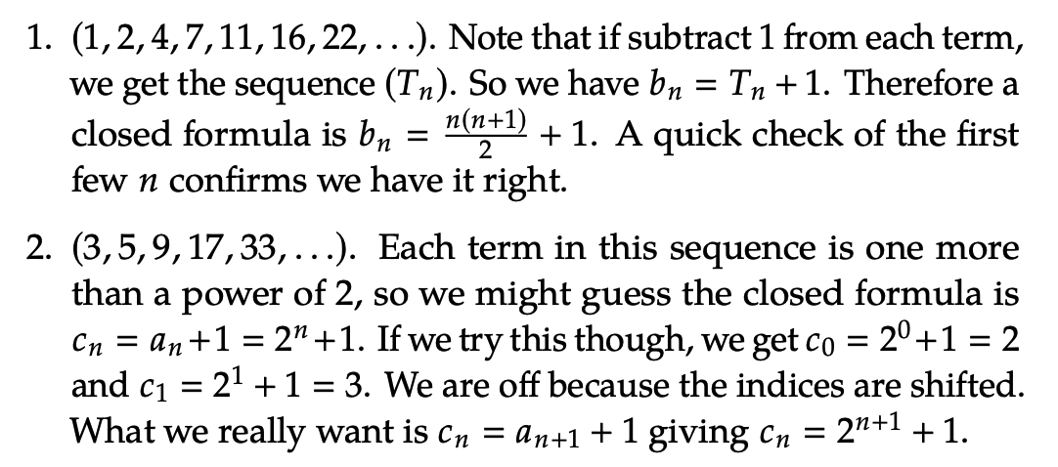
Closed Formula of Sequences
One method to derive a closed formula for a sequence, is to relate a given sequence to a known sequence. See Example 2.1.4.

Slide 6
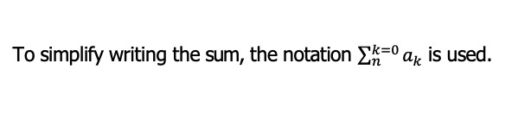
Closed Formula of Sequences
Partial Sums. Given any sequence (a_{n})_{n∈N} we can always form a new sequence (b_{n})_{n∈N} by
b_{n} = a₀ + a₁ + a₂ + · · · + a_{n}
Since the terms of (b_{n}) are the sums of the initial part of the sequence (a_{n}) ways, l (b_{n}) is known as the sequence of partial sums of (a_{n}). It is sometimes possible to find a closed formula for (b_{n}) from the closed formula for (a_{n}). See page 143.
To simplify writing the sum, the notation $\sum_{n}^{k=0}{a_{k}}$ is used.
The notation for multiplying the a terms is
Q
k=1
n
a_{k}
k

Slide 7
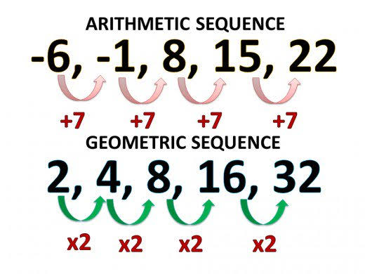
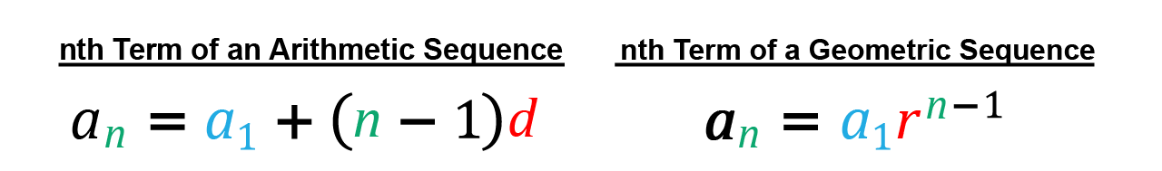
Arithmetic Sequences
If the terms of a sequence differ by a constant, the sequence is arithmetic.
If the initial term (a₀) of the sequence is a and the common difference is d ,
Recursive definition: a_{n} = a_{n−1} + d with a₀ = a
Closed formula: a_{n} = a + d · n
For example (see Example 2.2.1), for the sequence 2, 5, 8, 11, 14, . . ., the common difference d = 3 and the recursive definition is
a_{n} = a_{n−1} + 3 with a₀ = 2.
The closed formula is a_{n} = 2 + 3 · n

Slide 8
Geometric Sequences
A sequence like: 2, 6, 18, 54, . . . has a difference between terms that is not constant, however, the ratio between successive terms is constant. It is a geometric sequence.
The recursive definition for the geometric sequence with initial term a
and common ratio r is:
a_{n} = a_{n−1} · r a₀ = a
The closed formula for this sequence is:
a_{n} = a · r^{n}
The sequence: 3, 6, 12, 24, 48, . . . has the common ratio r = 2. The recursive definition is: a_{n} = 2a_{n−1} with a₀ = 3. See Example 2.2.2.
The closed formula is: a_{n} = 3 · 2^{n}

Slide 9
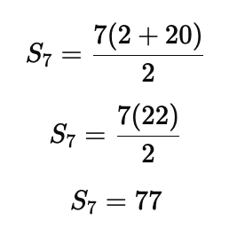
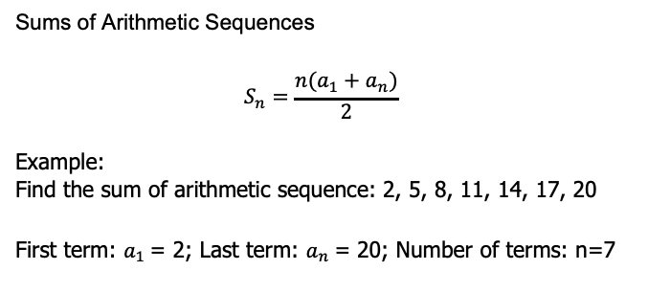
Sums of Arithmetic and Geometric Sequences
Sums of Arithmetic Sequences
$$S_{n}=\frac{n(a_{1}+a_{n})}{2}$$
Example:
Find the sum of arithmetic sequence: 2, 5, 8, 11, 14, 17, 20
First term: $a_{1}$= 2; Last term: $a_{n}$= 20; Number of terms: n=7

Slide 10
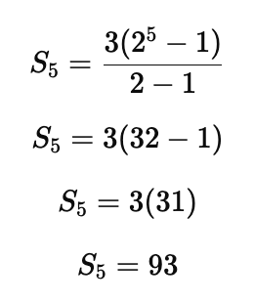
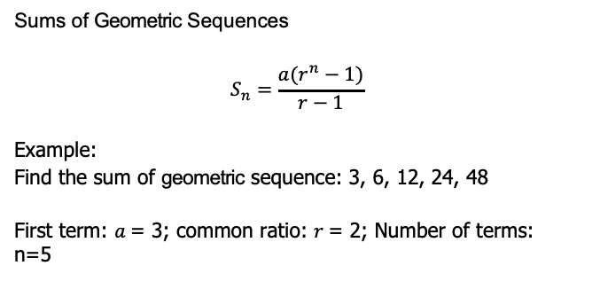
Sums of Arithmetic and Geometric Sequences
Sums of Geometric Sequences
$$S_{n}=\frac{a(r^{n}−1)}{r−1}$$
Example:
Find the sum of geometric sequence: 3, 6, 12, 24, 48
First term: $a$= 3; common ratio: $r$= 2; Number of terms: n=5

Slide 11
Sums of Arithmetic and Geometric Sequences
The sequence (T_{n})_{n≥1} that starts 1, 3, 6, 10, 15, . . . is not arithmetic and is not geometric.
Note that the differences between terms form an arithmetic sequence: 2, 3, 4, 5, 6, . . ..
This means that the nth term of the sequence (T_{n}) is the sum of the first n terms of the sequence 1, 2, 3, 4, 5, . . .
(T_{n}) is the sequence of partial sums of the sequence 1, 2, 3, . . .
T_{n} = 1 + 2 + 3 + · · · + n
In general,
n(n + 1)
T_{n} =
2

Slide 12
More Complex Sequences
The sequence ⟨1, 5, 14, 30, 55 . . .⟩ is not arithmetic and is not geometric; its sequence of differences might be arithmetic or geometric.
The sequence of differences is: ⟨4, 9, 16, 25, . . .⟩.
This sequence is not arithmetic because its differences are not constant
The second differences is: ⟨5, 7, 9, . . .⟩ is an arithmetic sequence because the differences are constant with value 2.
The first sequence had third differences constant. This original sequence is known as Δ³—constant
In general, a sequence is Δ^{k} —constant if the kth differences are constant

Slide 13
Finite Differences
The sequence of differences between terms gives information about the rate of growth of the sequence
The closed formula for a sequence will be a degree k polynomial if and only if the sequence is Δ^{k} —constant
If a sequence is Δ³—constant, it will have a cubic (degree 3 ploynomial) for its closed formula
If the closed formula is a degree k polynomial, we just need k + 1 data points to ‘fit’ the polynomial to the data.
See Example 2.3.2 on page 162

Slide 14
Solving Recurrence Relations
A recurrence relation is a recursive definition without the initial conditions
For the sequence: 1, 5, 17, 53, 161, 485, . . ., the first differences is:
4, 12, 36, 108, . . .
This sequence is geometric with a common ratio r = 3
Notice that these are growing by a factor of 3. Is the original sequence as well? 1 · 3=3, 5 · 3=15, 17 · 3=51 and so on. It appears that we always end up with 2 less than the next term.
The recurrence relation is a_{n} = 3a_{n−1} + 2, and the initial condition is
a₀ = 1 To solve this recurrence relation, iteration is used
Starting with the known initial condition, iterate finding the next term until a_{n} is found.
See Example 2.4.4 and Example 2.4.5

Slide 15
Characteristic Roots
From the recurrence relation a_{n} + αa_{n-1} + βa_{n−2} = 0, the characteristic polynomial is
x ² + αx + β
The characteristic equation is:
x ² + αx + β = 0 The solution to the recurrence relation is:
a_{n} = ar^{n} + br^{n}
1 2
Where r₁ and r₂ are distinct roots and a and b are constants determined by the initial conditions
See Example 2.4.6

Slide 16
Induction
Mathematical induction is another proof technique To prove that P(n) is true for all n ≥ 0
1
Base case: prove P(0) is true
Inductive case: Prove P(k) → P(k + 1) for all k ≥ 0
2
Therefore by the principle of mathematical induction, the statement
P(n) is true for all n ≥ 0
See Example 2.5.1

