Slide 1
S1= 🍈🍉🦉🦉 ❤️🦉 🥭🍒 🥭🫐 ❤️🦉
S2= ❤️🦉

Slide 2
NUMA node 0
NUMA node 1
Socket 0
Socket 0
Core 0
Core 1
Core 0
Core 1
Socket 1
Socket 1
Core 0
Core 1
Core 0
Core 1

Slide 3
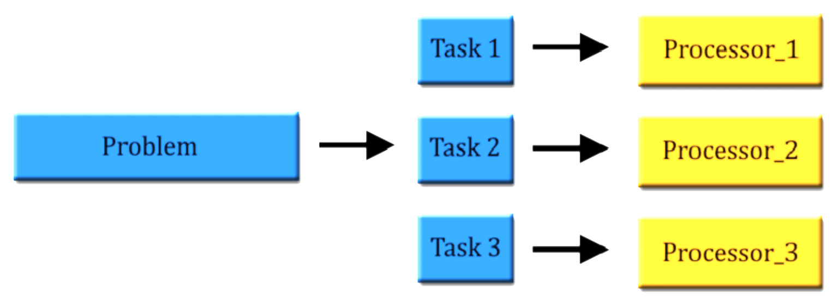
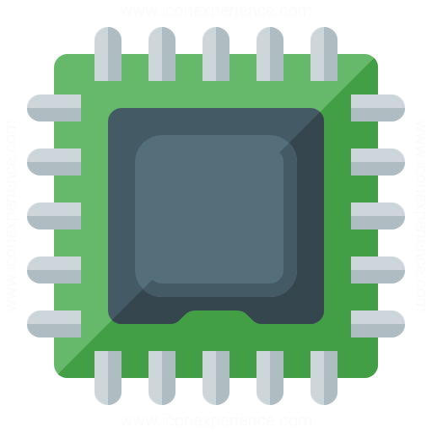
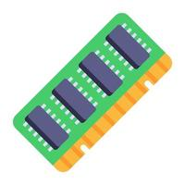



Software
Hardware

Slide 4
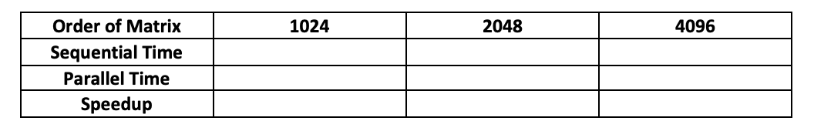
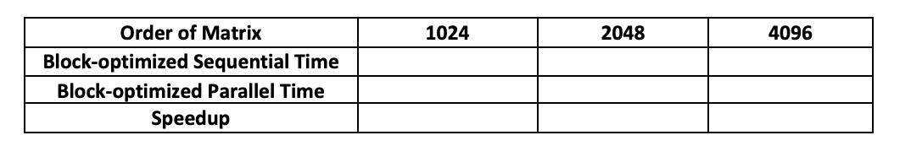
What is the impact of matrix size?
How much does OpenMP improve?
How much does block-opt improve on top of OpenMP?
How much does block-opt improve sequential code?

