Slide 1
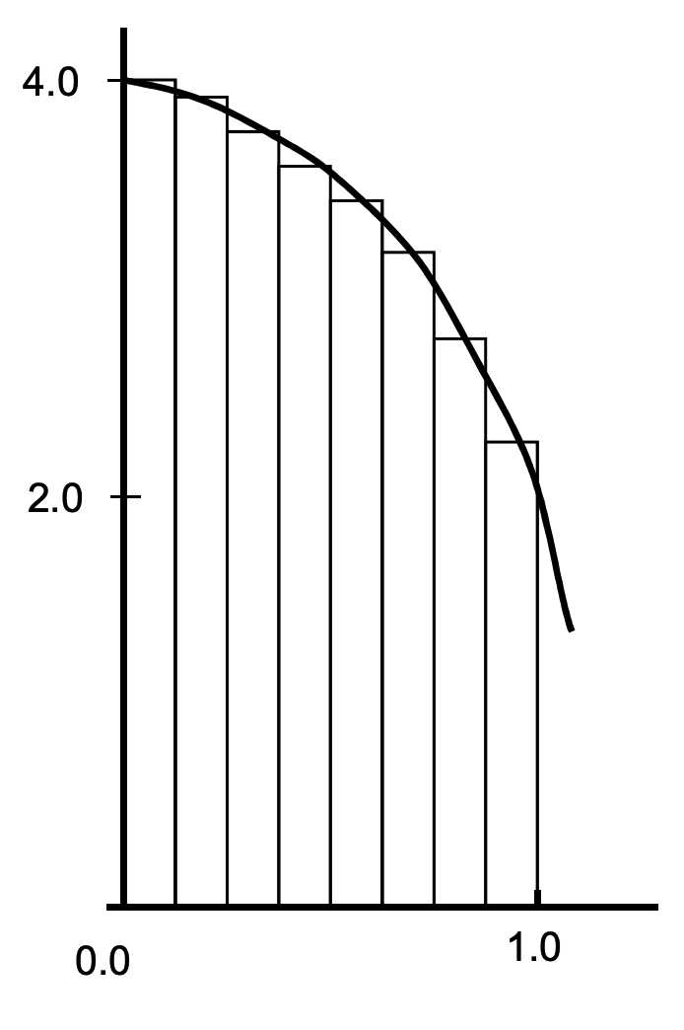
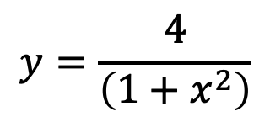
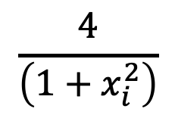

$$y=\frac{4}{\left(1+x^{2}\right)}$$
$$\frac{4}{\left(1+x_{i}^{2}\right)}$$
$$Δx$$

