Slide 1
CS5070 Mathematical Structures for Computer Science
Counting
Kun Suo
Department of Computer Science College of Computing and Software Engineering
Kennesaw State University
ksuo@kennesaw.edu

Slide 2
Counting (Chapter 1)
Counting Introduction
Consider this rather simple counting problem: there are 14 varieties of donuts, and 16 types of hot dogs. If you want either a donut or a dog, how many options do you have? This isn’t too hard, just add 14 and 16.
Additive Principle
The additive principle states that if event A can occur in m ways, and event B can occur in n disjoint ways, then |A ∪ B| is m + n.
Disjoint Events
Consider that events A and B be disjoint: i.e., that there is no way for event A and event B to both happen at the same time. Thus, A ∩ B = ∅

Slide 3
More on Counting
Multiplicative Principle
The multiplicative principle states that if event A can occur in m ways, and each possibility for A allows for exactly n ways for event B, then the event ‘A and B‘ can occur in m · n ways. Events A and B occur independently.
The College of Computing offers in the fall semester 7 sections of Programming I and 9 sections of Lab Programming I. Students can take any combination of a section of the lecture class and a section of the lab section. How many different ways can a student register these?
Answer: 7 x 9.

Slide 4
Counting with Sets
Using Sets
Instead of event A and event B, we use set A and a set B. The sets will contain all the different ways the event can happen.
Additive Principle with Sets
Given two sets A and B, if A ∩ B = ∅, that is, if there is no element common to both A and B, then
|A ∪ B| = |A| + |B|

Slide 5
Multiplicative Principle with Sets
The set Cartesian product of sets A and B is defined by:
A × B = {(a, b) : a ∈ A ∧ b ∈ B}
This is the set of all ordered pairs (a, b) such that elements a are in set A
and elements b are in set B. Example of a Cartesian product:
{1, 2} × {3, 4, 5} = {(1, 3), (1, 4), (1, 5), (2, 3), (2, 4), (2, 5)}

Slide 6
Cartesian Product Counting (2)
A × B = {
(a₁, b₁), | (a₁, b₂), | (a₁, b₃), . . . (a₁, b_{n}),
(a₂, b₁), | (a₂, b₂), | (a₂, b₃), . . . (a₂, b_{n}),
(a₃, b₁), | (a₃, b₂), | (a₃, b₃), . . . (a₃, b_{n}),
.
(a_{m}, b₁), | (a_{m}, b₂), | (a_{m}, b₃), . . . (a_{m}, b_{n})
.
There are m rows and n columns, for a total of m x n pairs

Slide 7
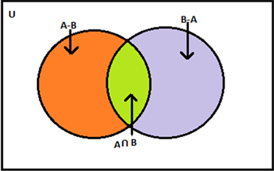
Multiplicative Principle with Sets
We can consider that A × B is really the union of m disjoint sets. Each of those sets has n elements. The total is n + n + n + · · · + n = m · n.
The Multiplicative Principle Given two sets A and B,
|A × B| = |A| · |B|
This can be extended to any number of sets
The cardinality of a union of two sets A and B, is:
|A ∪ B| = |A| + |B| − |A ∩ B|

Slide 8
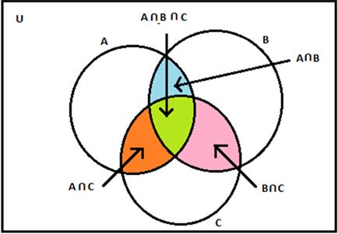
Cardinality of a Union of 3 Sets
For any finite sets A, B, and C ,
|A ∪ B ∪ C | = |A| + |B| + |C | − |A ∩ B| − |A ∩ C | − |B ∩ C | + |A ∩ B ∩ C |
This process is called the Principle of Inclusion/Exclusion (PIE) Example 1.1.8
Subject A B C AB AC BC ABC Failed 12 5 8 2 6 3 1
f =
How many students failed at least one subject?
|A| = 12, |B| = 5, |C | = 8, |A ∩ B| = 2, |A ∩ C | = 6, |B ∩ C | = 3, and
|A ∩ B ∩ C | = 1
|A ∪ B ∪ C | = 15

Slide 9
Subsets
The powerset of a set is a set of all subsets of a set For set A = {a, b, c}, the powerset of A is:
P(A) = {{}, {a}, {b}, {c}, {a, b}, {a, c}, {b, c}, {a, b, c}}
The number of elements in set A is k = |A| and the value is 3. The number of subsets of set A is n = 2^{k} , and this value is 8.
How many subsets of A have two elements? We know that 3 subsets have cardinality 2.

Slide 10
Decomposition Principle
Many larger problems are solved by partitioning a large problem into smaller problems (sub-problems)
Each sub-problem is solved independently of other sub-problems
The solution of the all sub-problems is combined to get the final result of the original problem. In general, the additive principle is applied in this step.

Slide 11
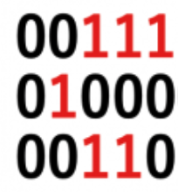
Bit Strings
An n-bit string is a bit string of length n
The weight of a bit string is the number of 1’s in it
B^{n} is the set of all n-bit strings
B^{n} is the set of all n-bit strings of weight k
k
The elements of of the set B³ are the strings 011, 101, and 110.
2
How many strings have length 5? The answer is 2⁵, which is 32.
How many of those have weight 3? Answer is 10
|B⁵| = |B⁴| + |B⁴|
3 2 3
|B⁴| = |B³| + |B³| and |B⁴| = |B³| + |B³|
2 1 2 3 2 3
With A = {1, 2, 3, 4, 5}, the number of 3-element subsets of A is the same as counting the number of 5-bit strings of weight 3.

Slide 12
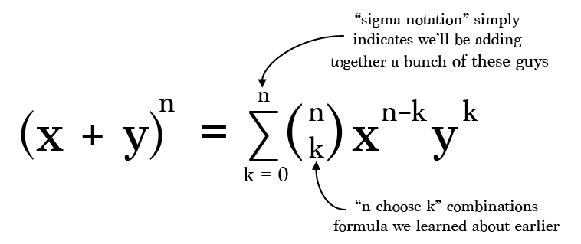
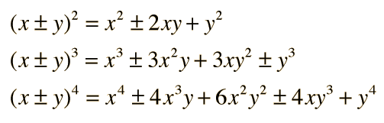
Binomial Coefficients
For each integer n ≥ 0 and integer k with 0 ≤ k ≤ n
n
k
n
n
= |B |, the number of n-bit strings of weight k
k
k
n
is the number of subsets of a set of size n each with cardinality k
k
n
k n−k n
is the coefficient x y in the expansion of (x + y )
k
n
is the number of ways to select k objects from a total of n objects
k

Slide 13
Applying Binomial Coefficients
How many subsets of {1, 2, 3, 4, 5} contain exactly 3 elements?
Answer:
5
3
How many bit strings have length 5 and weight 3? Answer:
5
3
Recurrence Relation for
n
k
|B^{n} | = |B^{n−1} | + |B^{n−1}|
k k−1 k
n n − 1
n − 1
=
+
k
k − 1
k

Slide 14
Permutations
A permutation is a (possible) ordered arrangement of objects. For example, there are 6 permutations of the letters a, b, c:
abc, acb, bac, bca, cab, cba
This problem determines how many ordered arrangements of distinct objects can be counted.
The permutation of n elements is:
n! = n · (n − 1) · (n − 2) · · · 2 · 1
How many permutations exist of k objects choosing those objects from a larger collection of n objects? This is denoted P(n, k) also called k-permutation of n elements with 1 ≤ k ≤ n
n!
P(n, k) =
= n(n − 1)(n − 2) · · · (n − (k − 1))
(n − k)!

Slide 15
Combinations
Combinations count the unordered selections of objects.
Combinations are the number of ways k items can be grouped from a total of n items: C (n, k)
n
n! (n − k)!k!
n(n − 1)(n − 2) · · · (n − (k − 1))
k(k − 1)(k − 2) · · · 1
C (n, k) =
=
=
k
Example. How many possible different teams of three students can be formed in a class section of 27 students?
27 27!
27 · 26 · 25 17, 550
3 · 2 · 1 6
= =
=
= 2, 925
3 3!24!
To count permutations, use P(n, k)
To count combinations, use C (n, k) or
n
k

Slide 16
Counting with Repetitions
The selections of objects allow repeated objects
Permutations with repetitions can be computed using the multiplicative principle
The number of k−permutations of a set of n objects with repetitions is computed by n^{k}
How many words of length 5 can be constructed with 26 upper case letters? Solution is 26⁵

Slide 17
Combinations with Repetitions
Combinations with repetitions can be computed using the expression of the binomial coefficient
The number of k−combinations from a set of n objects with repetitions is computed by:
C (n + k − 1, k) = C (n + k − 1, n − 1)
A tray has four different types of cookies. How many ways can six cookies be selected?
C (9, 6) = C (9, 3) = 84

