Slide 1
CS5070 Mathematical Structures for Computer Science
Formal Language
Kun Suo
Department of Computer Science College of Computing and Software Engineering
Kennesaw State University
ksuo@kennesaw.edu

Slide 2
How This Lecture Connects to Previous Topics
Previous Topics | Application in Programming Languages
Logic & Proofs | Program correctness, assertions, axiomatic semantics
Sets | Languages as sets of valid strings
Relations & Functions | Semantic mappings, variable lookup, denotational semantics
Sequences & Recursion | Recursive grammar rules and derivations
Induction | Loop invariants and correctness proofs
Graphs & Trees | Parse trees and syntax trees
Counting | Number of possible strings and grammar structures

Slide 3
Syntax vs. Semantics
Syntax
Form / structure of expressions, statements, and programs
Semantics
Meaning of expressions, statements, and programs
Example:
whether a = b + const is written correctly.
Example:
what happens after a = b + 1 executes.
Correct structure?
Meaning as effect

Slide 4
Language description terminology
Term | Meaning | Example
Sentence | A string of characters in a language | x = sum * 3;
Language | A set of valid sentences | All valid Python programs, all valid Java statements
Lexeme | Lowest-level unit, such as sum, *, begin | sum, *, begin, x, 100
Token | Category of lexemes, such as identifier, operator | sum → identifier; * → operator; 100 → integer literal
Recognizer | Determines whether a string belongs to a language | A compiler/parser checks whether x = 3 + 5; is valid syntax
Generator | Produces valid sentences of a language | A grammar rule generates valid expressions like x + y or a * b

Slide 5
Recognizers and generators
Recognizer
Reads an input string.
Answers: belongs to the language or not.
Compiler parser is a recognizer.
Generator
Produces valid sentences.
Grammar rules generate structure.
Useful for defining syntax.
Example:
input: a = b + const
output: valid?
Example:
<stmt> → <var> = <expr>
produces: a = b + const

Slide 6
BNF and Context-Free Grammars
BNF(Backus-Naur Form) is a notation for describing programming language syntax.
BNF is equivalent to context-free grammars.
A grammar is a finite, non-empty set of rules.
Rules have:
non-terminals, such as <expr>
terminals, such as +, if, identifier
a start symbol
Example:
<expr> → <term> + <term> | <term>
<term> → <var> | const

Slide 7
Derivations
A derivation is a repeated application of rules, starting with the start symbol and ending with a sentence (all terminal symbols)
<program> → <stmts>
<stmts> → <stmt> | <stmt> ; <stmts>
<stmt> → <var> = <expr>
<var> → a | b | c | d
<expr> → <term> + <term> | <term> - <term>
<term> → <var> | const
Grammar
<program>
⇒ <stmts>
⇒ <stmt>
⇒ <var> = <expr>
⇒ a = <expr>
⇒ a = <term> + <term>
⇒ a = <var> + <term>
⇒ a = b + const
Derivation

Slide 8
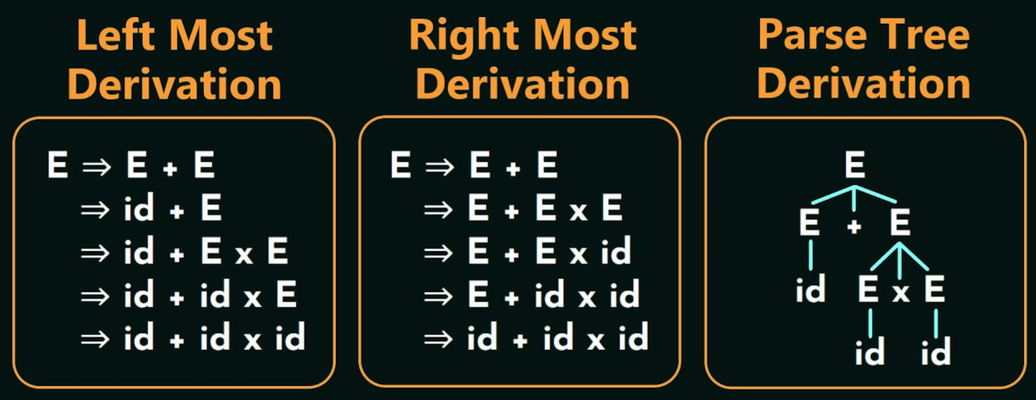
Derivations
A leftmost derivation is one in which the leftmost nonterminal in each sentential form is the one that is expanded
A derivation may be neither leftmost nor rightmost
A parse tree shows the hierarchical structure of a derivation.

Slide 9
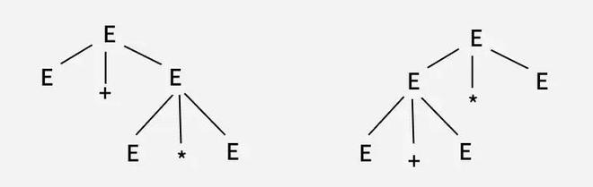
Ambiguity in Grammars
A grammar is ambiguous if and only if it generates a sentential form that has two or more distinct parse trees
Grammar: E-> E + E | E*E | id, We can create two parse tree from this grammar to obtain a string
id + id * id

Slide 10
Real-world example: Ambiguous if-then-else
<if_stmt> → if (<logic_expr>) <stmt>
| if (<logic_expr>) <stmt> else <stmt>
if (A)
if (B) S1
else S2
Question: does else belong to the inner if or outer if?
Most languages attach else to the nearest unmatched if.

Slide 11
Removing Ambiguity in Grammars
Grammar: E-> E + E | E*E | id
Idea: put higher-precedence operations lower in the grammar.
Separate the grammar into precedence levels:
E → E + T | T (low)
T → T * F | F (higher)
F → id
* has higher precedence than +

Slide 12
Extended BNF
Extended BNF (EBNF) is a more convenient version (shorter, cleaner, easier to understand) of BNF for writing grammar rules
EBNF Symbol | Meaning
[ ] | optional
(a | b) | choice
{ } | repetition, zero or more times
BNF describes syntax using rules like:
EBNF can write:
<expr> → <expr> + <term> | <term>
<term> → <term> * <factor> | <factor>
<expr> → <term> {(+ | -) <term>}
<term> → <factor> {(* | /) <factor>}
Notes:
square brackets 方括号
curly brackets 花括号

Slide 13
Why CFGs are not enough
Context-free grammars describe structure well.
But they cannot express every programming language rule cleanly.
Some rules require information about context, types, and declarations.
Static semantics:
Rules that are not easily captured by CFGs but should be checked before running the program.
x = y + 1
Questions CFGs do not answer:
Examples:
Was x declared?
Is y numeric?
Is the assignment type-correct?
Variables declared before use
Compatible operand types
Function arguments match parameters
Return type is correct

Slide 14
Attribute grammars
Attribute grammars extend CFGs by attaching information to grammar symbols.
Grammar symbols can carry attributes such as type, value, or scope.
Rules compute attributes and predicates check consistency.
Useful for type checking in compilers.
predicate:
type(left) = type(right)
<var>.actual_type
lookup(id)
Notes:
属性语法

Slide 15
Three approaches to semantics
Type | Main Idea | Focus | Best use
Operational semantics | Meaning is described by execution | How does it run? | teaching, manuals
Denotational semantics | Meaning is described by mathematical functions | What does it mean? | rigor, language design
Axiomatic semantics | Meaning is described by logic assertions | Why is it correct? | program correctness proofs
Same program, three ways to define what it means.

Slide 16
Operational Semantics
[Main idea] Operational semantics explains meaning by the state changes caused by execution.
It’s like writing an "operating manual" for the program.
Very intuitive; Good for teaching and language manuals.
Program state before
Statement
Program state after
x = 3
y = 5
x = x + y
x = 8
y = 5

Slide 17
Denotational Semantics
[Main idea] It does not concern itself with how the program executes, but only with the mathematical object the program ultimately represents.
Represent program state as values of variables.
Define expressions and statements as functions over states.
Very rigorous, but often heavy for language users.
mathematically heavy, so only introduce the idea briefly:
A variable lookup function returns the current value of a variable.
state s = {<x, 3>, <y, 5>}
VARMAP(x, s) = 3
M_expr(x + y, s) = 8

Slide 18
Axiomatic Semantics
Axiomatic semantics uses logic to reason about program correctness.
[Main idea] prove the program satisfies its specification.
{P} statement {Q}
Examples:
{ b > 0 }
a = b + 1
{ a > 1 }
P = precondition
Q = postcondition
Notes:
公理语义学

Slide 19
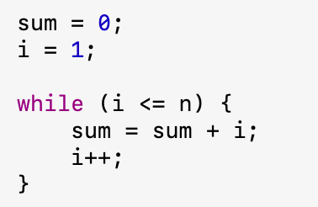
Loop Invariants
→ 1 + 2 + ... + n ?
A loop invariant is a condition that remains true:
before the loop starts
after each iteration
when the loop ends
This is useful for proving loop correctness.
Loop invariant: sum contains the total of processed elements.
while (i < n) {
sum = sum + A[i];
i = i + 1;
}
Loop invariant: After k iterations, sum = 1 + 2 + ... + k
sum = 0
for i = 1 to n:
sum = sum + i
Notes:
循环不变量

Slide 20
Summary
Concept | Main purpose or idea
BNF / CFG | Formal tools for describing syntax
Derivation / parse tree | How grammar rules generate structure
Ambiguity | Multiple parse trees; must be avoided
EBNF | Compact grammar notation
Static semantics | Type/declaration rules beyond CFG
Semantics | Operational, denotational, and axiomatic views of meaning
Formal syntax tells us what programs look like;
Formal semantics tells us what programs mean.

