Slide 1
CS5070 Mathematical Structures for Computer Science
- Notes 2
Kun Suo
Department of Computer Science College of Computing and Software Engineering
Kennesaw State University
ksuo@kennesaw.edu

Slide 2
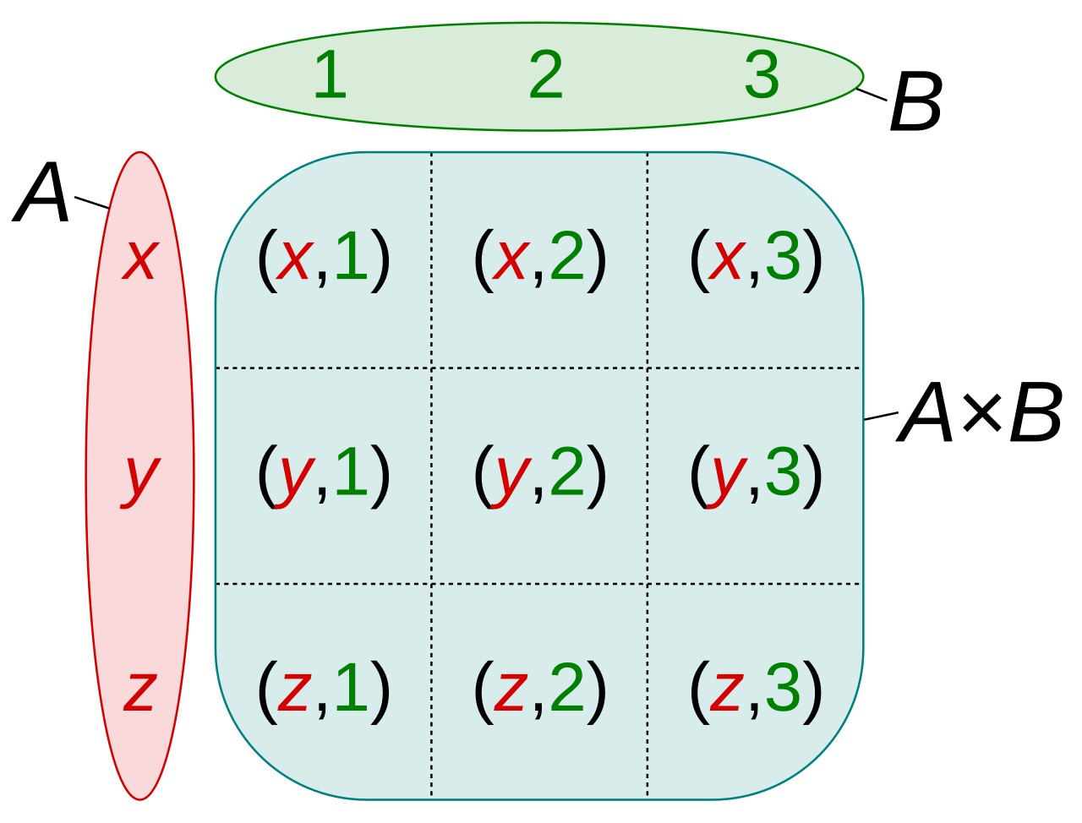
Cartesian Product
Given sets A and B, the following set operation is defined:
A × B = {(x, y ) : x ∈ A ∧ y ∈ B}
The Cartesian product of A and B is the set of all ordered pairs (x, y ) where x is an element of A and y is an element of B.
Let A = {a₁, a₂, a₃, . . . , a_{m}} and B = {b₁, b₂, b₃, . . . , b_{n}}
A × B = {
(a₁, b₁), | (a₁, b₂), | (a₁, b₃), . . . (a₁, b_{n}),
(a₂, b₁), | (a₂, b₂), | (a₂, b₃), . . . (a₂, b_{n}),
(a₃, b₁), | (a₃, b₂), | (a₃, b₃), . . . (a₃, b_{n}),
.
(a_{m}, b₁), | (a_{m}, b₂), | (a_{m}, b₃), . . . (a_{m}, b_{n})
}
.
Notes:
笛卡尔积

Slide 3
More on Cartesian Product
Notice what has been done in the Cartesian product: there are m
rows of n pairs, for a total of m · n pairs.
Each row above is really {a_{i} } × B for some a_{i} ∈ A
A × B = ({a₁} × B) ∪ ({a₂} × B) ∪ ({a₃} × B) ∪ . . . ∪ ({a_{m}} × B)
So A × B is really the union of m disjoint sets. Each of those sets has
n elements in them. The total (using the additive principle) is
n + n + n + · · · + n = m · n
To summarize, given two sets A and B,
|A × B| = |A| · |B|

Slide 4
Relations
Relations may exist between objects of the same set or between objects of two or more sets. A binary relation R from set U to V is a subset of the Cartesian product U × B
An n-ary relation on sets A₁, A₂, . . . , A_{n} is a subset of
A₁ × A₂, × . . . × A_{n}.
A binary relation R can be denoted as (x, y ) ∈ R and by xRy
A binary relation ‘<‘ can be represented by listing the pairs of elements as in {(0, 1), (0, 2), (1, 2)} or as a rule,
xRy, such that x, y ∈ {0, 1, 2}

Slide 5
Example of Relations
Given a Cartesian product:
{1, 3} × {2, 4} = {(1, 2), (1, 4), (3, 2), (3, 4)}
The ordered pair (3, 2) is a member of the cross product, and is denoted:
(3, 2) ∈ {1, 3} × {2, 4}
The ordered pair (3, 2) can also be expressed as: 3 → 2

Slide 6
Other Concepts of Relations
A relation F between between X and Y is a subset of the Cartesian product X × Y , and is denoted F ⊆ X × Y
The type of all relations between elements from X and Y is denoted
X ↔ Y
X ↔ Y ≡ P(X, Y )
Examples of common mathematical relations are:
<, >, ≤, ≥, =, /=, ⊂, ⊆
The domain of a relation R is:
dom (R) = {a ∈ A | (a, b) ∈ R for some b ∈ B}
The range of a relation R is:
range (R) = {b ∈ B | (a, b) ∈ R for some a ∈ A}

Slide 7
Functions
A function is a mapping or relation from an input to exactly one output. The set of all inputs for a function is known as the domain of the function. The set of all allowable outputs is known as the codomain. A function f is defined by:
f : X → Y
Set X is the domain and set Y is the codomain. For example,
f : N → N, f (x ) = x ³ + 3
In this example the domain and the codomain is the set of natural numbers. The set of output values is known as the image. The set of natural numbers that are actual output is known as the range of the function.

Slide 8
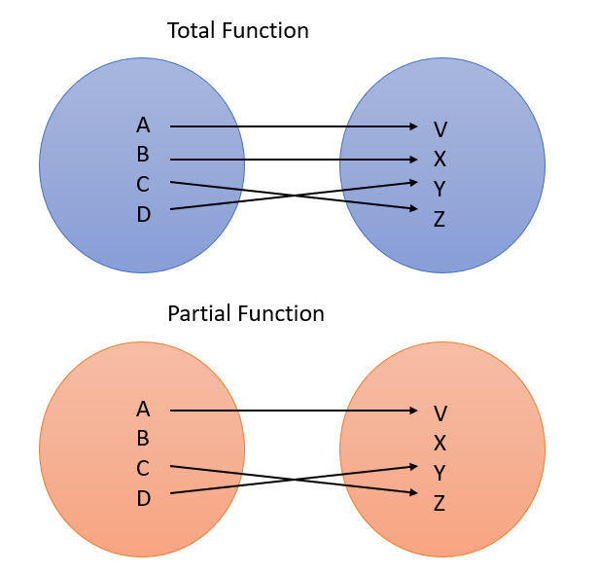
More on Functions
x
2
f : N → N, f (x ) =
f : N → N, f (x ) = x ³ + 3
If a function does not have an output value for a given input value the function is known as a partial function
A function that is not a partial function is known as a total function

Slide 9
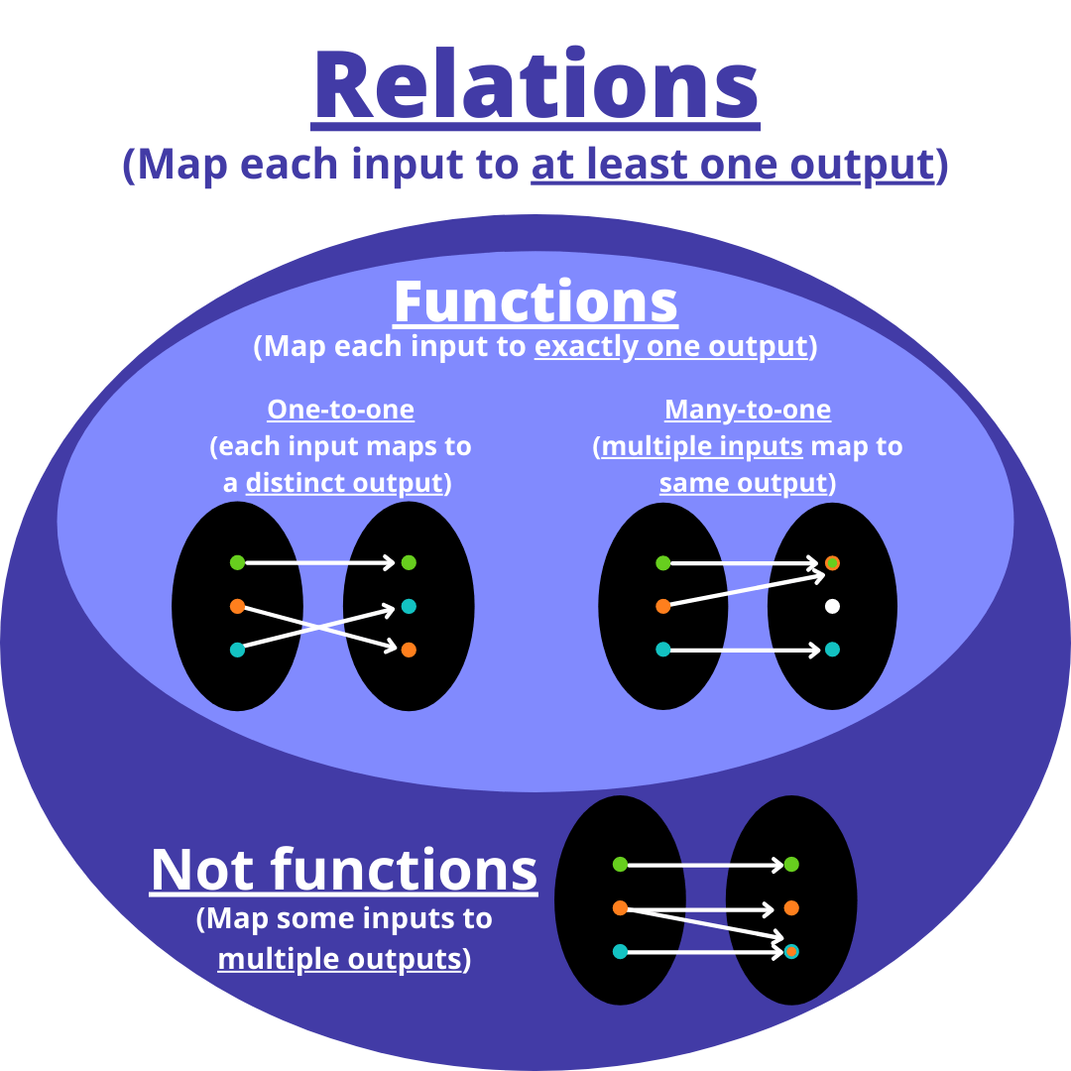
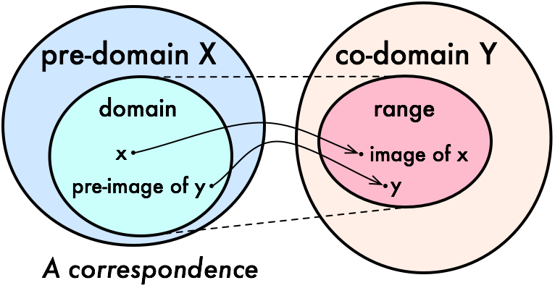
More on Functions
A function is a special type of relation. This implies that all functions are relations, however, not all relations are functions.
Function f is a relation on X and Y such that for each x ∈ X , there exists a unique y ∈ Y such that (x, y ) ∈ R. x is called pre-image and y is called image of function f .
A function can be one to one or many to one but not one to many.

Slide 10
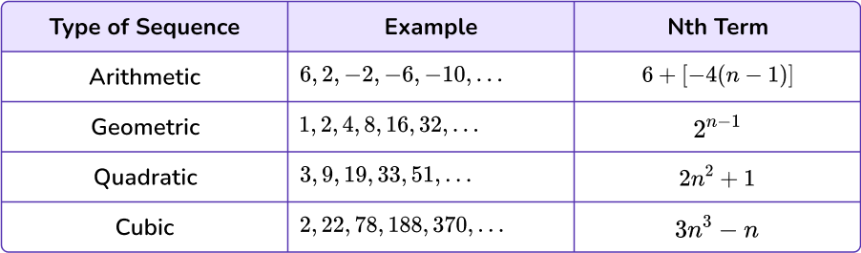
Functions as Tables
A function can be described as a table. The first row includes all the input values, the second row includes all the corresponding values of the function output
For example:
x 0 1 2 3 4
f (x ) 3 3 2 4 1
Using an explicit formula to calculate the image of any element in the domain is a great way to describe a function, and are known as closed formulas.

Slide 11
Defining Functions Recursively
For a function f : N → N, a recursive definition consists of:
1
an initial condition, which is the explicitly given value f (0)
a recurrence relation, which is a formula for f (n + 1) in terms of f (n) (and possibly n)
2
For example, derive the recursive definition of the following function:
h : N → N defined by f (n) = n! and 0! = 1. Recall that
n! = 1 · 2 · 3 · · · (n − 1) · n is the product of all numbers from 1 through n. The recursive definition of the function is:
f (0) = 1, f (n + 1) = (n + 1) · f (n)
or
f (0) = 1, f (n) = f (n − 1) · n

Slide 12
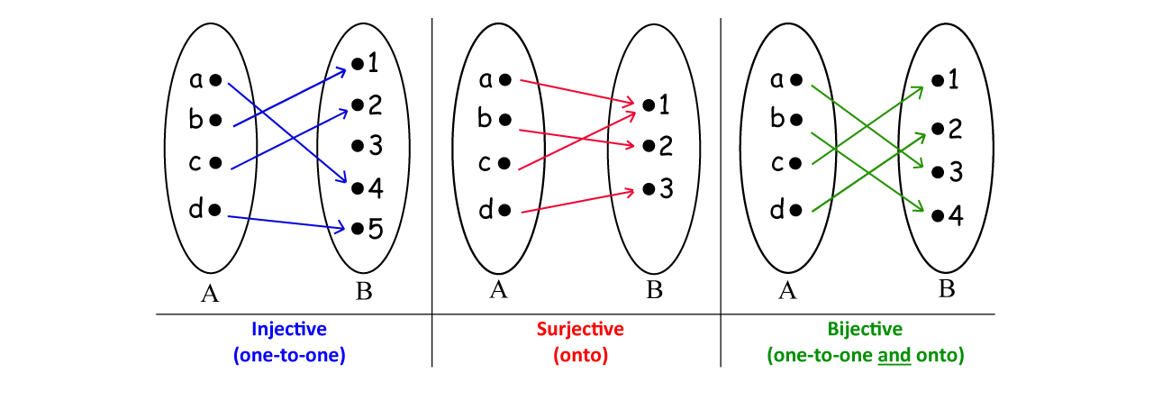
Additional Properties of Functions
A function is onto when all elements in the codomain are in the range, the function is also known as a surjective function
∀y ∈ B ∃x ∈ A f (x ) = y
A function f : A → B is surjective if the image of f equals its range.
Equivalently, for every b ∈ B, there exists some a ∈ A such that
f (a) = b. This means that for any y in B, there exists some value x
such that y = f (x )
For example: f : Z → Z, f (n) = 3n is not surjective because there are elements of the codomain that are not in the range.

Slide 13
Injective Function
When each element of the codomain is the image of at most one element of the domain, the function is one-to-one, or injective.
A function f : A → B is injective or one-to-one if and only if
f (x ) = f (y ) implies x = y for every x, y in the domain of f
Function f is injective if and only if for all x, y ∈ A, if f (x ) = f (y ) the x = y
For example:
f : N → N, f (x ) = 5x is injective
f : N → N, f (x ) = x ² is injective
f : R → R, f (x ) = x ² is not injective as (−x )² = x ²

Slide 14
Bijective Functions
There are functions that surjective but not injective, injective but not surjective, both, or neither
A function is bijective when it is both injective and surjective.

Slide 15
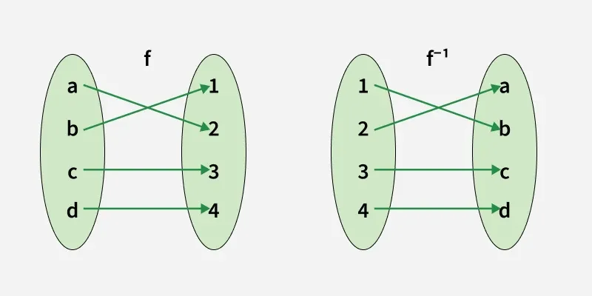
Inverse Image
Starting with some element of the codomain (say y), indicate which element or elements (if any) from the domain it is the image of.
Which elements of the domain get mapped to a particular set in the codomain?
Let f : X → Y be a function and suppose B ⊆ Y . The inverse image of B under f , denoted by f ⁻¹(B), is the set of elements in X whose image are elements in B.
f ⁻¹(B) = {x ∈ X : f (x ) ∈ B}

Slide 16
Image and Inverse Image
For a function f : X → Y , suppose A ⊆ X , the image of A under f
is denoted:
f (A) = {f (a) ∈ Y : a ∈ A}
Which elements of the domain get mapped to a particular set of codomain? For a function f : X → Y , suppose B ⊆ Y , the inverse image of B under f is denoted:
f ⁻¹(B) = {x ∈ X : f (x ) ∈ B}
B
A

Slide 17
Image and Inverse Image
The elements whose image is a particular element y of the codomain. The set of all elements in the domain that f sends to y , is denoted:
f ⁻¹({y }) It is also denoted: f inf(y ) for convenience, instead of
f ⁻¹({y })
If y is not in the range, then f ⁻¹({y }) = ∅
f might send multiple elements to y (if f is not injective),

Slide 18
Example of Image and Inverse Image
f ⁻¹(y ) is known as the complete inverse image of y under f . It is the set of all elements in the domain that are assigned to y by the function
Example:
For the function f : {1, 2, 3, 4, 5, 6} → {a, b, c, d } and
1 2 3 4 5 6
f =
a a b b b c
Find (a) f ({1, 2, 3}), (b) f inf({a, b}), and (c) f ⁻¹(d )

Slide 19
Solution
1
Sol a. f ({1, 2, 3}) = {a, b} because a and b are the elements in the codomain to which f sends 1 and 2.
2
Sol b. f inf({a, b}) = {1, 2, 3, 4, 5} because these are exactly the elements that f sends to a and b
3
Sol c. f inf(d ) = ∅ because d is not in the range of f

Slide 20
More examples
1
See Example 0.4.9 on page 49
2
See Example 0.4.10 on page 49

