Slide 1
CS5070 Mathematical Structures for Computer Science
- Graph
Kun Suo
Department of Computer Science College of Computing and Software Engineering
Kennesaw State University
ksuo@kennesaw.edu

Slide 2
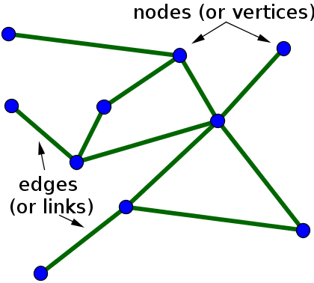
Graphs (Chapter 4)
Graphs are constructed of a collection of dots known as vertices and lines known as edges
Two vertices connected by an edge is said to be adjacent vertices A graph is an abstraction of a real situation
A graph is an ordered pair G = (V , E ) of two sets :
V is the set of vertices
E is the set of edges. Set E is a set of 2-element subsets of V

Slide 3
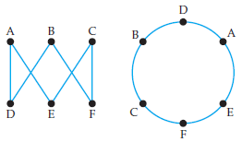
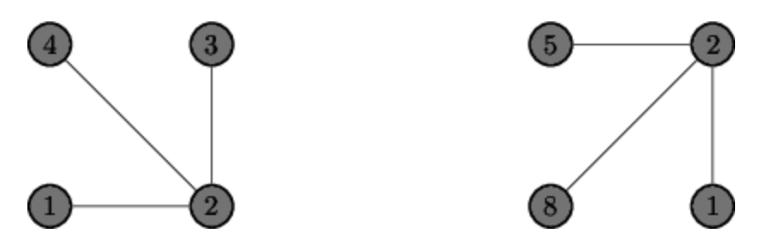
Graphs (Chapter 4)
Equivalent
Not equivalent
Example of a graph:
V = {a, b, c, d, e}
E = {{a, b}, {a, c}, {a, d }, {a, e}, {b, c}, {d, e}}
See Example 4.1.2 page 235
Two (or more) graphs are equal if the set of vertices and the set of edges are the same

Slide 4
Isomorphic Graphs
Two or more graphs are isomorphic if the are not be equal but may be the same except for the names of the vertices
An isomorphism between two graphs G₁ and G₂ is a bijection
f : V₁ ⇒ V₂ between vertices of the graphs such that {a, b} is an edge in G₁ if and only if {f (a), f (b)} is an edge in G₂
Two graphs are isomorphic if there is an isomorphism between them, and denoted G1 ∼= G2
An isomorphism is a function that renames the vertices See Example 4.1.3 on page 236
A collection of isomorphic graphs is often known as an isomorphism class

Slide 5
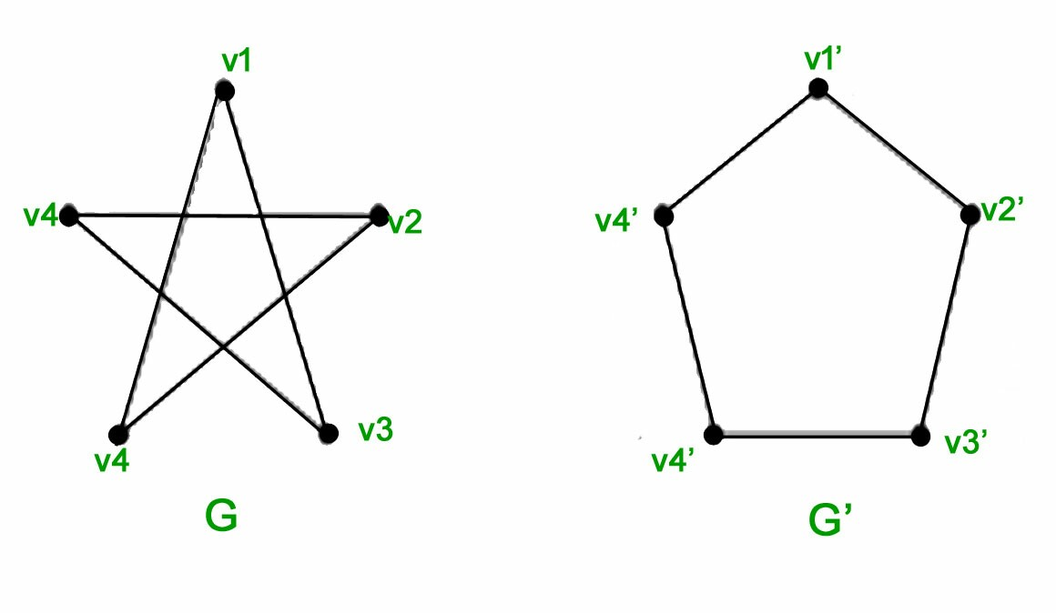
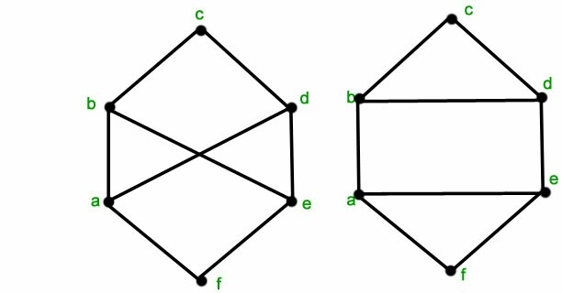
Isomorphic Graphs
isomorphic
Not isomorphic

Slide 6
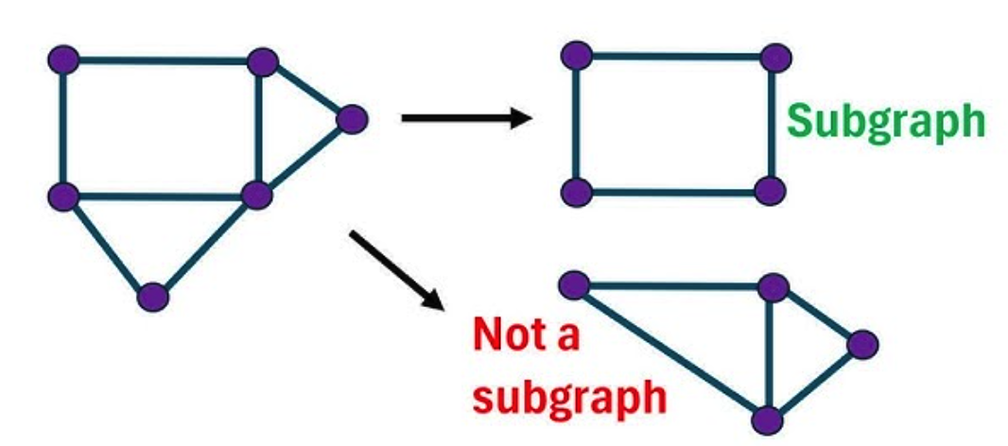
Subgraphs
Graph G ^{r} = (V ^{r}, E ^{r}) is a subgraph of G = (V , E ), denoted by
G ^{r} ⊆ G , provided V ^{r} ⊆ V and E ^{r} ⊆ E
G ^{r} = (V ^{r}, E ^{r}) is an induced subgraph of G = (V , E ) provided
V ^{r} ⊆ V and every edge in E whose vertices are still in V ^{r} is also an edge in E ^{r}
Every induced subgraph is also an ordinary subgraph, but not conversely
See Example 4.1.4

Slide 7
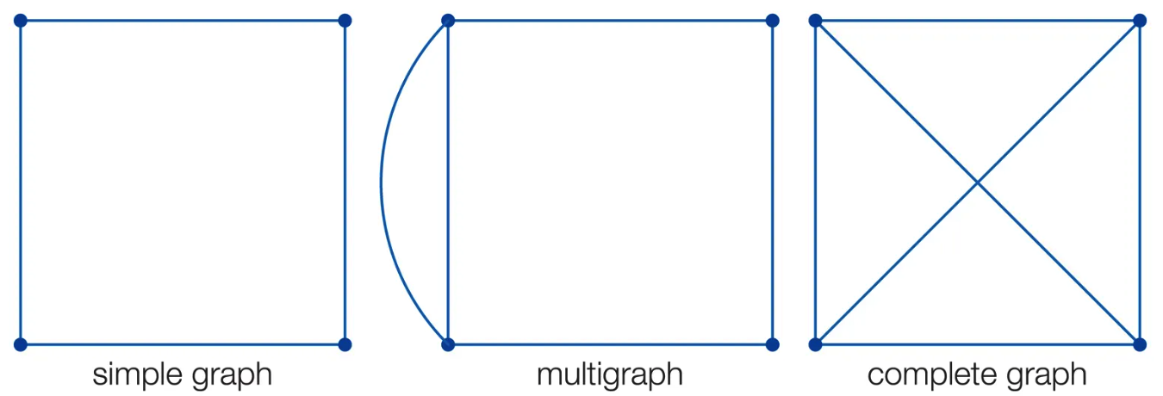
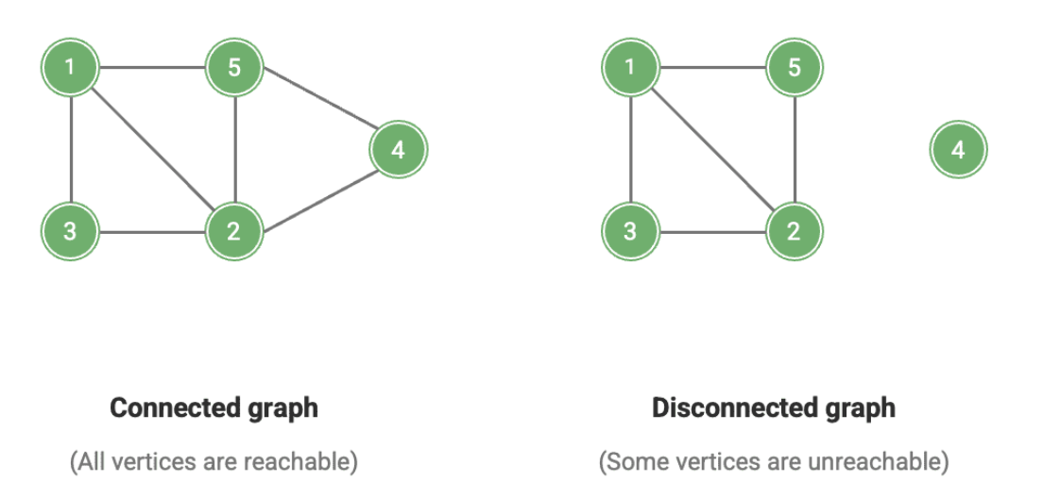
More Complex Graphs
When including two more edges connecting a pair of vertices, the graph is known as a multigraph
A graph is connected if we can get from any vertex to any other vertex by following some path of edges
A graph is complete if it has an edge between every pair of vertices, all possible edges

Slide 8
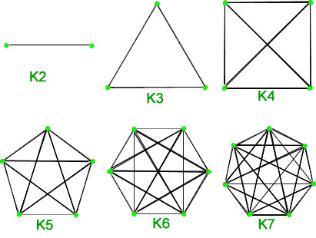
More Complex Graphs
There is only one complete graph with a given number of vertices. Denoted by K_{n} the complete graph on n vertices

Slide 9
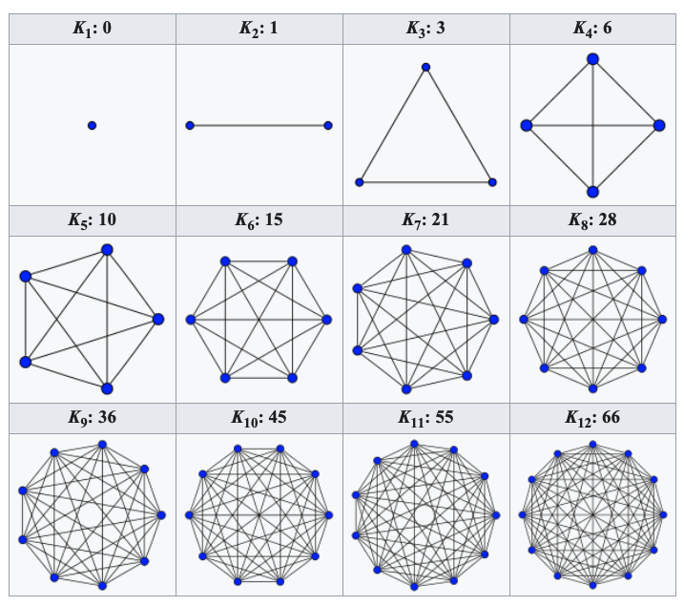
Complete Graphs
Each vertex in K_{n} is adjacent to n − 1 other vertices. The degree of the vertex is the number of edges emanating from the vertex
n
There are n(n − 1)/2 edges in K or edges
n
2

Slide 10
Complete Graphs
The sum of the degrees of all vertices will always be twice the number of edges, since each edge adds to the degree of two vertices. This implies that the sum of the degrees of all vertices in any graph must be even
The last bullet is the Handshake Lemma (see page 240)
^{Σ} d (v ) = 2e
v ∈V
To find the number of edges in a graph, we need the degree sequence for the graph. This is a list of every degree of every vertex in the graph, generally in non-increasing order. See Example 4.1.6 on page 240

Slide 11
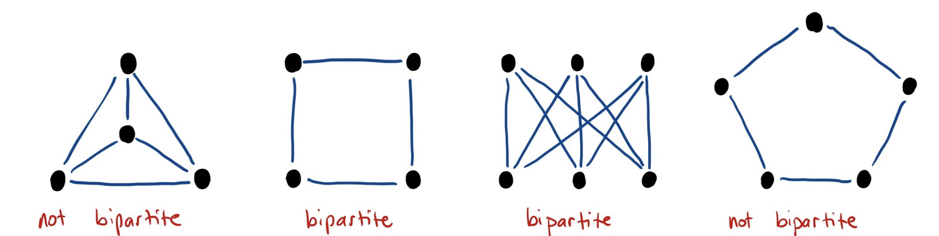
Odd Degree
Proposition 4.1.8. In any graph, the number of vertices with odd degree must be even
A graph is bipartite if the vertices can be divided into two sets, A and B, with no two vertices in A adjacent and no two vertices in B adjacent
If each vertex in A is adjacent to all the vertices in B, then the graph is a complete bipartite graph, known as K_{m,n}, where |A| = m and
|B| = n
complete

Slide 12
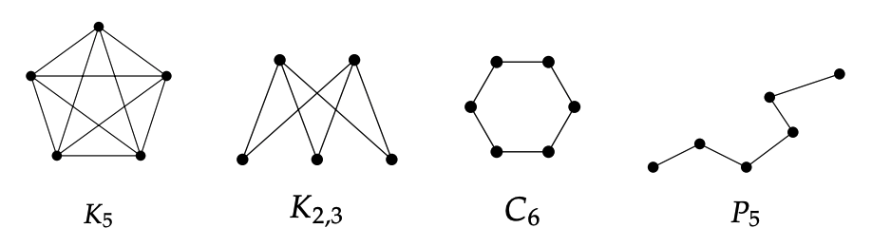
Named Graphs
K_{n} is a complete graph on n vertices
K_{m,n} is a complete bipartite graph with sets of m and n vertices
C_{n} is the cycle on n vertices, just one big loop
P_{n} is the path on n + 1 vertices (n edges), just one long path See graph examples on page 241

Slide 13
Graph Theory Definitions
Graph. A collection of vertices, some of which are connected by edges. It consists a pair of sets V and E where V is a set of vertices and E is a set of 2-element subsets of V .
Adjacent. Two vertices are adjacent if they are connected by an edge. Two edges are adjacent if they share a vertex.
Bipartite Graph. A graph for which it is possible to divide the vertices into two disjoint sets such that there are no edges between any two vertices in the same set.
Complete Bipartite Graph. A bipartite graph for which every vertex in the first set is adjacent to every vertex in the second set.
Complete Graph. A graph in which every pair of vertices is adjacent
Connected Graph. There is a path from any vertex to any other vertex

Slide 14
More Definitions
Chromatic Number. The minimum number of colors required in a proper vertex coloring of the graph
Cycle. A path that starts and stops at the same vertex, but contains no other repeated vertices
Degree of a Vertex. The number of edges incident to a vertex
Euler Path. A walk that uses each edge exactly once
Euler Circuit An Euler path that starts and stops at the same vertex
Multigraph. A graph that can contain multiple edges between two vertices as well as single edge loops (an edge to itself)
Path. A walk that doesn’t repeat any vertices (or edges) except perhaps the first and last. If a path starts and ends at the same vertex, it is known as a cycle
Planar. A graph that can be drawn (in the plane) without any edges crossing

Slide 15
More Definitions 2
Subgraph. H is a subgraph of G if every vertex and edge of H is also a vertex or edge of G .
Induced Subgraph. H is an induced subgraph of G if every vertex of H is a vertex of G and each pair of vertices in H are adjacent in H if and only if they are adjacent in G
Tree. A connected graph with no cycles. If we remove the requirement that the graph is connected, the graph becomes a forest. The vertices in a tree with degree 1 are known as leaves
Vertex Coloring. An assignment of colors to each of the vertices of a graph. A vertex coloring is proper if adjacent vertices are always colored differently
Walk. A sequence of vertices such that consecutive vertices are adjacent. A walk in which no edge is repeated is known as a bf trail, and a trail in which no vertex is repeated is known as a path

Slide 16
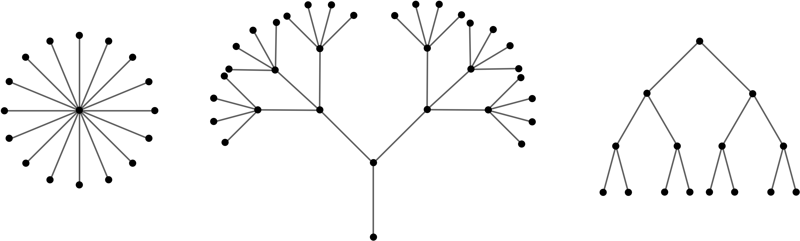
Properties of Trees
A tree is a connected graph containing no cycles. A forest is a graph containing no cycles
Proposition 4.2.1. A graph T is a tree if and only if between every pair of distinct vertices of T there is a unique path
Corollary 4.2.2. A graph F is a forest if and only if between any pair of vertices in F there is at most on path

Slide 17
Properties of Trees
Proposition 4.2.3. Any tree with at least two vertices has at least two vertices of degree one
Proposition 4.2.4. Let T be a tree with v vertices and e edges. Then e = v − 1

Slide 18
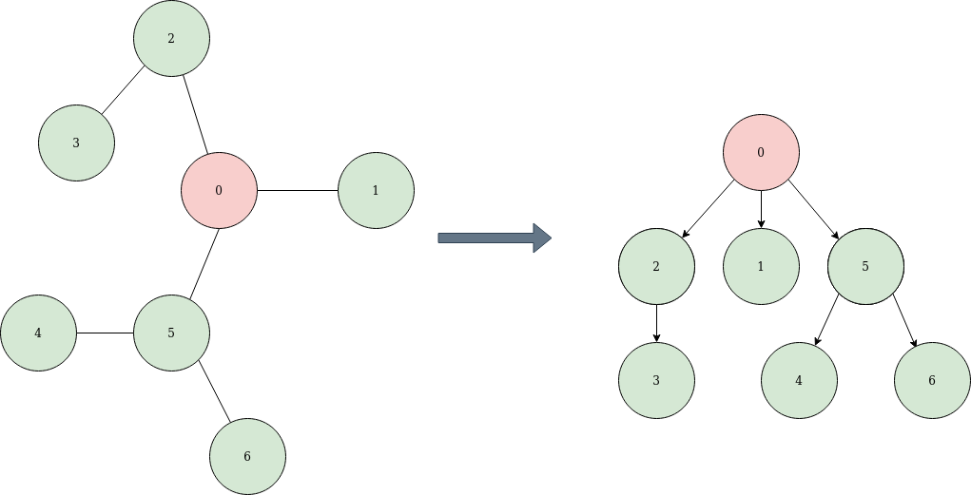
Rooted Trees
One vertex of the tree is designated as the root, and every other vertex on the tree can be characterized by its position relative to the root
From any vertex, we can travel back to the root in exactly one way. This also allows us to describe how distinct vertices in a rooted tree are related
If two vertices are adjacent, then one of them is the parent of the other, which is known as the child of the parent
The parent is the vertex closer to the root. The root of a tree is a parent, but is not the child of any vertex. All non-root vertices have exactly one parent

Slide 19
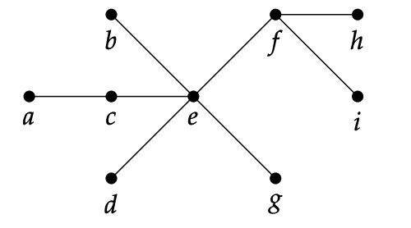
More on Rooted Trees
A vertex v is a descendant of a vertex u provided u is a vertex on the path from v to the root
In this case, vertex u is an ancestor of vertex v
When there are pairs of vertices neither of which is a descendant of the other, they are known as siblings
Vertices u and v are siblings provided they have the same parent. Note that these vertices are never adjacent
See Example 4.2.5

Slide 20
Navigating a Tree
To navigate through a tree is traversing a tree, starting at the root and visiting each vertex in some order
When all visiting vertices in the same generation before any vertices of the next generation is known as breath first search
Depth first search is visiting one child of the root, then visit a child of that vertex, then visit its child. When you get to a vertex with no children, retreat to its parent and see if the parent has any other children.
The parent is the vertex closer to the root. The root of a tree is a parent, but is not the child of any vertex. All non-root vertices have exactly one parent

Slide 21
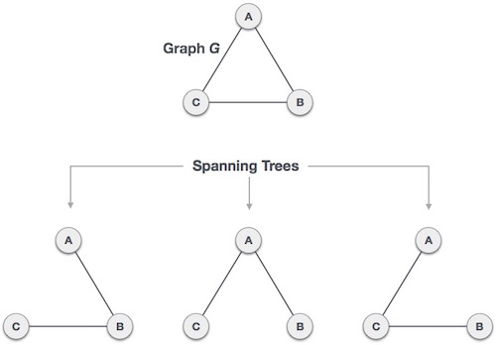
Spanning Trees
If a connected graph is not a tree, then we can still use the traversal algorithms if we identify a subgraph that is a tree
We can take a single edge of connected graph G , we need to visit all vertices, such a tree is known as a spanning tree. Every connected graph has a spanning tree
Spanning Tree. Given a connected graph G , a spanning tree of G is a subgraph of G hat is a tree and includes all vertices of G

Slide 22
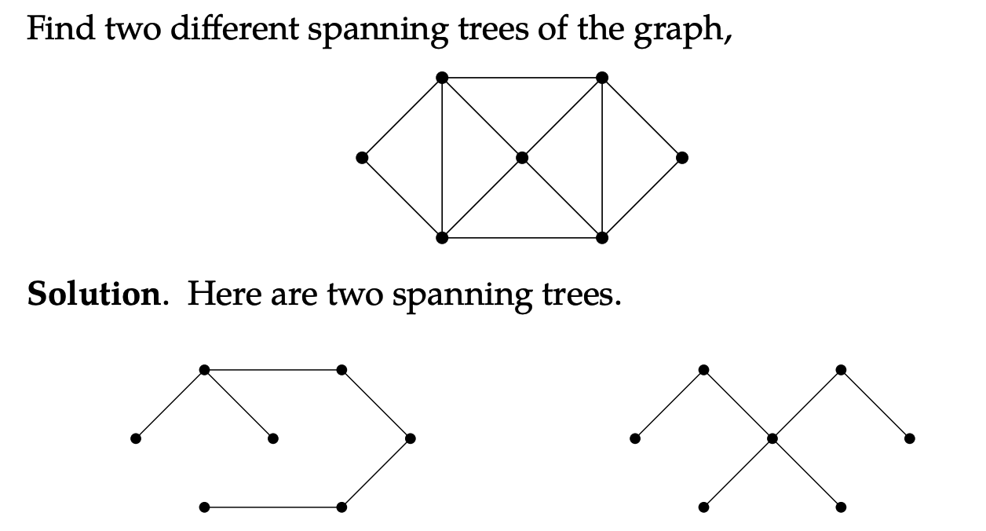
Spanning Trees Algorithm
We can define an an algorithm for finding a spanning tree.
Start with a connected graph G
If there is no cycle,then G is already a spenning tree
If there is a cycle, let e be any edge in that cycle and consider the new graph G₁ = G − e. This graph is still connected since e belonged to a cycle
Repeat: if G₁ has no cycles, we are done.
If there is a cycle, define G₂ = G₁ − e₁, where e₁ is an edge in G₁
Continue until a tree is found.
See Example 4.2.7

Slide 23
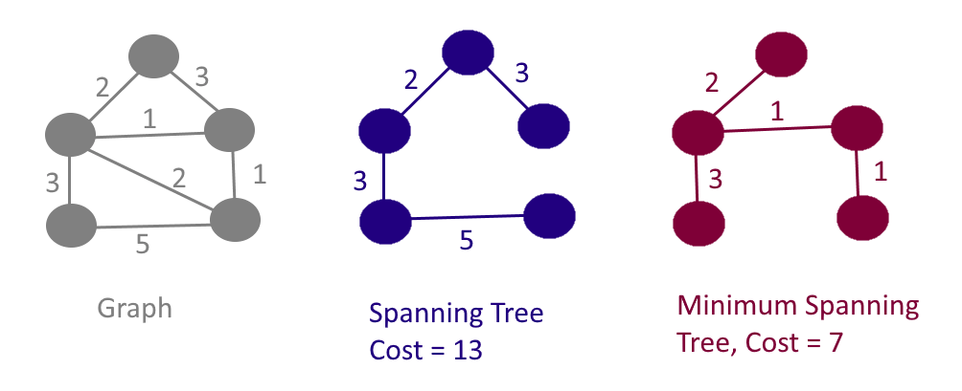
Spanning Trees Algorithm
In practice, these type of algorithms are applied to weighted graphs, which have values associated with each edge.
If the goal is to find a spanning tree with the smallest possible combined weight, the tree is a minimum spanning tree

Slide 24
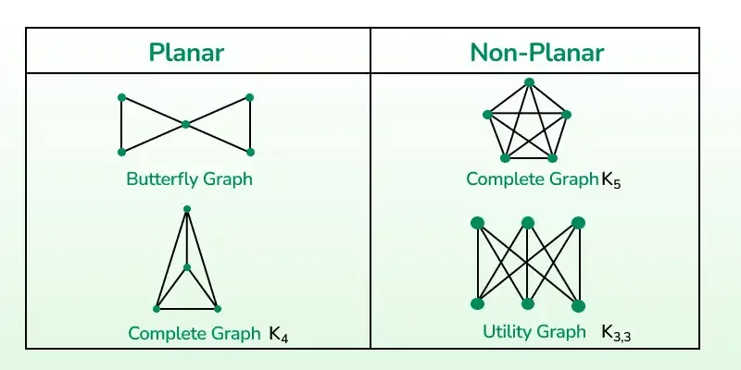
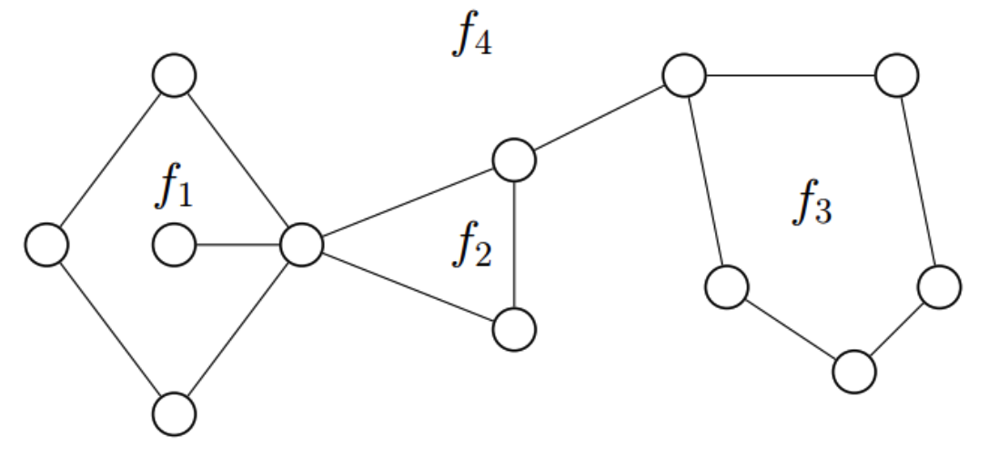
Planar Graphs
When a connected graph can be drawn without any edges crossing, the graph is known as planar
This planar graph divides the plane into regions known as faces
For any (connected) planar graph with v vertices, e edges, and f
faces:
v − e + f = 2
Not all graphs are planar. If there are too many edges and too feww vertices, then some edges will need to intersect

Slide 25
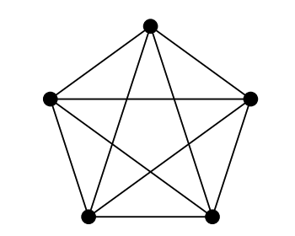
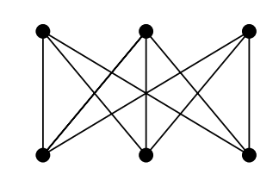
Planar Graphs
Theorem 4.3.1. K₅ is not planar. See proof in page 260
Theorem 4.3.2. K_{3,3} is not planar
In general, if g is the size of the smallest cycle in a graph, then for any planar graph g · f ≤ 2e

Slide 26
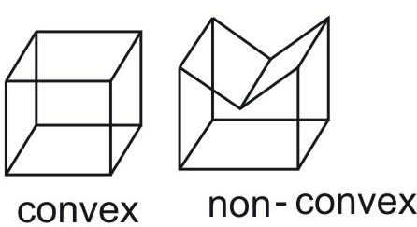
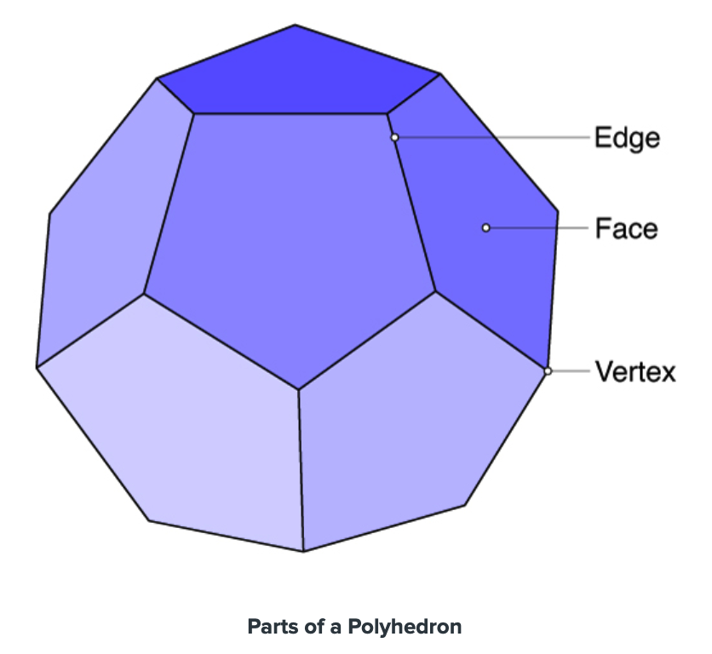
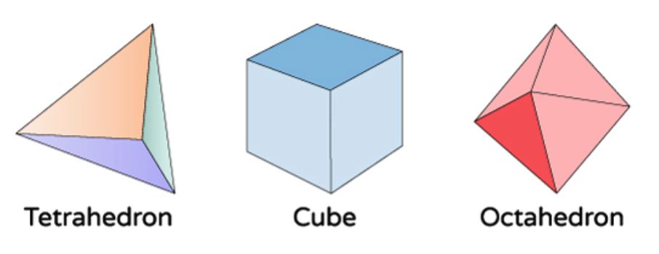
Polyhedra
A polyhedron is a geometric solid made up of flat polygonal faces joined at edges and vertices
A convex polyhedron is a geometric solid in which any line segment connecting two points on the interior of the polyhedron must be entirely contained inside the polyhedron
The cube is a regular polyhedron (also known as a Platonic solid) because each face is an identical regular polygon and each vertex joins an equal number of faces

Slide 27
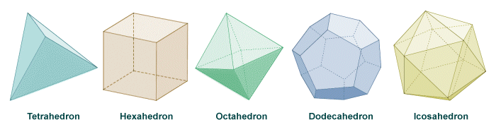
Polyhedra
There are exactly four other regular polyhedra: the tetrahedron, octahedron, dodecahedron, and icosahedron with 4, 8, 12, and 20 faces respectively
Every convex polyhedron can be projected onto the plane without edges crossing
Since every polyhedron can be represented as a planar graph, Euler’s formula for planar graphs holds for all convex polyhedra

Slide 28
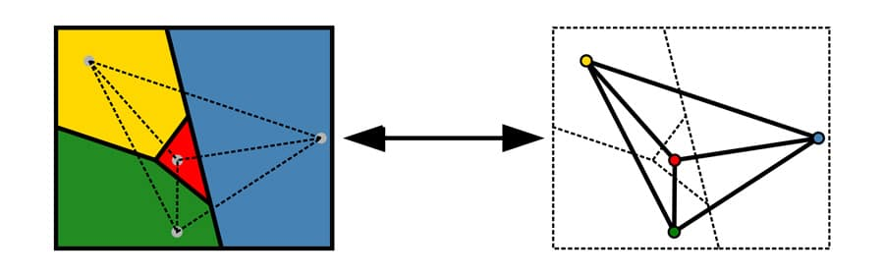
Coloring
If we place a vertex in the center of each region (of a map) and then connect two vertices if their states share a border, we get a graph
Coloring regions on the map corresponds to coloring the vertices of the graph
The graph cannot have vertices colored the same when these vertices are adjacent

Slide 29
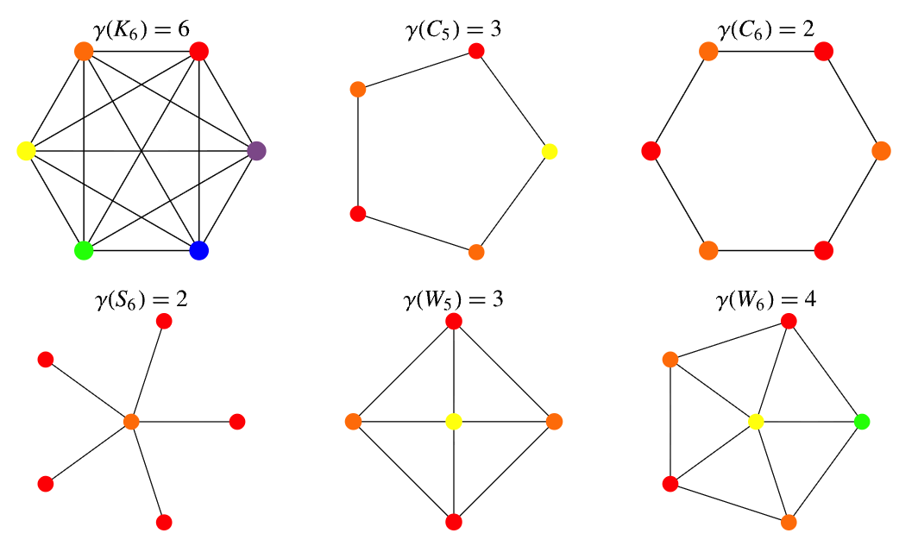
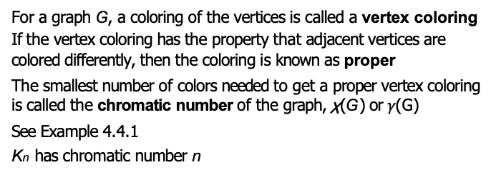
Coloring
For a graph G , a coloring of the vertices is called a vertex coloring
If the vertex coloring has the property that adjacent vertices are colored differently, then the coloring is known as proper
The smallest number of colors needed to get a proper vertex coloring is called the chromatic number of the graph, χ(G ) or $γ$(G)
See Example 4.4.1
K_{n} has chromatic number n

Slide 30
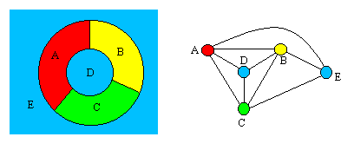
More on Coloring
Theorem 4.4.2 The Four Color Theorem. If G is a planar graph, then the chromatic number of G is less than or equal to 4. Thus any map can be properly colored with 4 or fewer colors
Coloring regions on the map corresponds to coloring the vertices of the graph
There are many applications of graph coloring. See Example 4.4.3 in page 270

Slide 31
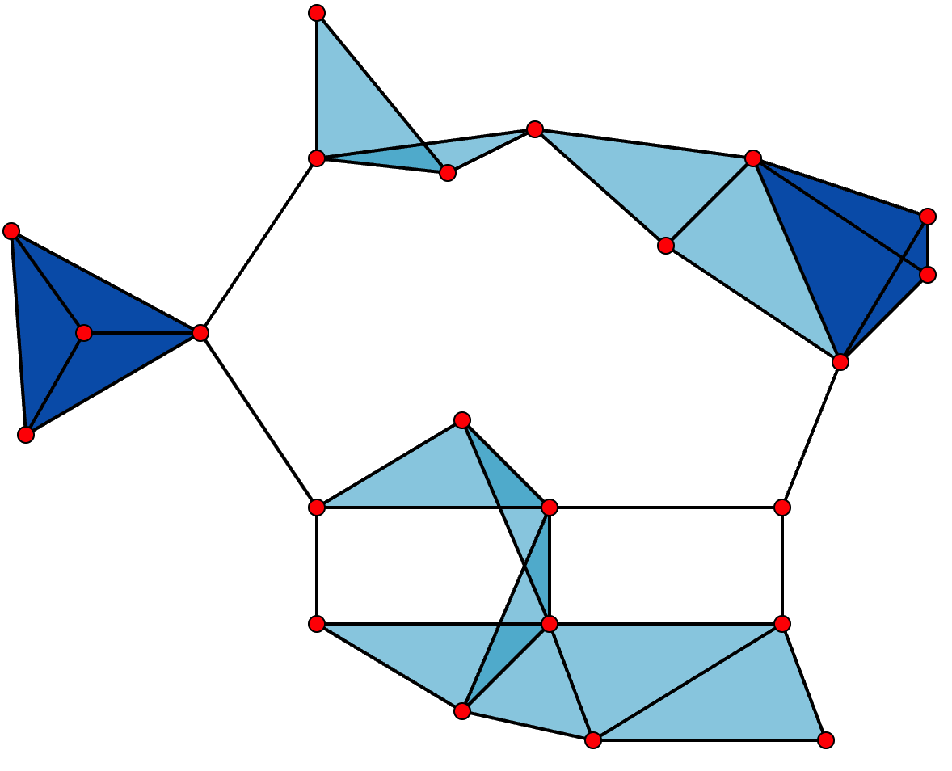
More on Coloring
A clique in a graph is a set of vertices all of which are pairwise adjacent. In other words, a clique of size n is just a copy of the complete graph K_{n}
The clique number of a graph is the largest n for which the graph contains a clique of size n

Slide 32
More on Coloring..
Any clique of size n cannot be colored with fewer than n colors, so this is a lower bound
Theorem 4.4.4 The chromatic number of a graph G is at least the clique number of G
When the chromatic number of G is equal to the clique number, the graph is known as perfect
Let ∆(G ) be the largest degree of any vertex in graph G .
Theorem 4.4.5 Brooks’ Theorem. Any graph G satisfies χ(G ) ≤ ∆(G ), unless G is a complete graph or an odd cycle, in which case χ(G ) = ∆(G ) + 1

Slide 33
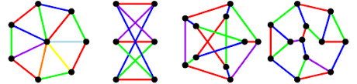
Coloring Edges
Two edges are adjacent if they are incident to the same vertex
The least number of colors required to properly color the edges of a graph G is called the chromatic index of G and written χ‘(G )
See Example 4.4.6
Theorem 4.4.7 Vizing’s Theorem. For any graph G , the chromatic index χ‘(G ) is either ∆(G ) or ∆(G ) + 1

Slide 34
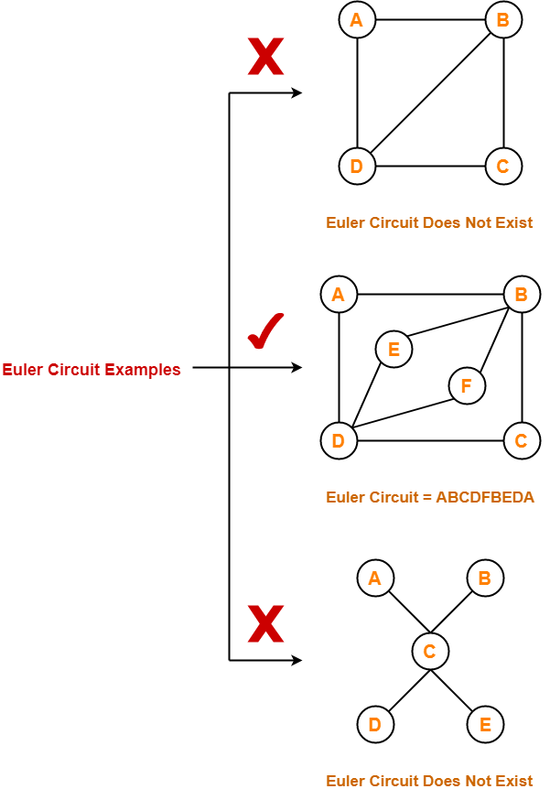
Euler Paths and Circuits
A walk in a graph is a sequence of vertices such that every vertex in the sequence is adjacent to the vertices before and after it in the sequence
An Euler path, in a graph or mutigraph, is a walk through the graph that uses every edge exactly once
An Euler circuit is an Euler path that starts and stops at the same vertex
Notes:
游走（walk）：就是允许重复经过某些顶点和边的“走法”。
迹（Trail）：边各不相同的游走。
路径（Path）：顶点各不相同的游走（不会重复经过同一个顶点）。

Slide 35
Euler Paths and Circuits
One way to guarantee that a graph does not have an Euler circuit is to include a spike, which is a vertex of degree 1
A graph has an Euler circuit if and only if the degree of every vertex is even
A graph has an Euler path if and only if there are at most two vertices with odd degree

Slide 36
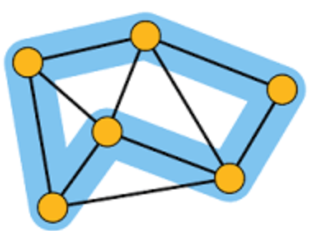
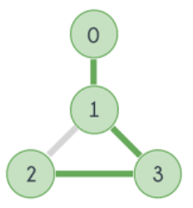
Hamilton Paths
If there is a path that visits every vertex exactly once, the path is known as a Hamilton path
A Hamilton cycle is a Hamilton path that starts and stops at the same vertex
Given a bipartite graph, a matching is a subset of the edges for which every vertex belongs to exactly one of the edges
Matching Condition. If a bipartite graph G = {A, B} with two sets of vertices A and B, has a matching of A, then
|N(S )| ≥ |S |, for all S ⊆ A
Define N(S ) to be the set of all the neighbors of vertices in S . That is N(S ) contains all vertices (in B) that are adjacent to at least one of the vertices in S
Hamilton path
Hamilton cycle

