Slide 1
EMC SourceOne Knowledge Transfer Version 6.6 SP1 Full Text Indexing Overview
Jerry Jourdain
Architect
01/24/2011

Slide 2
Agenda Section 1 - Current Status
Why are Customers Experiencing Index Corruptions?
Delayed Writes
Over-running network storage throughput due to buffered writes
SourceOne uses buffered writes in a variety of places
Index / message deletion transaction files
Content cache
Ancillary DB
Index creation / merge
Moving to non-buffered I/O will guarantee network data write integrity
Under-sized configurations
Run out of I/O capability in the kernel
Previously Recommended NAS to Solve Delayed Write
The potential for delayed writes still exists with NAS
We cannot require NAS as doing so puts us at a competitive disadvantage

Slide 3
Current Status Continued
Why are Customers Experiencing Missing Messages?
Data Driven Failures During Unpack
Unpack Crashes
ISYS Text Scrapping Hangs
Text Scrapping Crashes
Missing Data From Unpack Area During Indexing
Disk Full condition in Unpack Area
Stopping and Restarting during an Index Run
Incomplete Content Cache
Missing data during Unpack or Unpack Crashes
Index Mutex Lock Failures
Results in more than one Index Component working on the same index at the same time

Slide 4
Current Status Continued
Overall Index Performance Issues
Attempts to Reindex Large Number of Indexes
Over taxes the system producing long delays and Delayed Writes
Backs up Journaling and the Unpack Area
Introduces long operational delays
Indexing takes longer and longer as Indexes get larger
Indexing Components spending too much time waiting for Merge Locks
Large delays when attempting to shutdown indexing either for system reboot or suspension for backup

Slide 5
6.6 SP1 Highlights
Remove Indexing Over the Network
Copy Indexes to and from Index Shares to Local temporary directory
Perform all indexing locally
Single index merge for entire index run
Rebuild and Refresh entire Index locally
Eliminate Buffered I/O during Indexing
Buffered I/O has been removed from all these places
Index Merging which are now performed locally
Content Cache Updates
Ancillary Database Updates
Index Transaction Files Updates

Slide 6
6.6 SP1 Highlights - Continued
Throttle Number of Index Rebuilds/Refreshes
Don’t allow a single Index Server to schedule all rebuilds/refreshes
This allows many index rebuilds to be submitted at once and the system will self throttle
Change Index Run Submission Frequency from 10 mins to an Hour
In order to limit the number of index copies from the network as well as increase overall index performance, an hour worth of indexing is accumulated before indexing
Index Merging which are now performed locally
Content Cache Updates
Ancillary Database Updates
Index Transaction Files Updates

Slide 7
6.6 SP1 Highlights - Continued
Fault Tolerant to Missing Data
Missing data from the Unpack Area now fetches from container
Incomplete Content Cache no longer an error. Content Cache is rectified when necessary.
Several issues reworked to prevent missing data conditions
Index Transaction File Error Handling Improved
Case for unpack crash, text scraping hangs, etc are now automatically retried.
Better handling of un-indexable content
Ability to identify missing messages and un-indexable content through queries
Index Copies are Throttled on a per Index Share basis
Index Service/Index Component Shutdown Enhanced

Slide 8
6.6 SP1 Highlights - Continued
Indexing Performance Enhanced
Items are no longer decompressed over the network from the unpack area during indexing
This eliminates many small reads from the network.
Items are unpacked from memory objects as well. Failing over for items above 4MB in size
Index Merging Totally Reworked
Prior to 6.6SP1 an index merge took place every 3,000 document. Now only one merge per index run is performed.
Before Index merges took place over the network resulting in slower and slower merges as the index grew in size.
No more contention between Native Index Servers during merging.
As Indexing backs up the Actual Index Time per document goes down.
Index transaction files process up to 4 times faster

Slide 9
SourceOne Archiving Overview
Message Center Discussion
Comprised of two Major Components
Temporary Open Volume Storage
Separate Open Volumes for Each Month For Each Archive Folder
Control Files Transitioning Open Volumes Out to Permanent Storage
Unpack Area For Storing Msgs to Index
Compressed msgs for full text indexing
Full Text Index Transaction Files
Single or Multiple Message Centers
Archive Service Functions
Hosting Multiple RPC Connections
Writing Messages to MsgCenter
Writing Messages to UnpackArea and Updating Transaction Files
Renaming Full Text Index Transaction Files
Writing Containers Out to Permanent Storage
Retrieving Messages from MsgCenter and/or Container Files

Slide 10
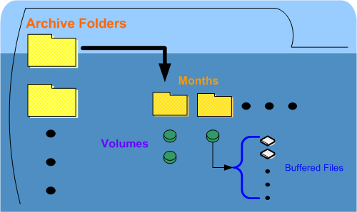
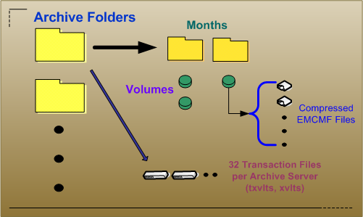
Message Center
MsgCenter
Unpack Area

Slide 11


Archive Service RPC Archival Thread
IExDoc
2
3
Buffered Files
1
MsgProps
RPC
Ancillary Props
Months
Volumes
4
Assign Msg To Volume
SQL
MsgCenter
Archive Folders
Compressed EMCMF Files
5
Index Transaction Files
6
UnpackArea

Slide 12
SourceOne Index Process Overview
Full Text Index Transaction Processing Discussion
Messages are not assigned to Full Text Indexes, Volumes are.
A single Volume cannot span more than one index
TXVLTS files are for immediate insertions, XVLTS are for Processing
An Index Server processes Transaction Files for Particular Archive Servers
Index Pooling
Defined as assigning more than one index Area to an Archive folder
Allows full text volume assignment to round robin across multiple index locations
Spanning indexes across physical locations provides distributed reads and writes
Full Text Index Component Processing
Five main functions for a Single Index Component(ExAsIdxObj.exe)
Index runs (xvlts)
Index Update runs (upds)
Index Rebuild (rebuild)
Index Refresh (refresh)
Message Deletion (delmsg)

Slide 13
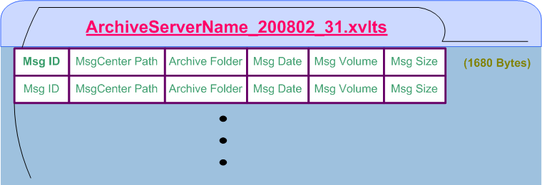
Index Transaction File
Transaction Files live in Unpack Area under an Archive Folder sub-directory
Each Archive Server produces 32 Transaction files, 0 through 31 per month
File Naming is ArchiveServer_YYYYMM_Sequence
Insertions happen into .txvlts files and processing happens from .xvlts

Slide 14


Unpack Area Transaction File Processing
Index Area(s)
32 Transaction Files per Archive Server Per Month
Folder_YYYYMM_025.txvlts
Drop Directory
F1
F1
F1
F1
F1
F1
F1
Archive Folder
F1
Archive Folder
F2
F1
Archive Folder
YearMonth
F3
SQL Folder Plan
YearMonth
YearMonth
Unpack Area
001
002
085
Indexes
Enumerate Transactions As new volumes are encountered assign them to full text indexes
001
002
085
Indexes
001
002
085
Indexes
Volumes
Volumes
Volumes

Slide 15


Assigning Volumes to Index Pool
Each New Volume is assigned to next Index Area in the Index Pool
Index Areas
Drop Directory
Volume
Index Transactions
F1
Volume
Drop Directory

Slide 16
Index Area DropDir Control Files
DropDir Control Files
Index runs (xvlts)
Index Update runs (upds)
Index Rebuild (rebuild)
Index Refresh (refresh)
Message Deletion (delmsg)
Index Areas
Folder_Month_IndexNum.Extension
Drop Directory
Folder1_200901_033.xvlts
Folder1_200812_025.upds
Folder3_200804_002.rebuild
Folder2_200805_001.refresh

Slide 17
Agenda Section 3
Launching ExAsIdxObj Components
Each Index Server polls Folder List in the SQL Folder Plan
For each folder traverse its index locations
For each index location check if this server is configured for it
Process index location DropDir
Launch ExAsIdxObj components
ExAsIdxObj Operation
Each instance runs against a single full text index
Each instance runs until completion and then terminates
Performs a large, constant amount of I/O to the Index Temporary Directory
Make sure this directory is eliminated from Virus Scanning Configuration
Performs a large index copies to and from index area
Number of simultaneous copies to and from a single index share is throttled

Slide 18
Discussion Topics and/or Questions?
- ES1LogViewer Enhancements
- ES1ObjectViewer
Support for viewing all index transaction files
Support for read Content Cache, Ancillary database and ISYS IXC files
- Index Share I/O Performance
- Virus Scan Directory Exclusions
- I/O performance considerations
Index share I/O footprint
Local Index Temp Directory
Inter-process local temporary directory throttling
Increased size requirements
Increased I/O requirements
Unpack Area I/O footprint
Questions?

Slide 19


