Slide 1


Pokemon Fight Simulator
Team: Elnara, Yunke, Kevin

Slide 2


Description of the game
“The original Pokémon is a role-playing game based around building a small team of monsters to battle other monsters in a quest to become the best.
Pokémon are divided into types, such as water and fire, each with different strengths. Battles between them can be likened to the simple hand game rock-paper-scissors.”

Slide 3

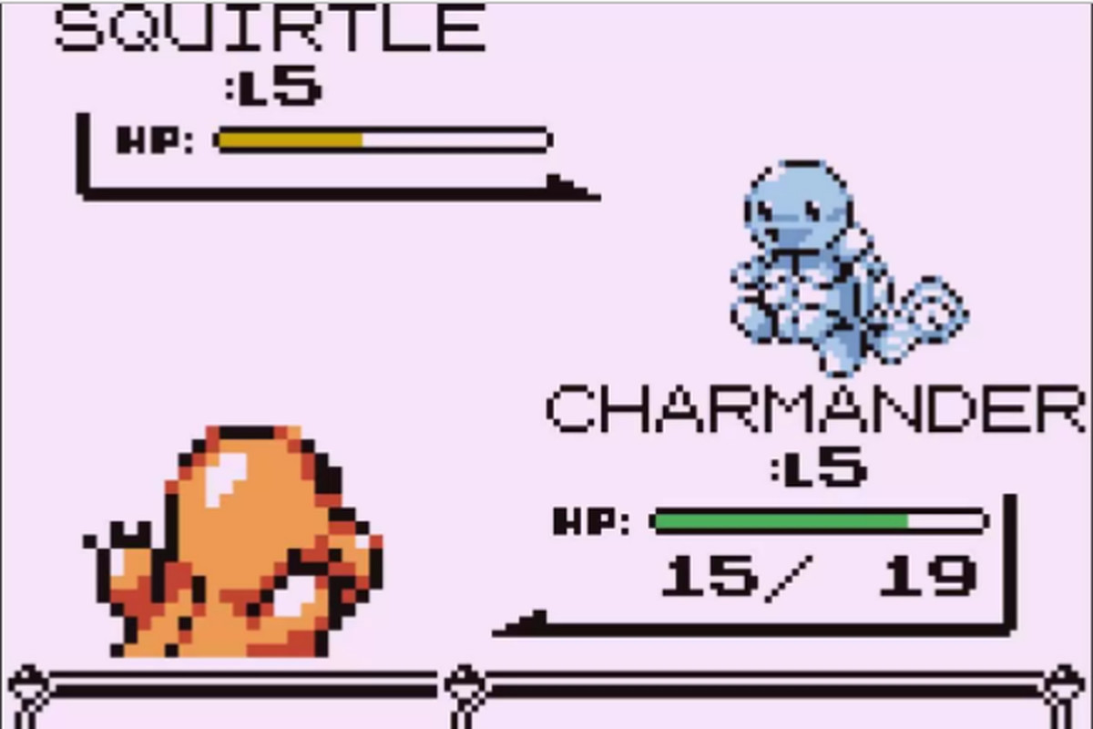
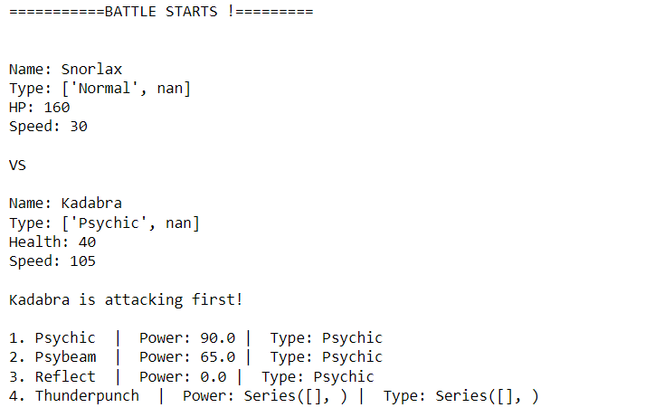
Challenges (1/2)
Expectation
Reality :D

Slide 4

Challenges (2/2)
Scope definition: struggling at the beginning because initial expectations were too high
Time and pressure management

Slide 5

Process
Start by setting up our working environment (GitHub)
Brainstorming and scoping
Start coding, went through challenges and re-scoping
Achieving a V1 version end of Friday
Re-iterating to achieve a V2 with more features

Slide 6

Highlights/Learnings
Set achievable expectations to deliver a V1 code even if it’s not perfect (consistent with what we have learnt) and be fine with it
Keep calm when blocked, go simple
Re-iterate once V1 is finished to add more features

Slide 7
DEMO Time thank you!

