Slide 1

Data Cleaning fake jobs dataset
Gabrielle
Kevin

Slide 2
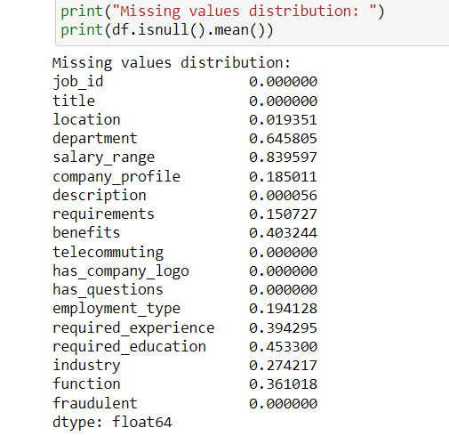

Description of our dataset

Slide 3
Main challenge: reduce #nan CELLS

Slide 4
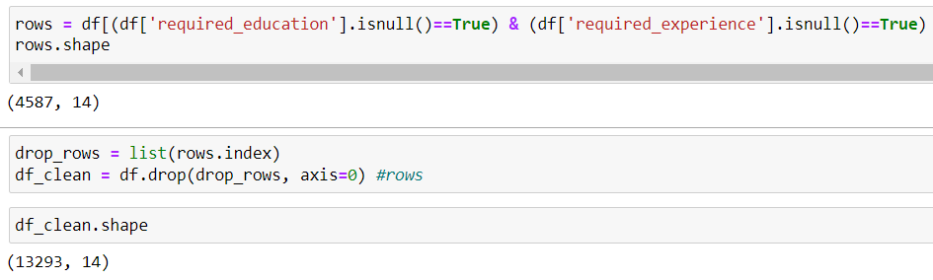
Step1: DROP columns and rows WITH HIGH %NAN values

Slide 5
Step2: DROP columns and rows WITH HIGH %NAN values

