Slide 1
Data Visualisation Project Hotels Bookings dataset Katerina & Kevin
P4

Slide 2
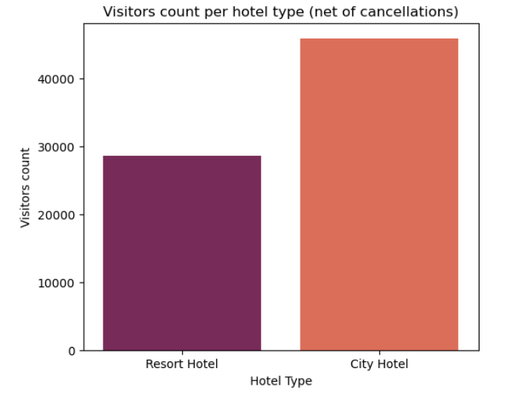
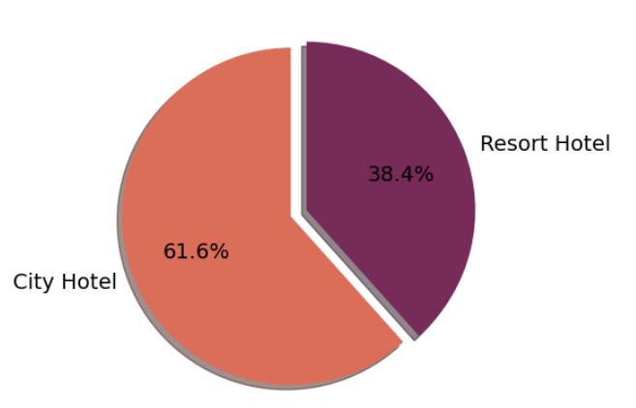
Insight 1: Resort vs City Hotel breakdown

Slide 3
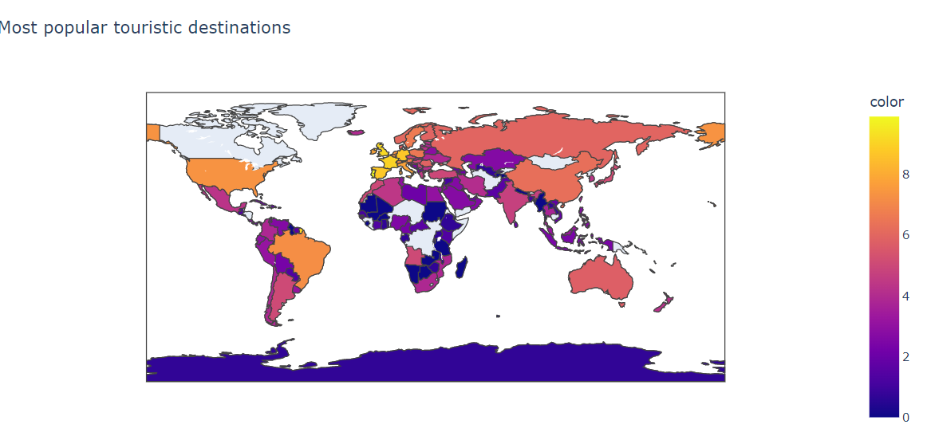
Insight 2: Most popular bookings destinations (1/2)

Slide 4
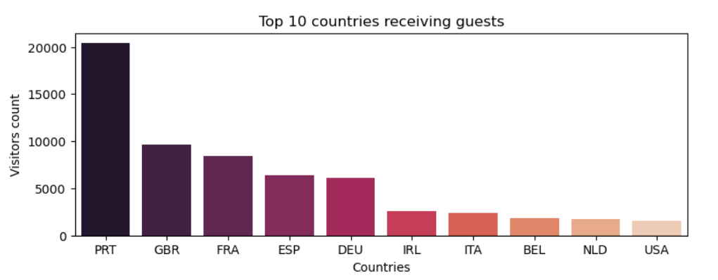
Insight 2: Most popular bookings destinations (2/2)

Slide 5
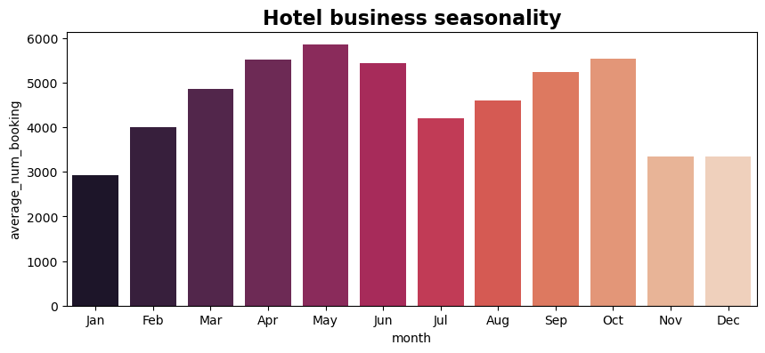
Insight 3: Seasonality (1/3)

Slide 6
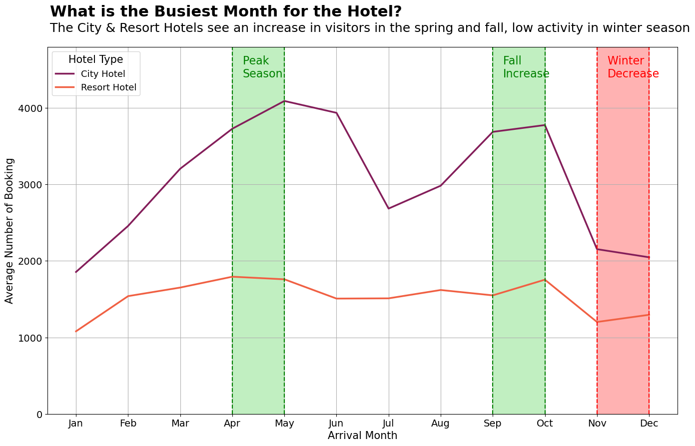
Insight 3: Seasonality (2/3)

Slide 7
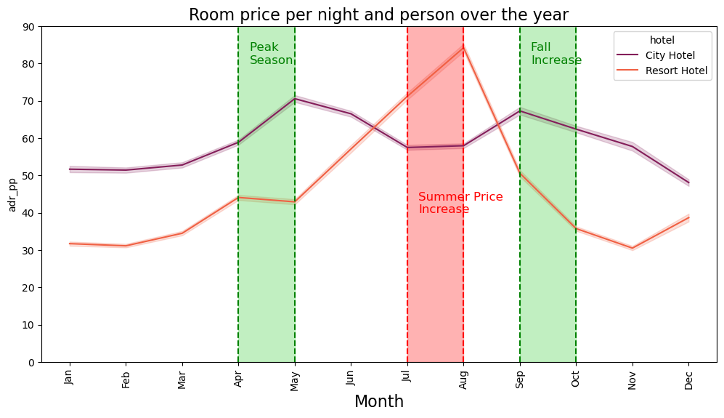
Insight 3: Seasonality (3/3)

Slide 8
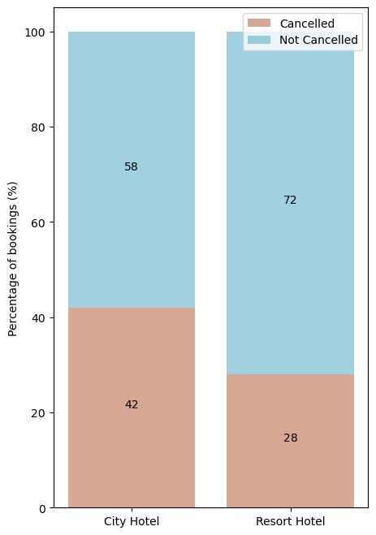
Insight 4: Challenge of cancellation rate (1/3)

Slide 9
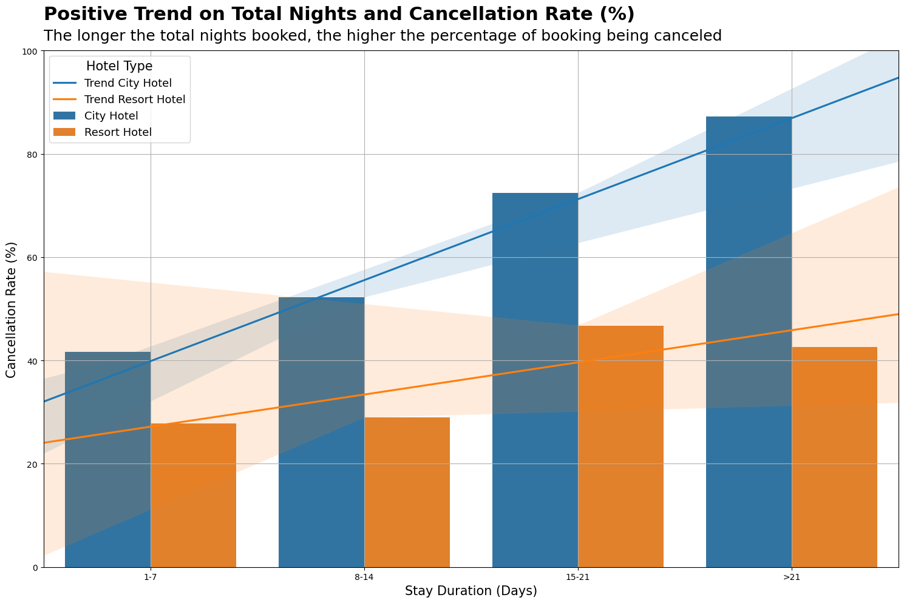
Insight 4: Challenge of cancellation rate (2/3)

Slide 10
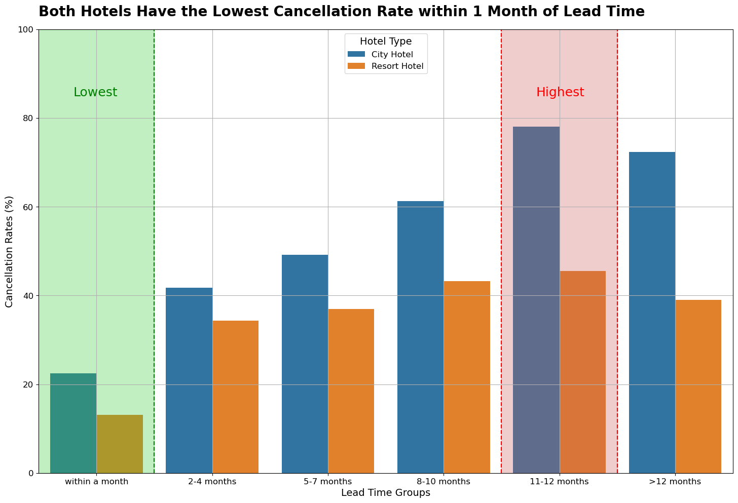
Insight 4: Challenge of cancellation rate (3/3)

