Slide 1
Kevin Shoemaker
Research Day 2026

Slide 2
Research overview
Conservation modeling
Estimation of population and metapopulation ‘vital rates’
Survival, movement, occupancy, recruitment, population growth, occupancy trends
“Messy” data: capture-recapture, telemetry, occupancy surveys
Synthesize into matrix population models or more complex stochastic simulations (Population Viability Analysis, or PVA)
Scenario tests to perform status assessments, rank conservation and management interventions, etc.
Collaborations with other NRES faculty:
Active ongoing work with Stewart, Matocq, Bisbing labs (also Chandra and Nussear labs). Potential near-term projects with Cushman, Williams labs.

Slide 3
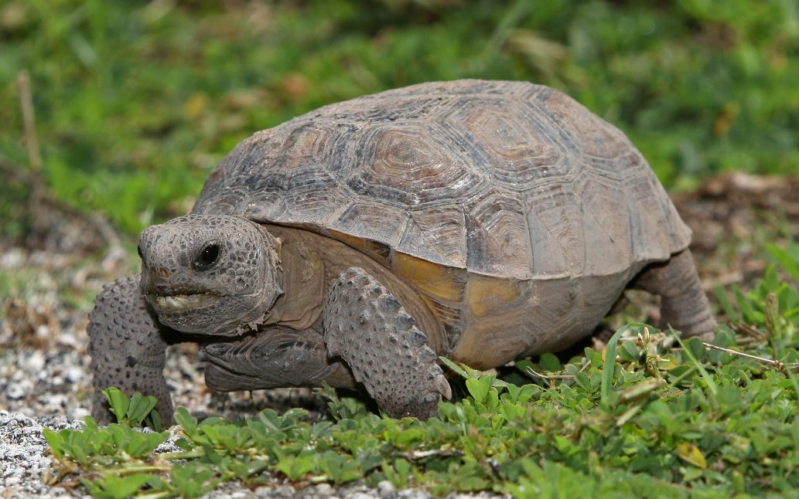
Assessing the rangewide conservation status and conservation needs for the gopher tortoise (Gopherus polyphemus) –
Widespread but declining ecosystem engineer of the southeastern USA
Current projects:
Simple matrix-based assessment of growth potential
Rangewide PVA to inform future listing decisions
Collaborators: Kevin Loope and Elizabeth Hunter, Virginia Tech.
Funding: Center for Biological Diversity
https://commons.wikimedia.org/

Slide 4
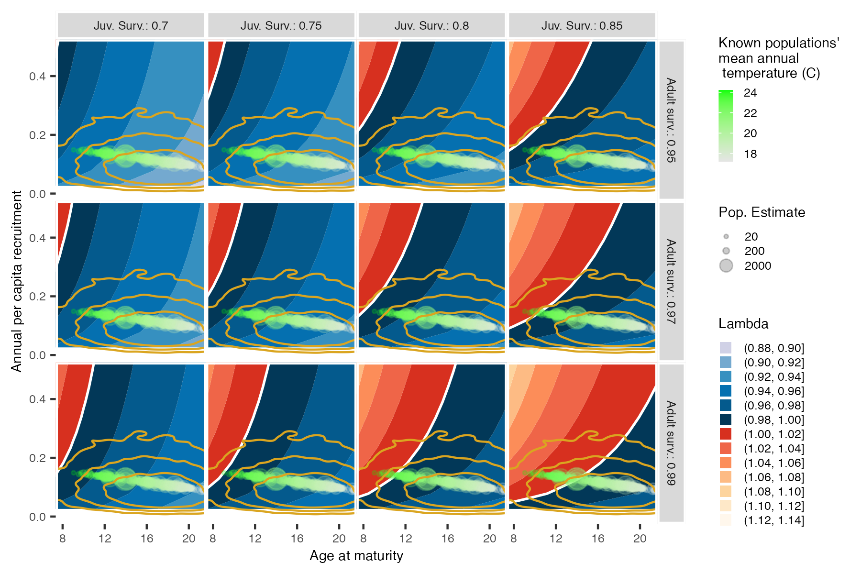

Slide 5
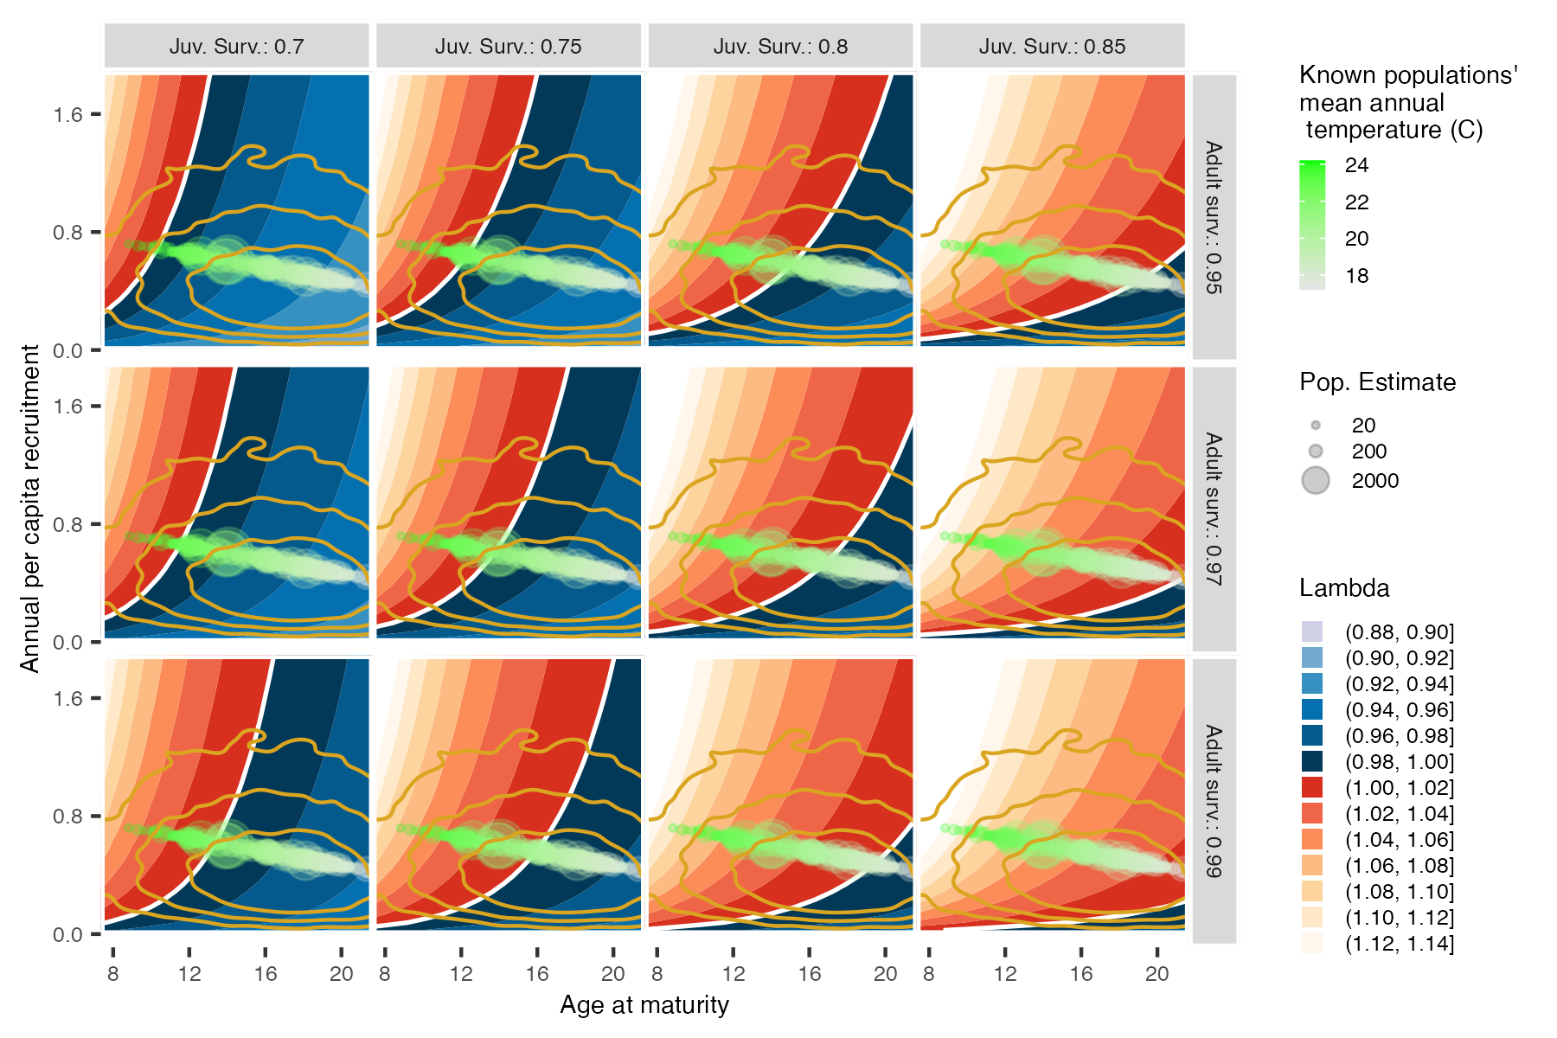

Slide 6
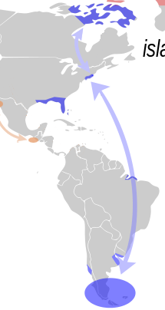
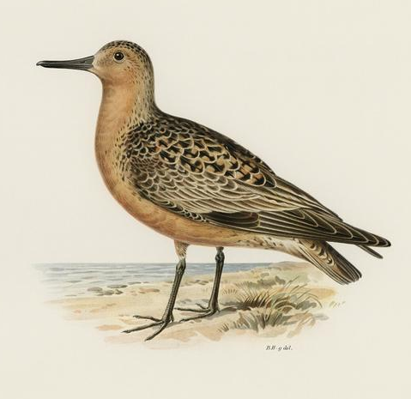
Eggs to Knots: measuring the demographic link between horseshoe crabs and red knots
Horseshoe crab eggs form the primary food resource at key coastal migratory staging areas.
Goal: link beach restoration to increased HSC eggs to red knot population growth!
Collaborators: Larry Niles, Amanda Dey (Wildlife Restoration Partnerships)
Funding: NFWF

Slide 7
Other projects
Quantifying the role of prairie dog colonies as positive or negative drivers of rangeland biodiversity and livestock production
Collaboration with Colorado State University.
Assessing rangewide threats and recovery potential for the Mojave desert tortoise
Collaborations with Nussear lab (Geography), others.
Assessing the viability of the Summit Lake population of Lahontan Cutthroat Trout – one of two remaining native adfluvial populations
Collaboration with Chandra lab (Biology), Summit Lake Paiute Tribe, others.

Slide 8
Questions?

