Slide 1
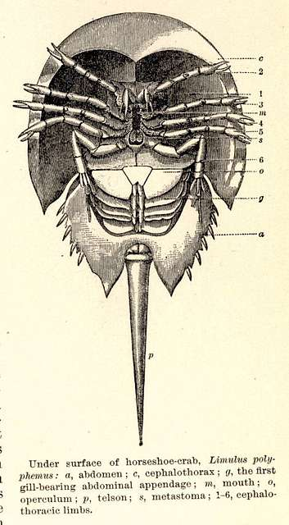
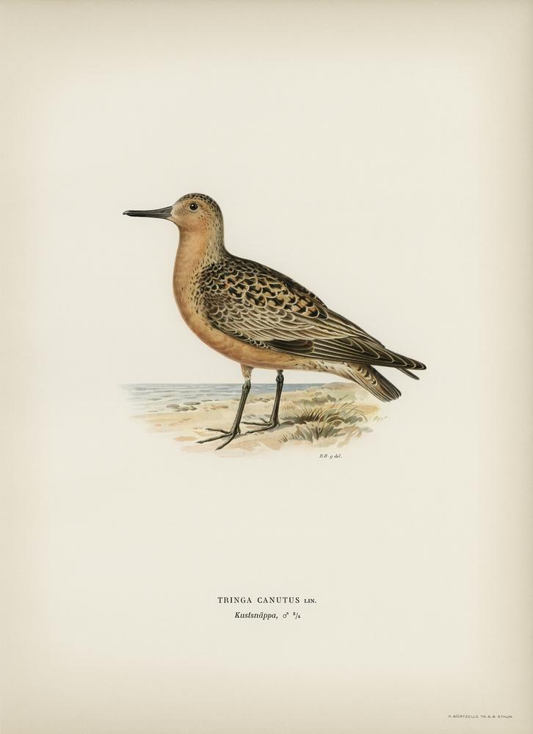
Case study: Red Knots and Horseshoe Crabs
NRES 421: Conservation Biology
Kevin Shoemaker – NRES

Slide 2
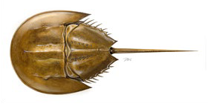
Atlantic States Marine Fisheries Commission (ASMFC). 2021. Revision to the Framework for Adaptive Management of Horseshoe Crab Harvest in the Delaware Bay Inclusive of Red Knot Conservation. Arlington, VA. 302 pp. http://www.asmfc.org/species/horseshoe-crab

Slide 3
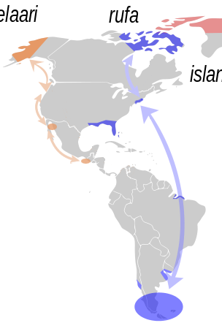
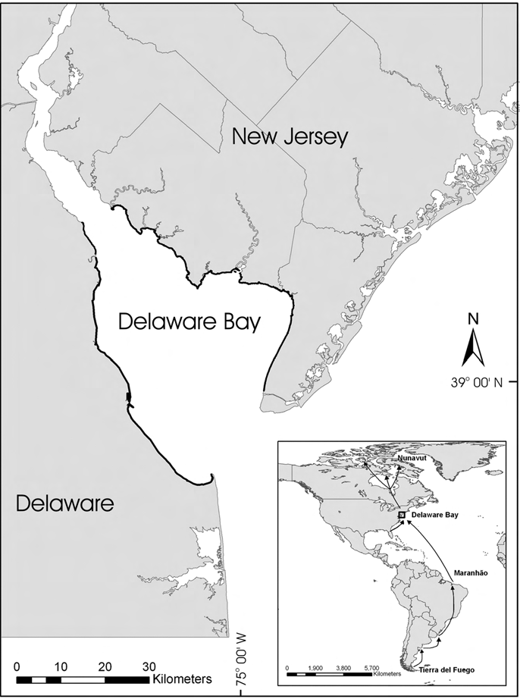

Slide 4
Overview of Changes
Problem Statement
Manage harvest of horseshoe crabs in the Delaware Bay to maximize harvest but also to maintain ecosystem integrity, provide adequate stopover habitat for migrating shorebirds, and ensure that the abundance of horseshoe crabs is not limiting the red knot stopover population or slowing recovery.

Slide 5
Red Knot model

Slide 6
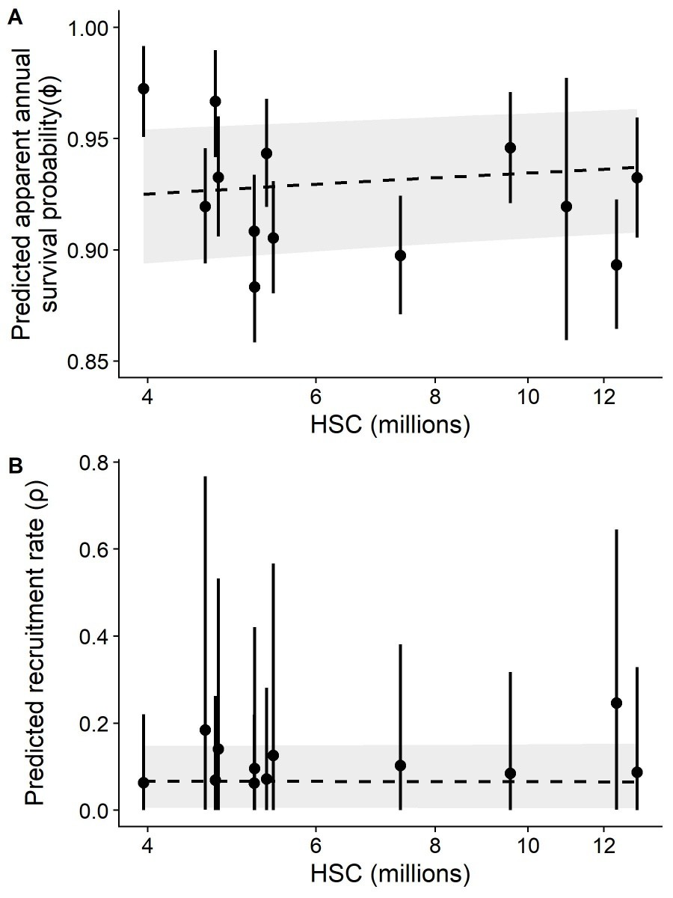
Let’s return to those REKN/HSC relationships…

Slide 7

Two-stage population model for Red Knot:
ϕ^{A}
ϕ^{J}
Juveniles
Adults
f^{J}

Slide 8
Red Knot (REKN) population model specification
Life history: juvenile and adult stages. Start breeding at 2 years of age. Can live up to 20 years, but most don’t make it past 7 or 8 years.
Adult Survival rate: 93% per year at “normal” HSC abundance
Juvenile Survival rate: 75% annually
Reproduction: each adult produces 0.15 offspring annually that survive to become juveniles
Abundance: around 50,000 adults and 5,000 juveniles
Let’s build a REKN population model using InsightMaker

Slide 9
REKN scenario tests (group activity)
Baseline- run the model with all parameters at baseline levels (normal levels of horseshoe crab eggs)
Run the model with the HSC population cut in half
Run the model with the HSC population set to zero (catastrophic collapse of the population)
Please work together to describe the results of your scenario tests, and what this might mean for regulating the harvest of horseshoe crabs in Delaware Bay. Does this result make sense, based on what you know about red knots?

Slide 10
(In class exercise)
https://insightmaker.com/insight/hoWpE5JlD9x5AaPHujVg4/Red-Knot-Matrix-Model

Slide 11

Horseshoe crab model

Slide 12
Horseshoe crab model specification
Only model female adult (reproductive) HSC (single stock)
Starting population size is around 10 million females in Delaware Bay
Baseline harvest due to all other sources (biomedical, bycatch) is around 50,000 per year
Recruitment rate (rate of entry of new adults into the population each year) is modeled using a lognormal random number generator with average recruitment of 3.2 million per year and log-sd of 0.5.
Adult mortality is 30%

Slide 13
HSC scenario tests (group activity)
Baseline- run the model with no commercial harvest of females (only baseline harvest)
Run the model with maximum proposed commercial harvest of females: 210,000 females harvested per year
Run the model with 1 million females harvested each year (much higher than max proposed harvest)
What is the maximum sustainable harvest rate (number of females harvested per year) in this population? Note that you need to define what “sustainable” means here!
Keeping the same harvest rate (maximum harvest rate identified above), run the model again with the average recruitment parameter cut in half. Is the population still sustainable?
Please work together to describe the results of your scenario tests. Do you think this population is likely to be resilient to the maximum allowable female harvest rates? Why or why not?

Slide 14
(In class exercise)
https://insightmaker.com/insight/gim35Z9XDbmFy7gcQy2JD/Horseshoe-crab-model

