Slide 1
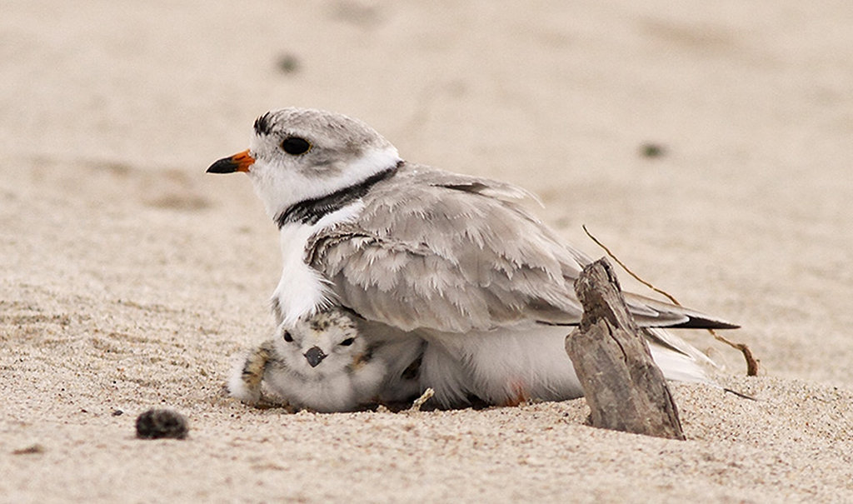

Case study: Piping Plover nest protection
NRES 421: Conservation Biology
Kevin Shoemaker – NRES

Slide 2
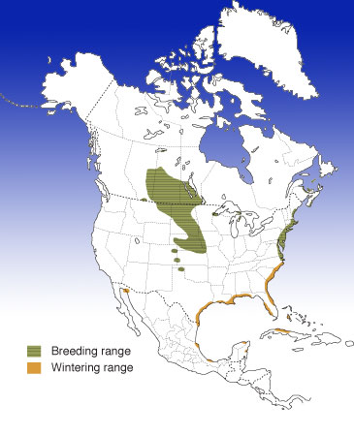
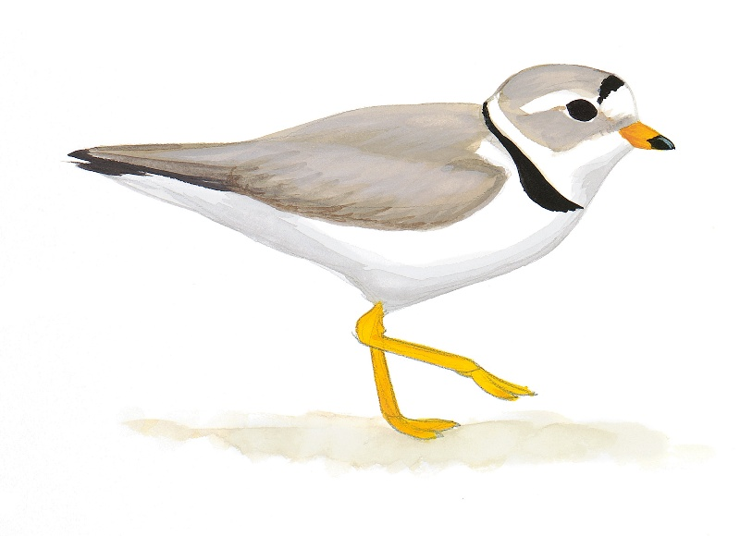
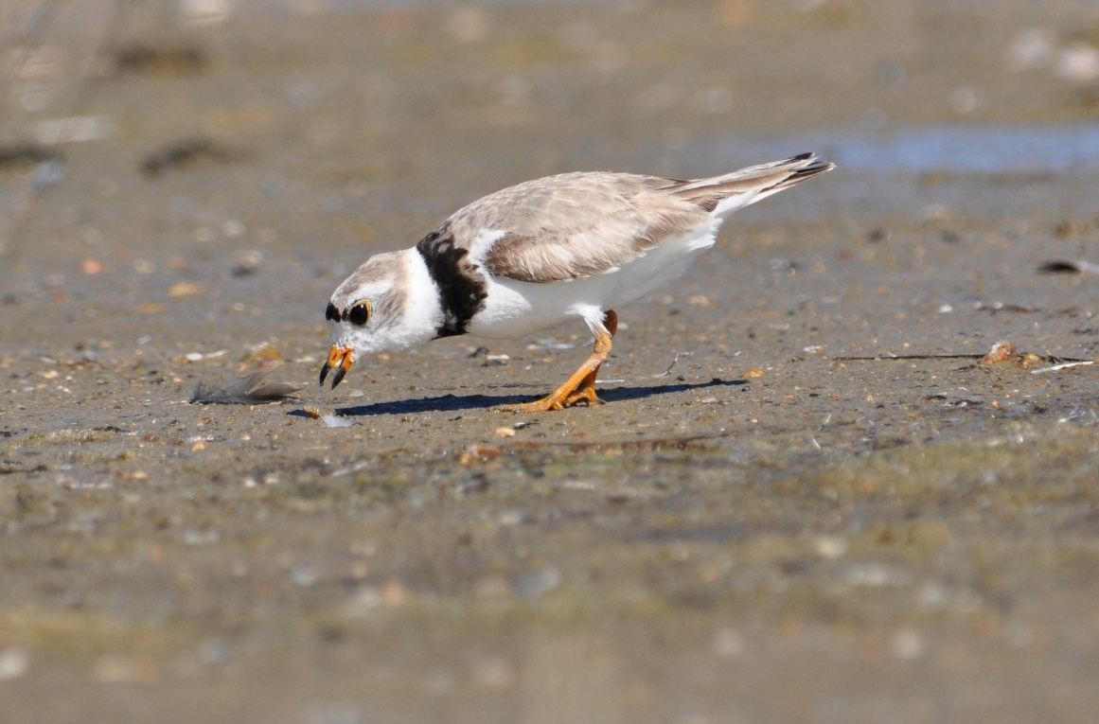
Notes:
Piping plovers are carnivorous shorebirds that eat small invertebrates, primarily marine worms, beetles, insects (like flies and ants), spiders, crustaceans, and tiny mollusks. They forage day and night along the water's edge and wrack line, using a "dash-stop-peck" technique, often using "foot trembling" to bring prey to the surface

Slide 3
Overview of Changes
Conservation history
Atlantic coast population was overharvested, primarily for millinery trade (ladies hats!) in the early 1900s.
Habitat loss and degradation (dune stabilization, summer homes, and road construction) has also negatively impacted this population

Slide 4
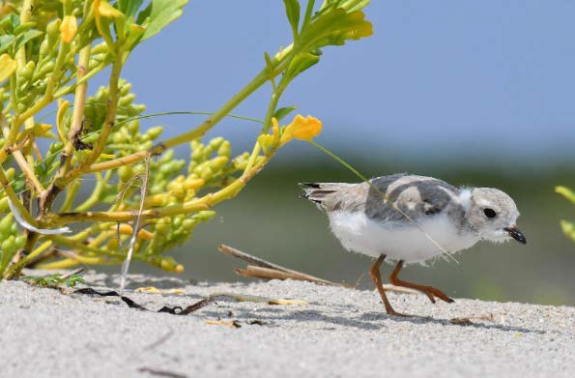
Predator exclosures are widely used to protect nests
BENEFITS
Increase nest survival! More eggs hatch, leading to faster population growth.
RISKS
Predators can occasionally ‘breach’ the exclosures
Often kills adults. Even where adults are not killed, they will abandon the nest and move elsewhere
Humans can occasionally vandalize or disturb exclosures (becomes a visible target)

Slide 5
In class exercise
You are a refuge manager for an Atlantic coast park with 5 km of shoreline beaches. You currently have around 20 nesting pairs, and you would like to maximize population growth.
Try running ‘mini experiments’ by changing the fraction of nests protected
What is the maximum population size attainable by the year 2100?
What is the optimal fraction of the nests to protect?
What happens if you protect all the nests- it this a good idea?
Consider that there is substantial uncertainty about (1) the fraction of protected nests that will be breached by predators, and (2) the fraction of unprotected nests that will be destroyed by predators
The rate of exclosure breaching may be anywhere from very low (e.g., 5%) to nearly 50%. Nest survival for unprotected nests may be anywhere from 30% to 60%.
Design a strategy for protecting nests at your refuge that accounts for your uncertainty about nest predation and breaching rates. Can you identify a “safe” strategy?

