Slide 1
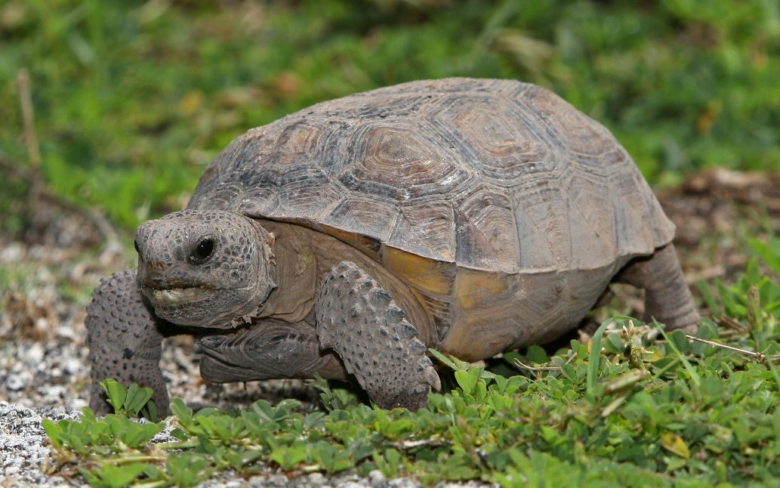
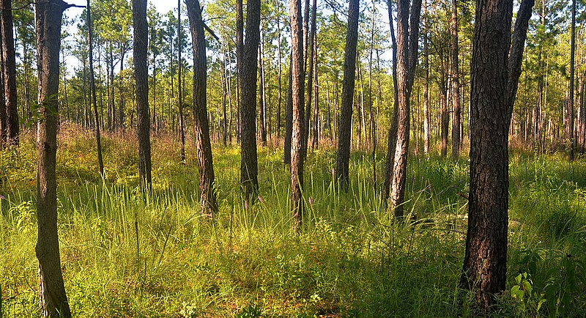
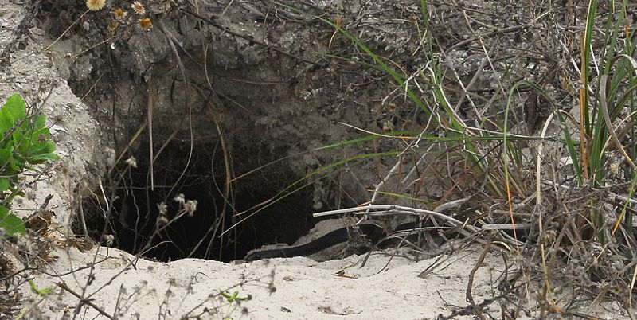
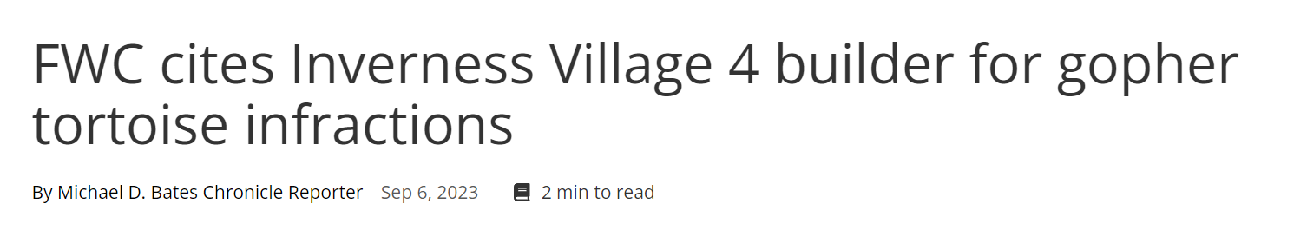
Gopher tortoise: a keystone of the American Southeast
https://commons.wikimedia.org/
https://commons.wikimedia.org/
https://commons.wikimedia.org/
Notes:
[1] The gopher tortoise is a burrowing reptile that occurs from Southeastern South Carolina to extreme Southeastern Louisiana, and its stronghold is in the state of Florida.
Typical gopher tortoise habitat consists of a pine savanna with diverse herbaceous vegetation on well-drained soil with widely spaced trees and other woody vegetation.
Gopher tortoise is strongly associated with Longleaf pine ecosystems.
These ecosystems depend on frequent disturbance, primarily from fire.
Gopher tortoise is a classic keystone species. In many longleaf pine systems, the gopher tortoise is the primary grazer.
Even more importantly, the gopher tortoise digs extremely deep and long burrows (up to 10 ft deep and 40 ft long) that provide important refuge for many native species including native species like the gopher frog and the indigo snake.
Conservation of the gopher tortoise is a hot button political issue in the state of Florida, because they are fairly widespread and listing of the species could present a widespread threat to economic development in the region.

Slide 2
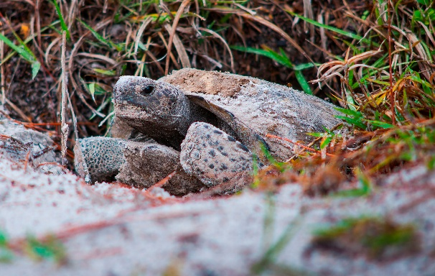
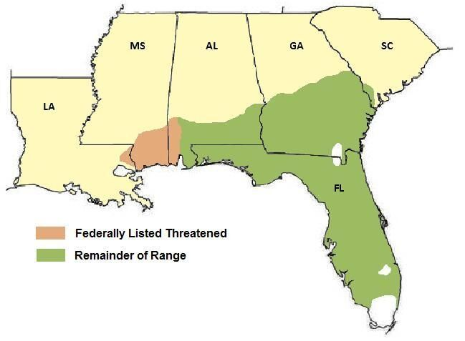
How is the gopher tortoise doing?
USFWS 2022
Eastern population segment (~92% of population): Secure
Western population segment (~8% of population): Federally Threatened
Prior to 2022
Eastern segment was a candidate for listing
Formally: “warranted but excluded”
Notes:
How are they doing- well, according to USFWS, they are doing okay for now.
Gopher tortoise is not currently listed as threatened or endangered through much of its range
In 2022 the USFWS determined that the gopher tortoise populations are Secure and not warranted for federal protections under the ESA.
I’ll have much more to say about this!!
Prior to the 2022 decision, it was a candidate for listing . Technically it was “warranted but precluded” – meaning the evidence was strong enough to list it, but cannot proceed due to higher priority listing actions for other species. Basically, it was a perpetual candidate species- until 2022.
Technically, the gopher tortoise range is divided into two “distinct population segments” (DPS).
Western segment (west of west of the Tombigbee and Mobile Rivers in Alabama) has been listed as threatened since 1987, and retains that status after the 2022 decision.
Today I’ll focus on the eastern population segment, which was determined to be “Secure” in the recent listing decision.

Slide 3
Gopher tortoise conservation challenges
Habitat loss and fragmentation
~3% of original longleaf pine habitat remains
Fire suppression, urbanization, commercial forestry
Climate change
Reduced prescribed fire opportunities under climate change
Sea level rise
Temperature dependent sex determination
Severe weather
Road mortality
Fire ants
Other: invasive flora, nest predation, utility scale solar, disease
Notes:
The gopher tortoise faces a number of threats
Most importantly, researchers have estimated that only around 3% of original longleaf pine habitat remains.
Habitat loss has been driven by fire suppression, urbanization and commercial forestry.
Climate change is another major threat- largely due to restriction of opportunities for prescribed burning but also due to sea level rise, which threatens many coastal gopher tortoise populations.
In addition, climate change may disrupt sex ratios, since tortoises have temperature dependent sex determination (luckily higher temperatures lead to more females, which could be beneficial in some cases)
Finally, increased severity of tropical storms could impact many populations.
Other threats include road mortality,
red imported fire ants that consume hatchlings,
and many other factors- including invasive plants like cogongrass, subsidized mesopredators that consume eggs and hatchlings, utility scale solar, and diseases like URTD.
INVASIVE PLANTS: The spread of exotic plants species has the potential to alter and degrade gopher tortoise habitat and ultimately influence gopher tortoise viability on a site. Some species postulated to impact tortoise habitat include kudzu (Pueraria montana), Chinese privet (Ligustrum sinense), Callery pear (Pyrus calleryana), natal grass (Melinis repens), and Japanese climbing fern (Lygodium japonicum), though quantified impacts of these species on tortoises are unknown. One species known to impact gopher tortoise use of habitat is cogongrass (Imperata cylindrica), a prolific invasive which occurs throughout much of the gopher tortoise’s range. Unlike other invasive plant species in upland communities, cogongrass can rapidly spread following disturbances including prescribed fire (Yager et al. 2010, entire; Holzmueller and Jose 2011, p. 436-437). It can quickly form a tall, dense ground cover with a dense rhizome layer and can outcompete native vegetation (Dozier et al. 1998, pp. 737-740; Mushinsky et al. 2006, p. 360; Minogue et al. 2018, p.1-4). Widespread areas of dense cogongrass (Figure 3.8) could result in habitat loss as gopher tortoises do not use these areas, nor do they consume cogongrass (Basiotis 2007, p. 21). Cogongrass can also decrease gopher tortoise habitat quality by reducing forage quality and quantity, and the availability of burrowing and nesting locations (Lippincott 1997, pp. 48- 65; Basiotis 2007, p. 24). Additional research is needed to quantify the impacts of invasive vegetation spread on gopher tortoises and the quality of their habitat.
Fire ants kill hatchlings

Slide 4

Conservation actions for gopher tortoise
Species is Federally protected in western population segment
But… no critical habitat designation
Many states provide some conservation measures
Incentives for management on private lands
Illegal to harm tortoises
Legal to move them out of development sites!
Few restrictions on private land development
“Entombment” practice ended in FL in 2007
Notes:
Gopher tortoise populations receive some degree of protection across the range.
Like I said, the western population is federally protected. However, critical habitat has not been designated, reducing the level of protection.
Outside the western segment, in the majority of the population, the gopher tortoise is protected in various ways at the state level, incuding
Incentives for private land owners to manage habitat to benefit tortoises,
Making it illegal to kill or harm tortoises.
Unfortunately, harming gopher tortpoise habitat IS allowed on private land. To get permits for development, developers just have to move tortoises off the land first
Amazingly, until 2007 it was legal in Florida to “entomb” tortoises, leaving them to die in their burrows. Luckily that practice has ended!!

Slide 5
(Digression warning)
And now…
Some background on US endangered species policy

Slide 6

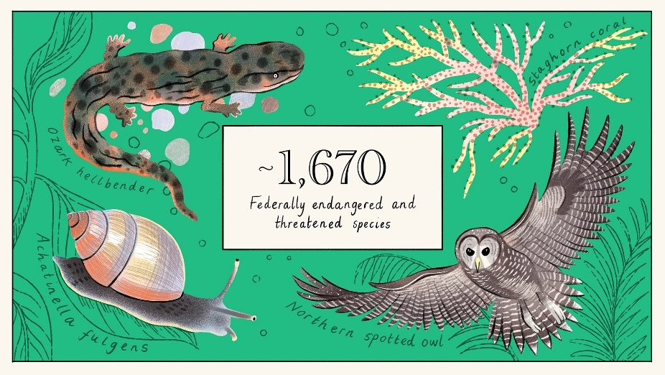
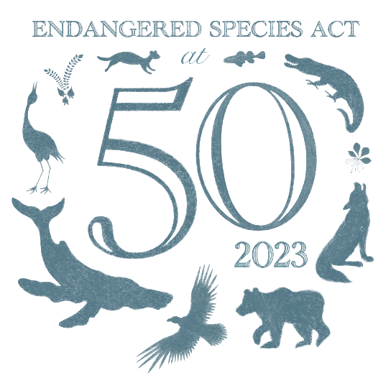
Endangered Species Act of 1973
The Endangered Species Act of 1973 (ESA) is the primary US law protecting rare and endangered species and their habitat.
“pit bull of environmental laws”
one of the worlds strongest endangered species protection laws
Notes:
The Endangered Species Act of 1973 (ESA) is the primary US law protecting rare and endangered species and their habitat.
pit bull of environmental laws
5 factors used for listing species
Habitat loss and destruction
Overharvest
Disease and predation
Inadequacy of existing regulatory mechanisms
Other natural or manmade factors affecting viability

Slide 7
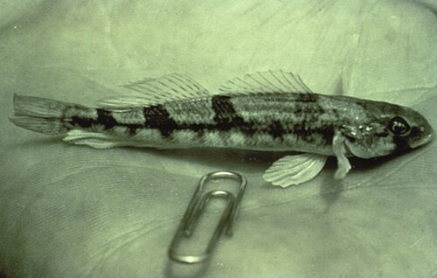
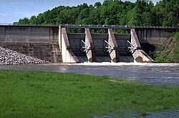
A controversial law
The ESA can restrict development projects.
Example: Tellico dam and snail darter
Critical habitat designation
Citizen petitions enhance controversy
Advocacy groups like CBD, WildEarth Guardians, DoW, frequently file listing petitions
Sometimes accused of frivolous or disingenuous use of legal system
Endless litigation is a reality of species conservation in USA
Notes:
The ESA has garnered controversy from the very beginning
Controversy: snail darter and Tellico Dam in Tennessee (supreme court ruled in favor of abandoning the Tellico dam project. The cabinet level god squad, formed to allow exceptions, did NOT allow project to continue. Only an act of congress specifically allowed the project to continue).
The ESA allows citizens to petition species for listing. Technically the USFWS and NMFS can evaluate species on their own, but a citizen petition is by far the most common way that a species is considered for listing.
A petition triggers USFWS to decide if a species should be considered “endangered”, “threatened” or “not warranted
The fact that petitions are often generated by advocacy groups on behalf of citizens generates controversy- and many accuse petitioners like CBD , defenders of wildlife, and wildearth guardians, of abusing the legal system.
For better or worse, endless litigation is a reality of species conservation in this country. Major conservation battles are carried out in the courtrooms, often over many years…

Slide 8
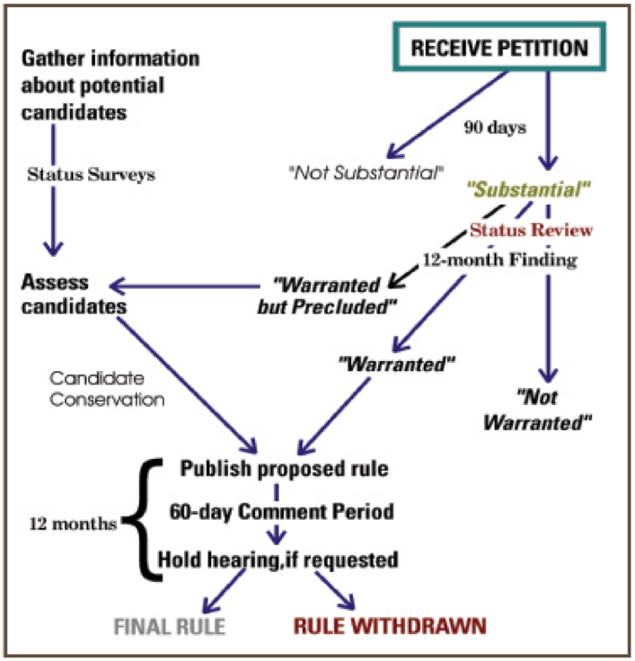

Slide 9
‘Best available science’ mandate
Listing determinations “solely on the basis of the best scientific and commercial data available”
Desire for objective, rule-based decision making
Does NOT dictate that the agencies must collect new data or monitor actions recommended in Biological Opinions
All decisions must be made under some uncertainty
Uncertainty and limits of science are not often formally acknowledged and implemented formally by USFWS in conservation procedures and decisions.
Notes:
The use of science in decision making is baked into the language of the ESA- this in informally known as the ‘best available science’ mandate.
Listing determinations (and all other decisions) must be made “solely on the basis of the best scientific and commercial data available”
This reflects a desire for objective rule based decision making
Critical habitat designations can be influenced by politics, but all other decisions are supposed to be only (solely) based on science.
The best available science mandate is redundant in some ways, since the APA already requires that agency decisions can not be “arbitrary and capricious”, meaning they must be based on hard evidence.
The best available science mandate requires that decisions be made in light of the evidence that is available- which means that the agencies must review the literature, talk to experts, conduct peer reviews.
However, it does NOT mean the agencies need to collect new data, run new analyses, or implement monitoring programs to ensure actions are successful.

Slide 10
Role of politics in endangered species conservation
Conservation questions can be ‘wicked’. Such problems involve values, and solutions must involve politics.
Should the gray wolf be restored to some or all of its historic range?
Should barred owls be killed to protect spotted owls?
Are hatchery salmon a substitute for wild salmon?
Science does not and can not have all the answers
“Sound science” principle vs precautionary principle?
Science can be used to forestall regulations or to quantify risk and uncertainty
Notes:
Conservation questions can be ‘wicked’. (famous paper by Rittel and Webber 1973).
Such problems involve values, and solutions must involve politics.
Should the gray wolf be restored to some or all of its historic range?
Should barred owls be killed to protect spotted owls?
Are hatchery salmon a substitute for wild salmon?
Science does not and cannot have all the answers. In fact, science is often used to justify very different conservation mindsets- exemplified in the distinction between:
“Sound science” principle vs precautionary principle?
Science can be used to forestall regulations or
To quantify risk and uncertainty
It comes down to the fact that science is a tool for decisions, but it can not make the decisions! Politics must play out, from the local level to the national level to determine a final answer.

Slide 11
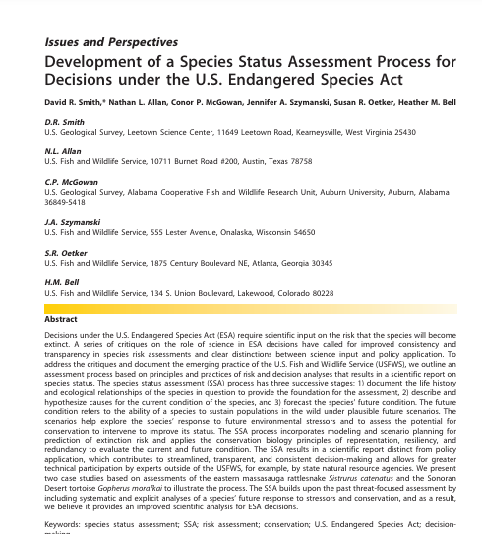
What is a USFWS Species Status Assessment (SSA)?
USFWS mandated to use “best available science” in species listings (and other decisions)
A Species Status Assessment, or SSA, provides scientific basis to inform listing decision and recovery plans
Relies heavily on the “3 R’s of conservation”: resiliency, redundancy, and representation.
Smith et al. 2018 JFWM
Notes:
So, we have established the best available science mandate,
A Species Status Assessment, or SSA, is a systematic approach used to provide scientific basis to inform listing decision,
An SSA typically provides the scientific grounding for (or against) listing a species under the ESA, designating critical habitat, and planning for recovery.
SSA is empirical: the listing decision itself is normative judgement and often involves political considerations- but the SSA process is intended to reflect the best available science.
An SSA also guides recovery planning for species that are determined to be warranted for federal protections.
The SSA paradigm, which has emerged as central to scientific decision making for endangered species management in the US over the last 10 years, relies heavily on the three Rs of conservation biology:
resiliency, redundancy and representation.
Resiliency refers to the ability of populations to withstand natural environmental variability.
Redundancy represents an assessment of the ability of a species to recover from catastrophic loss of populations.
Representation generally represents the ability of a species to adapt to long term changes in the environment (this often is interpreted to mean, we need to preserve genetic diversity across the range.

Slide 12
SSA objective: future conditions modeling to support ESA listing decision
Goal:
“To analyze the available scientific information to estimate a particular species’ current condition and forecast the species’ future condition for ESA decisions.”
Smith et al. 2018 JFWM
Notes:
One of the mandates for preparing an SSA is to forecast the future condition of the species under plausible future scenarios: in their words, “To analyze the available scientific information to estimate a particular species’ current condition and forecast the species’ future condition for ESA decisions.”

Slide 13
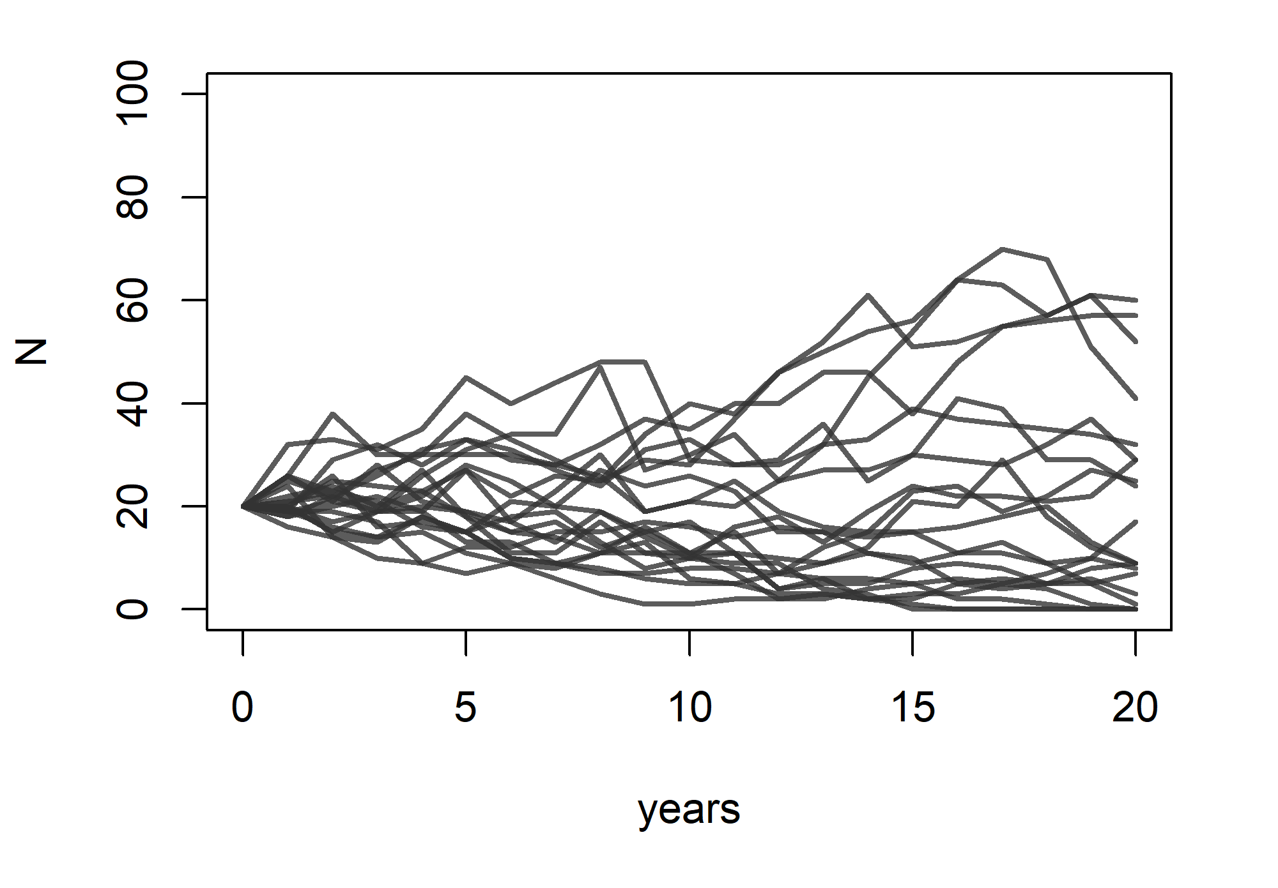
Population Viability Analysis (PVA)
Core workhorse of conservation biology
Determine population status
Assess future risks from climate change and habitat loss
Rank management alternatives
Notes:
This brings up the idea of modeling populations and forecasting population dynamics into the future.
This is what I do for a living!
Population viability analysis, or PVA, is a core workhorse of conservation biology.
PVAs is often integral to the SSA process, and can serve as a major component of the scientific basis for major listing decisions and other actions taken by the USFWS.
Using PVA we can ask questions about the overall status of the population. Like, Is it doing well? Is it at risk of extinction? We can also run experiments to ask what might happen in the future. For example: Is the population resilient to extended droughts? Finally we can ask questions about management. For example, how might an endangered fish population rebound after stream restoration or invasive species removal.

Slide 14
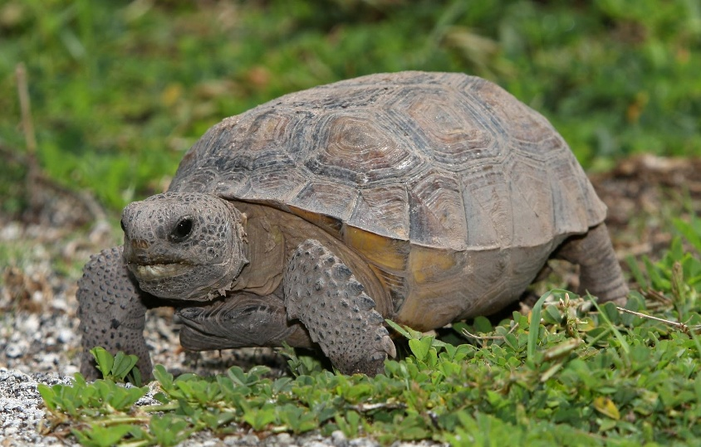
And now…
Back to the gopher tortoise!

Slide 15
PVA was used to help justify a “not warranted” finding in 2022
“Of the individuals … and populations modeled, projections among scenarios for 80 years in the future suggested the presence of 47,202–50,846 individuals (adult females) among 188–198 local populations within 106–114 landscape populations.” (USFWS 2022 p 61859).
“...the future condition of the species with relatively large numbers of individuals and populations suggests resiliency to withstand stochastic environmental and demographic change, and redundancy to buffer from future catastrophic events.” (USFWS 2022 p 61859).
Notes:
PVAs are often implemented as part of USFWS Species Status Assessments (or SSAs).
This was the case for the Gopher Tortoise.
In the case of the gopher tortoise, USFWS issued a decision of “Not Warranted” in 2022, meaning they decided not to confer any federal protections for this species across the majority of its range (it is listed as federally threatened in the far western part of its range).
The PVA was instrumental in making this decision:
“Of the individuals … and populations modeled, projections among scenarios for 80 years in the future suggested the presence of 47,202–50,846 individuals (adult females) among 188–198 local populations within 106–114 landscape populations.” (USFWS 2022 p 61859).
“...the future condition of the species with relatively large numbers of individuals and populations suggests resiliency to withstand stochastic environmental and demographic change, and redundancy to buffer from future catastrophic events.” (USFWS 2022 p 61859).

Slide 16
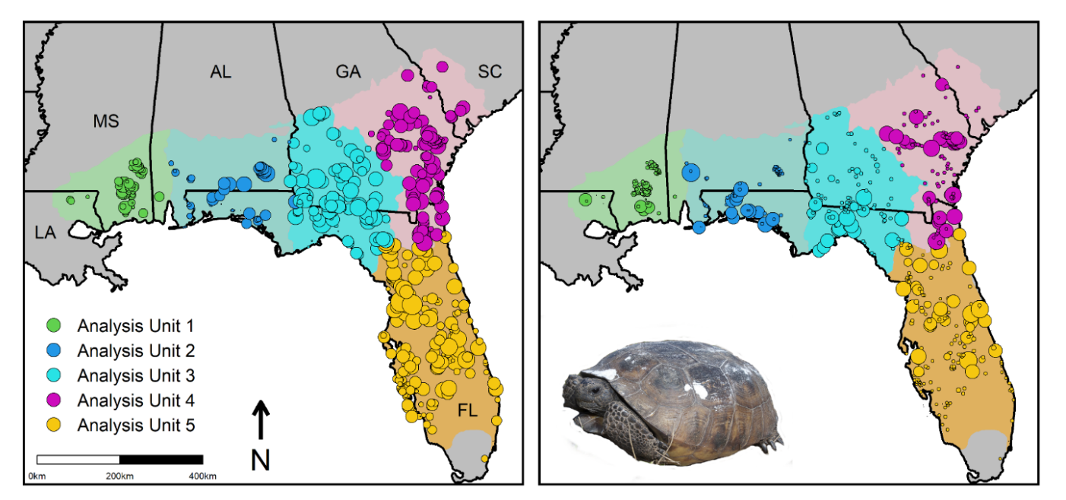
Predictions from gopher tortoise SSA model
Current rangewide population: ~70,000 females, ~600 pops, ~250 metapopulations
Projected at year 2100: ~47,000 females, ~200 pops, ~100 metapopulations
USFWS 2021. Gopher Tortoise Species Status Assessment
Notes:
The estimate for the current rangewide population includes approximately 626 populations and around 70,000 female tortoises.
By the year 2100, under the future scenario considered the most plausible, the PVA said that the population was expected to decline to around 50,000 females, but with less than half of the original populations and metapopulations (referred to as landscape populations).
It may be interesting to you that this evidence for decline and loss of populations was not enough to warrant protection under the ESA- I know I wondered that when I first saw this result…
USFWS used this model to conclude that there were enough females spread across enough metapopulations spread across the geographic range, to convince the service that this keystone species does NOT warrant federal protection across the majority of its range under the conservation principles of resiliency, redundancy and representation.

Slide 17
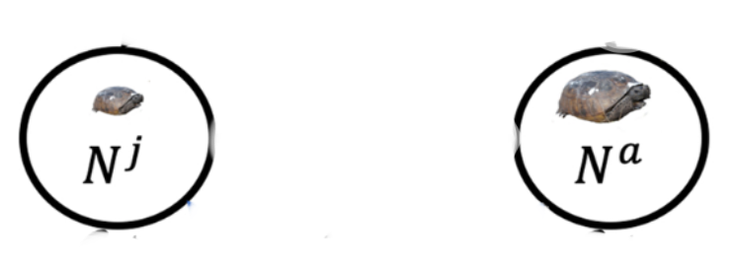
PVA model
Timeline: 2020 to 2100 (80 years)
Initial data: ~600 populations; ~70k females
Two stages: juvenile, adult
USFWS 2021. Gopher Tortoise Species Status Assessment
Notes:
Let’s talk about the PVA model in a bit more depth. This may get a little technical but hopefully not too much!
The gopher tortoise PVA model was run for 80 years representing the time period from 2020 to 2100.
Since the gopher tortoise is so long lived, this only represents a few generations!
The simulations start at the initial conditions, which includes 70k females divided into 600 populations, some of which are connected via immigration.
The underlying model was a two stage population model: individuals could be either juvenile or adult, with a maturation term dictating the transition from juvenile to adult.

Slide 18
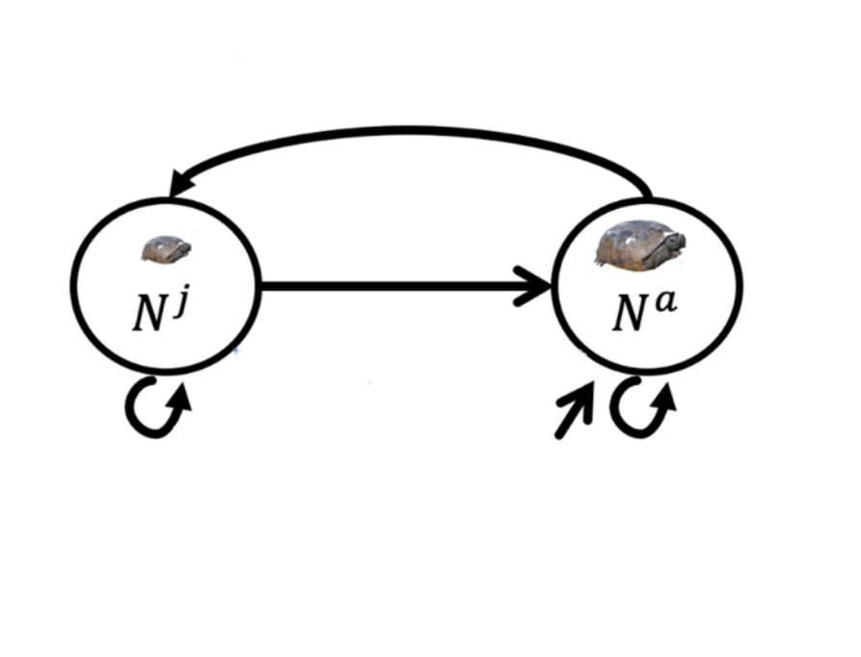
SSA PVA model
Timeline: 2020 to 2100 (80 years)
Initial data: ~600 populations; ~70k females
Two stages: juvenile, adult
Dynamics: reproduction, survival, maturation, immigration
Threats: Climate warming, Urbanization, Prescribed fire, Sea-level rise
Reproduction
Maturation
Survival
Survival
Immigration
USFWS 2021. Gopher Tortoise Species Status Assessment
Notes:
So, the key processes that need to be specified to make this model work are: survival (both juvenile and adult), reproduction, maturation, and immigration.
Threat scenarios that were modeled include climate warming (influencing survival and reproduction), urbanization (altering connectivity), prescribed fire (altering vital rates- this is a species that thrives in recently burned pine savannas), and sea level rise (affecting habitat availability- there are a substantial number of coastal populations that may be severely affected by SLR).
In reviewing this model after it had already been used to make the decision, we identified two major and highly consequential errors
one in the immigration process and
one in the maturation process.

Slide 19
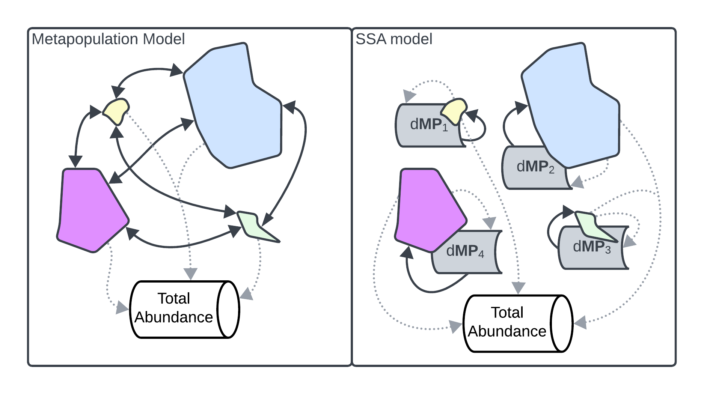
Modeling Immigration
“Metapopulation” defined to be a set of populations that can exchange migrants
Standard approach:
All immigrants (I) to one population must be emigrants (E) from another population.
Births (B) is the only process that generates new individuals in the metapopulation
Dispersal rate is determined based on multiple factors
(e.g., distance between patches, size, shape, density, and quality of patches)
Notes:
Modeling immigration can be one of the more challenging parts of PVA
First of all, a “Metapopulation” defined to be a set of populations that can exchange migrants
In the standard approach to modeling connectivity between populations, immigration is a zero sum process. Individuals arriving in one population necessarily came from another population.
The only process that can generate new individuals in the metapopulation is reproduction.
This is kind of a ‘conservation of mass’ principle. Aside from reproduction, no process can create new individuals. Keep this in mind as we move on to the next slide!
The exact rate of dispersal is determined based on multiple factors, including distance between patches, etc.
The total abundance of the metapopulation is often of interest, and is determined by adding up the abundances of all the subpopulations.

Slide 20
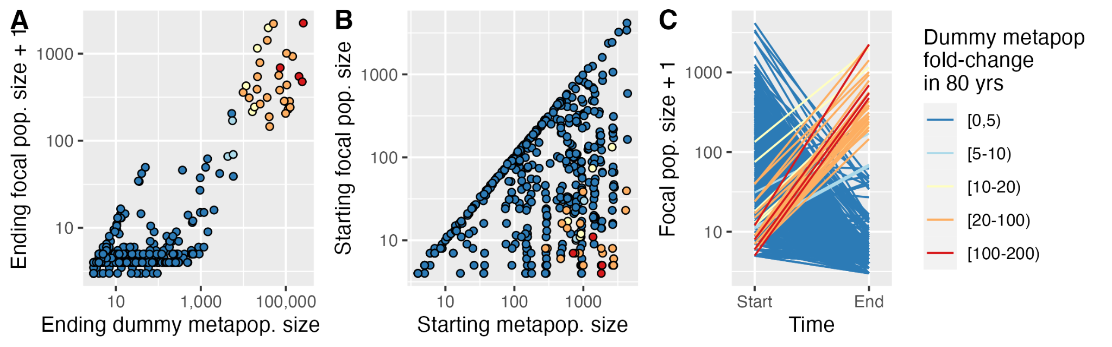
Flawed immigration rates strongly influenced SSA model results
Loope, Shoemaker and Akcakaya 2024. Global Ecology and Conservation
Notes:
We can see that this unintentional positive feedback error was very influential in the SSA model and therefore in the listing decision itself.
First of all, take a look at the set of small populations (y axis) nested within large metapopulations (y axis). These populations are the ones the end up being propped up by unrealistic immigration from the dummy metapopulations (hotter colors are those populations that end up increasing by orders of magnitude,
And in fact, these are the largest populations by the end of the simulation, despite starting out often in the range of 5 to 10 tortoises.

Slide 21
Erroneous feedback loop strongly influenced SSA model results
Loope, Shoemaker and Akcakaya 2024. Global Ecology and Conservation
Notes:
Strikingly, these were the ONLY populations that consistently grew in size over the simulation timeframe.
That is, the populations that exhibited substantial growth over the simulation were the ones most affected by the unrealistic feedback process.

Slide 22
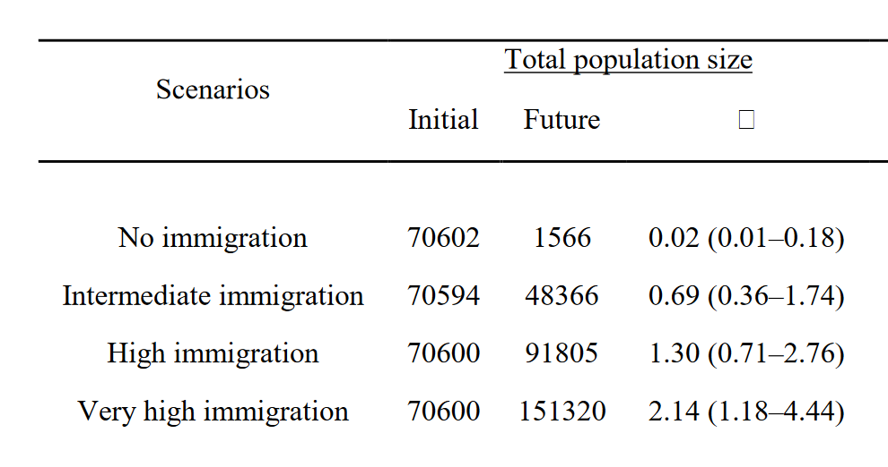
Fraction change
USFWS 2021. Gopher Tortoise Species Status Assessment
Notes:
One of the consequences of this unintentional feedback process is that the SSA model produced results like this. This is a sensitivity test in which the modelers ran the model across a range of values for immigration rate.
With no immigration the population goes from 70,000 to virtually extinct over just a few tortoise generations (80 years).
With a ‘very high immigration’ scenario of 4% (4% of the dummy metapopulation enters the population each year), the population doubles over the same timeframe.
Intermediate immigration scenarios are somewhere in the middle- the 1% scenario is the one that was considered most plausible by USFWS
Just a reminder that this is a table from the SSA document that was used to justify not listing this keystone species in the USA. This document was peer reviewed. In my opinion, the peer reviewers should have flagged this as problematic. But when a table like this is embedded in a 300 page document, it’s easy to miss things…

Slide 23
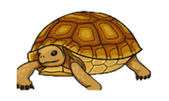
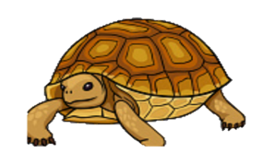
Maturation rate error
Maturation
Maturation
Juvenile (ages 1 - 10)
Adult (ages 11+)
Each year, how many juveniles become adults?
Notes:
Okay, moving on to the second major error in the SSA PVA model that contributed to the decision to deny federal protection to this species.
This error involves the maturation rate.
The SSA model uses a two-stage population model to project the population forward in time. One of the key parameters in this model is the annual rate at which juvenile females mature into the adult stage- at which point they can give birth!
Clearly this is an important parameter, as the higher this rate is, the sooner females can contribute to reproduction in the population. Computing this rate in matrix population models is surprisingly challenging.
In 2019 Kendall et al published a very influential paper showing that a large proportion of published matrix population models committed one of three major errors:
two of these errors related to errors in the specification of fecundity- including failing to include a survival term and accidentally postponing the age of first reproduction by one year (for post-breeding census models).
The third error involves the calculation of maturation rate out of a multi-year stage. This is the type of error committed in the SSA model.

Slide 24
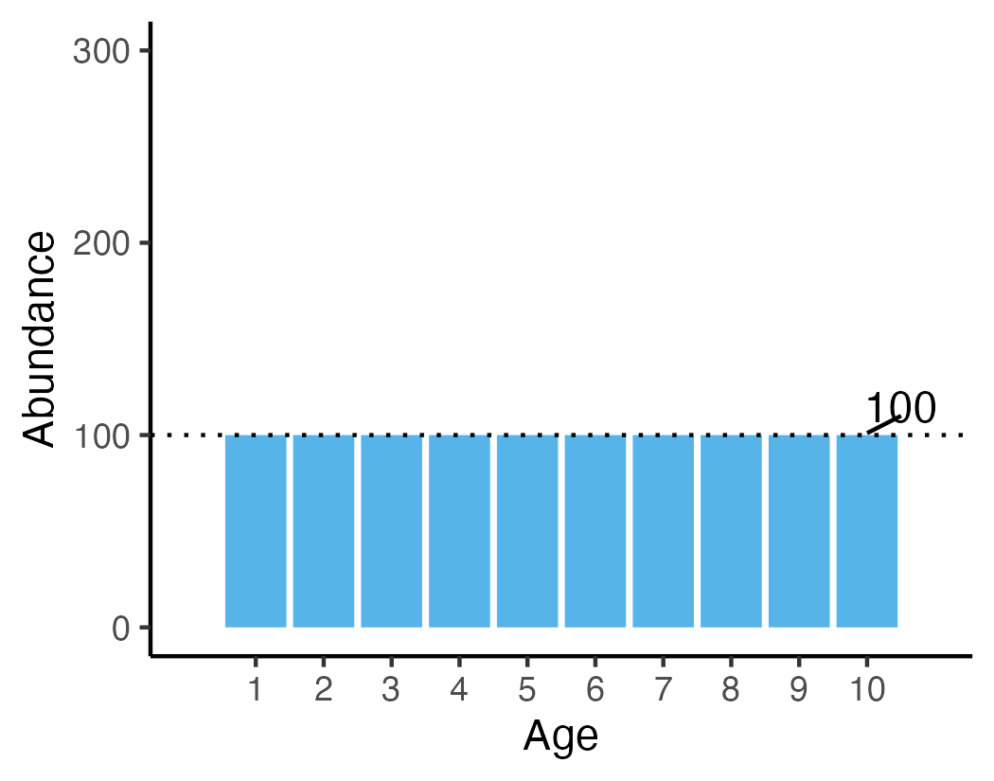
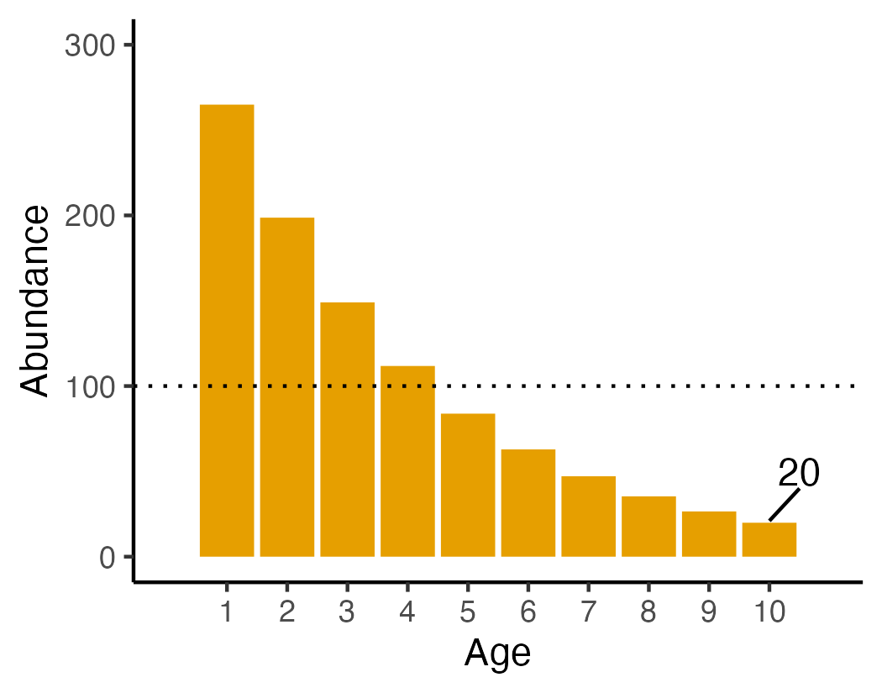
SSA approach
Problem:
“Flat age within stage” (FAS)
Equal number of each age
Fraction that transition = 1/10 [or 1/(MA-1)]
Juvenile mortality means many fewer older individuals (Kendall et al. 2019)
Notes:
In the SSA, the number of juveniles eligible to transition to adulthood was modeled as the inverse of the age at maturity, coded here as MA. So if the MA is 10, the fraction of juveniles eligible to transition is 10% of the current number of juveniles (actually 1/9 since this was a pre breeding census but let’s ignore that for simplicity).
The problem with this is that it’s wrong in most real-world cases
For a species with relatively low juvenile survival rate and which remains in the same stage for many years, the actual rate of maturation out the juvenile stage and into the reproductive stage will be much smaller than this. This is due to the fact that there are far more young juveniles in the stage than older (maturing) individuals at any given point in time.
The problem isn’t so much that it’s wrong but it’s wrong in a way that matters, and it’s wrong in a way that inflates the population growth rate, giving an artificially inflated estimate of population viability.

Slide 25
If we correct/mitigate these issues, how do predictions change?
Mitigate immigration error
Fix maturation rate
Fix another error I haven’t mentioned relating to the ceiling density dependence model that allowed some populations to “break free” from their carrying capacity
Try all the above!
Notes:
Okay, what happens if we fix these issues?
To “fix” the immigration issue, we only permitted a maximum of 3% growth in the dummy metapopulations (not a real solution but illustrative nonetheless), which is much less than the 150% growth we saw earlier
To fix the maturation rate, we simply modeled each age class explicitly for the juvenile class, forcing individuals to move through all ages prior to maturing- one of the solutions recommended by Kendall et al 2019.
And of course, we tried both fixes independently and together.

Slide 26
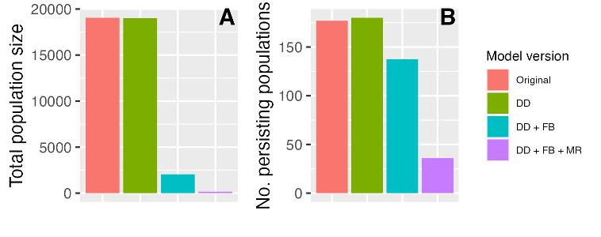
Results (Medium threats + low management scenario)
Declines are much greater than originally predicted
Original
Immigration
Immigration +
Maturation
Loope, Shoemaker and Akcakaya 2024. Global Ecology and Conservation
Notes:
Okay, so here’s the results from our tests.
This is total projected rangewide abundance at the end of the simulation, projected for the year 2100, and on the right is the number of persisting populations at 2100.
The SSA model predicted around 20,000 individuals (this is the published version- the original SSA was more like 45,000- I’ll get to that) and a bit less than 200 populations.
After correcting the density dependence error, there was very little change, if at all.
Correcting the immigration error (and the DD error) resulted in a much greater decline in abundance than the SSA predicted.
Correcting the maturation error in addition to the other errors resulted in a much greater decline in the number of persisting populations relative to the original SSA model.

Slide 27
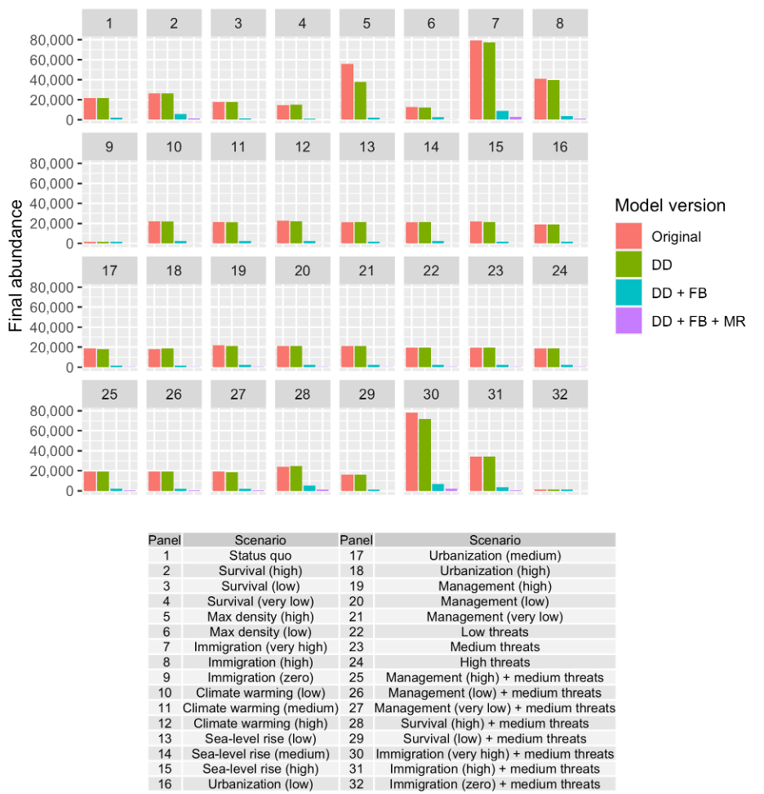
Same pattern for other scenarios
Notes:
The same pattern arose for all of the other scenarios that were run as part of the SSA process.

Slide 28
Next steps
Develop and test a new rangewide population model for the gopher tortoise (with collaborators)
Hopefully, USFWS will re-evaluate the status of the species, and our new model will be considered as an important piece of evidence.
Lesson learned: it can be very difficult to correct an error once it becomes part of an established conservation policy!

Slide 29
Questions?

Slide 30
PVAs in USFWS status assessments
Goal:
“To analyze the available scientific information to estimate a particular species’ current condition and forecast the species’ future condition for ESA decisions.”
Smith et al. 2018 JFWM
Notes:
PVAs is often integral to the SSA process, and can serve as a major component of the scientific basis for major listing decisions and other actions taken by the USFWS.
One of the mandates for preparing an SSA is to forecast the future condition of the species under plausible future scenarios: in their words, “To analyze the available scientific information to estimate a particular species’ current condition and forecast the species’ future condition for ESA decisions.”
SSA is empirical: the listing decision itself is normative judgement and often involves political considerations- but the SSA process is intended to represent the best available science.

Slide 31
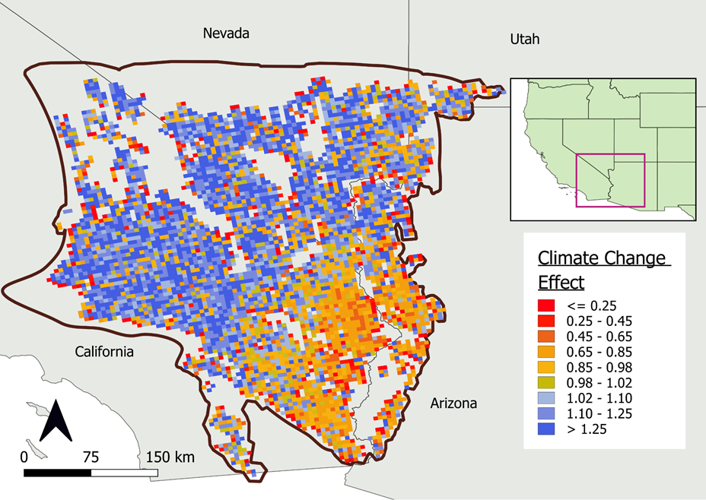
PVA challenges and opportunities
Large-scale questions require large-scale PVA models!
Restoring species’ ecological role
IUCN Green Status Assessment
Multi-species assessments
Complexity comes at a cost!
Notes:
Now, the questions we are attempting to address using PVA are rapidly becoming more complex, motivated by the needs of conservation organizations and governmental agencies.
For example, my lab recently built a PVA to assess the impact of climate-change across the entire range of the Mojave Desert Tortoise.
Furthermore, conservation organizations and governmental agencies are becoming as interested in preserving and restoring the ecosystem functions of species as they are in preventing the extinction of species – and this can necessitate more complex simulation models that include large geographic areas and multiple interacting species!
As the questions asked by conservation biologists expand in scope, PVA models become more complex, data hungry and computationally intensive, even as they become more central to the field of conservation biology than ever before.
As we all know, complexity comes at a cost.
As modelers scramble to develop ad hoc code for running these models, the resulting PVA models can be opaque and really difficult to test and evaluate.

Slide 32
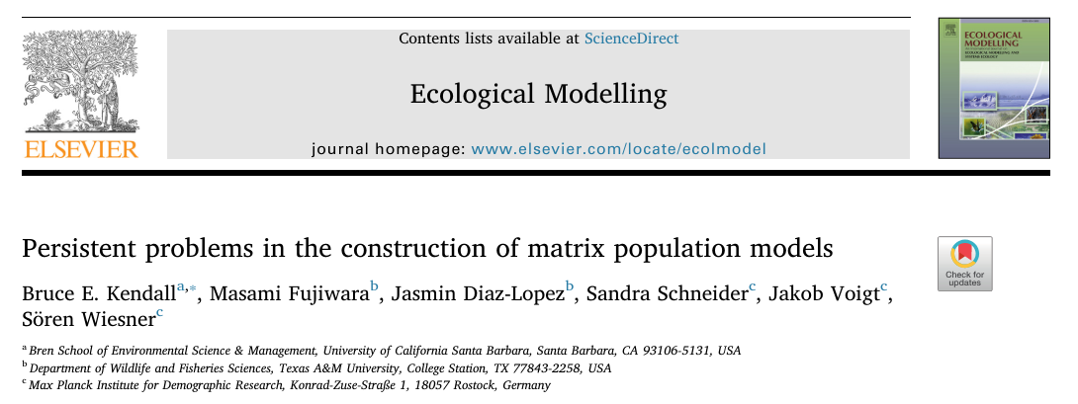
Notes:
In 2019 Kendall et al published a very influential paper showing that a large proportion of published matrix population models committed one of three major errors:
two of these error related to errors in the specification of fecundity- including failing to include a survival term and accidentally postponing the age of first reproduction by one year (for post-breeding census models).
The third error involves the calculation of maturation rate out of a multi-year stage. This is the type of error committed in the SSA model.

Slide 33
Approach used in the USFWS gopher tortoise SSA
“Dummy” metapopulations represent pool of dispersers to each focal population
Simple and fast, but:
The same metapopulation can be both big and small at the same time
Immigration process can effectively generate new adult individuals out of “thin air”
Introduces strong positive feedback loop
Leads to logically impossible outcomes
Loope, Shoemaker and Akcakaya 2024. Global Ecology and Conservation
Notes:
In the SSA model, there was no explicit movement process. Instead, they used what I call “dummy metapopulations”.
Each population in a metapopulation had its own private pool of potential immigrants to draw from.
Each dummy metapopulation is iinitialized with the total number of individuals in the surrounding populations- but after that, each immigrant pool, or dummy metapopulation, is free to grow or shrink independent from the immigrant pool for neighboring populations.
After initialization, the number of individuals in the dummy metapopulation changes in lockstep with the focal population it belongs to.
The method is simple and fast, but wrong for several reasons.
Because dummy metapopulations within a single metapopulation essentially represent the same thing, yet are modeled independently, the same metapopulation can be both big and small at the same time.
Even more importantly, by having individuals immigrate from the dummy metapopulations rather than from other populations, the immigration process is effectively generating new adult female gopher tortoises out of thin air.
Even more importantly, the way immigration is modeled introduces a strong and unrealistic positive feedback loop, which causes some populations to be continuously supplied by a large number of immigrants from the dummy metapopulation throughout the simulation. This leads to logically impossible outcomes. For example:
Dummy metapopulations often greatly exceed the abundance of all the subpopulations in the metapopulation- and sometimes even exceeds the rangewide abundance.

Slide 34
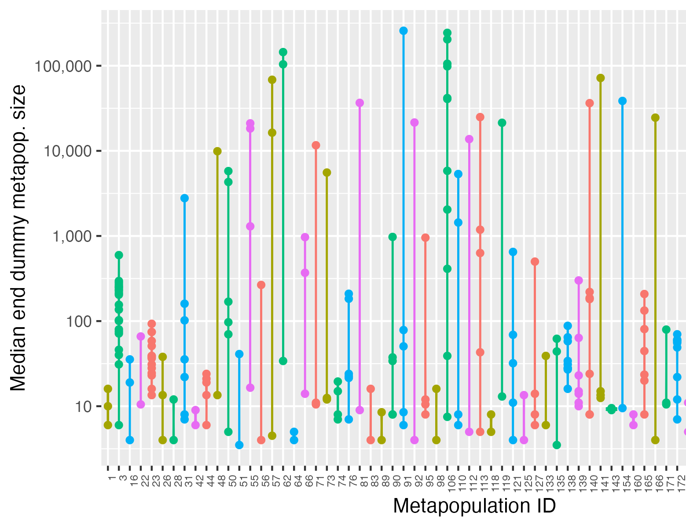
Logically impossible outcomes
Dummy metapopulations representing the same group of populations can differ from one another by orders of magnitude
Dummy metapopulations can grow at biologically impossible rates
Notes:
Just to illustrate the logical impossibility of the framework used for modeling dispersal in the SSA PVA: each value on the x axis represents a unique metapopulation ID. Each dot represents a population belonging to that metapopulation
some metapopulations have 10 or more constituent populations. The y axis represents the final size of the dummy metapopulation belonging to each constituent population- note that the y axis is log scale. The final size of these immigrant pools can differ by several orders of magnitude even though they are intended to represent the total abundance within the same exact set of populations!
Note also that many dummy metapopulations are larger than the initial rangewide abundance of 70,000 females despite an overall decline in the simulated rangewide abundance.

Slide 35
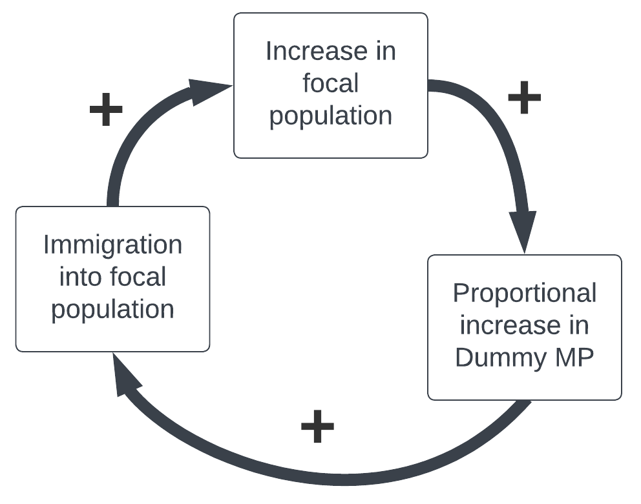
A strong and unrealistic feedback
For example…
N = 20, dMP = 5000
1% dispersal rate leads to 50 immigrants entering the population
Focal population increases from 20 to 70 (250% increase)
Dummy MP increases by 250%, from 5000 to 17,500 (12,500 more potential immigrants that can enter next year!)
Loope, Shoemaker and Akcakaya 2024. Global Ecology and Conservation
Notes:
Here’s how the dummy metapopulation structure unintentionally introduces a strong positive feedback.
Remember the dummy metapopulation grows in lockstep with the focal population. So imagine a focal population of size 20, paired with a large dMP of 5000 (this is based on a real example from the SSA pva model).
With a 1% dispersal rate this leads to 50 dispersers entering the population in the first year, increasing the focal population by 250% from 20 to 70.
The dummy MP also therefore increases by 250%, from 5000 to 17,500. This means the pool of potential dispersers just grew by 12,500! Through this process, the population quickly grows until it reaches its ceiling, which can be orders of magnitude larger than the initial abundance.
Clearly this is a powerful feedback process, and there is no ecological basis to support such a feedback, either logically or empirically.

Slide 36
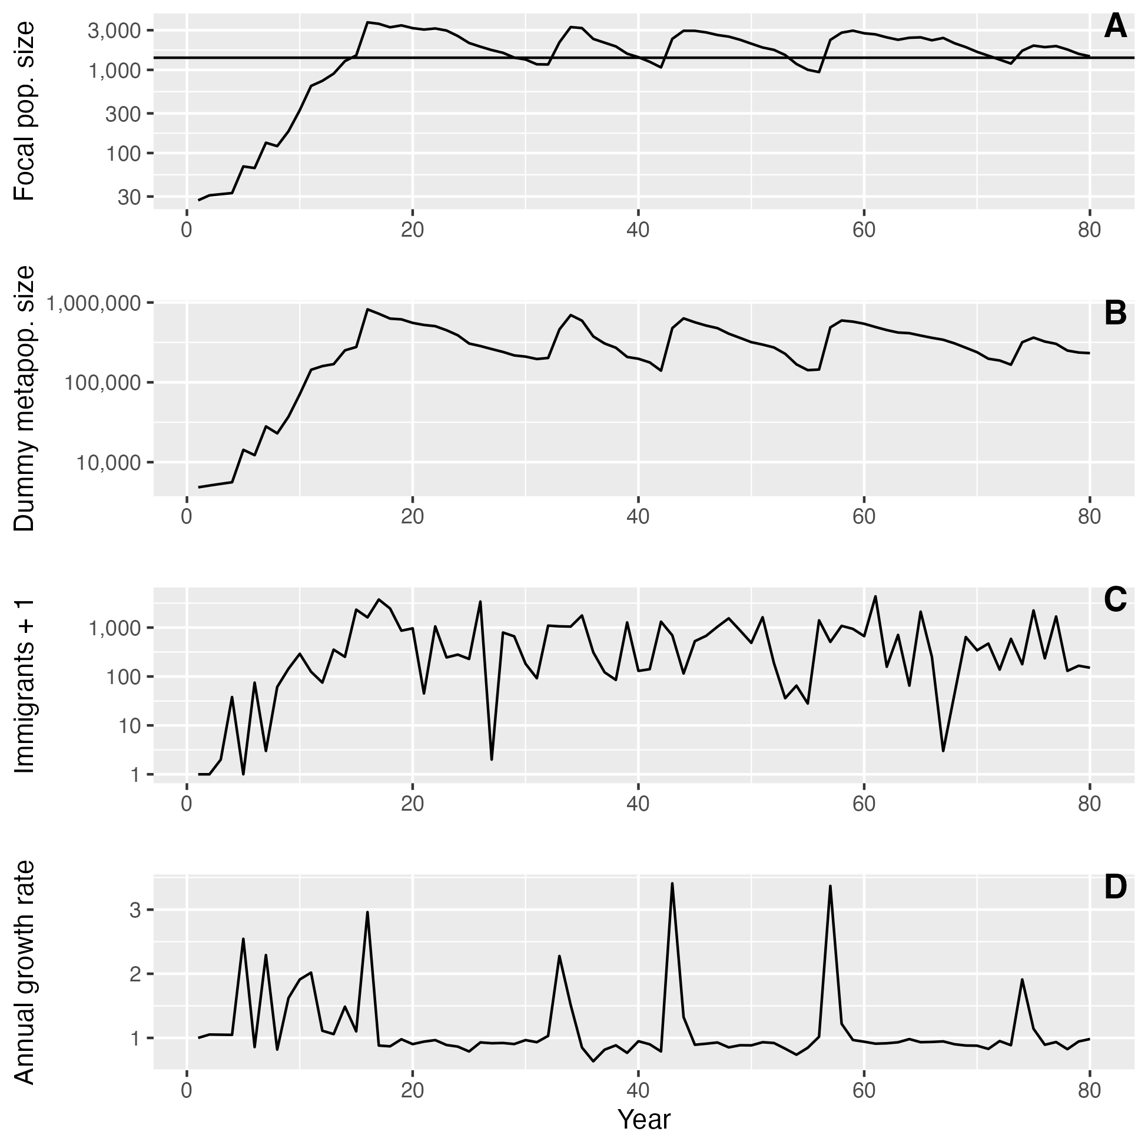
Erroneous feedback loop strongly influences focal population dynamics
Loope, Shoemaker and Akcakaya 2024. Global Ecology and Conservation
Notes:
This is an illustration of the consequence of this positive feedback in the SSA model.
This figure illustrates the growth of a single population in the SSA model, similar the example we just discussed.
The top panel represents the focal population, the middle panel represents the dummy metapopulation, and the bottom panel is the number of immigrants migrating into the focal population from the dummy metapopulation.
The y axis is log scale, so this illustrates rapid exponential growth in this focal population, driven by the runaway immigration feedback between focal populations and their dummy metapopulations.
This growth only ends when the population reaches its ceiling, at which point the population is continually propped up by a large number of immigrants arriving each year from the dummy metapopulation.
This problem is most apparent for populations whose initial size is small, but with a large dummy metapopulation and a ceiling that is much higher than the initial abundance.

Slide 37
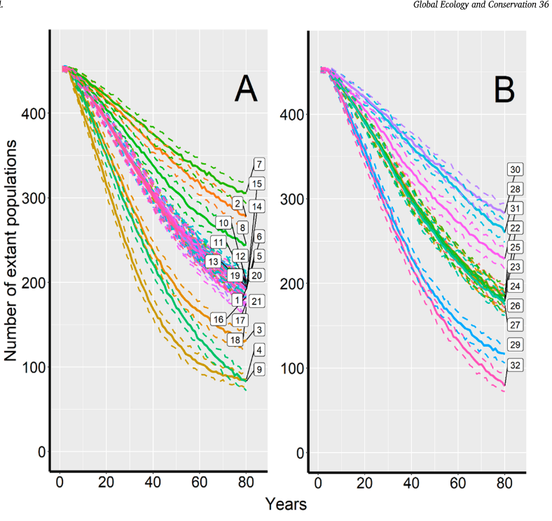
Differences between two versions of the model
SSA (USFWS 2021)
Folt et al. 2022
Start:
626 populations
~70,600 females
End:
~47,000 females
Start:
457 populations
~70,500 females
End:
~20,000 females
Notes:
One thing I haven’t mentioned- there are 2 published versions of this model- the first is the original 2021 SSA model, the second is a paper published by the PVA modelers in 2022.
I think it’s instructive to examine the results of the two published versions, since they are quite different in notable ways that likely relates to the immigration error we identified.
The original SSA model included some very tiny populations that were nested within larger metapopulations- exactly the type of population that is most susceptible to the positive feedback issue I talked about earlier.
Therefore, although the initial abundances in the two models were nearly identical, there were substantially more populations included in the original model versus the published version.
Strikingly, the final abundance in the published version showed a much steeper decline than the original SSA model- only 20k females remained, while over 45k females remained in the original SSA model. Despite minimal differences in the overall starting population size.

