Slide 1
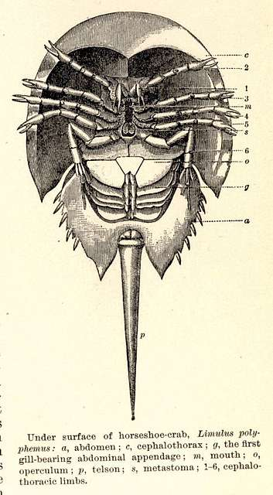
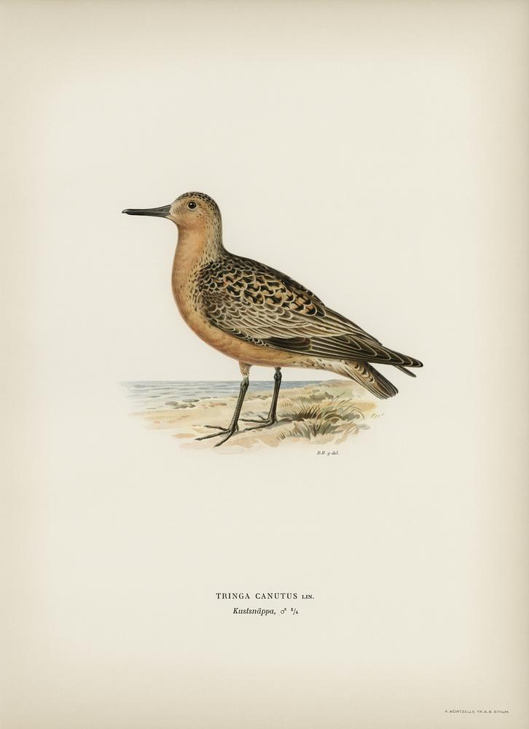
Case study: Red Knots and Horseshoe Crabs
NRES 421: Conservation Biology
Kevin Shoemaker – NRES

Slide 2
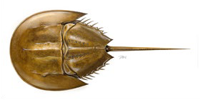
Atlantic States Marine Fisheries Commission (ASMFC). 2021. Revision to the Framework for Adaptive Management of Horseshoe Crab Harvest in the Delaware Bay Inclusive of Red Knot Conservation. Arlington, VA. 302 pp. http://www.asmfc.org/species/horseshoe-crab

Slide 3
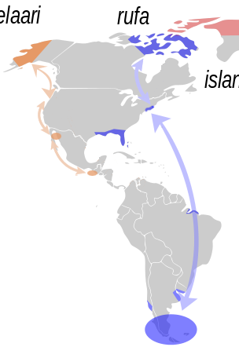
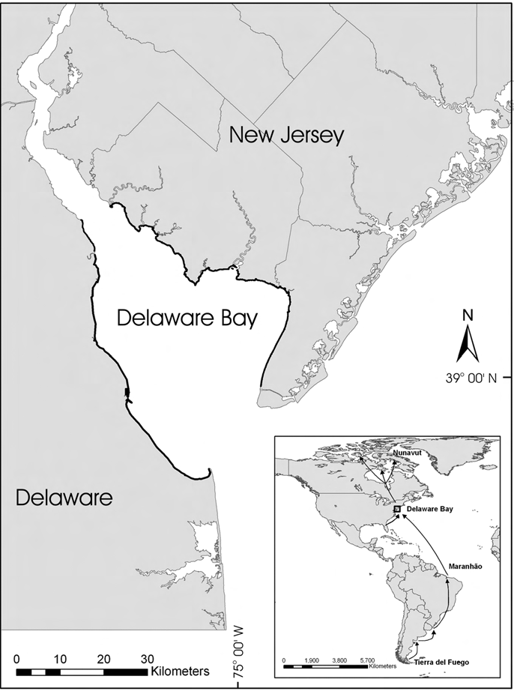

Slide 4
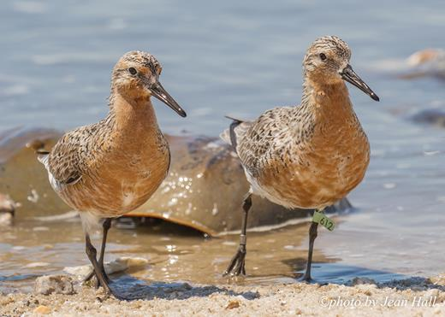

Slide 5
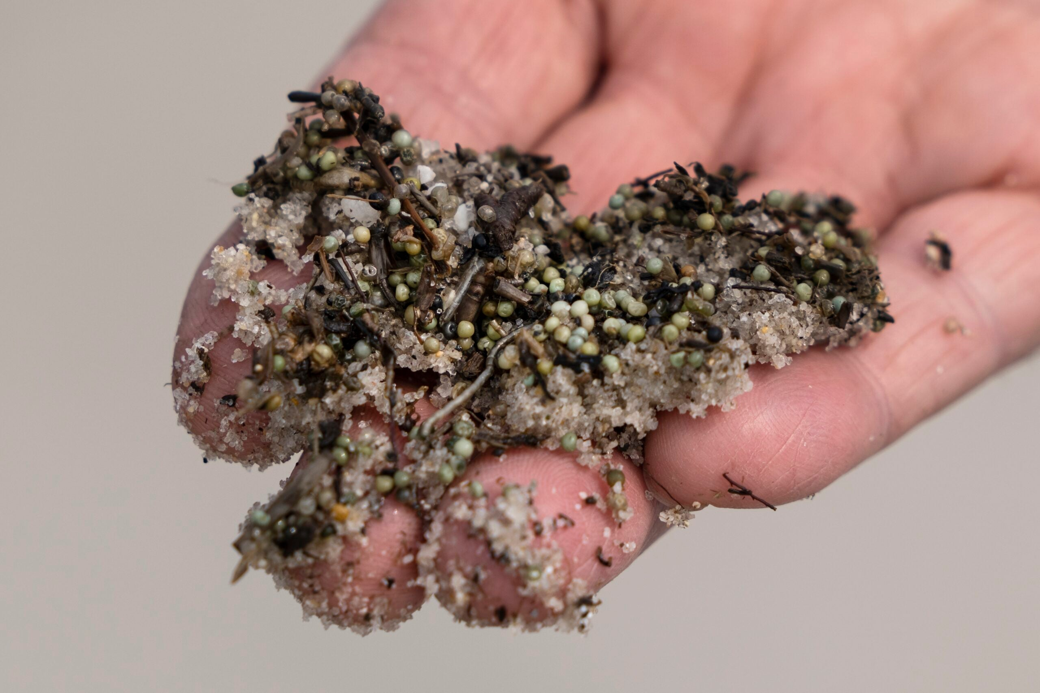

Slide 6
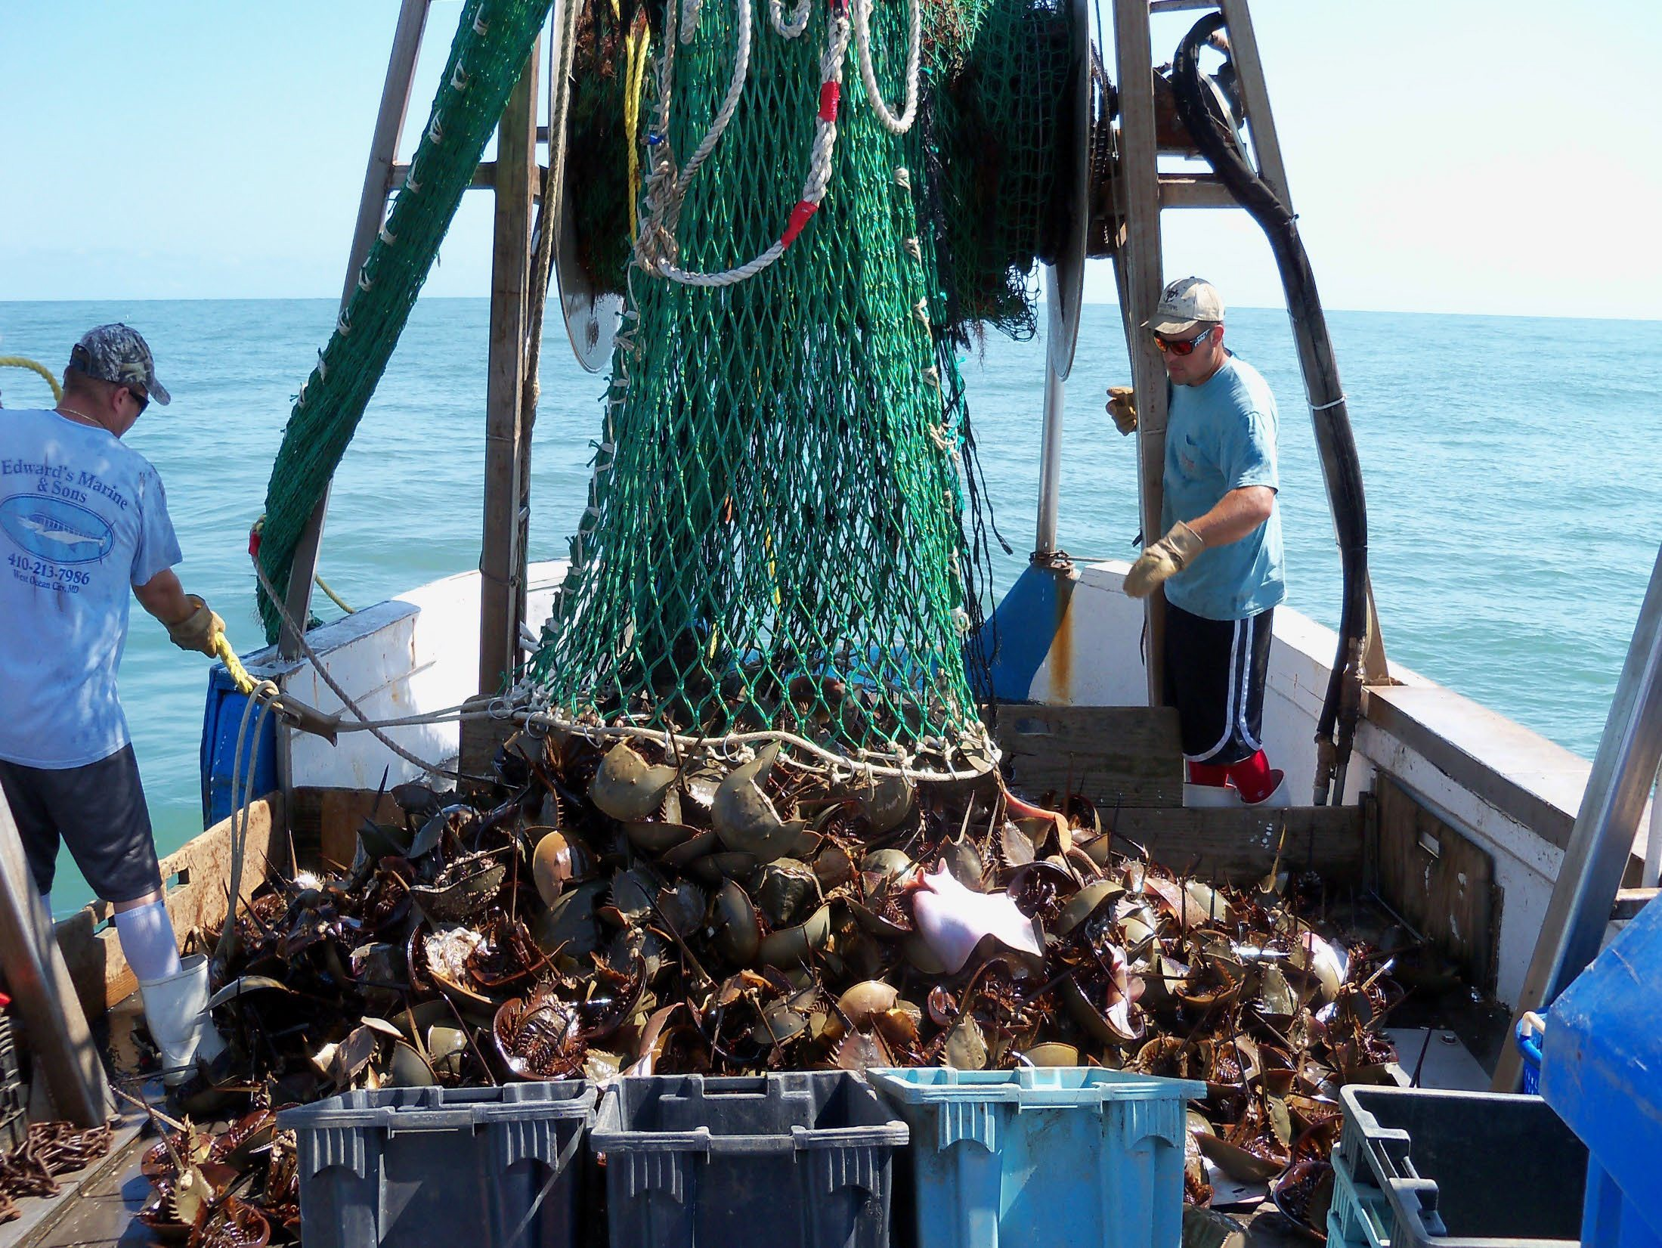

Slide 7
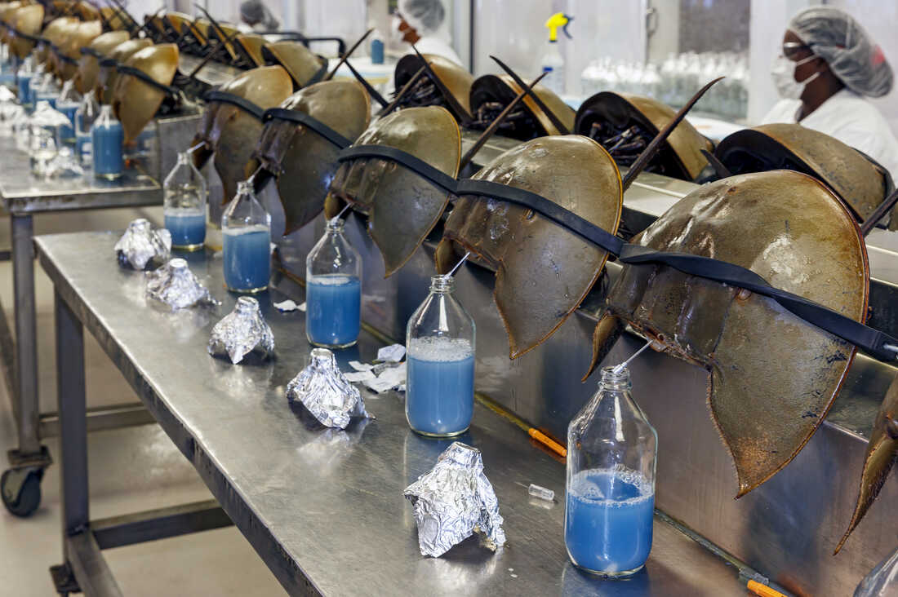

Slide 8
Overview of Changes
Problem Statement
Manage harvest of horseshoe crabs in the Delaware Bay to maximize harvest but also to maintain ecosystem integrity, provide adequate stopover habitat for migrating shorebirds, and ensure that the abundance of horseshoe crabs is not limiting the red knot stopover population or slowing recovery.

Slide 9
Management and Monitoring History for Horseshoe Crabs and Red Knots
1990s: Unregulated harvest of Horseshoe Crabs (HSC)
Aerial shorebird counts: decline in Rufa Red Knot (REKN) population
Horseshoe Crab harvest regulations approved
2000s: Begin rigorous monitoring programs for REKN and HSC
2010s: Adaptive Resource Management (ARM) framework
Two species approach: maximize HSC harvest, minimize risk to REKN
REKN listed under ESA -- HSC harvest identified as major threat
2020s: Revised two-species ARM
Outdated software and methods- needed to update the model!
Revised ARM instituted in 2023

Slide 10
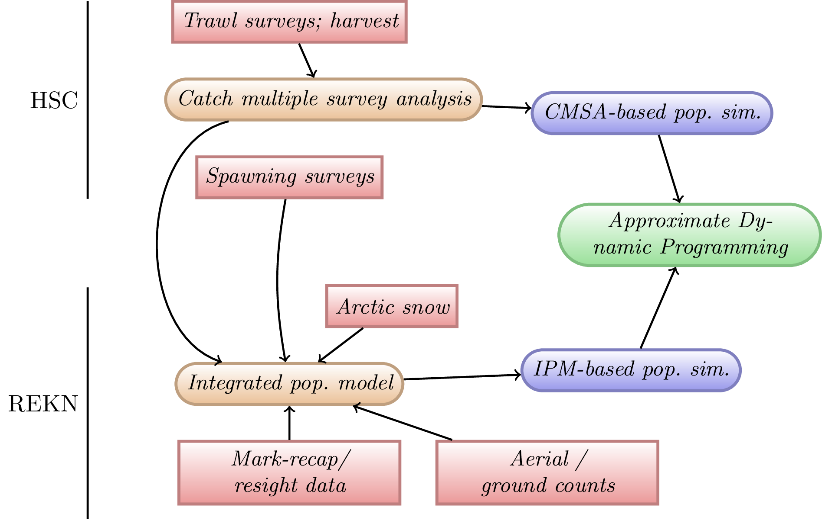
Revised ARM Conceptual Model

Slide 11
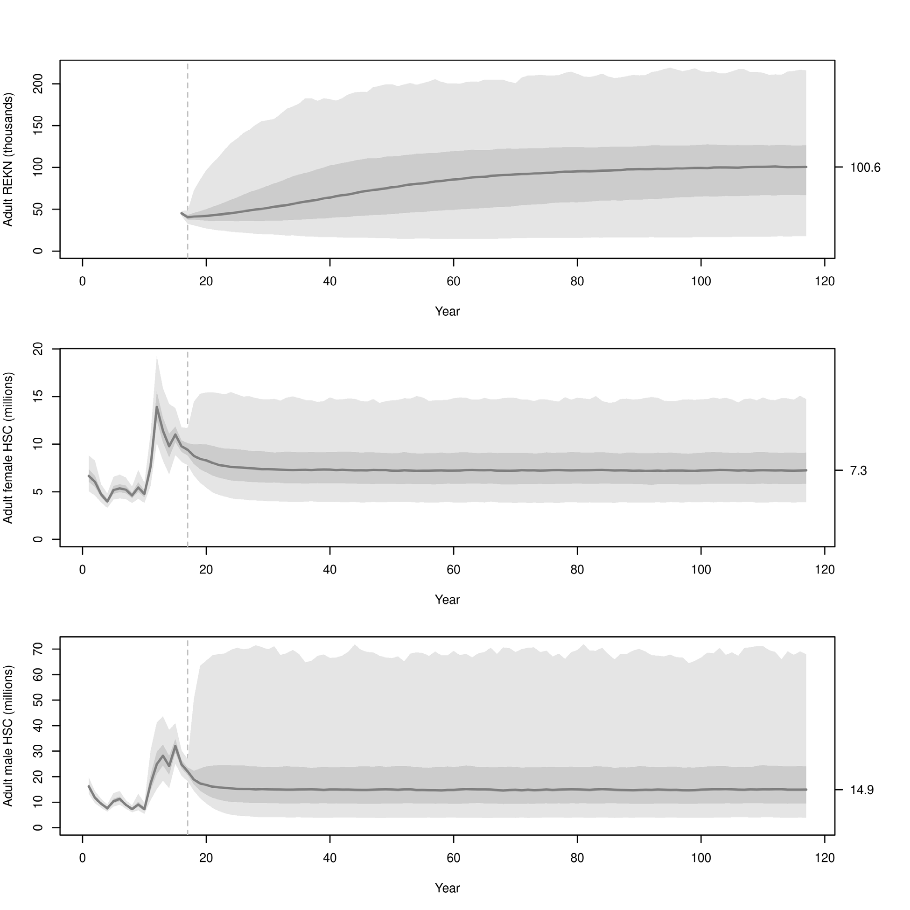
Results: Predicted population sizes
REKN simulation results:
HSC simulation results (female):
HSC simulation results (male):

Slide 12
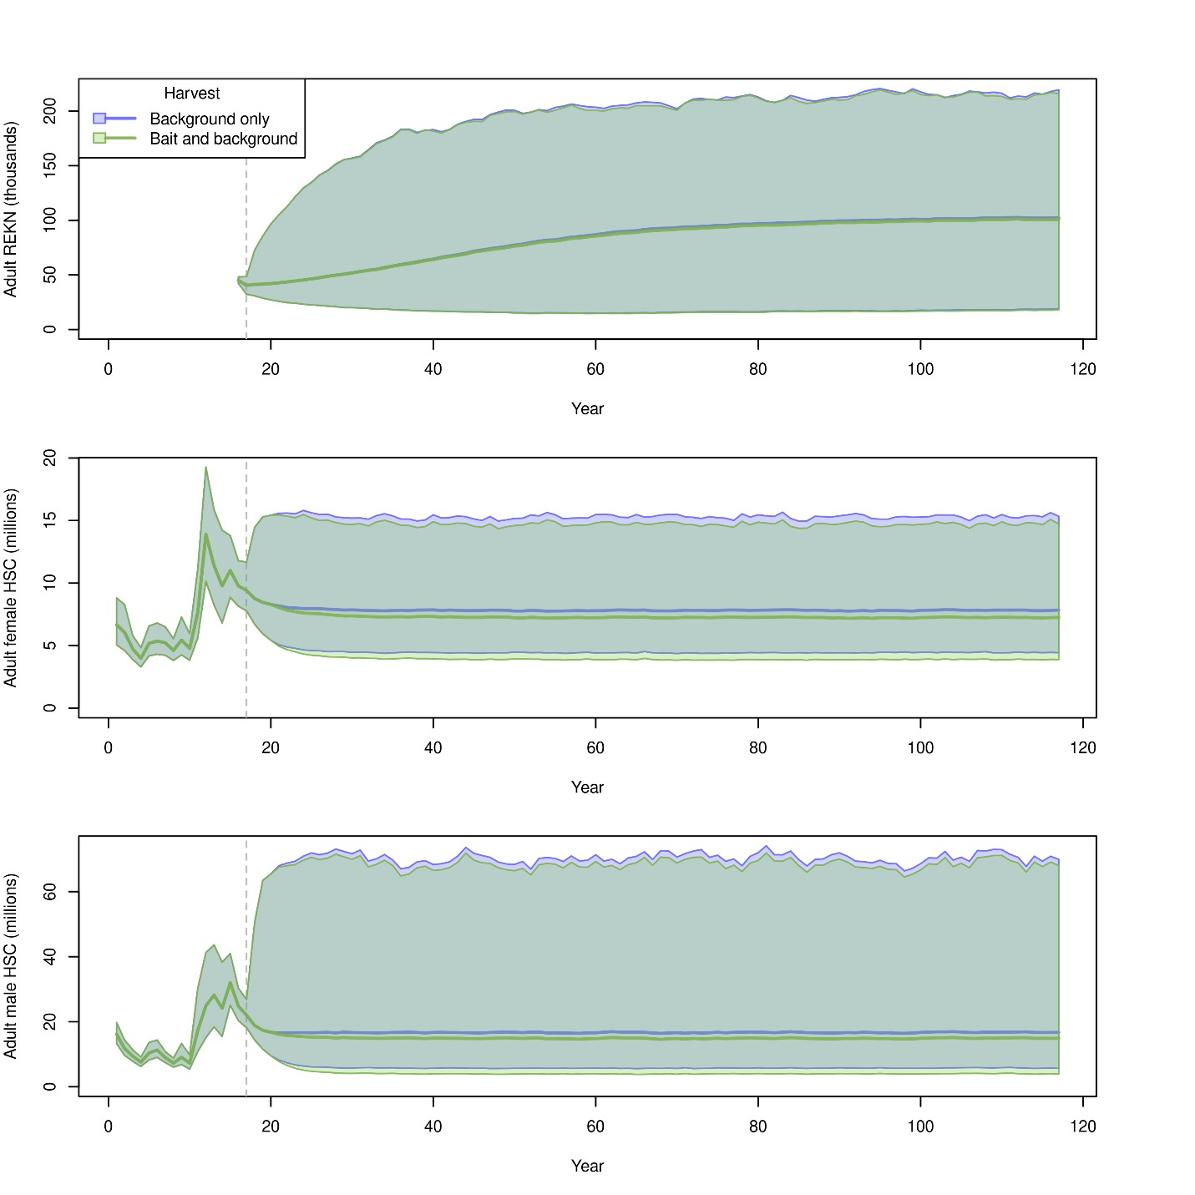
Results: Predicted population sizes
REKN simulation results:
HSC simulation results (female):
HSC simulation results (male):
Notes:
This is the figure that convinced USFWS that the harvest of female HSC is not going to harm HSC or REKN population

Slide 13
Example Harvest Recommendation
Year | VA Tech Swept Area Estimates |  | Red knots | Optimal HSC Harvest (previous ARM)
 | Female HSC | Male HSC |  | Female | Male
2017 | 6,654,877 | 21,405,997 | 49,405 | 0 | 500,000
2018 | 7,555,622 | 19,346,403 | 45,221 | 0 | 500,000
2019 | 7,934,057 | 16,645,912 | 45,133 | 0 | 500,000
Year | CMSA Estimates |  | Red knots | Optimal HSC Harvest (revised ARM)
 | Female HSC | Male HSC |  | Female | Male
2017 | 10,967,100 | 31,664,430 | 49,405 | 154,483 | 500,000
2018 | 9,735,690 | 24,715,290 | 45,221 | 146,792 | 500,000
2019 | 9,357,400 | 21,897,920 | 45,133 | 144,803 | 500,000

Slide 14
Red Knot model

Slide 15
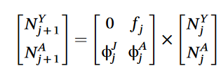
Two-stage population model for Red Knot:
ϕ^{A}
ϕ^{J}
Juveniles
Adults
f^{J}

Slide 16
Red Knot (REKN) population model specification: original model
Life history: juvenile and adult stages. Start breeding at 2 years of age.
Adult Survival rate: 93% per year at “normal” HSC abundance.
Juvenile Survival rate: 75% annually
Reproduction: each adult produces 0.15 offspring annually that survive to become juveniles
Abundance: around 50,000 adults and 5,000 juveniles

Slide 17
Red Knot (REKN) population model specification: reanalysis
Adult Survival rate: Average survival rate is ~80%.
Reproduction: My reanalysis suggests this needs to be nearly double the value used by ASMFC to maintain a stable population – around 0.3 per capita
Abundance: My reanalysis suggests a higher fraction of the population should be juvenile

Slide 18
(In class exercise)
See Excel spreadsheet

Slide 19
Let’s discuss!

Slide 20
L

Slide 21
REKN Lambda = 1.04 (at baseline HSC abundance)
Tucker et al. 2023

Slide 22

‘Reward' Function for optimization
Annual reward:
Multiple Criteria Decision Analysis: ideal situation is when we harvest the maximum allowed and red knot abundance ≥81,900
Values of u can range from 0 to 1; therefore r_{y} ranges from 0 to 3
r_{y} = 1 + 1 + 1x1 = 3 (Everybody is happy!)
This formulation of the reward function prevents getting all the reward from only horseshoe crab harvest (e.g., r_{y} = 1 + 0 + 1x0 = 1)
Notes:
Illustrates how PVA intersects with decision analysis.

Slide 23
Monitoring data
Horseshoe crab
Trawl surveys: DE (since 1990), NJ (since 1995) and Virginia Tech (since 2003)
Spawning surveys since 1999 (citizen science!)
Egg density surveys (since 2000)
Red Knot
Aerial counts (since 1986)
Capture/banding records (since early 1900s)
Resighting records (since 2003)

Slide 24
REKN scenario tests
Baseline- run the model with all parameters at baseline levels (normal levels of horseshoe crab eggs)
Run the model with the HSC population cut in half
Run the model with the HSC population set to zero (catastrophic collapse of the population)

Slide 25
REKN Lambda = 1.04 (at baseline HSC abundance)
REKN Lambda = 1.01 (at ZERO HSC abundance)

Slide 26
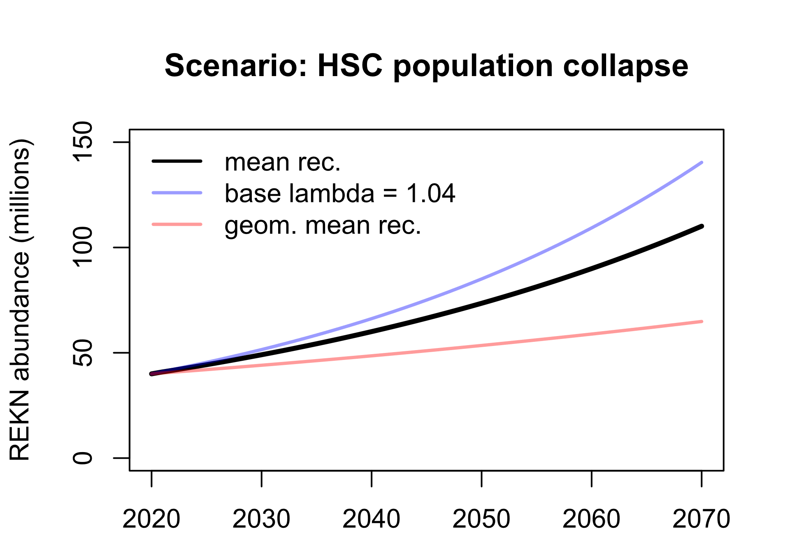

Slide 27
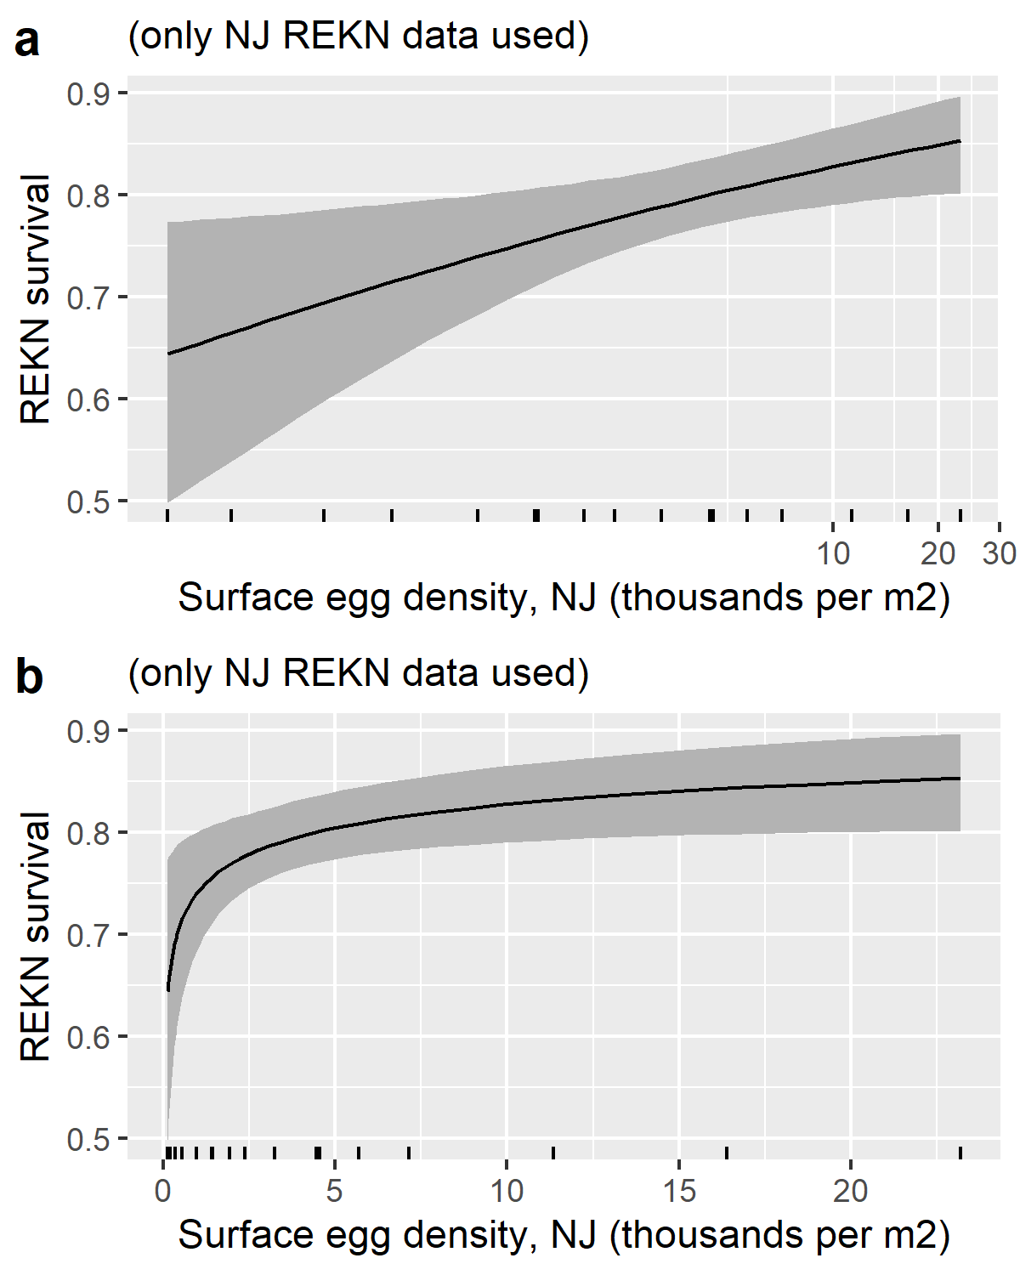
REKN survival is related to surface egg density
NOTE: Since egg density data was not collected on the DE side of Delaware Bay, only birds resighted in NJ were used for this analysis

Slide 28
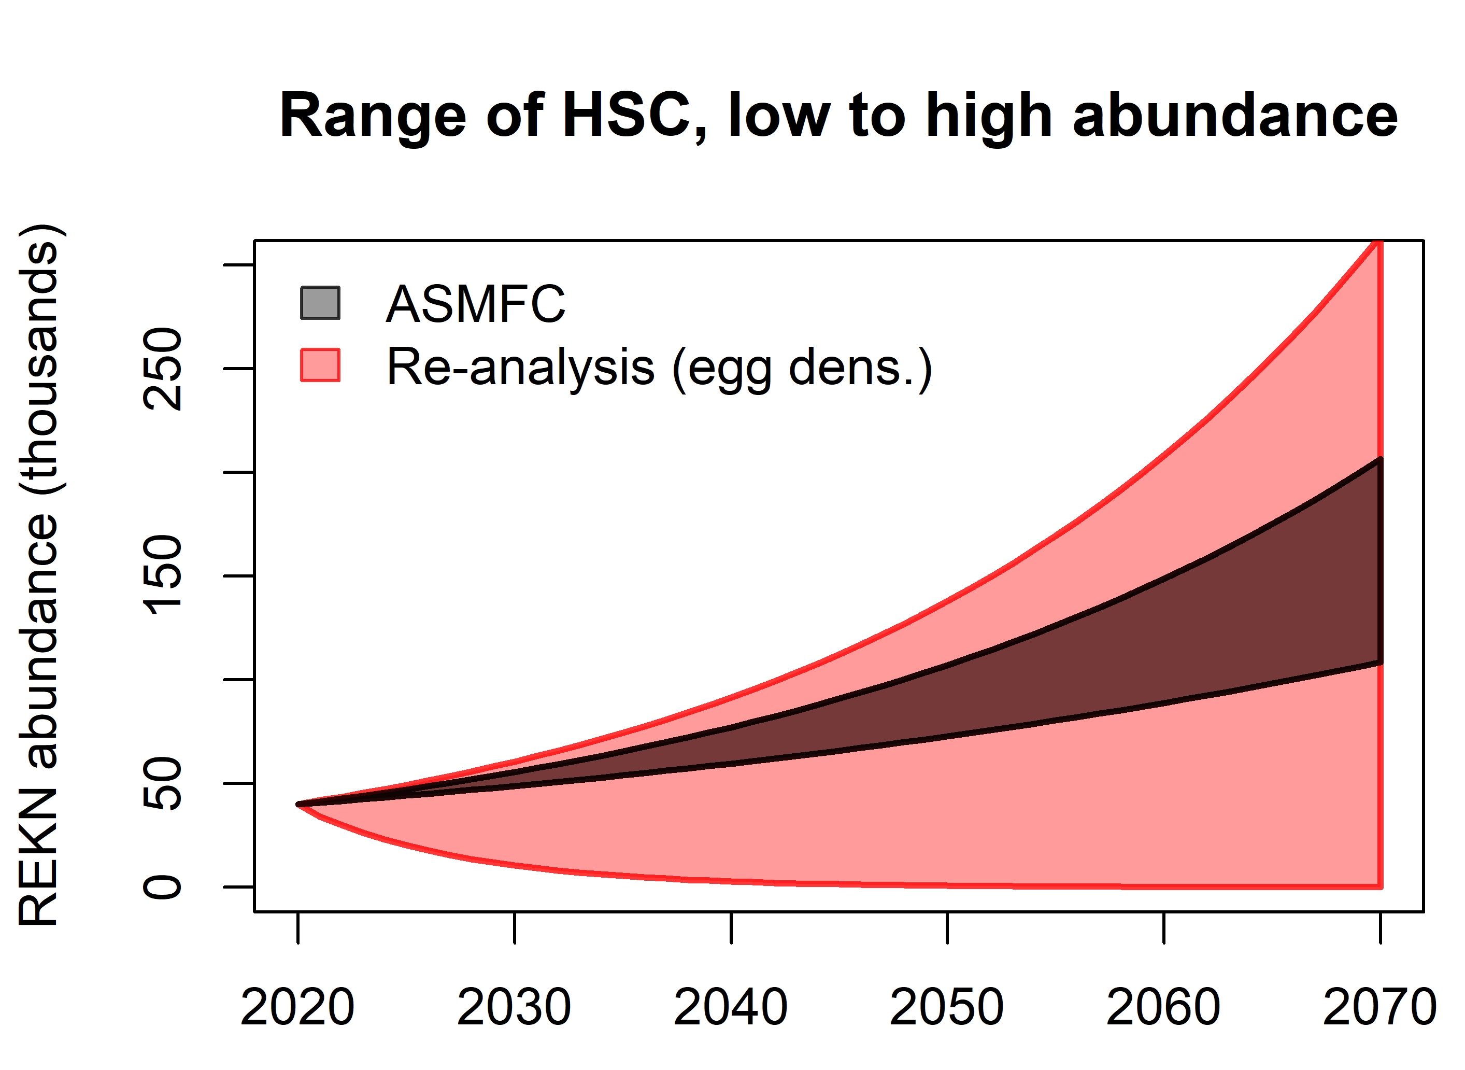
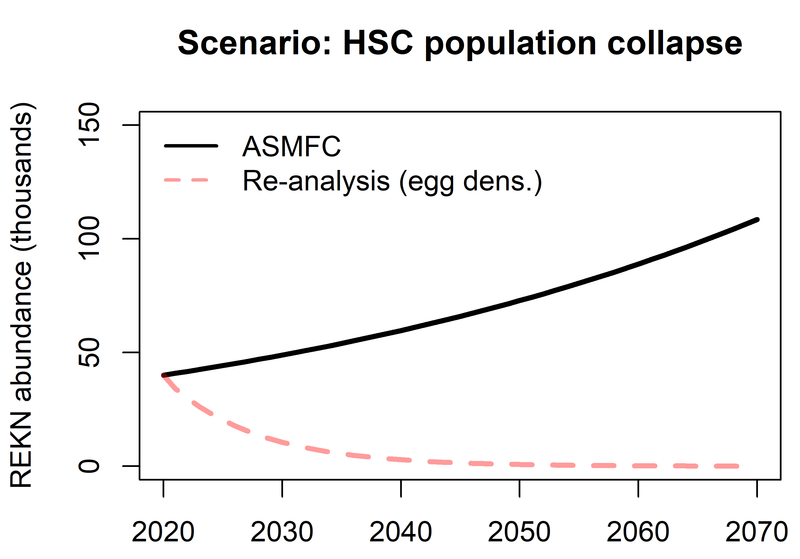

Slide 29
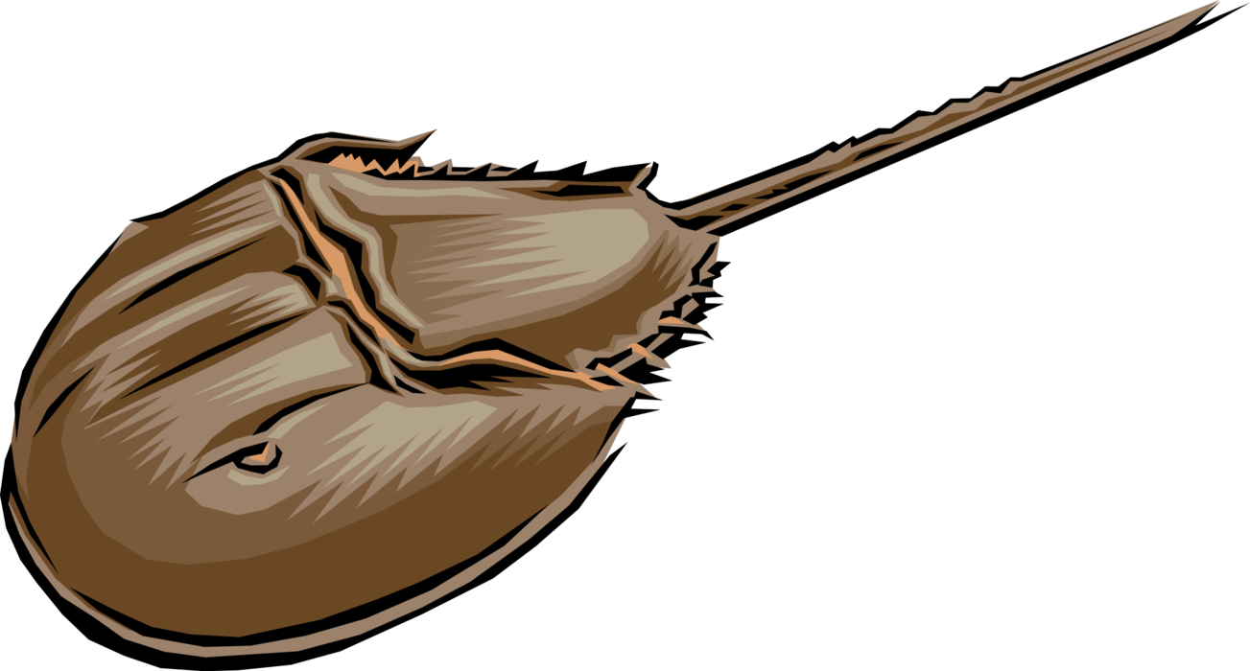
Horseshoe crab model

Slide 30
Stochasticity and uncertainty
Lack of Knowledge
Simulate under many replicates of alternative scenarios covering the range of uncertainty we have about our study system
Randomness of the system
Environmental stochasticity
Demographic stochasticity

Slide 31
The future is uncertain. Model it anyway!
Any of these trajectories might represent the future of the population. The distribution of outcomes can be interpreted as our prediction.

Slide 32
Horseshoe crab model specification
Only model female adult (reproductive) HSC (single stock)
Starting population size is around 10 million females in Delaware Bay
Baseline harvest due to all other sources (biomedical, bycatch) is around 50,000 per year
Recruitment rate (rate of entry of new adults into the population each year) is modeled using a lognormal random number generator with average recruitment of 3.2 million per year and log-sd of 0.5.
Adult mortality is 30%

Slide 33
HSC scenario tests (group activity)
Baseline- run the model with no commercial harvest of females (only baseline harvest)
Run the model with maximum proposed commercial harvest of females: 210,000 females harvested per year
Run the model with 1 million females harvested each year (much higher than max proposed harvest)
What is the maximum sustainable harvest rate (number of females harvested per year) in this population? Note that you need to define what “sustainable” means here!
Keeping the same harvest rate (maximum harvest rate identified above), run the model again with the average recruitment parameter cut in half (set to 1.6 million per year). Is the population still sustainable?
Please work together to describe the results of your scenario tests. Do you think this population is likely to be resilient to the maximum allowable female harvest rates? Why or why not?

Slide 34
(In class exercise)
https://insightmaker.com/insight/gim35Z9XDbmFy7gcQy2JD/Horseshoe-crab-model

Slide 35
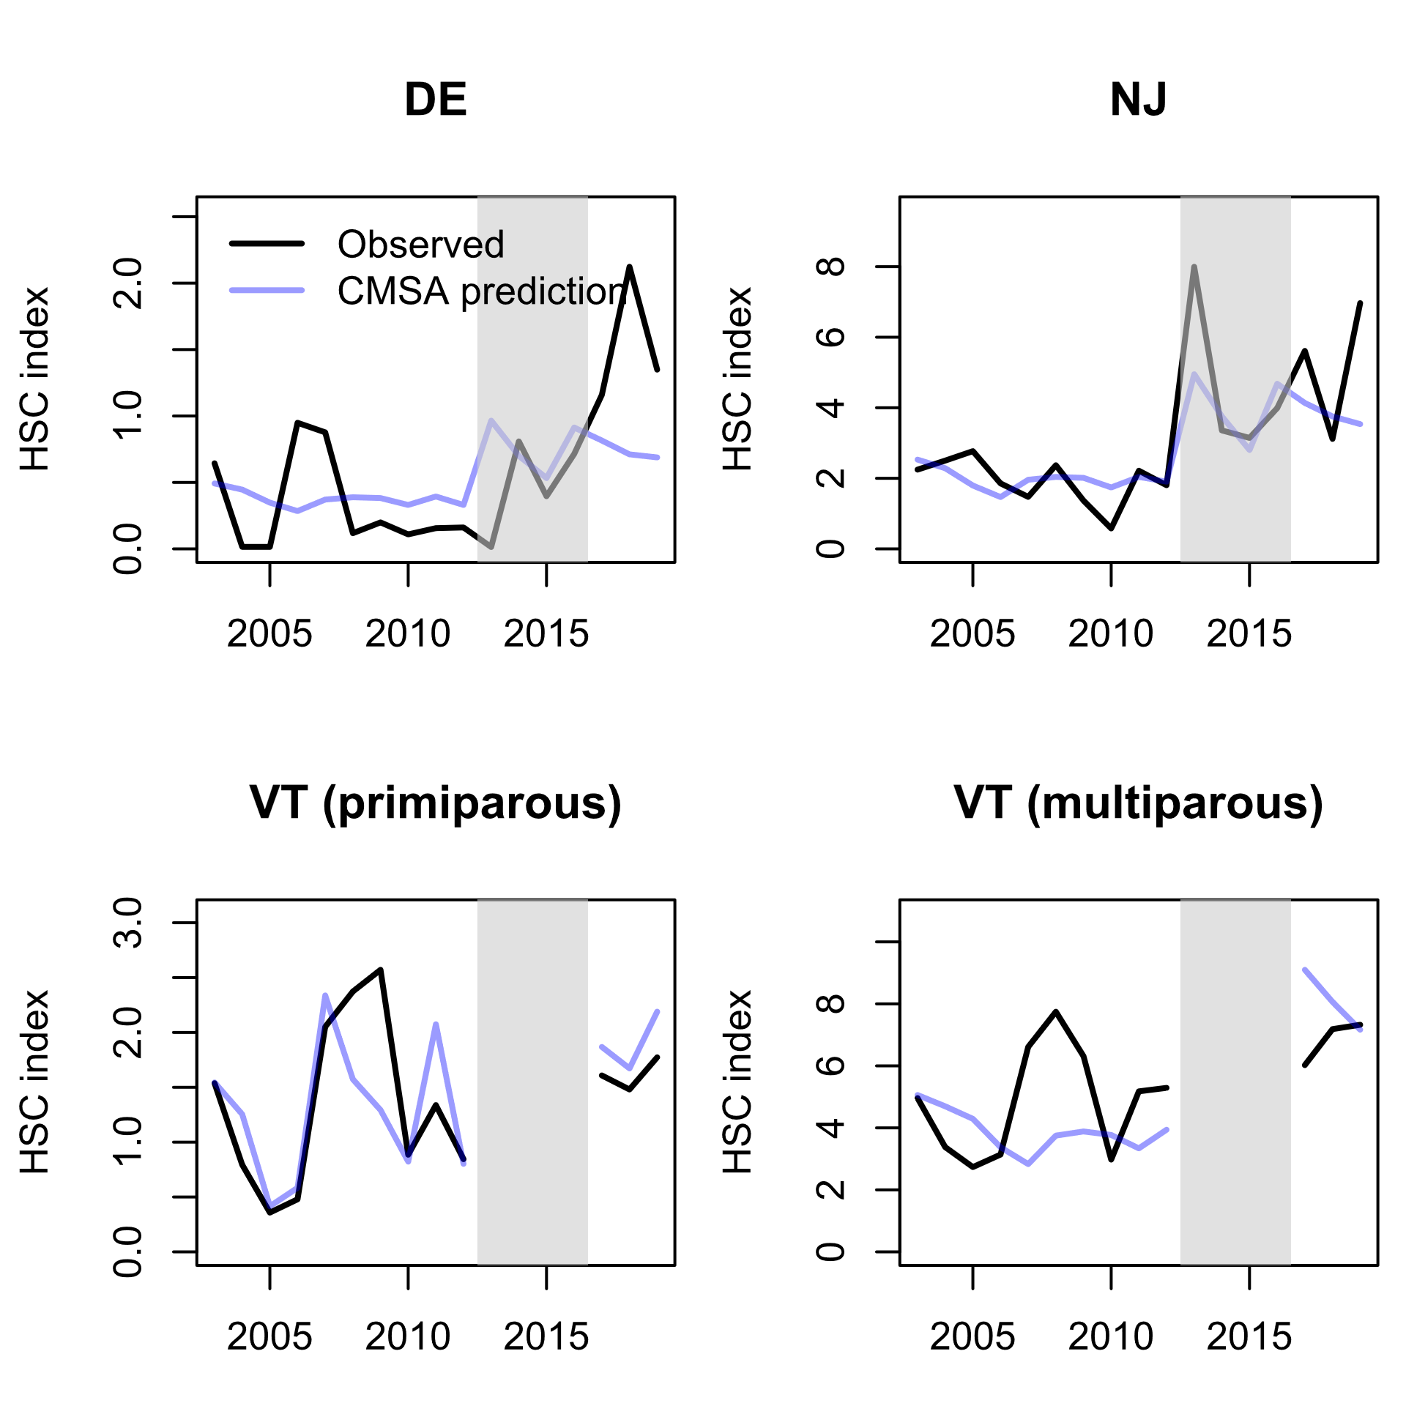

Slide 36
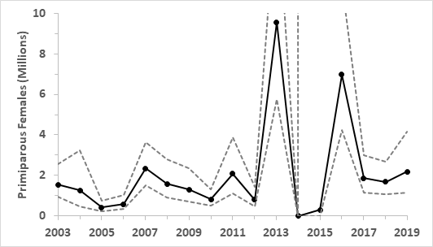
ASMFC 2021

Slide 37
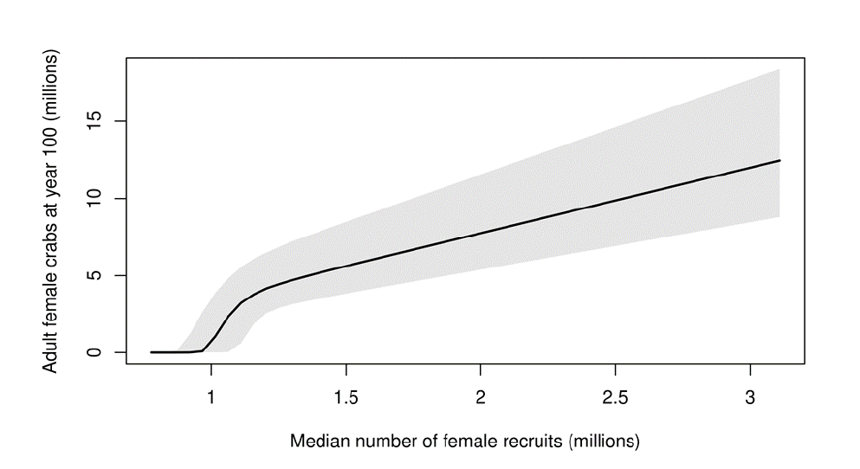
Post-gap years: 1.9 million
VT gap years: 4.21 million
Pre-gap years: 1.12 million
Avg., excluding gap
Avg., ARM report
Avg., ARM supp.
4
Notes:
Figure 33 original report

Slide 38
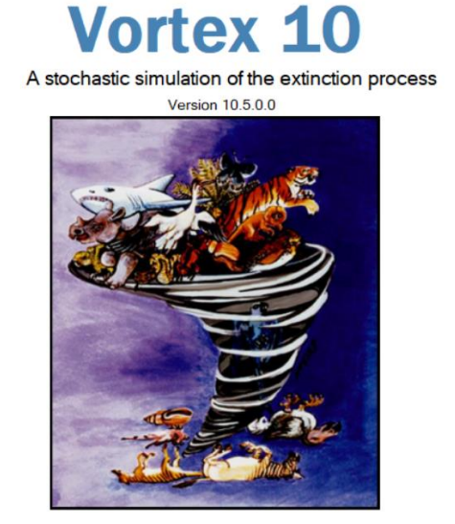
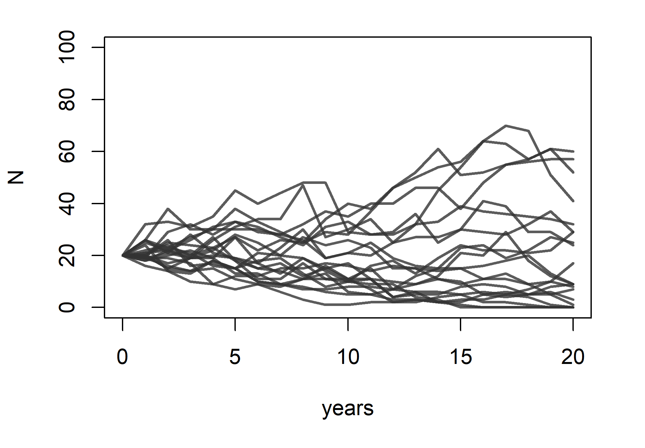



Population Viability Analysis (PVA)
Core workhorse of conservation biology
Risk of extinction
Rank management alternatives
Vortex, Ramas, HexSim
Ad hoc R code
Notes:
To test hypotheses about how to conserve and manage rare and endangered species, we need to run experiments.
However, running real-world experiments on rare and endangered species can be impractical- and unethical!
Instead, conservation biologists typically test hypotheses using in silico experiments, using stochastic simulation models of wildlife populations, known as Population Viability Analyses (PVA)
For decades, PVA models have been used for decision making in wildlife conservation and management—for instance, determining which species warrant protection under the US Endangered Species Act (ESA).
PVA has traditionally been performed using stand-alone software packages like Vortex, Ramas, and HexSim [show logos].
However, these closed-source software packages are rapidly becoming outdated, and PVA is now commonly performed using ad hoc computer code (often using R).

Slide 39
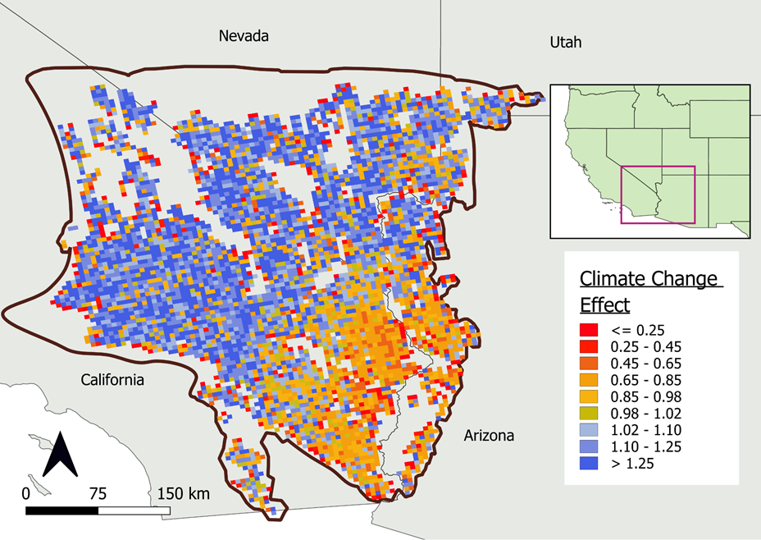
PVA challenges and opportunities
Large-scale questions require large-scale PVA models!
Restoring species’ ecological role
IUCN Green Status Assessment
Multi-species assessments
Notes:
Now, the questions we are attempting to address using PVA are rapidly becoming more complex, motivated by the needs of conservation organizations and governmental agencies.
For example, my lab recently built a PVA to assess the impact of climate-change across the entire range of the Mojave Desert Tortoise.
Furthermore, conservation organizations and governmental agencies are becoming as interested in preserving and restoring the ecosystem functions of species as they are in preventing the extinction of species – and this can necessitate more complex simulation models that include multiple interacting species!
As the questions asked by conservation biologists expand in scope, PVA models become more complex, data hungry and computationally intensive, even as they become more central to the field of conservation biology than ever before.
As we all know, complexity comes at a cost.
As modelers scramble to develop ad hoc code for running these models, the resulting PVA models can be opaque and exceedingly difficult to test and evaluate.

Slide 40
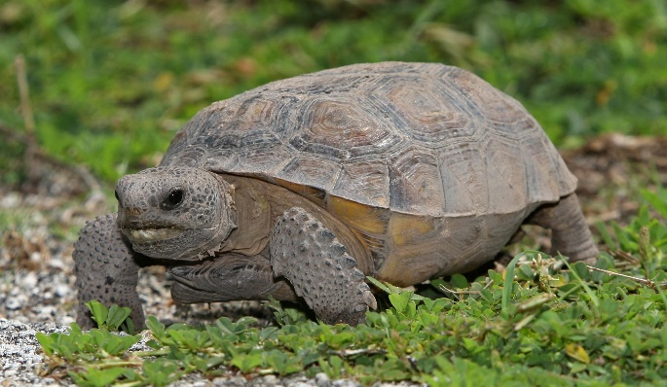
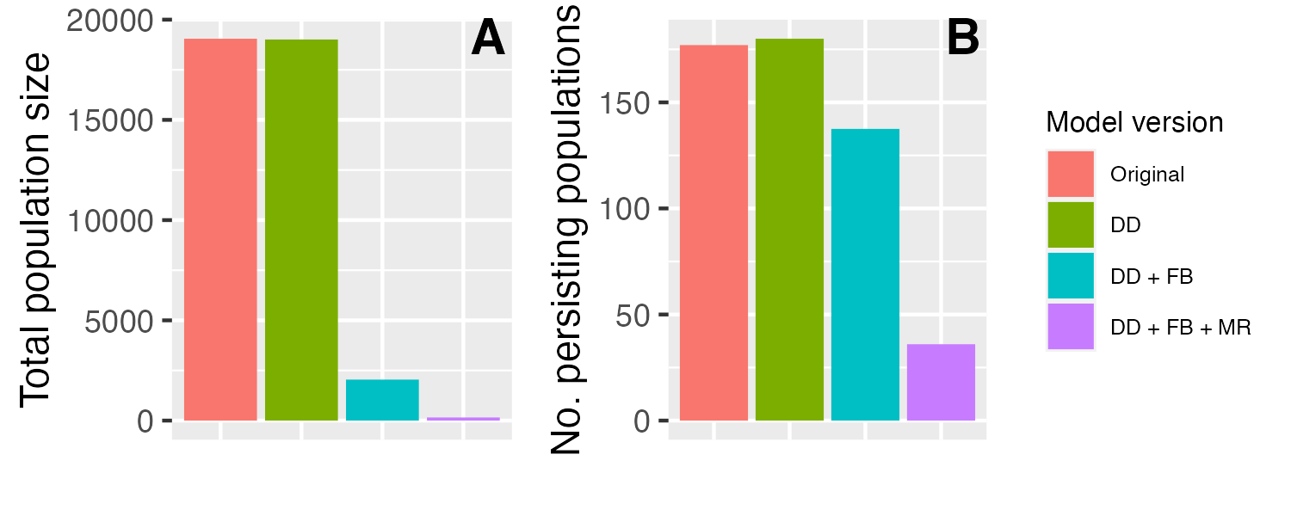
Case study: gopher tortoise Species Status Assessment
Notes:
This lack of transparency and reproducibility has resulted in flawed PVA models being used to support important conservation decisions.
As a case in point, consider the gopher tortoise- a keystone species of the American Southeast whose burrows provide refuge for hundreds of species.
Based on a recent rangewide PVA model, the USFWS recently withdrew the gopher tortoise as a candidate for federal protection.
However, my colleagues and I discovered three major coding errors in this model that together completely invalidate the results of this model.
The pink bar here illustrates the results from the original model, both for predicted total population size and number of persisting populations by the year 2100.
In contrast, these are the results from the corrected model.
The authors of the original PVA model agree with us and are currently working to correct the record.
Nonetheless, it is sobering to consider that this PVA model made it through three separate peer review processes, and my colleagues and I only discovered the errors after spending months working through its many thousands of lines of R code.

Slide 41
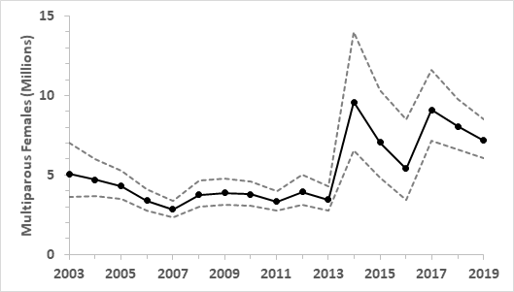
CMSA Results – Female Horseshoe Crabs
Primiparous (R)
Multiparous (N)

Slide 42
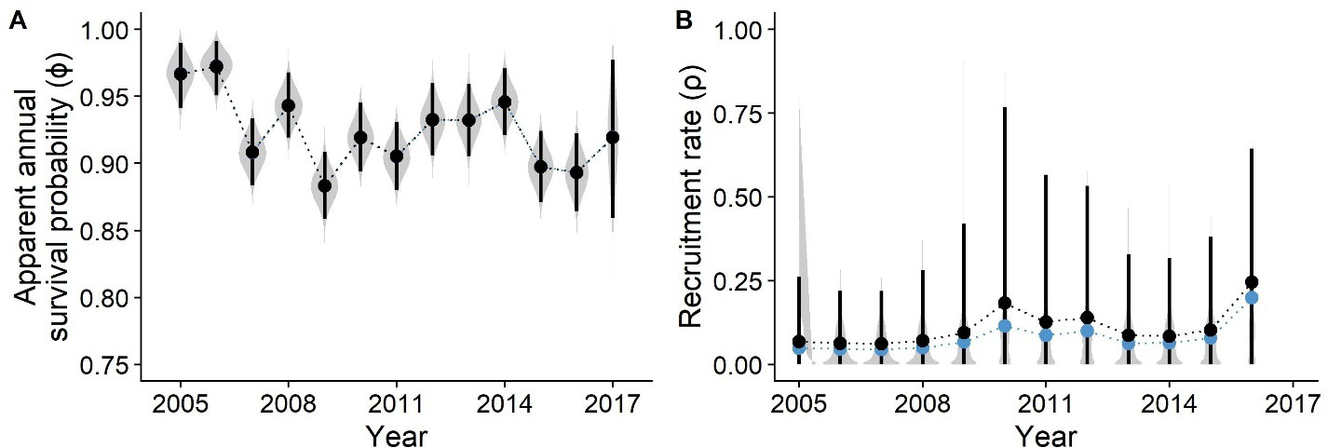
Red Knot IPM – Survival and Recruitment
Red Knot Population Model: IPM Results

Slide 43
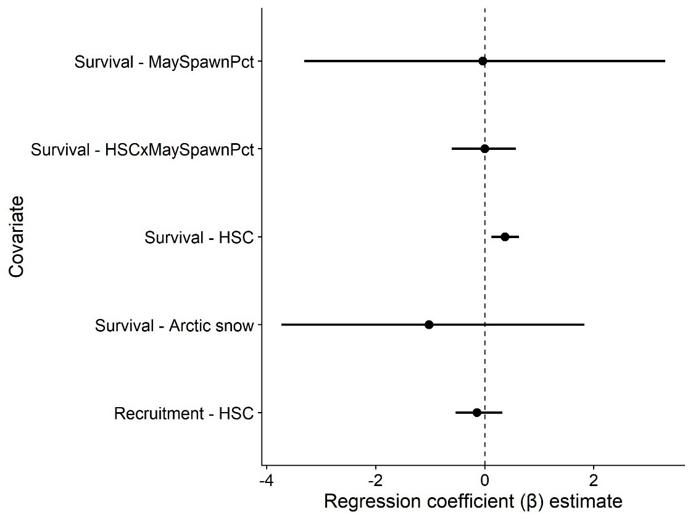
Red Knot IPM – Covariate Effects
ASMFC 2021

Slide 44
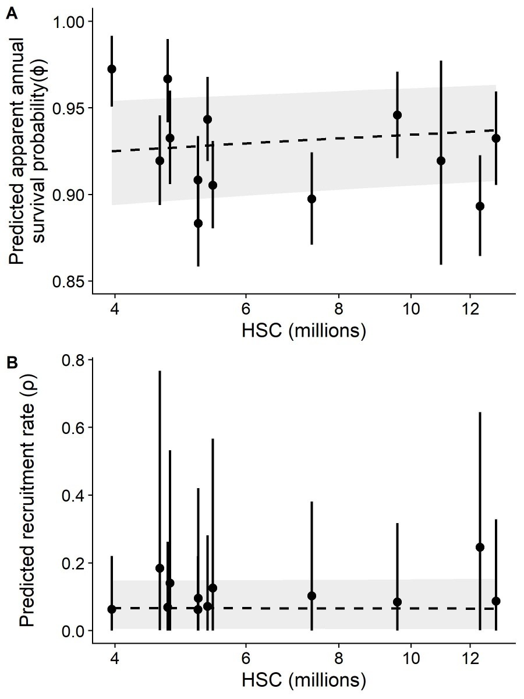
Red Knot IPM – Covariate Effects

Slide 45
Population Viability Analysis (PVA) Models
Horseshoe Crabs
Annual recruitment process derived from CMSA results
Fit a distribution to the CMSA results (bivariate lognormal)
Decreased recruitment when total females <3.75 million or sex ratio becomes female biased
Red Knots
Simulation model based directly on the IPM
Models were then linked and simulated together for the optimization of harvest policy functions in Approximate Dynamic Programing (ADP)

Slide 46
Let’s return to those REKN/HSC relationships…

Slide 47
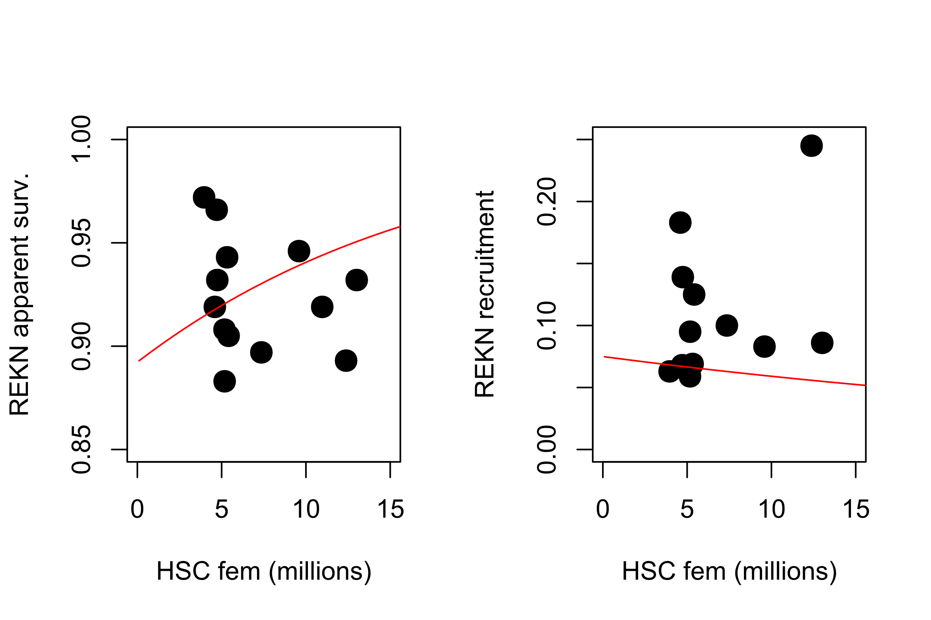

Slide 48

Fundamentals of population ecology: exponential growth
$$∆n=Births −Deaths+Immigrants −Emigrants$$
Per capita births minus per capita deaths = r, or the intrinsic rate of increase
Often ignored at first – assume a self-contained population

Slide 49


Fundamentals of population ecology: exponential growth
$$N_{t }= N_{t−1}∙λ$$
$$N_{t }= N_{0}∙λ^{t}$$
Growing or stable population: Lambda ≥ 1 (r ≥ 0)
Notes:
What is the per-capita population growth rate?
The power of population is indefinitely greater than the power in the earth to produce subsistence for man

Slide 50
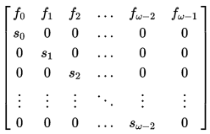
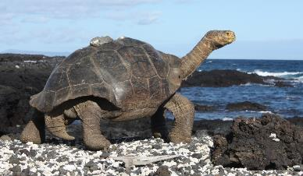

Age Structure and Stage Structure
Vital rates can vary substantially among individuals, and often much of this variation can be explained by age or age class!
$Transition matrix$ f = fecundity, s = survival
Important for species with highly “skewed” fecundity and survival rates.
For example, turtles and tortoises:
Low survival in first few years of life, very high survival in later years
Non-reproductive for many years, high reproductive capacity when adults

Slide 51
Build a Red Knot population model!

