Slide 1

Bayesian Networks
NRES 746: Laura Cirillo, Cortney Hulse, Rosie Perash

Slide 2
Bayesian Networks
Bayesian Networks (or Bayesian Belief Networks) are probabilistic graphical models
Acyclical
Directed
Network structures contain nodes and links
Nodes are random variables
Direction of the links indicate causality

Slide 3
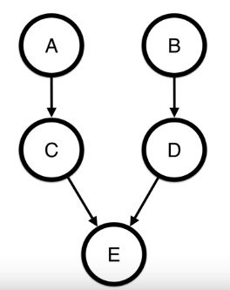
Nodes and BN
Nodes can represent observed variables, latent variables, or hypotheses/hypothetical parameters
Descendant variables are dependent on parent variables
Variables will be conditionally independent of its non-descendants given its parents

Slide 4
Conditional Probability Tables
BNs will also contain conditional probability tables
Contain the belief in the state of each of our nodes (random variables)
Include both prior probabilities and conditional probabilities

Slide 5
Prognostic BN
Prognostic view of a BN
Experimental variables on top
Object we are looking at the bottom
Causes above effects, and confounding variables above everything else
Notes:
Belief vs. decision networks
Consider a simple, hypothetical survey whose aim is to investigate the usage patterns of different means of transport, with a focus on cars and trains.  Age (A): young for individuals below 30 years old, adult for individuals between 30 and 60 years old, and old for people older than 60.  Sex (S): male or female.  Education (E): up to high school or university degree.  Occupation (O): employee or self-employed.  Residence (R): the size of the city the individual lives in, recorded as either small or big.  Travel (T): the means of transport favoured by the individual, recorded either as car, train or other. The nature of the variables recorded in the survey suggests how they may be related with each other.

Slide 6
Diagnostic BN
Diagnostic view of a BN
Same relationships are shown
Effects are on top and causes are on bottom
Either way, you are capable of making an accurate inference
Notes:
Two DAGs defined over the same set of variables are equivalent if and only if they: 1) have the same skeleton (i.e. the same underlying undirected graph) and 2) the same v-structures

Slide 7
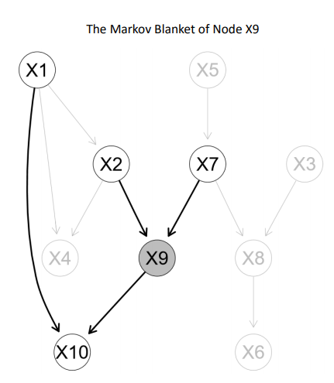
Markov Blanket
Information about a node are found in the parents and children nodes
By isolating that node and its family you are better able to understand its direct effect on the network
Notes:
d-separation – reveals how variables are related and provides a means for efficient inferencing by determinging if that set of variables is independent of another based on a third set

Slide 8
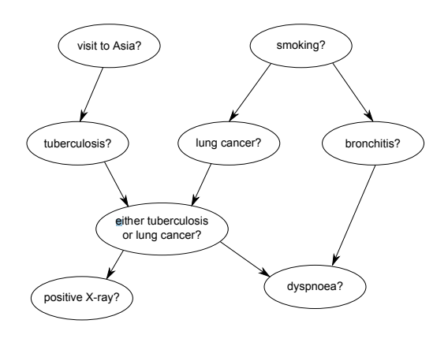
Discrete Variables
Discrete Bayesian Networks
Binomial variables
Asia network (Lauritzen & Spiegelhalter 1988)
Notes:
All variables contain discrete data
Local probability distributions can be plotted using the bn.fit.barchart function from bnlearn • The iss argument to include a weighted prior for parameter learning using the bn.fit function from the bnlearn only works with discrete data • Discretization produces better BNs than misspecified distributions and coarse approximations of the conditional probabilities

Slide 9
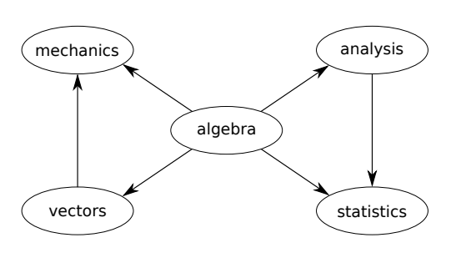
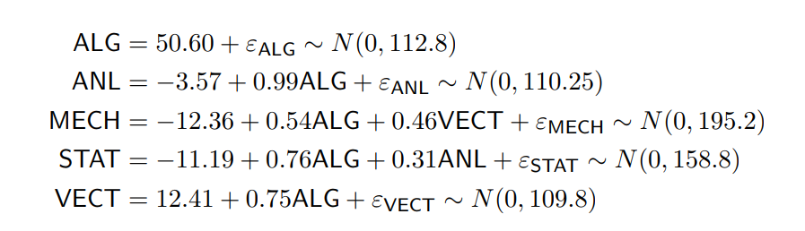
Continuous Data
Gaussian Bayesian Network
Continuous data
All nodes become linear regressions
All probabilistic dependencies are linear
Marks networks (Mardia, Kent & Bibby JM 1979)
Notes:
Each node follows a normal distribution
Each node has a variance that is specific to that node and does not depend on the values of the parents
The local distribution of each node can be expressed as a gaussian linear model which includes an intercept and the node’s parents as explanatory variables without any interaction terms
Joint distribution of all nodes
Perform better than hybrid BNs when few observations are available • Greater accuracy than discretization for continuous variables • Computationally more efficient than hybrid BNs

Slide 10
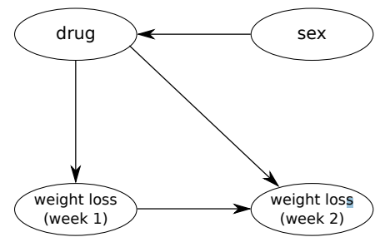
Mixed Data
Conditional linear gaussian
Mix of continuous and discrete nodes
Continuous nodes cannot be parents of discrete nodes
Continuous nodes become linear regressions with a discrete parent acting as the regressors
Rats weight network (Edwards 1995)
Notes:
Sex has 2 levels, drug has 3 levels, and weight loss is continuous
Coninuous variables cannot be parents of discrete variables
Continuous variables will have a unique linear model for each configuration of its discrete parents
Greater flexibility • No dedicated R package • No structure learning

Slide 11
Real World Discrete BN example
Notes:
Bayesian network structured to analyse ladder-based tasks. Abbreviations: TD = task duration; T = training; E = experience; SHU = safety harness use; KR = knowledge of
regulations; and HP = hazard perception) plus the response variable (AI = previous accidents or incidents).
TD: S1: >8h, S2: >2 &<8 h, S3: >2
T: S1: task specific trained, S2: generic training, S3: no training
KR: S1: excellent regulation knowledge, S2: some knowledge, S3: poor knowledge
HP: S1: clear perception of risk, S2: no perception of risk
SHU: S1: used, S2 99
IP: S1: complies with regulation
AI: RESPONSE – yes accident or no accident

Slide 12
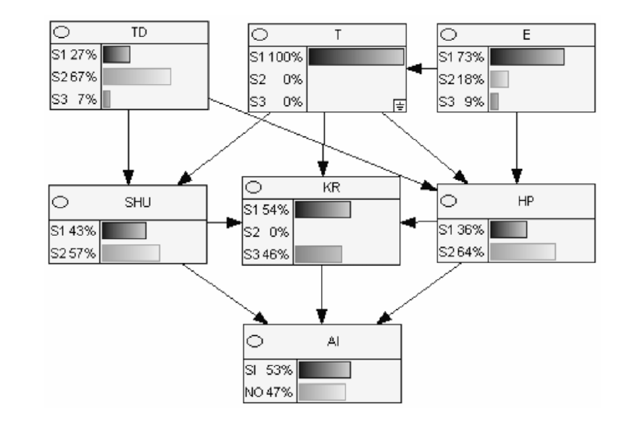
Training Influence
Notes:
Detail of Bayesian network for analyzing ladder-based tasks, focusing on the variables T (training), TD (task duration), HP (hazard perception), SHU (safety harness use),
KR (knowledge of regulations), E (experience) and AI (previous accidents or incidents).
the established condition is that the worker has received specific training

Slide 13
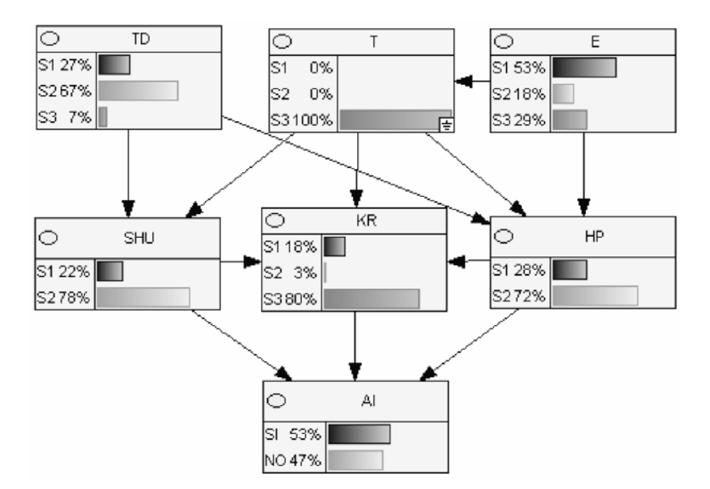
No Training Influence
Notes:
Detail of Bayesian network for analysing ladder-based tasks, focusing on the variables T (training), TD (task duration), HP (hazard perception), SHU (safety harness use),
KR (knowledge of regulations), E (experience) and AI (previous accidents or incidents).
On the bottom, the worker has received no training

Slide 14
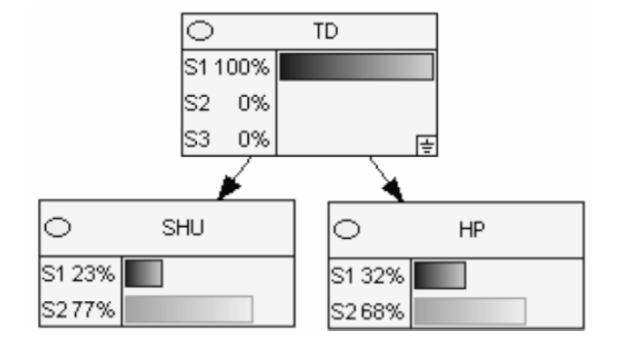
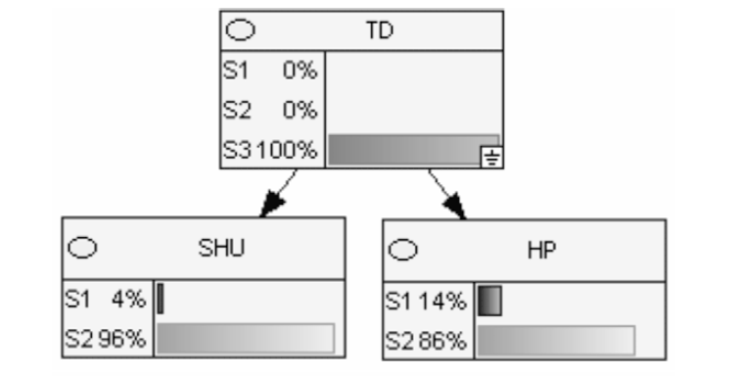

Slide 15
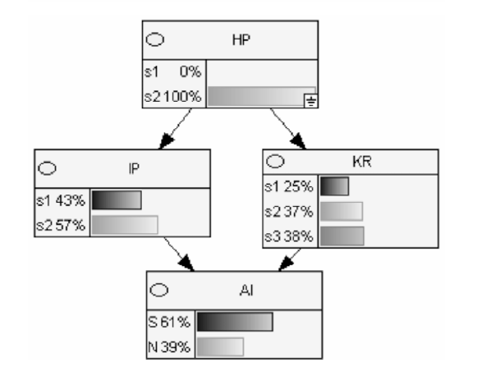
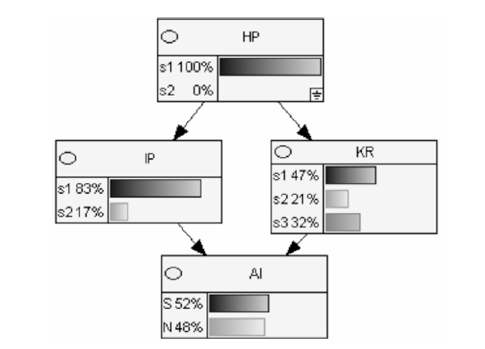
Notes:
Risk Assessment – hazard perception
Do they think it is risky or not?

Slide 16
BN vs. Previous Models
SEM is useful for determining factors that influence each variable.
BN is useful to see how changing one variable can impact another
BN is traditionally the method used in probabilistic inference (finding the probability of some assignment of a subset of the variables given assignments of other variables)

Slide 17
Advantages and Disadvantages of Bayesian Networks
Advantages
Disadvantages
Prognostic view of a BN
Can handle incomplete datasets
Utilizes prior knowledge
Can use our observed knowledge to assess causality
Allow for probabilistic inference
Avoids overfitting
Experimental variables on top
Variables we are interested in in the middle
Object we are looking at at the bottom
Causes above effects, and confounding variables above everything else
Need your own decision analysis and knowledge when deciding on variables to include
The number of possible network structures increases with the number of nodes
In general, more arbitrary and subjective than classical probability
Notes:
\

