Slide 1
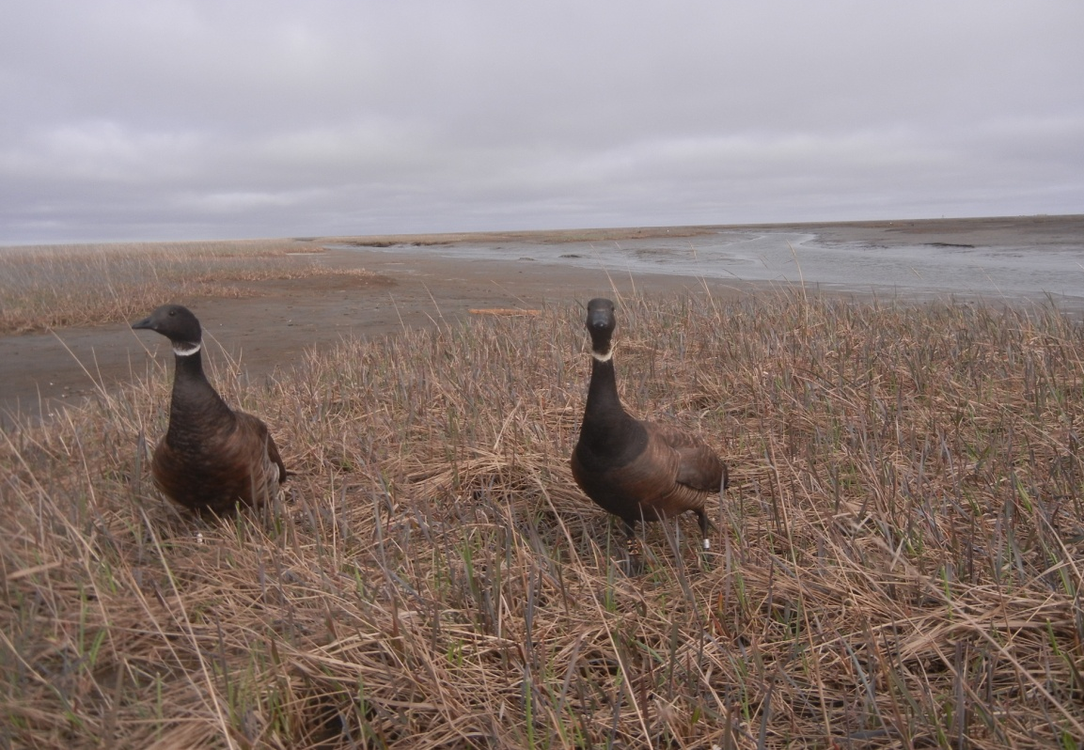

Integrated population models: an introduction to structure and behavior Tessa L. Behnke & Thomas V. Riecke
Population data
State-space model
Recruitment
Poisson model
λ_{t} * N_{t}
Survival
State-transition model
J
Φ
N_{t+1}
November 7th, 2016
NRES 746

Slide 2
‘Is anyone gonna tell us what the fuck an IPM is?’
-anonymous (excellent) Waterfowl Biologist

Slide 3
What is an IPM?
Method for modeling population dynamics
Fundamental part of ecology
Informs conservation actions
IPMs consist of a set of ‘integrated’ sub-models
These models share parameters
Linked through the ‘system process’
Notes:
And why does Thomas keep bringing them up!
Models mainly used on birds, but also bears, bats, sheep, dolphins…

Slide 4
System process
N_{t} = λ * N_{t-1}
N_{t} = N_{t-1} + B_{t} + I_{t} - D_{t} - E_{t}
This should look familiar…
Notes:
To understand IPMs, we have to go back to the fundamentals of ecology.
Demographic processes (reproduction, survival, immigration, emigration) drive population dynamics

Slide 5
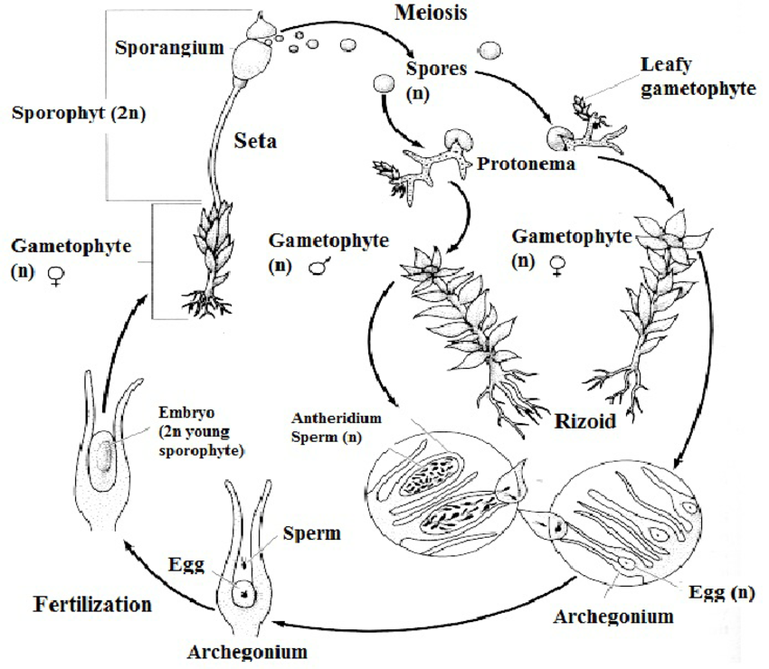
Life Cycles

Slide 6
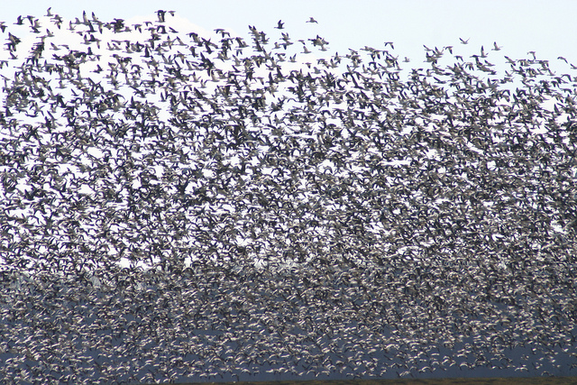
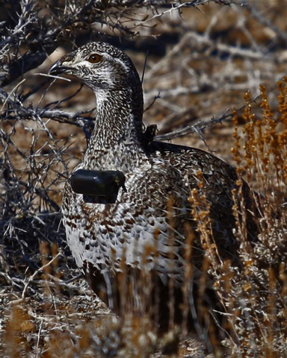
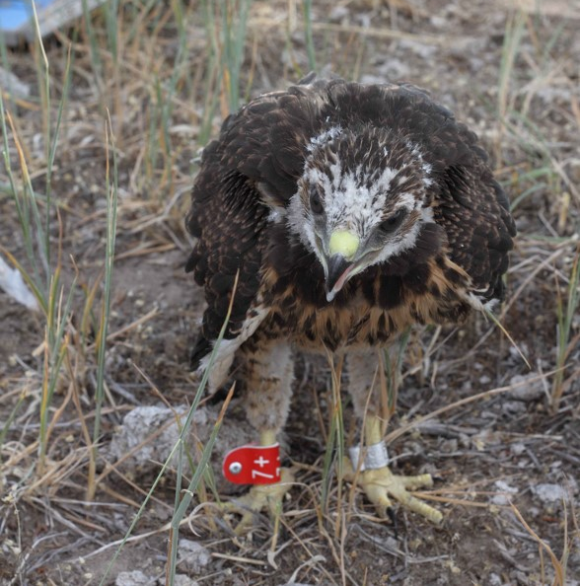
So how do we estimate these things?
Census/counts
Abundance
Age-ratio
Mark-recapture
Survival
Reproduction
Abundance

Slide 7
Count Data

Slide 8
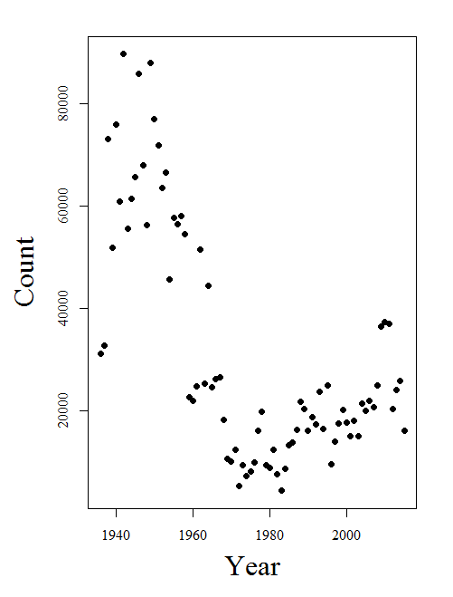
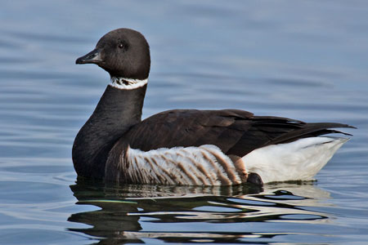
Count-based Models
Potential distributions:
Normal
Binomial
Zero-inflated Poisson, etc., ad nauseum
Derive from mark-recap data
Why do we have to model count data?
Detection!

Slide 9
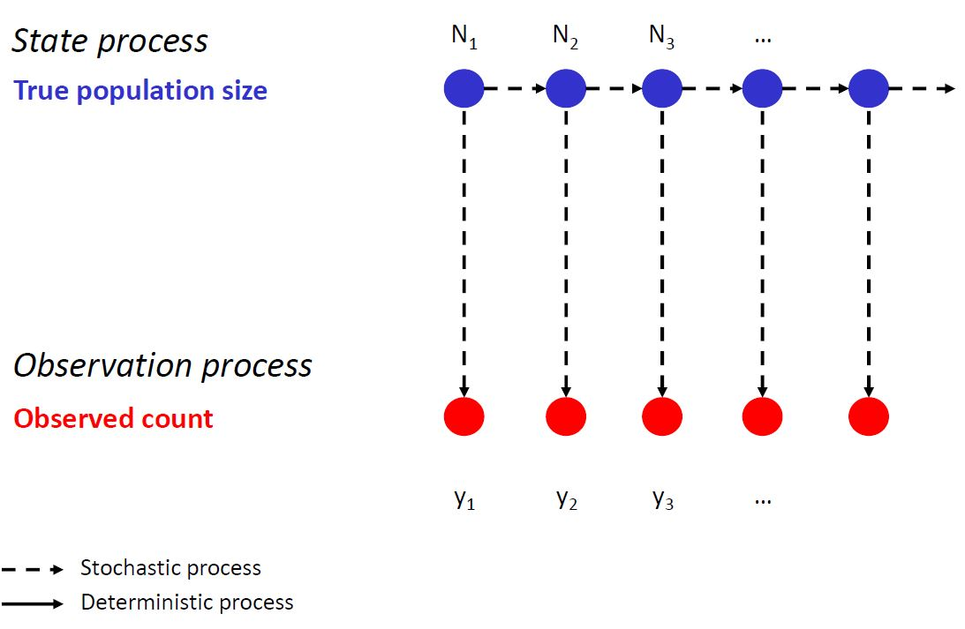
Count-based Models
Figure from Kéry & Schaub 2012

Slide 10

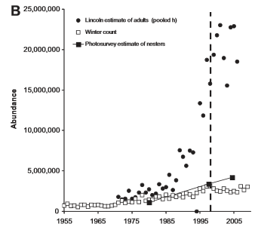

Slide 11
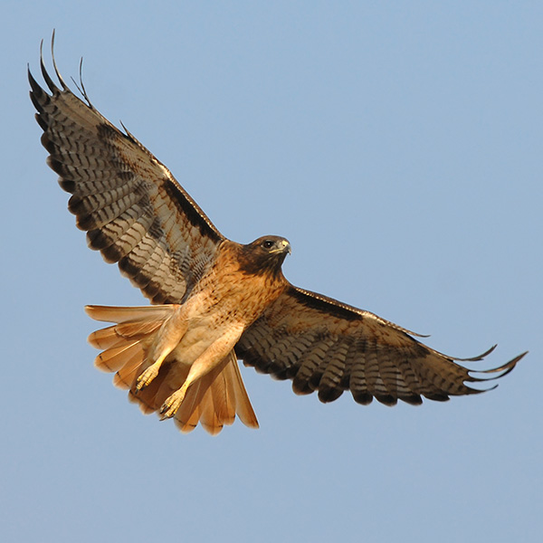
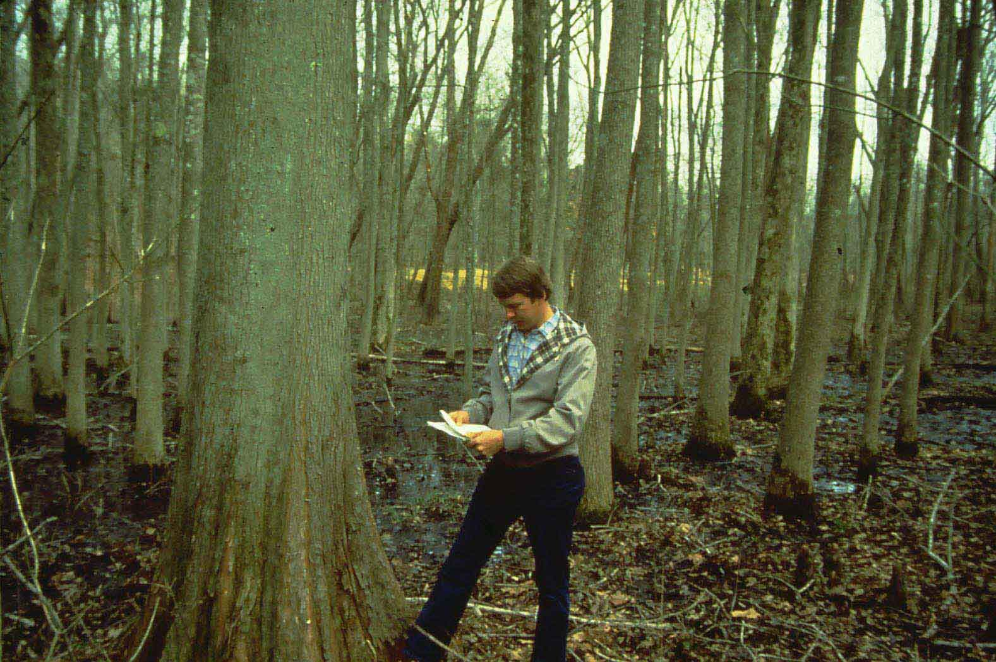
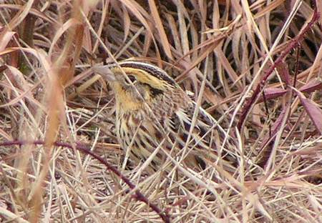
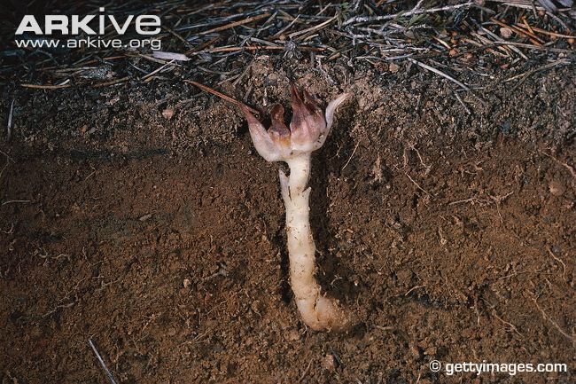
Detection probability (p) is heterogeneous among species

Slide 12
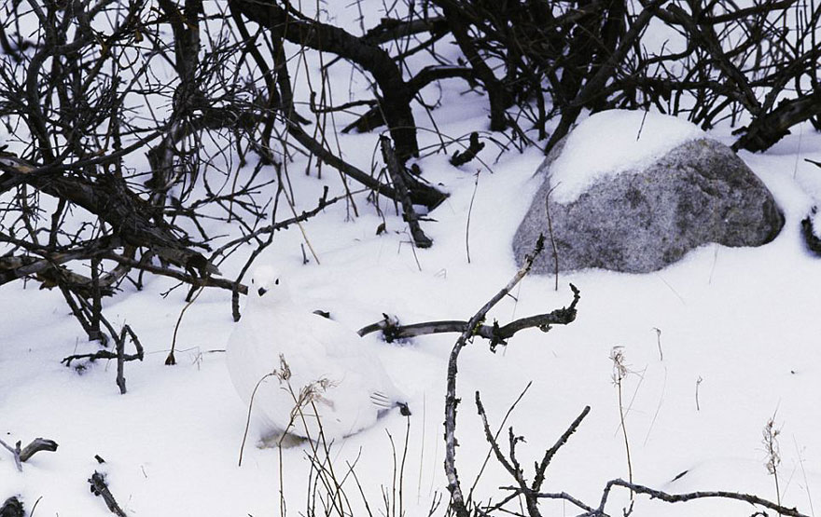
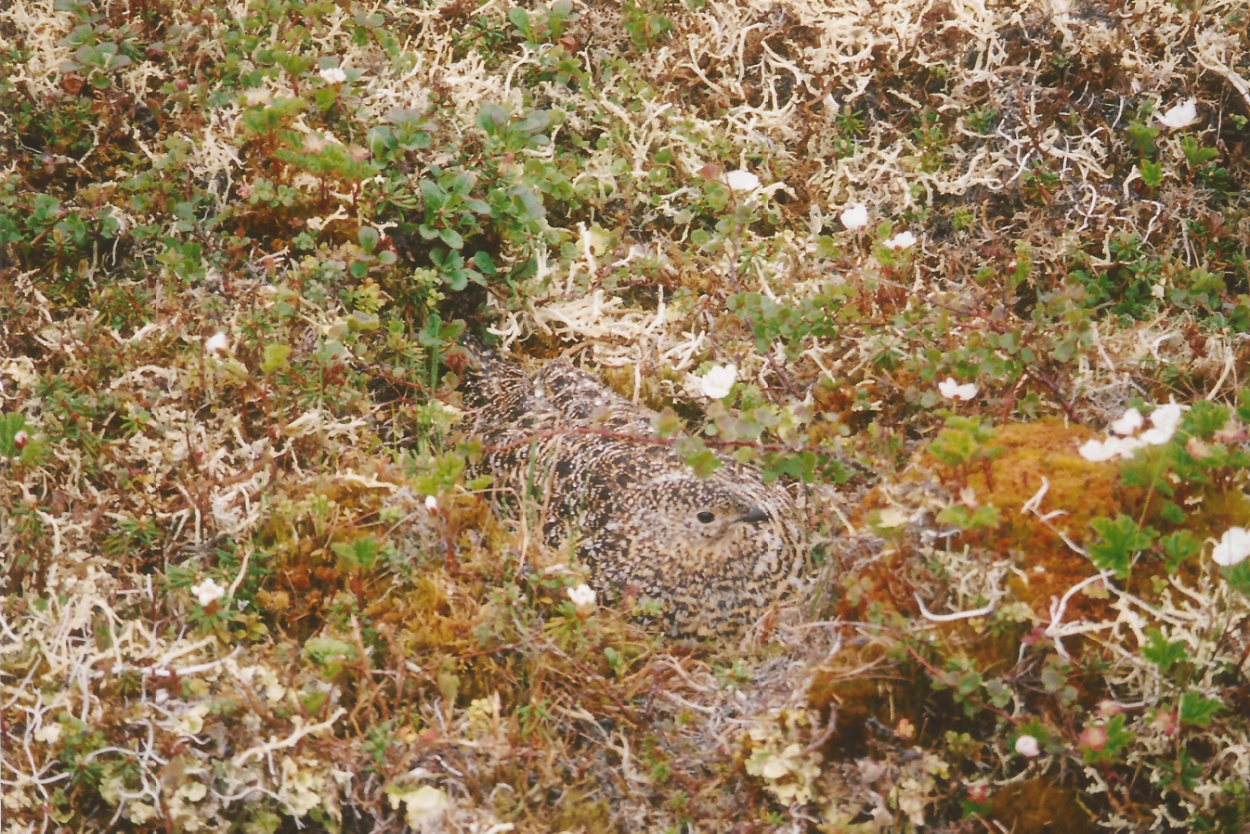
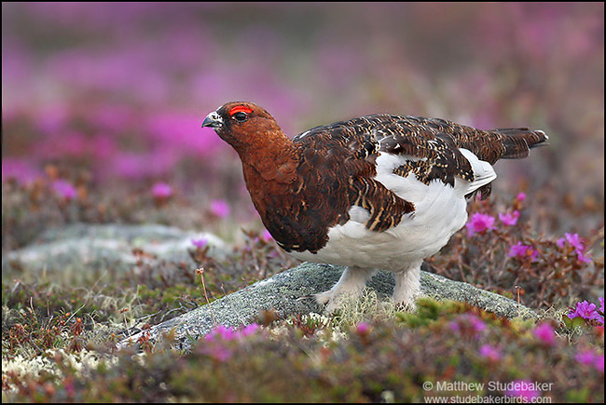
p is heterogeneous within species as plumage varies temporally
Notes:
Willow ptarmigan
Unpaired warblers

Slide 13
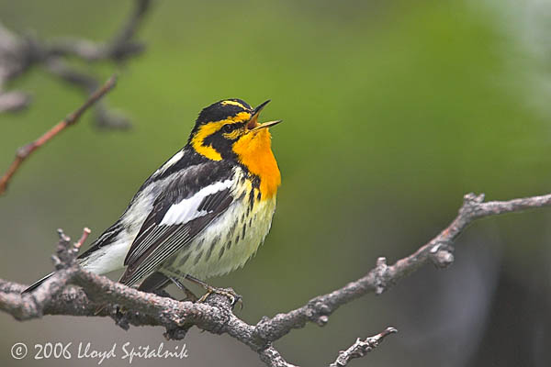
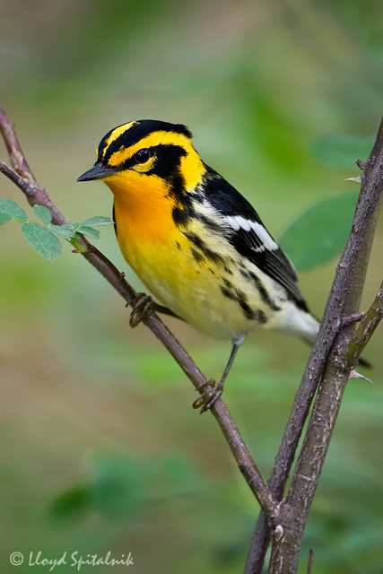
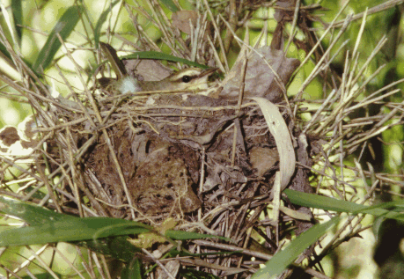
p is heterogeneous within species as behavior varies temporally
Notes:
Males are more readily detectable than females.
Singing males are more detectable than non-singing males.
Unpaired males often sing more than paired males.
How do females choose mates?
Surveys may detect males on lower quality territories more readily than those on quality territories.
Surveys will never detect incubating females.
Parents with flighted young are easy to detect….

Slide 14
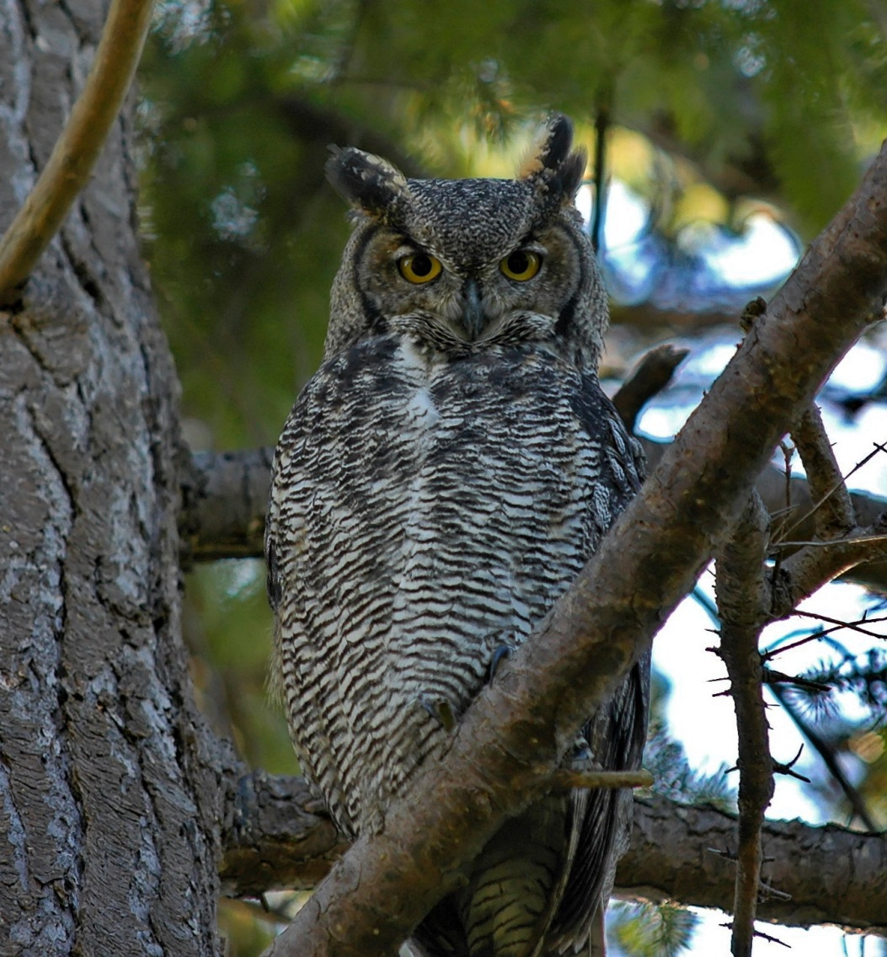
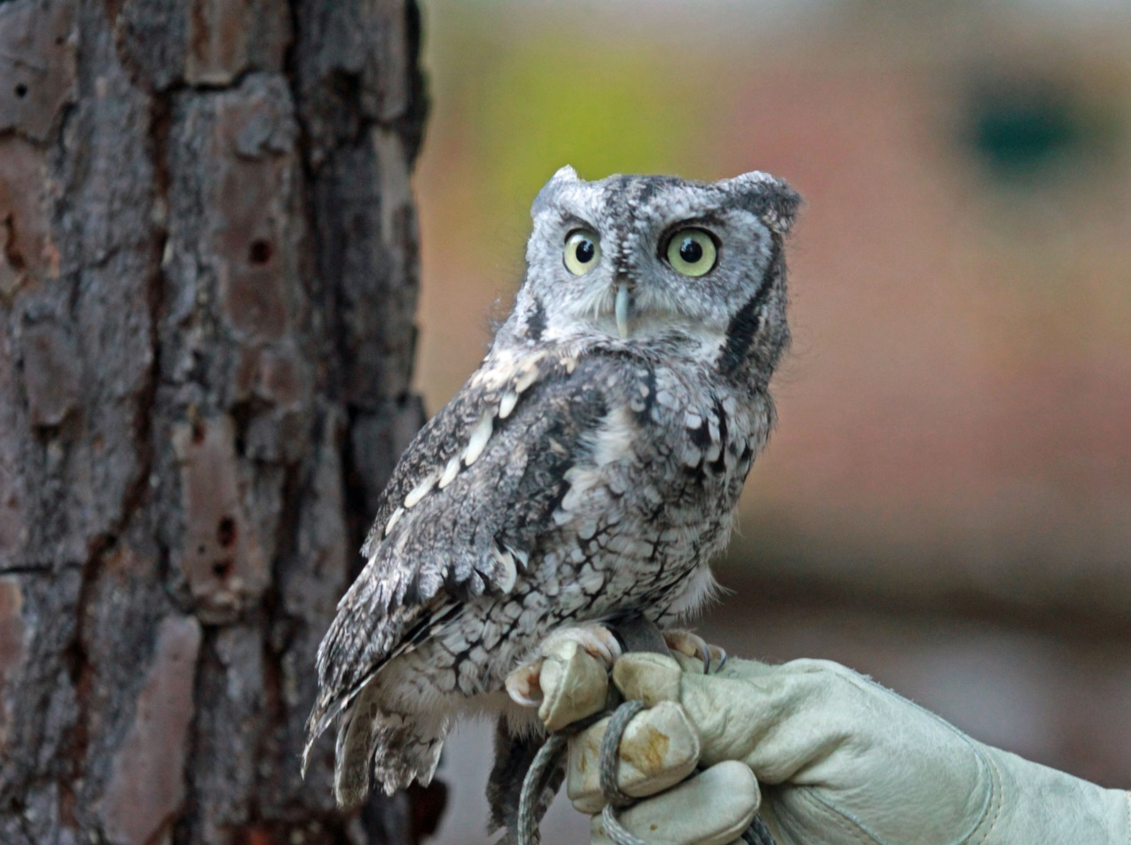
p for one species can be biased by the presence of other species

Slide 15
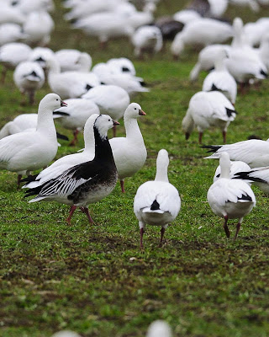

Slide 16


Slide 17
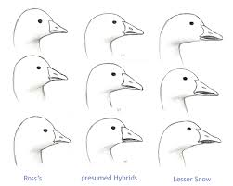
Misidentification can induce bias in count and presence-absence data

Slide 18
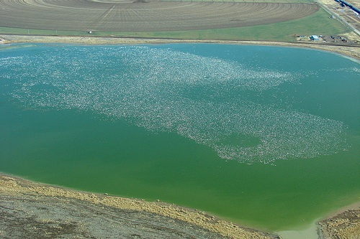
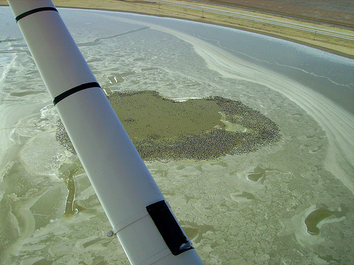
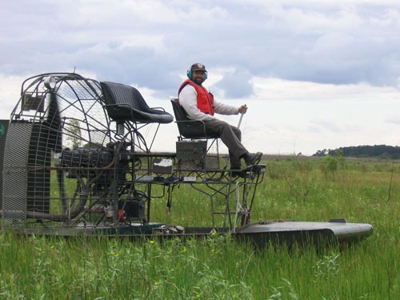
These biases are systemic in many long-term population count datasets

Slide 19
These are easy to comprehend issues
Yet they’re frequently not incorporated into our model structures

Slide 20
If you’re not modelling detection (uncertainty) then you’re assuming you’re perfect

Slide 21
Sorry

Slide 22
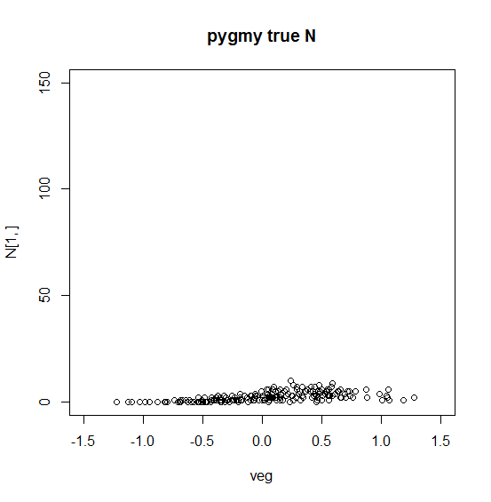
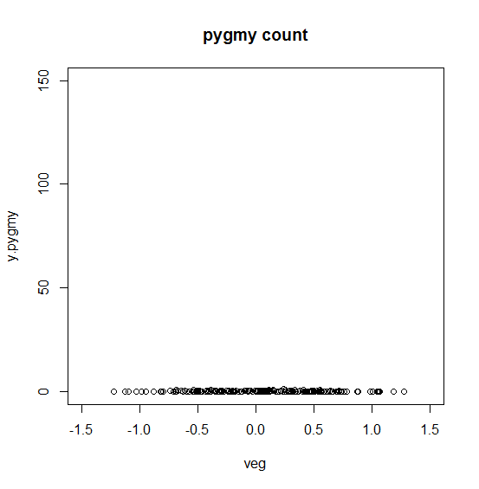
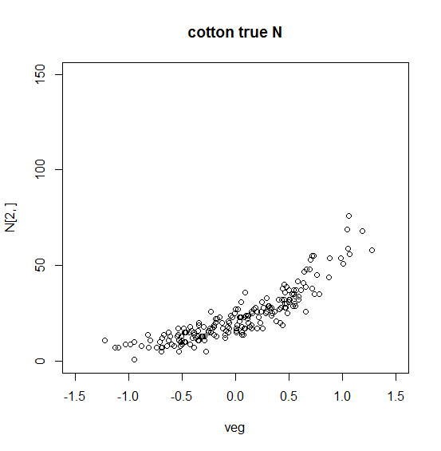
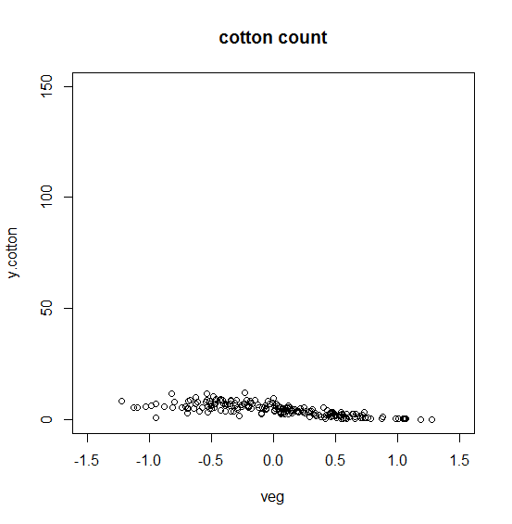
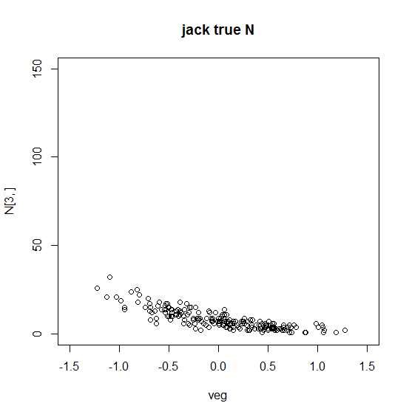
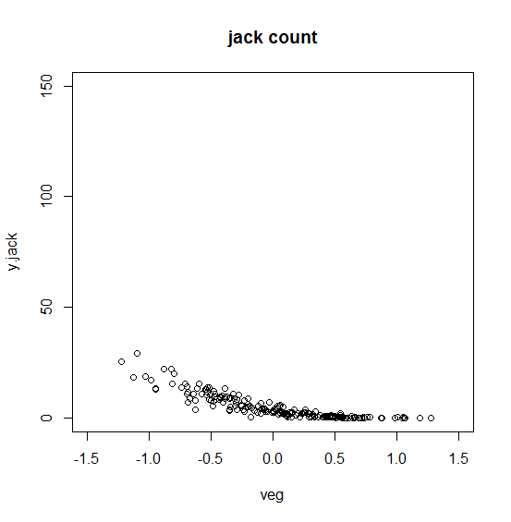
Example
If detection is correlated with covariates, spurious correlations occur due to observation processes, not biological processes
Detection increases as vegetation decreases
For example… if we just used raw count data we’d go 1 for 3 estimating the relationship between rabbit abundance and vegetation cover
That’s good in baseball… but not in science

Slide 23
Survival

Slide 24
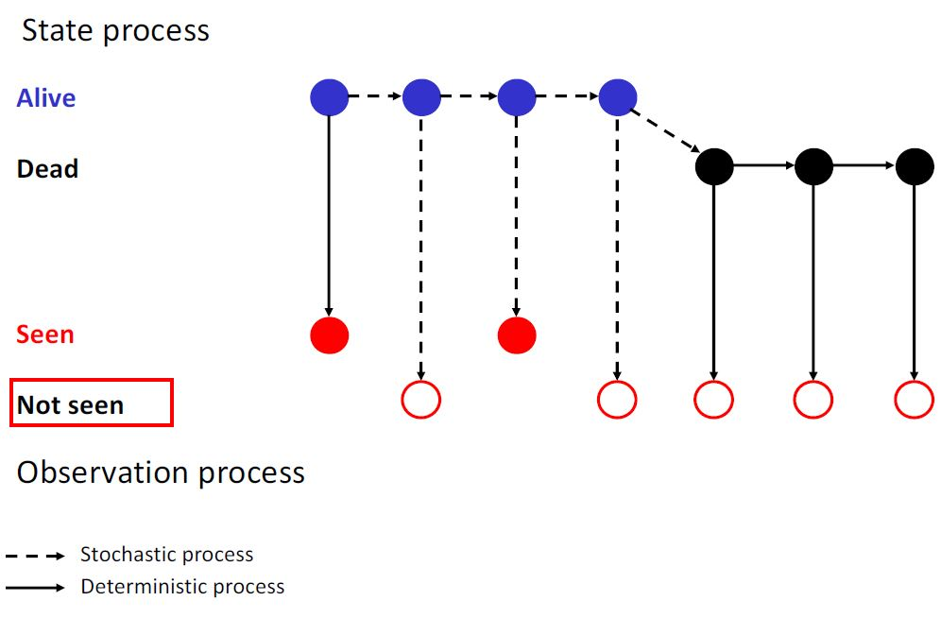
Survival Models
Figure from Kéry & Schaub 2012

Slide 25
See the pattern?

Slide 26
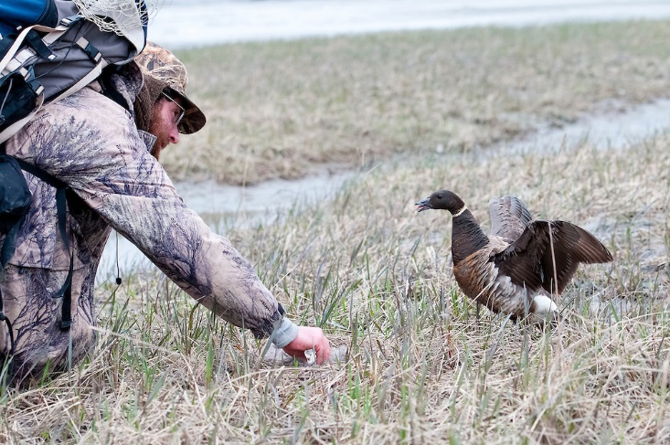
What do we know about the zeroes between the ones? (two things…)
100010000011100010000

Slide 27
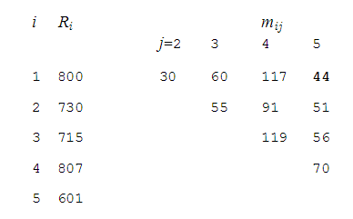
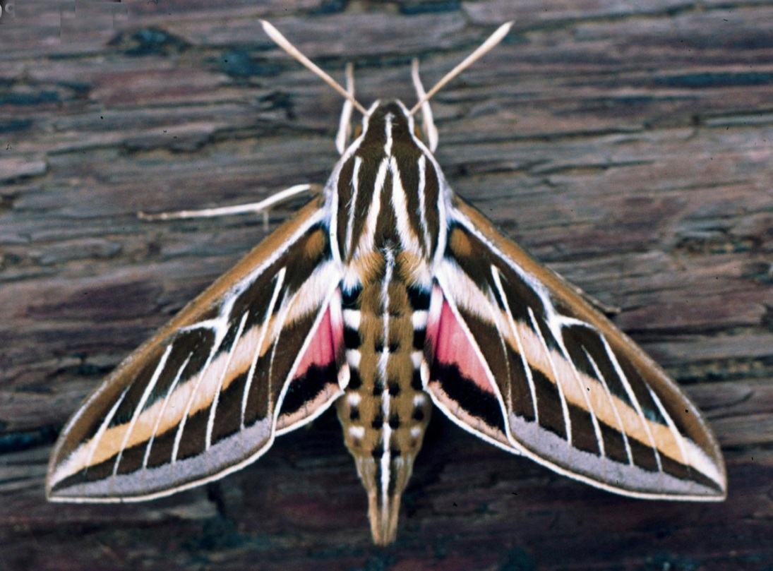
M-arrays

Slide 28
Reproduction

Slide 29
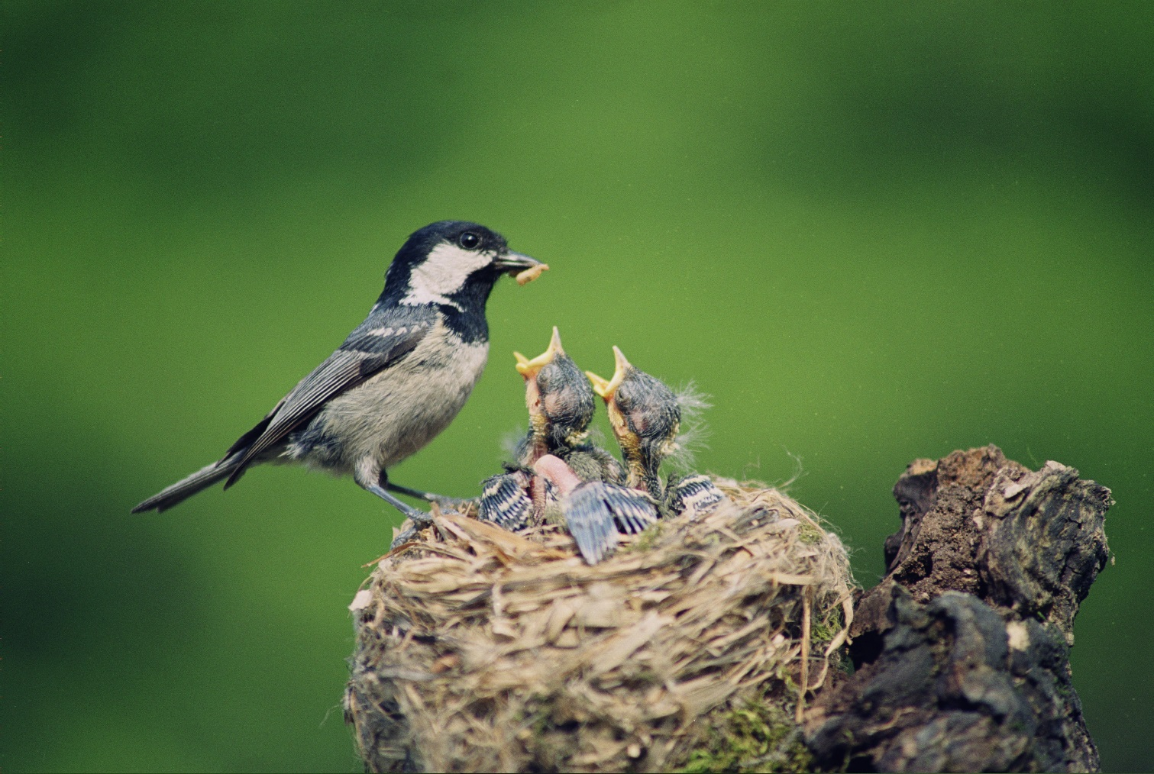
Modelling reproduction
Breeding propensity
Clutch Size
Nest Survival
Egg Hatchability
Pre-fledging Survival
Post-fledging Survival
Recruitment

Slide 30
Example

Slide 31
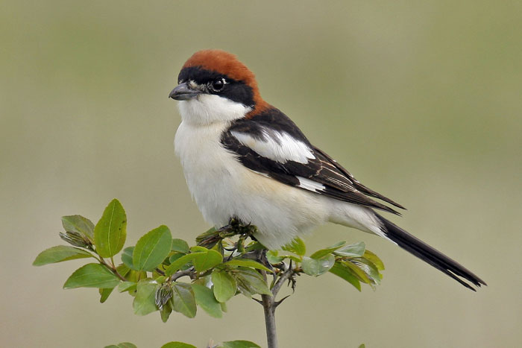
Woodchat Shrike (Lanius senator)
Notes:
Now for an example!
A particular favorite of Marc Kery & Michael Schaub

Slide 32
IPM in 3 Basic Steps (according to Kéry & Schaub)
Set up a population model that links demographic rates with population size
Write the likelihood for the single data sets
Develop the joint likelihood and analyze it

Slide 33
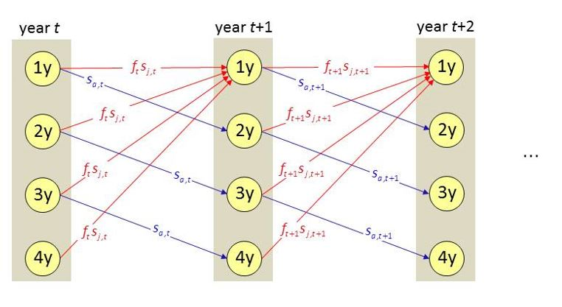
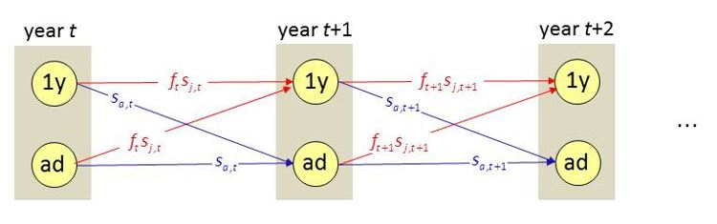
Shrike Life Cycle
Age structured
Stage structured
Figures from Schaub & Kéry (unpub)

Slide 34
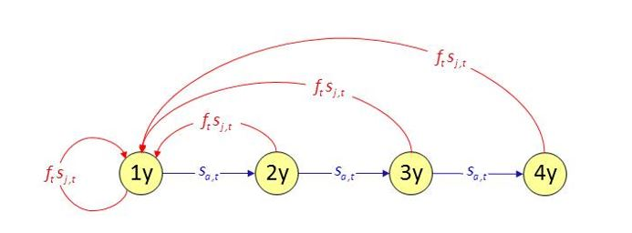
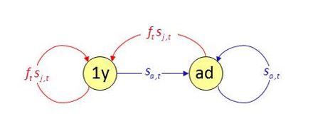
Shrike Life Cycle
Age structured
Stage structured
Figures from Schaub & Kéry (unpub)

Slide 35
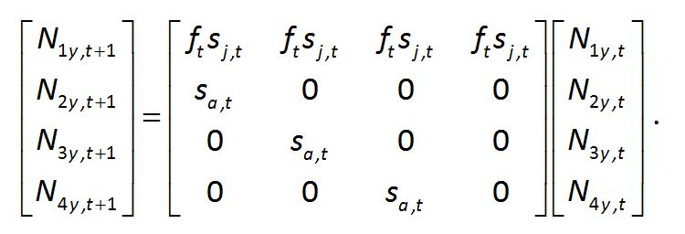
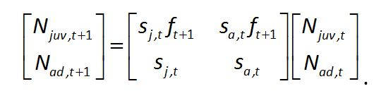
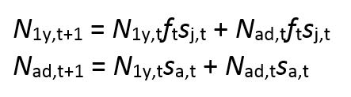
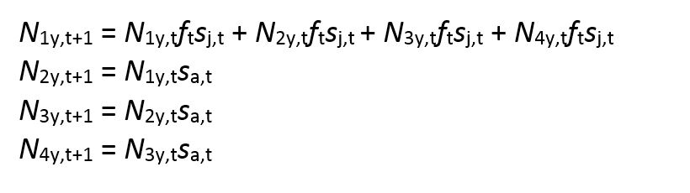
Population Equations
Stage structured
Age structured
Figures from Schaub & Kéry (unpub)

Slide 36
Available Datasets
10 years of capture-recapture data
Annual counts of breeding pairs
Reproductive success from nest monitoring

Slide 37
Bayesian Framework
WinBUGS or JAGS
Build likelihoods for each part and a joint likelihood
Priors for all parameters
Very flexible
Building these things in a maximum likelihood framework is a nightmare…
Notes:
IPMs got their start in a ML framework, as Bayes hadn’t made his comeback yet. However, using MLE requires stronger assumptions.

Slide 38
Rmarkdown files
file:///C:/Users/tbehnke/OneDrive/Documents/Behnke_UNR/NRES_746_Advanced_Analysis/Project/Shrikepopulation_simulation.html
file:///X:/Public/Riecke_Behnke/NRES746IPMtalk.html

Slide 39
Why use an IPM?
Efficient incorporation of available data
Inform “missing” parameters
Recruitment
Immigration
Contribution of unmonitored populations
Forces understanding of how biological processes relate to each other and observation processes
Formal accounting for uncertainty
Enhanced precision of estimates
Notes:
Of course you can analyze the different datasets separately, but as you would expect, there are many benefits of jointly analyzing the data.

Slide 40
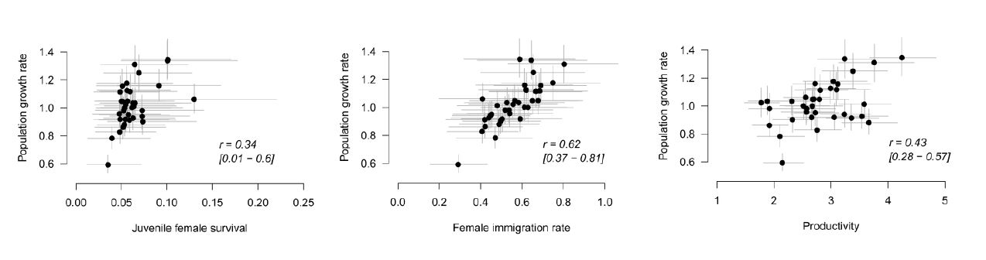
Retrospective Analyses
How and why populations have changed through time
Now can evaluate correlations between demography and population growth

Slide 41
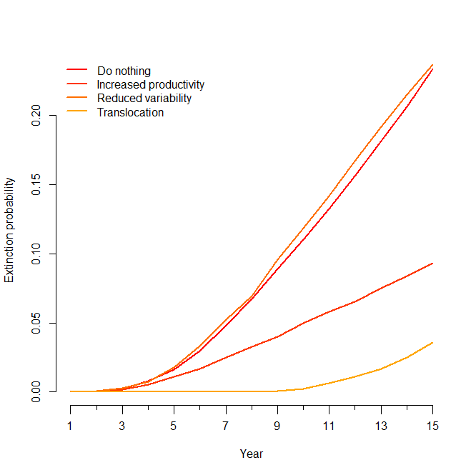
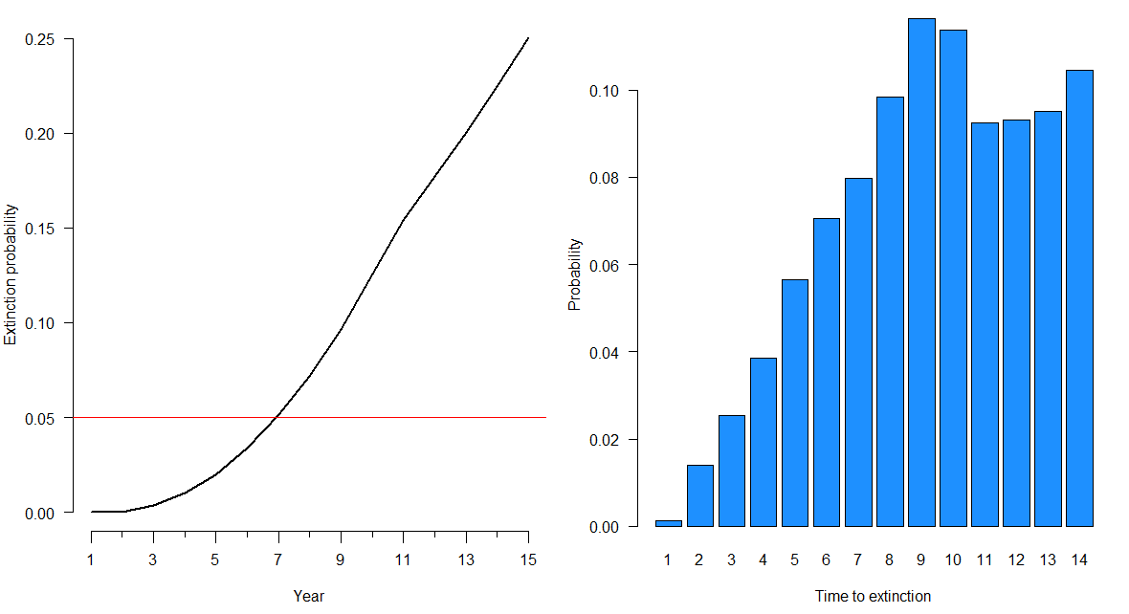
Prospective Analyses
Population Viability Analysis
Can estimate extinction/persistence probability under different scenarios
Compare management strategies
Figures from Schaub & Kéry (unpub)

Slide 42
Cautions & Considerations
Assessing model fit
“Garbage in, garbage out”
Estimating missing parameters
Retain assumptions of individual models
Independence of datasets
Demography of all individuals in different datasets is the same
Notes:
Whiteboard

Slide 43
Take homes
Estimate uncertainty!
IPMs aren’t a panacea
They are an incredibly flexible and powerful way to ask questions about populations of organisms.
It’s not the concepts… it’s the coding
Notes:
Switch to Rmarkdown file or take screenshots

Slide 44
Someday they will simply be called ‘population models’ – Marc Kéry

Slide 45
Resources for learning more
Workshops with Michael Schaub & Marc Kéry
M. Schaub and M. Kéry are currently developing a book
Notes:
Switch to Rmarkdown file or take screenshots

