Slide 1
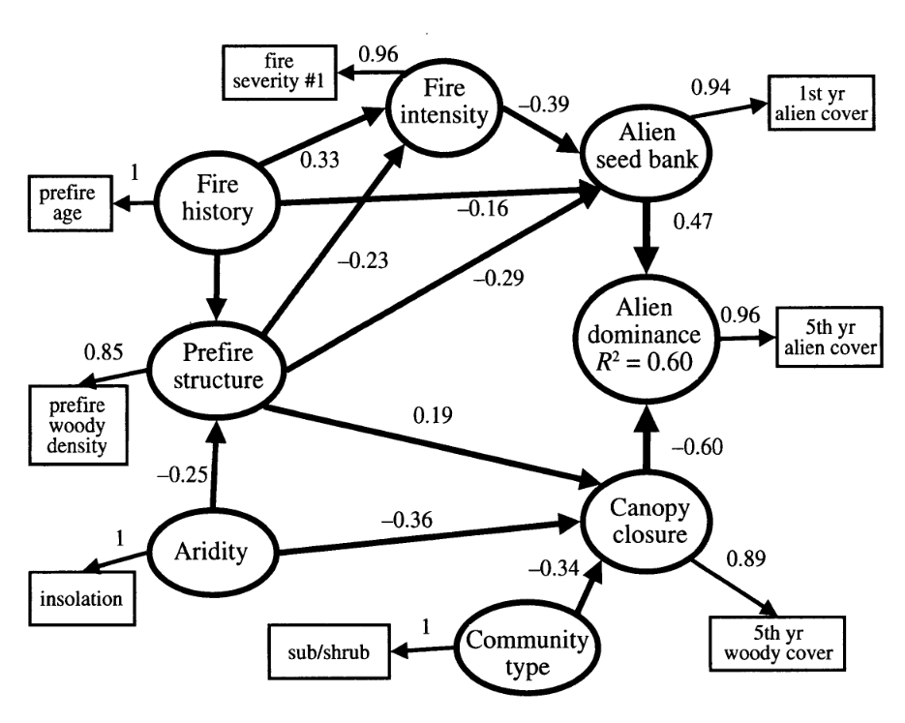
Structural Equation Modeling
Karly Feher
Margarete Walden
September 26, 2016

Slide 2
Outline
What is Structural Equation Modeling?
Terminology
Model requirement: Identification
How to calculate path coefficients
Example: Path analysis
Example: Latent variable structural model
Future directions

Slide 3
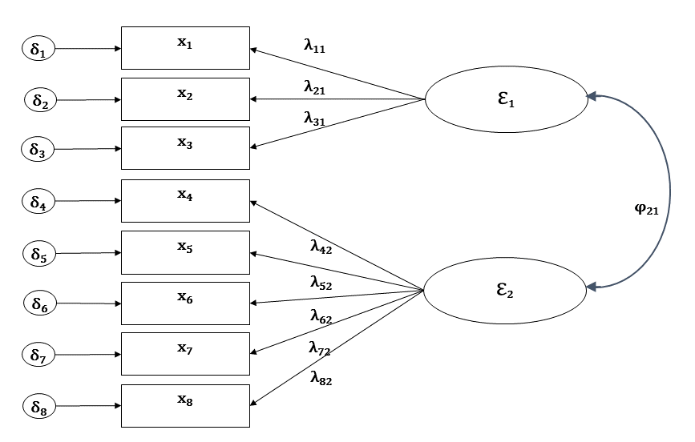
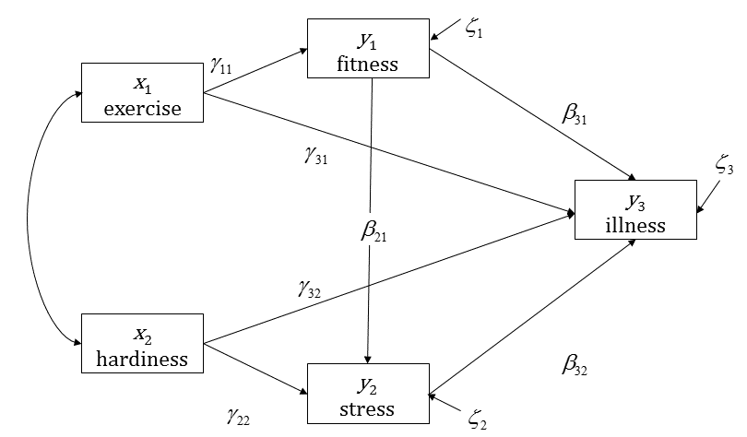
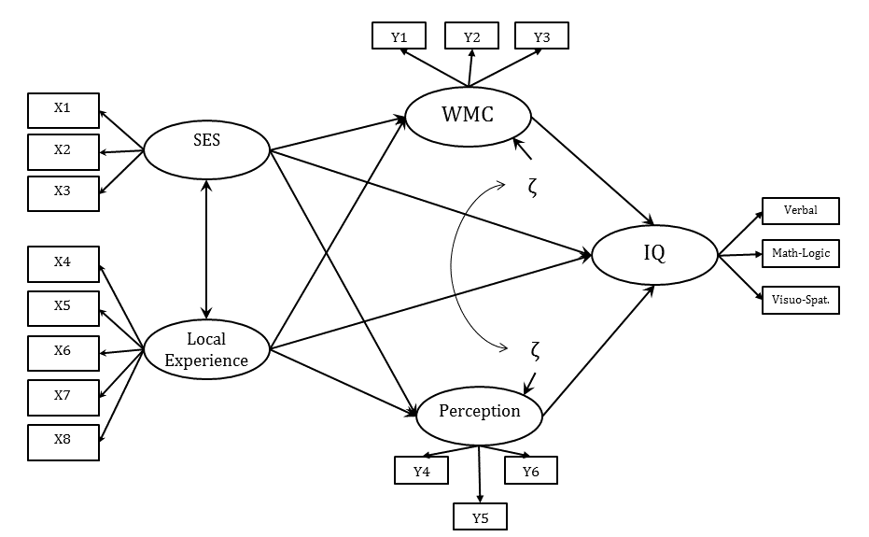
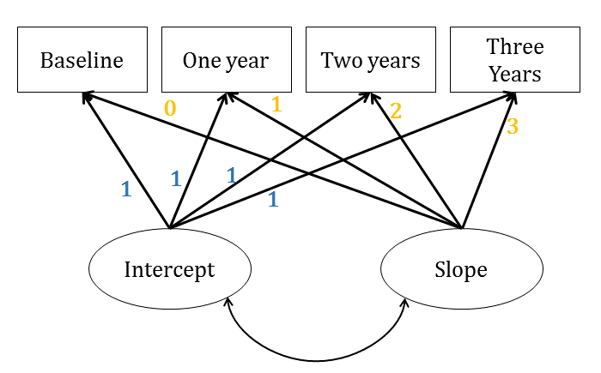
What is Structural Equation Modeling?
Path Analysis: Only Observed Variables
Confirmatory Factor Analysis / Measurement Model
Latent Growth Model
Latent Variable Structural Model
Graphical examples credit to Manolo Romero Escobar. http://www.theanalysisfactor.com/four-types-sem/

Slide 4
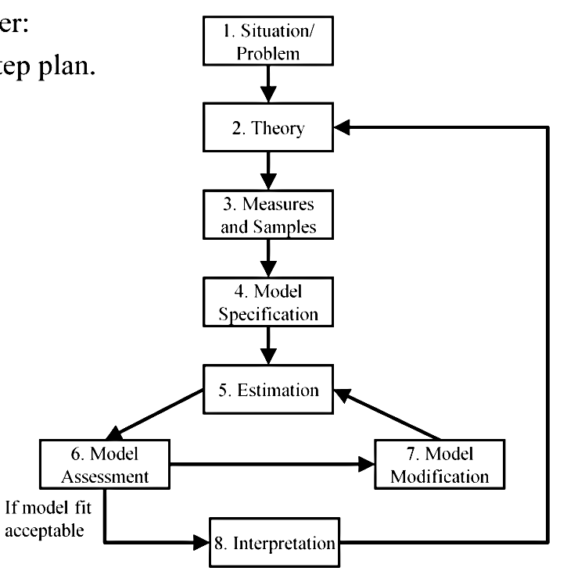
What is Structural Equation Modeling?

Slide 5
Understanding Causality in SEM
What is Structural Equation Modeling?
Causal
Relationships
Probability Theory
-> Directed Separation ->

Slide 6

Terminology
Direction of causal relationship
y₁
x₁
y₂
y₃

Slide 7
Terminology
y₁
x₁
y₃
y₂
Exogenous variable

Slide 8
Terminology
y₁
x₁
y₃
Endogenous variables
y₂
Exogenous variable

Slide 9







Terminology
Path coefficients
y₁
x₁
y₃
Endogenous variables
y₂
Exogenous variable
Unexplained variation

Slide 10

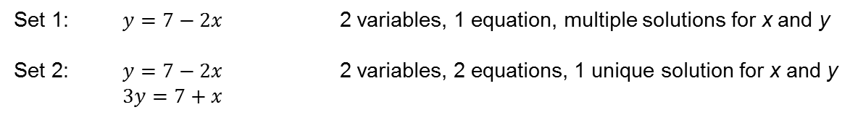

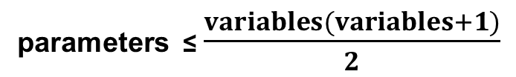


Identification: Can my model be fitted?
Model Requirements
Is there a unique solution for every parameter to be estimated, given my model variables?
Set 1: $y=7−2x$ 2 variables, 1 equation, multiple solutions for x and y
Set 2: $y=7−2x$ 2 variables, 2 equations, 1 unique solution for x and y
$3y=7+x$
Remember what we’re trying to determine:
parameters ≤ $\frac{variables(variables+1)}{2}$
ẟ₁
ζ₁
ζ₂
5 ≤ $\frac{3(3+1)}{2}=\frac{3(4)}{2}=\frac{12}{2}=6$
x₁
y₁
y₂
$$γ_{11}$$
$$β_{12}$$
5 < $6$ : Overidentified
Degrees of Freedom: t_{max}-t = 6-5=1
Notes:
# knowns versus # unknowns

Slide 11
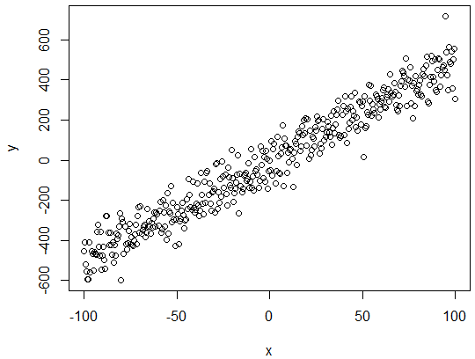
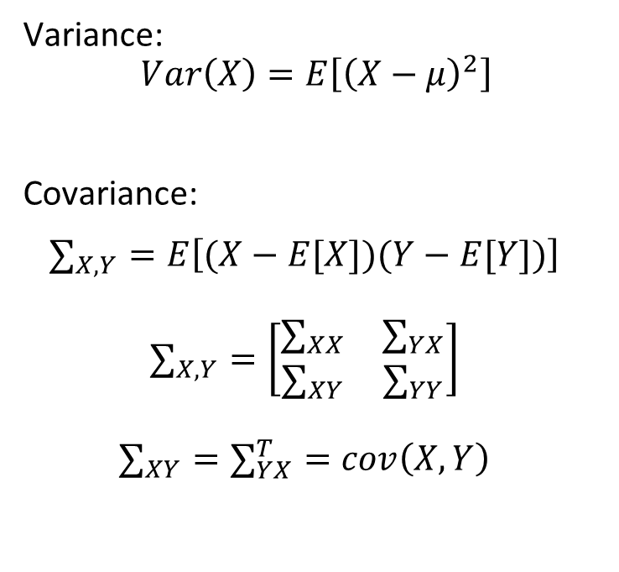
Recall the variance-covariance matrix…
Path Coefficients
Variance:
$$Var\left(X\right)=E\left[{\left(X−μ\right)}^{2}\right]$$
Covariance:
$$∑_{X,Y}=E\left[(X−E[X])(Y−E[Y])\right]$$
$$∑_{X,Y}=\left[\begin{matrix}∑_{XX} & ∑_{YX} \\ ∑_{XY} & ∑_{YY}\end{matrix}\right]$$
$$∑_{XY}=∑_{YX}^{T}=cov\left(X,Y\right)$$
Covariance matrix:
 | x₁ | y₁ | y₂
x₁ | 3.2
y₁ | 0.65 | 0.8
y₂ | 1.98 | 1.19 | 4.8

Slide 12
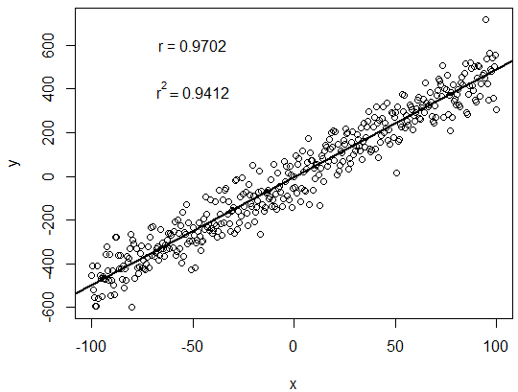
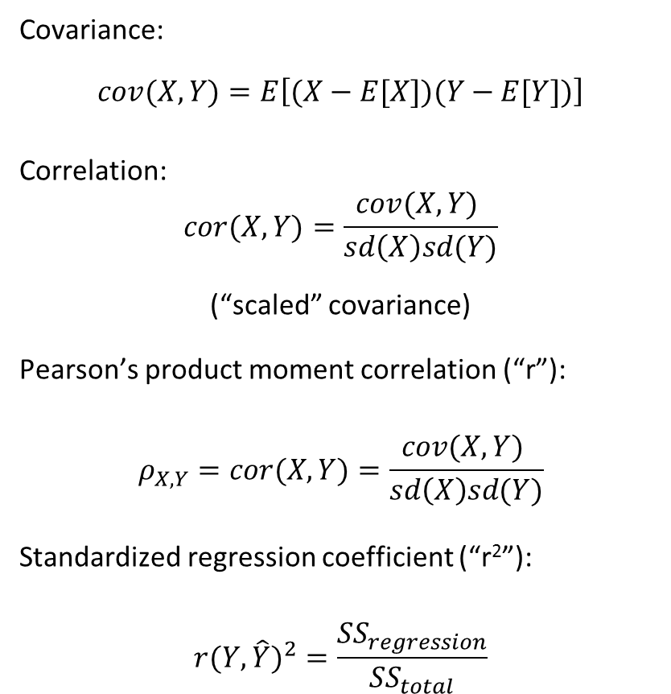
… correlation, and the regression coefficient
Path Coefficients
Covariance:
$$cov(X,Y)=E\left[(X−E[X])(Y−E[Y])\right]$$
Correlation:
$$cor(X,Y)=\frac{cov(X,Y) }{sd\left(X\right)sd(Y)}$$
(“scaled” covariance)
Pearson’s product moment correlation (“r”):
$$ρ_{X,Y}=cor(X,Y)=\frac{cov(X,Y) }{sd\left(X\right)sd(Y)}$$
Standardized regression coefficient (“r²”):
$${r(Y,\hat{Y})}^{2}=\frac{{SS}_{regression}}{{SS}_{total}}$$
Correlation matrix:
 | x₁ | y₁ | y₂
x₁ | 1.0
y₁ | 0.40 | 1.0
y₂ | 0.50 | 0.60 | 1.0

Slide 13
Path Coefficients
Covariance matrix serves as the dataset to be analyzed.
Correlations are used for interpretation
path coefficient= standardized regression coefficient
x1 y1 y2
---‐---‐--‐--‐--‐--‐--‐--‐‐--‐--‐
X1 1.0
Y1 0.54 1.0
Y2 0.18 0.34 1.0
x₁
.54
y₁
.34
y₂

Slide 14
Path Coefficients
The effect of x1 on y2 is the product of the coefficients along the path.
0.54 x 0.34= 0.18
x1 y1 y2
--‐---‐--‐--‐--‐--‐--‐--‐‐--‐--‐
X1 1.0
Y1 0.54 1.0
Y2 0.18 0.34 1.0
x₁
.54
y₁
.34
y₂

Slide 15
Path Coefficients
The effect of x1 on y2 is the product of the coefficients along the path.
0.54 x 0.34= 0.18
Since the effect of x1 on y2 is equal to the correlation between x1 and y2, they are conditionally independent
x1 y1 y2
--‐---‐--‐--‐--‐--‐--‐--‐‐--‐--‐
X1 1.0
Y1 0.54 1.0
Y2 0.18 0.34 1.0
x₁
.54
y₁
.34
y₂

Slide 16
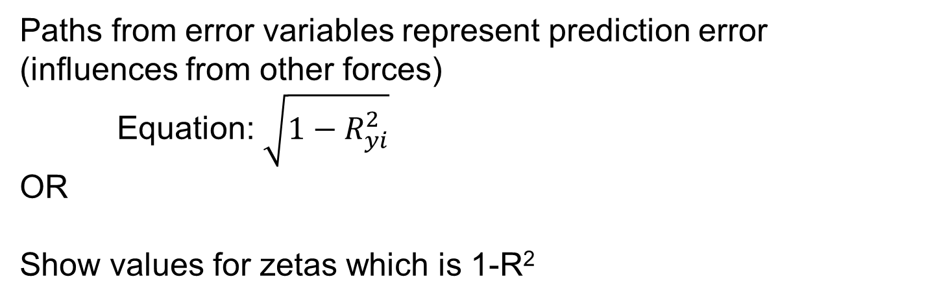
Path Coefficients
Paths from error variables represent prediction error (influences from other forces)
Equation: $\sqrt{1−R_{yi}^{2}}$
OR
Show values for zetas which is 1-R²
R^{2=0.16}
y₁
.75
x₁
R^{2=0.44}
y₂
.56
R^{2=0.16}
y₃
.84

Slide 17
Example: Path Analysis
Workflow of path analysis: Regressions to SEM
Linear Regression/Multiple Regression
ANOVA: F-tests assess whether a variable contributes to observed variation in data
Standardize coefficient
Evaluating Mediation
D-Separation
R^{2=0.16}
y₁
x₁
R^{2=0.44}
y₂
R^{2=0.16}
y₃

Slide 18
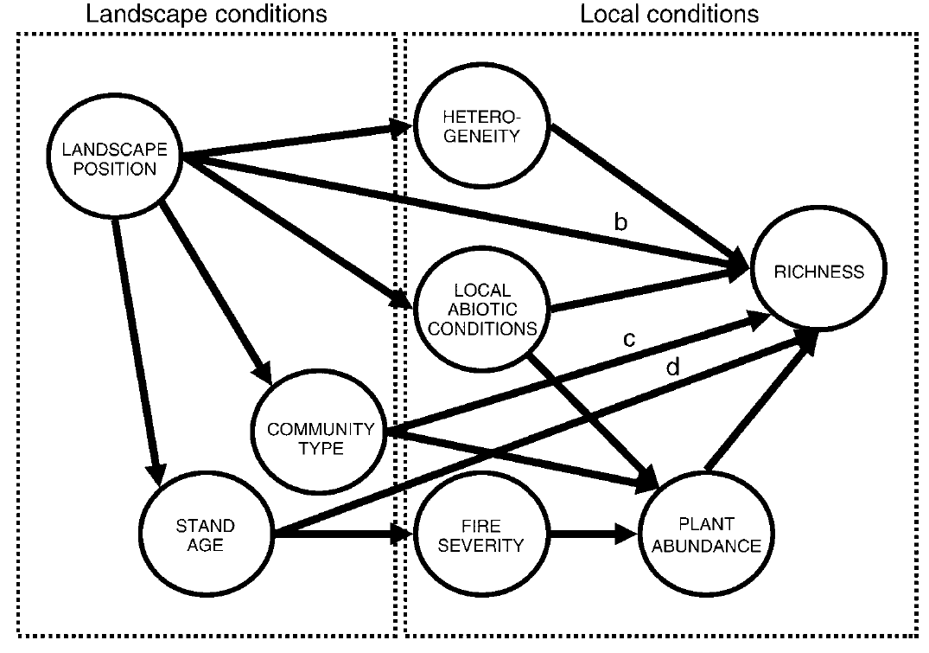
Path Analysis Example in R
Example: Path Analysis
Grace, J. B., & Keeley, J. E. (2006). A structural equation model analysis of postfire plant diversity in California shrublands. Ecological Applications, 16(2), 503-514.
Goal: Understand species richness over the five years following fire.
90 x 1000 m² plots
5 years
Measured:
plant cover
species richness
aspect
soil
elevation
stand age
Figure 1 from Grace and Keeley 2006.

Slide 19
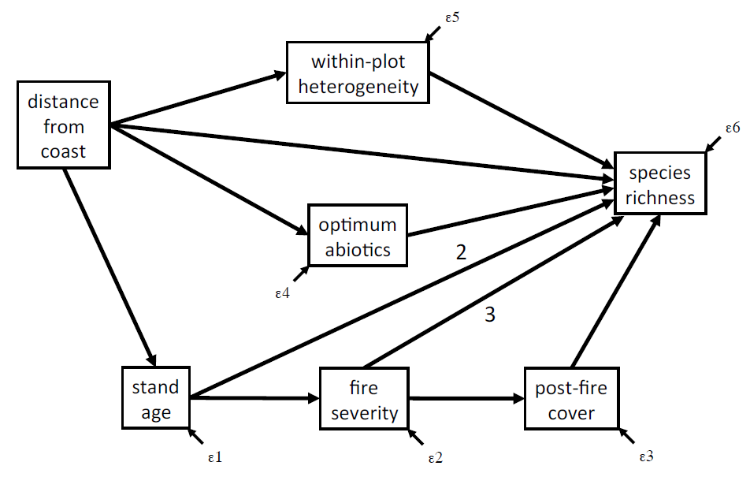
Example: Path Analysis
Theory > Hypothesis > Model > Data

Slide 20
Example: Path Analysis
abiotic
distance
rich
hetero
>keeley<-read.csv("./Keeley_rawdata_select4.csv")
#fit model
>abioticLM <- lm(abiotic ~ distance, data=keeley)
>heteroLM <- lm(hetero ~ distance, data=keeley)
>richnessLM <- lm(rich ~ abiotic + hetero, data=keeley)

Slide 21
Example: Path Analysis
Evaluating effects on multiple regression
#evaluate the pieces
>aov(abioticLM)
>aov(heteroLM)
>aov(richnessLM)

Slide 22
Standardizing the Coefficient
Example: Path Analysis
abiotic
R²=0.21
0.460
0.266
distance
0.374
rich
R²=0.47
0.346
hetero
R²=0.12
0.254
#standardized coefficients & r^2
>lm.beta(abioticLM) >summary(abioticLM)$r.squared
>lm.beta(heteroLM) >summary(herteroLM)$r.squared
>lm.beta(richnessLM) >summary(richnessLM)$r.squared

Slide 23
Evaluating Mediation: distance->rich
Example: Path Analysis
#Evaluate Mediation
>richnessLM2 <- lm(rich ~ abiotic + hetero, data=keeley)
>summary(richnessLM2)$r.squared
>lm.beta(richnessLM2)
abiotic
R²=0.21
0.46
0.41
distance
rich
R²=0.36
0.35
hetero
R²=0.12
0.34
Notes:
Fit model with and
without path. Evaluate
if path is significant.
2. Evaluate rela?onship
between residual of y2
~ y1 rela?onship and x1

Slide 24
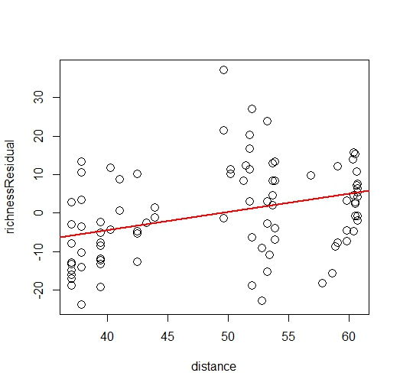
Example: Path Analysis
#evaluate the residual relationship
>keeley$richnessResidual<-residuals(richnessLM2)
>richResidLM<-lm(richnessResidual ~ distance, data=keeley)
>aov(richResidLM)
#plot result
plot(richnessResidual ~ distance, data=keeley, cex=1.5)
abline(richResidLM, col="red", lwd=2)
Analysis of Variance Table Response: richnessResidual Df Sum Sq Mean Sq F value Pr(>F) distance 1 1545 1544.96 12.016 0.0008177 *** Residuals 88 11314 128.57 --- Signif. codes: 0 ‘***’ 0.001 ‘**’ 0.01 ‘*’ 0.05 ‘.’ 0.1 ‘ ’ 1
Notes:
The residuals of the covariances (not residual scores) need to be small and centered about zero. Some goodness of fit tests (like the Lagrange Multiplier test) remain robust against highly deviated residuals or non-normal residuals.

Slide 25

Evaluate Model Fit
Example: Path Analysis
y₁
x₁
Directed Separation:
$$\text{x}\text{⏊}\text{y}\text{3 | (}\text{y}\text{1, }\text{y}\text{2)}$$
Two nodes are d-separated if they are conditionally independent
y₃
y₂

Slide 26
Example: Path Analysis
Directed Separation
The d-separation criterion for any pair of variables involves:
Controlling for common ancestors that could generate correlations between the pair
Controlling for causal connections through multi- link directed pathways via parents
Not controlling for common descendent variables

Slide 27
Example: Path Analysis
y₁
x₁
y₃
For example, for x and y3:
(1) There are no common ancestors.
(2) We include the parents of y3 that are
part of mediating pathways: y1 and y2
(3) There are no common descendants to
worry about.
Thus, their residuals are predicted to be
uncorrelated.
y₂

Slide 28
Example: Path Analysis
Directed Separation
Basis Set: the minimum set of d-separation statements. This is sufficient to predict the entire set of d-separation statements.
1. x ⏊ y3 | (y1, y2)
2. y1 ⏊ y2 | (x)
y₁
x₁
y₃
y₂

Slide 29

Directed Separation
Example: Path Analysis
Basis Set: the minimum set of d-separation statements. This is sufficient to predict the entire set of d-separation statements.
$\frac{V!}{2\left(V−2\right)!}−A$
y₁
x₁
y₃
y₂
Notes:
The number of pairs of variables that don’t have an arrow between them is always equal to the total number of pairs minus the number of arrows in the causal graph . There are V variables and A arrows

Slide 30
Directed Separation
Example: Path Analysis
Each of the d-separated statements predicts a (conditional) probabilistic independence
1. x ⏊ y3 | (y1, y2)
2. y1 ⏊ y2 | (x)
y₁
x₁
y₃
y₂
Notes:
The number of pairs of variables that don’t have an arrow between them is always equal to the total number of pairs minus the number of arrows in the causal graph . There are V variables and A arrows

Slide 31
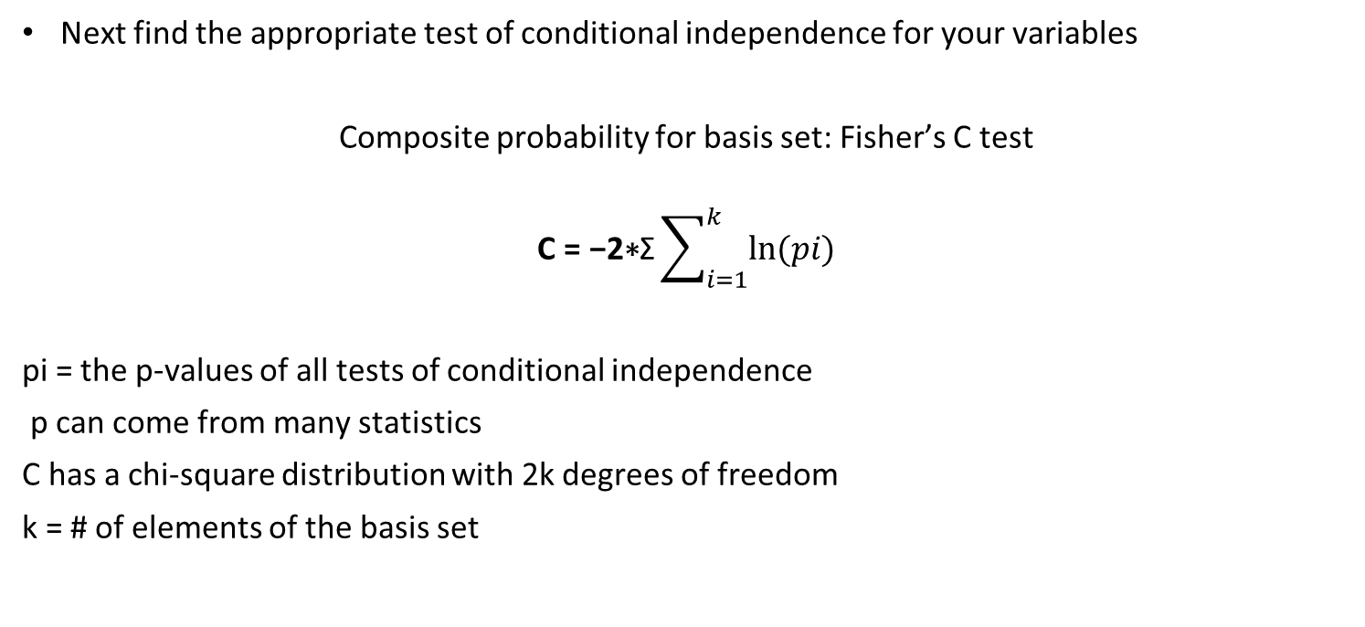
D-Separation and conditional independence tests
Example: Path Analysis
Next find the appropriate test of conditional independence for your variables
Composite probability for basis set: Fisher’s C test
$$\text{C}\text{ = −2∗}\text{Σ}\sum_{i=1}^{k}{ln⁡(pi)}$$
pi = the p-values of all tests of conditional independence
p can come from many statistics
C has a chi-square distribution with 2k degrees of freedom
k = # of elements of the basis set
Notes:
Use fishers C test because the conditional independence tests Implied by the basis set are mutually independent. We can contain composite probability for the entire thing
If all k independent relationships are true then this statistic will follow a chi squared distribution w 2k degrees of freedom

Slide 32
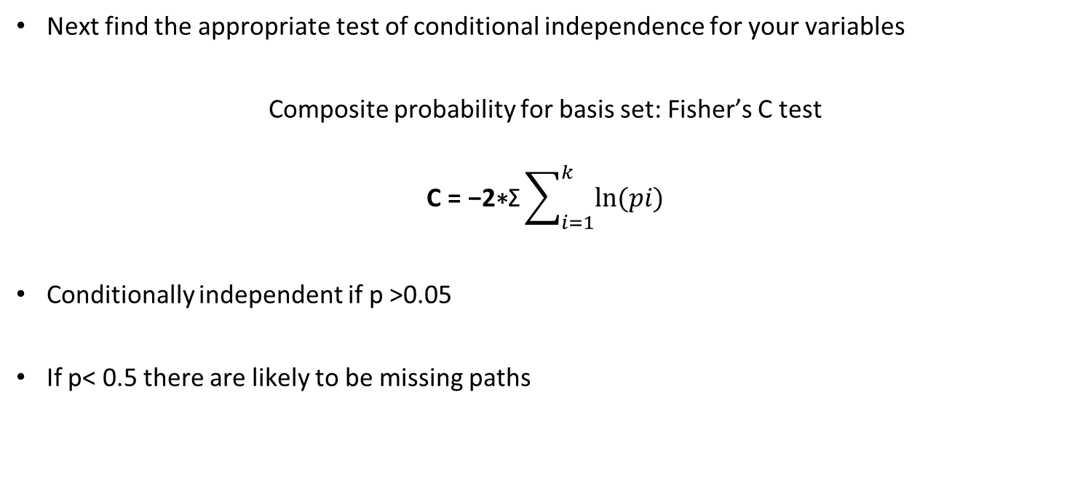
D-Separation and conditional independence tests
Example: Path Analysis
Next find the appropriate test of conditional independence for your variables
Composite probability for basis set: Fisher’s C test
$$\text{C}\text{ = −2∗}\text{Σ}\sum_{i=1}^{k}{ln⁡(pi)}$$
Conditionally independent if p >0.05
If p< 0.5 there are likely to be missing paths
Notes:
Use fishers C test because the conditional independence tests Implied by the basis set are mutually independent. We can contain composite probability for the entire thing
If all k independent relationships are true then this statistic will follow a chi squared distribution w 2k degrees of freedom

Slide 33
Coding path analysis in R
Example: Path Analysis
Using piecewiseSEM package
>library(piecewiseSEM)
#write out the list of models that compose the SEM
>modList <- list(
>lm(abiotic ~ distance, data=keeley),
>lm(hetero ~ distance, data=keeley),
>lm(rich ~ abiotic + hetero, data=keeley))
Notes:
Piecewise SEM allows for fitting of models with different distributions and/or incorporates hiearchial/random nested structures

Slide 34
Coding path analysis in R
Example: Path Analysis
#Extract path coefficients
>sem.coef(modList, data=keeley)
#Find Basis Set
>sem.missing.paths(modList, data=keeley) #Get goodness of fit
>sem.fit(modList, data=keeley)
#Fisher C test
>sem.fisher.c(modList, data=keeley)

Slide 35
Example: Path Analysis
abiotic
R²=0.21
0.46
0.41
distance
rich
R²=0.36
0.35
hetero
R²=0.12
0.34
Results of Fisher test indicates the model is missing something!
fisher.c k p.value
1 21.86 4 0

Slide 36
Latent Variables
Example: Latent Variable Structural Model
ẟ_{x1}
x₁
λ_{x1}
λ_{x2}
ξ
ẟ_{x2}
x₂
Exogenous
ẟ_{x3}
λ_{x3}
x₃
ε_{y1}
ζ
y₁
λ_{y1}
λ_{y2}
η
ε_{y2}
y₂
Endogenous
ε_{y3}
λ_{y3}
y₃

Slide 37



Example using Grace and Keeley (2006)
Example: Latent Variable Structural Model
Correlation matrix on measured variables:
ẟ_{x1}
abiotic
λ_{x1}
 | dist | elev | abiotic
dist | 1.0
elev | 0.606 | 1.0
abiotic | 0.460 | 0.328 | 1.0
ẟ_{x2}
λ_{x2}
distance
terrain
ẟ_{x3}
λ_{x3}
elevation
ẟ_{x1}
abiotic
λ_{x1}
ζ₂
ẟ_{x2}
λ_{x2}
$$γ_{12}$$
distance
terrain
richness
ẟ_{x3}
λ_{x3}
$$γ_{11}$$
elevation
$$β_{12}$$
heterogeneity
ζ₁

Slide 38
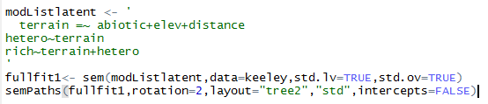
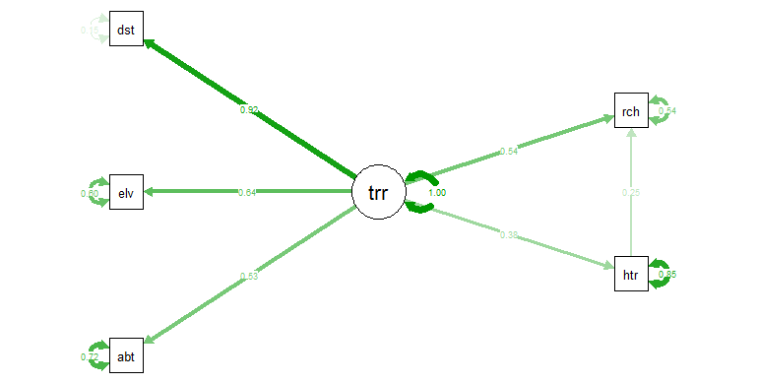
Example: Latent Variable Structural Model

Slide 39
Future Directions
What’s next for SEM?
Why aren’t more ecologists using SEM?
Predictive probabilistic networks

Slide 40







Multiple regression versus SEM
$$y_{1}=y_{11}x_{1}+y_{21}x_{2}+ζ_{1}$$
$$y_{1}=y_{11}x_{1}+ζ_{1}$$
$$y_{2}=y_{12}x_{1}+β_{12}y_{1}+ζ_{2}$$
ζ₂
ζ₁
$$γ_{12}$$
x₁
x₁
y₂
$$γ_{11}$$
y₁
$$γ_{11}$$
$$β_{12}$$
x₂
$$γ_{21}$$
y₁
ζ₁
Notes:
SEMs allow for multiple dependent variables
SEM allows for measurement error while MR does not
Multiple regression is a tool to predict variance in an interval dependent variable, based on linear combinations of interval, dichotomous or dummy independent variables.
In addition, multivariate regression also estimates the between-equation covariances. This means that it is possible to test coefficients across equations.

