Slide 1

Empowering your Statistics with Better Stories
aka.ms/better-stories
Kevin Tupper (aka.ms/kevintupper)
Microsoft, Federal AI Evangelist

Slide 2

Use LLMs to improve
Speaking
Writing
Ideating
“Your success in life will be determined largely by your ability to speak, your ability to write, and the quality of your ideas, in that order.” — Patrick Winston

Slide 3
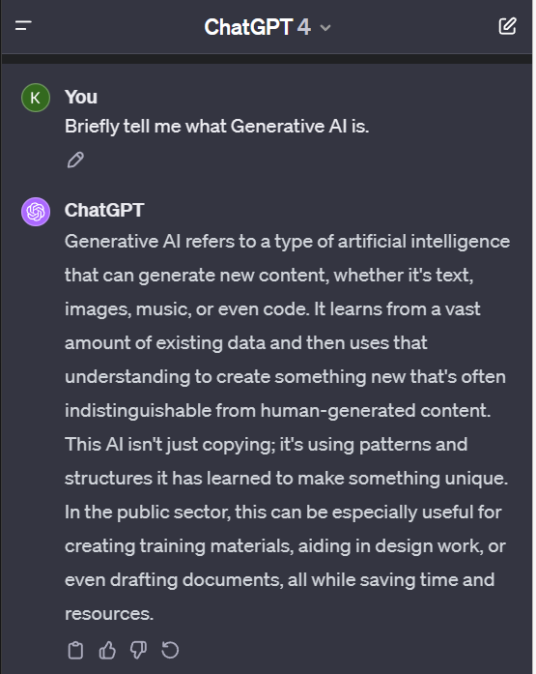
Generative - creates coherent and sensible output based on statistical probabilities of what comes next in a sequence of words. While plausible, and usually right, it is not always right.
Pre-trained - with vast amounts of content from various sources like books, articles, websites, and code repositories.
Transformer - a machine learning model that understands words, parts of words, and patterns of words and how they relate to each other in context.
GPT-4

Slide 4

Visiting France? You must see . . .
Paris (12.3%)
the (8.1%)
Notre (5.6%)
Top 10 things to do in France
Choose the most likely word or phrase that follows for given a context, add in some randomization, and GPTs generate very human-like output.

Slide 5
Your data is your data
Microsoft Azure Cloud
Runs on trust
Data is stored encrypted in your Azure subscription
Your data from any fine-tuning is not used to train the foundation AI models
Azure OpenAI Service provisioned in your Azure subscription
Model fine tuning stays in your Azure subscription and never moves into the foundation AI models
Your data is protected by the most comprehensive enterprise compliance and security controls
Encrypted with Customer Managed Keys
Private Virtual Networks, Role Based Access Control
Soc2, ISO, HIPPA, CSA STAR Compliant
And now approved as a Service within the FedRAMP High Authorization for Azure Commercial
Notes:
When we say your data is your data, we mean that all of the data you use or generate with Azure OpenAI Service is stored encrypted at rest in your organization’s Azure subscription.
The data is always under your control.
And when we say your data is not used to train foundation models, we mean that training data provided by the customer is only used to fine-tune the customer’s model and is not used by Microsoft to train or improve any Microsoft models.
Any fine-tuning you do stays in that Azure subscription, and never moves into the foundation AI models used by the world at large.
You don’t have to worry about training the model with your data, and then having a competitor be able to use that learning. The fine-tuned model only lives in your subscription and only you get to use it.
And all of your data and AI models are protected by the most comprehensive enterprise compliance and security controls in the industry.
This gives you the confidence to build great AI solutions on Azure and the Microsoft cloud.

Slide 6

Hallucinate much?
A situation where the model generates text that is not grounded in reality, is factually incorrect, or doesn't align with the input provided.

