Slide 1
Notes:
Humanity is in a transitional period. We are moving from the Digital Age into the AI Age. In this new era, AI is more than just a tool – it's a fundamental part of how we process information and make decisions. AI can help us interpret complex data, assist us in tackling difficult problems, and act as an advisor for our most challenging decisions.
For government, AI can help streamline operations, inform decision-making, and enhance citizen engagement.
To thrive in this new era, we need to become AI literate. This includes having some functional/foundational knowledge. That’s what this initial primer is about.

Slide 2
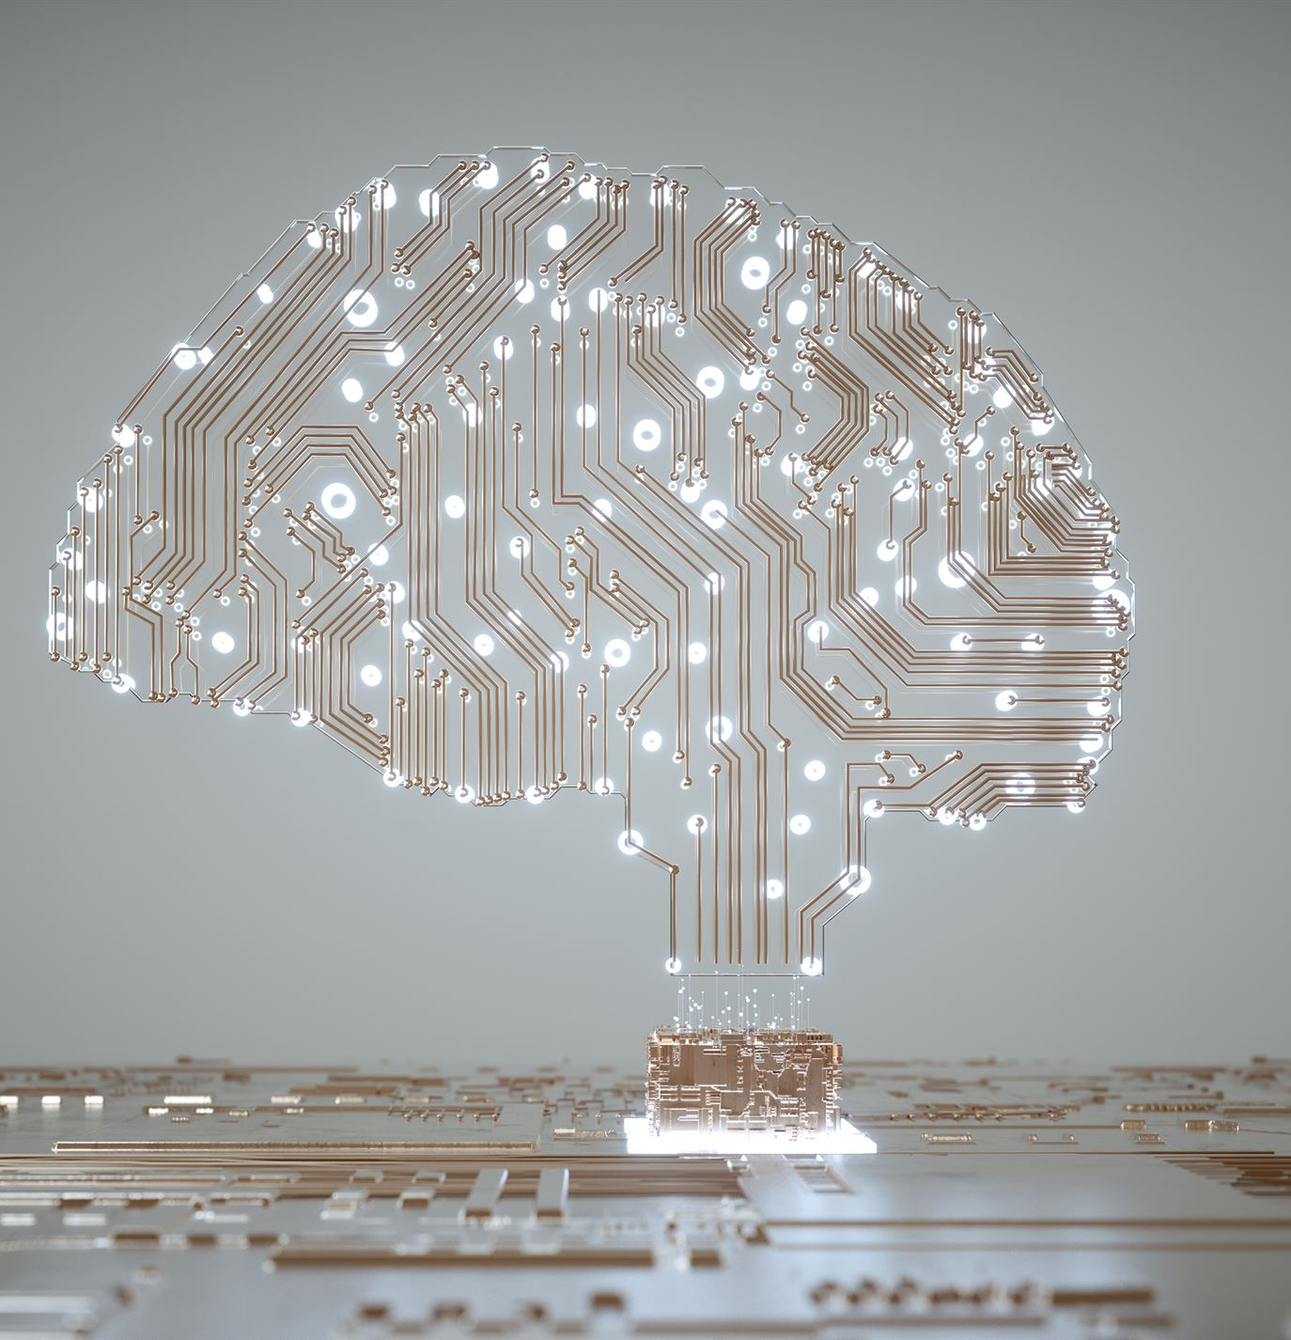
AI Literacy
Artificial Intelligence (AI) is about giving devices abilities that we typically associate with human intelligence, like reasoning, learning from experience, or making decisions.
Machine Learning Engineers develop AI models by using data to teach computers how to make predictions or take actions without being explicitly programmed.
A Model is an outcome of machine learning. It is a sophisticated program that analyzes data to find patterns and uses them to predict or decide on new information.
Inference: End users make inferences by inputting data into the model, which then applies its learning to provide predictions or decisions.
Notes:
Shift from Digital to AI
As we shift from the Digital Age to the AI Age, our role at Microsoft Federal becomes increasingly vital. We are not just participants but leaders in fostering AI Literacy. It's essential that we empower our customers with the knowledge to harness our platforms and services to their fullest potential, driving value and innovation.
AI Literacy is part of our job description
Becoming AI literate is part our job description, regardless of our role. Artificial Intelligence gives computers capabilities that we typically attribute to humans – like reasoning, learning, and making decisions. These capabilities are encapsulated in models develop by machine learning engineers. We interact with these models daily, through the software applications and devices we rely on.
Benefits to government
For our government partners, this translates to AI as a transformative force: streamlining operations, informing decision-making, and enhancing citizen services. As stewards of this technology, we have the privilege and responsibility to guide its integration and ensure it's used to enhance the public good.

Slide 3
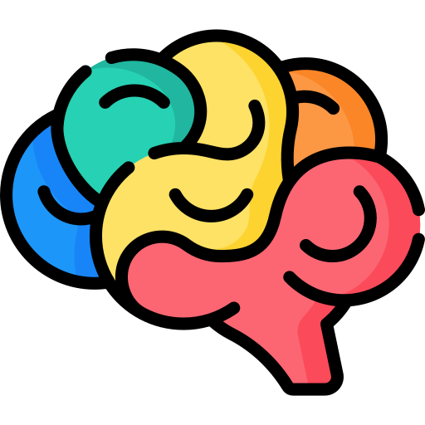







Foundation Models
Sample Tasks
Question and Answering
Image Captioning
Training Data
Sentiment Analysis
Object Recognition
Text
Foundation Model
Information Extraction
Instruction Follow
Images
Speech
Training
Adaptation
Report Generation
Code Generation
Structured Data
3d Signals
Transformer Model
Audio Transcription
Code Explanation
Translation
Code Debugging
Foundation models excel in diverse tasks, handling text, images, audio, and video.
They can “see," “hear," and “speak" and respond digitally in a variety of forms.
Combined they comprise a comprehensive digital support platform, a veritable team of interns.
Notes:
Revolutionary foundation models
Enabling this transition is a new set of models that are far more capable than their predecessors. We call these 'Foundation Models,' and they are a leap forward in the AI landscape. Unlike traditional models which are often designed for specific tasks, Foundation Models are versatile powerhouses trained on diverse data types – from text and images to audio and video.
Versatility and human-like processing
These models excel in a wide range of tasks because they understand and process data in a way that's closer to human cognition. They can 'see' through image recognition, 'hear' by processing speech, 'speak' by generating audio, and even 'comprehend' by understanding and translating languages. This versatility means that with a single foundational model, we can perform tasks that previously would have required multiple specialized models.
Adaptability and customization
The beauty of Foundation Models lies in their adaptability. Trained on vast and varied datasets, they can be fine-tuned – or adapted – with additional data to perform specific tasks incredibly well. This adaptation process means that a single model can be customized to support different applications, from answering questions to generating reports, or from transcribing meetings to debugging code.
Strategic value for government partners
For Microsoft Federal and our government partners, these models represent an opportunity to consolidate and streamline AI efforts. Think of Foundation Models as a comprehensive digital support platform – akin to a versatile team of interns ready to tackle a multitude of tasks, from the mundane to the complex. This doesn't just save on resources; it creates a more unified, intelligent, and responsive AI system.
Setting a new standard with AI
As we deploy these models, we’re not just optimizing our operations; we’re setting a new standard for what AI can do. They’re not just tools but partners that enhance our ability to serve, analyze, and innovate, taking us from mere digitization to truly intelligent automation.

Slide 4


Microsoft and OpenAI partnership
Ensure that artificial general intelligence (AGI) benefits humanity
Empower every person and organization on the planet to achieve more
Azure OpenAI Service – as of April 20, 2024
GPT-4, 4-Turbo and 3.5-Turbo
GPT-4 Vision
Babbage and Davinci
DALL·E 3
Whisper
Language
Multi-modal
Fine tuning
Images
Transcription & Translation
On Your Data
Azure AI Studio
Assistants
Notes:
Narrative/talk track:
The MSFT / OpenAI partnership and how we collaborate
Microsoft has formed a partnership with OpenAI to collaborate on the development of artificial intelligence technologies. The partnership aims to accelerate the development of advanced AI systems and bring the benefits of AI to more people.
As part of the partnership, Microsoft and OpenAI have agreed to work together on several key areas, including:
Developing AI technologies: The two companies will collaborate on the development of new AI models and algorithms, with a focus on natural language processing, computer vision, and other areas of AI.
Building an AI computing platform: Microsoft and OpenAI will work together to build a new AI computing platform that will allow developers to easily access and use advanced AI models and algorithms.
Advancing AI research: The two companies will also collaborate on a range of research projects aimed at advancing the state of the art in AI.
Making AI more accessible: The partnership aims to make AI more accessible to a wider range of developers and organizations, in order to bring the benefits of AI to more people.
Microsoft has also announced it will use OpenAI's GPT-3 technology to add more capabilities to its products such as Cortana, Power Virtual Agents and Dynamics 365.
Additionally, Microsoft has also made an investment in OpenAI, allowing the company to use Microsoft Azure as its preferred cloud platform, and allowing OpenAI to tap into the vast resources of Microsoft to accelerate its research. This partnership gives OpenAI the ability to scale its models and services on Azure and make them more widely available to customers.
Overall, the partnership between Microsoft and OpenAI aims to accelerate the development and use of advanced AI technologies, with a focus on making AI more accessible to developers and organizations, in order to bring the benefits of AI to more people.

Slide 5
Azure OpenAI Service
GPT-4
GPT-4-Turbo
GPT-3.5-Turbo
DALL·E 3
New: GPT-4 for Vision
Generative Text Models, with varying capabilities and uses
Generative Image Model
Deploy on your own data
Provisioned throughput units (PTUs)
Assistants, Functions and Plugins

