Slide 1
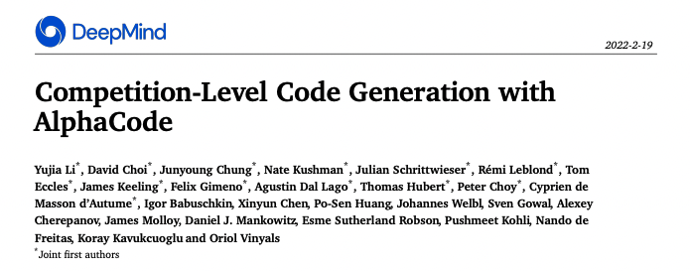
计算机学院-电子信息 何峙

Slide 2
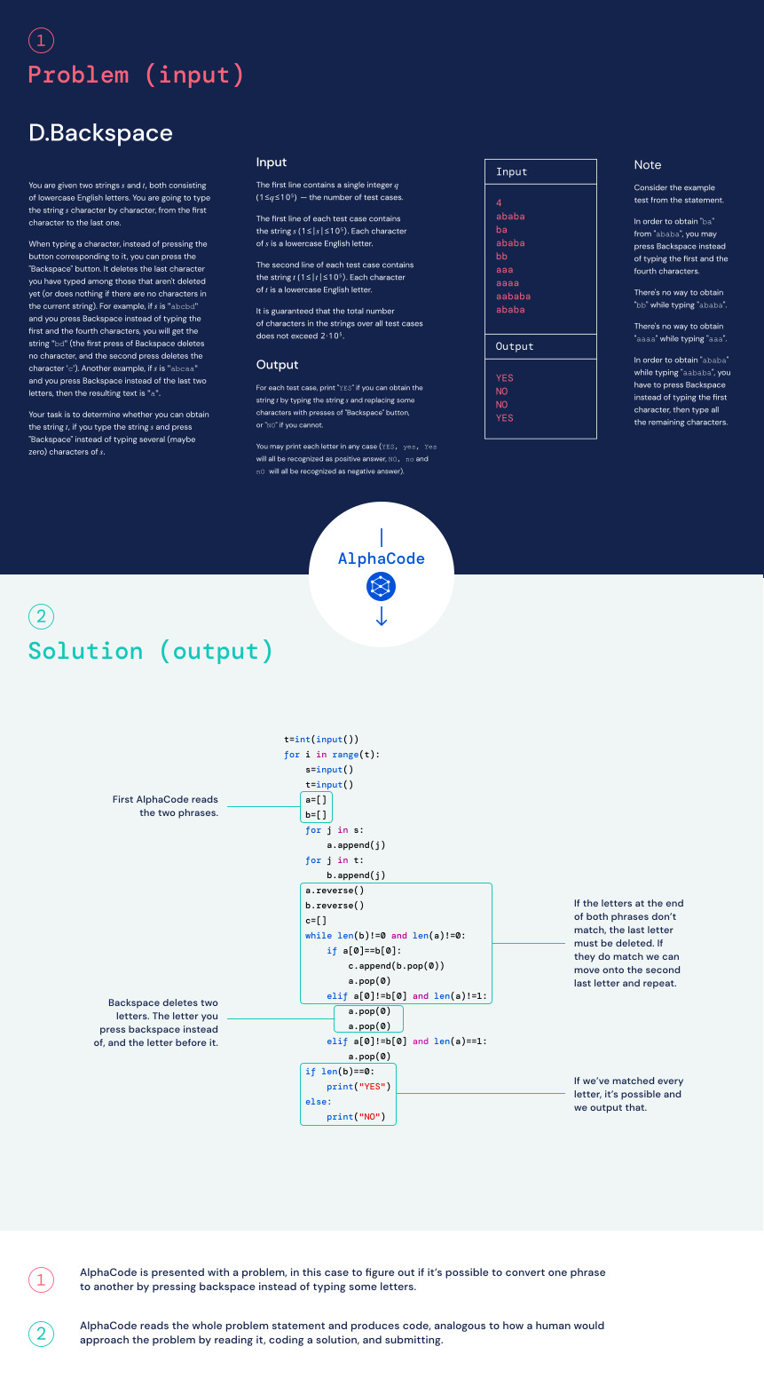

Slide 3
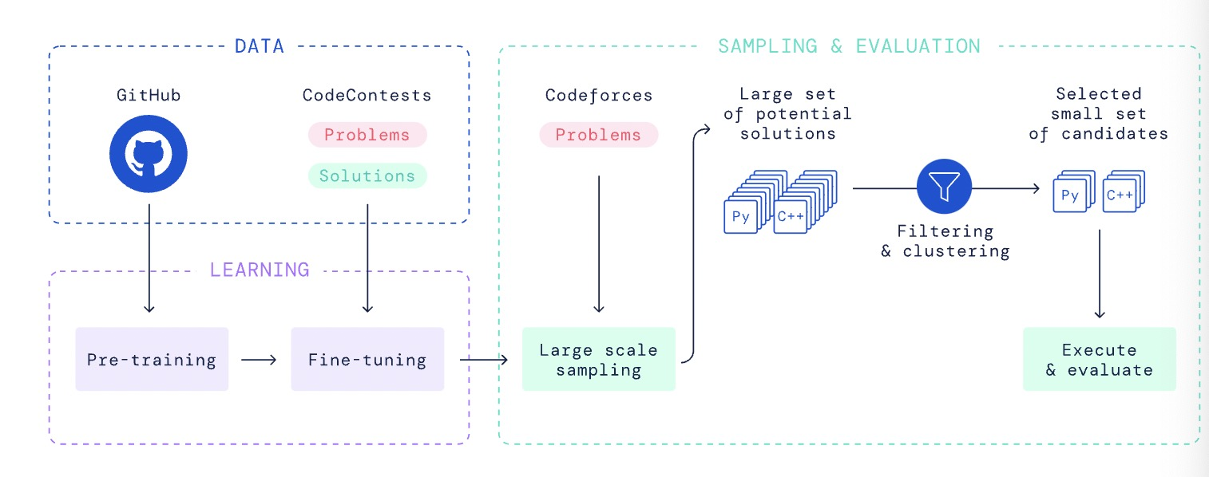
系统架构

Slide 4
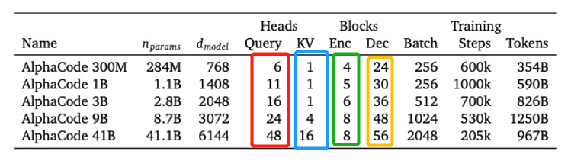
总体基于transformer的seq2seq模型
encoder用的transformer层数比decoder要少得多
“Using a full set of query heads but sharing key and value heads per attention block significantly reduces memory usage and cache update costs...”

Slide 5
Pre-training
代码片段的后半部分
transformer_block
transformer_block
transformer_block
encoder
decoder
embedding
token embeded
代码片段的前半部分
综合使用两个loss:
1. decoder：next-token prediction loss
2. encoder：masked language modeling loss

Slide 6
Fine-tuning
解题代码
transformer_block
transformer_block
transformer_block
encoder
decoder
embedding
token embeded
问题的自然语言描述
综合使用两个loss:
1. decoder：next-token prediction loss
2. encoder：masked language modeling loss

Slide 7
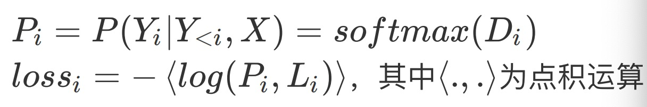
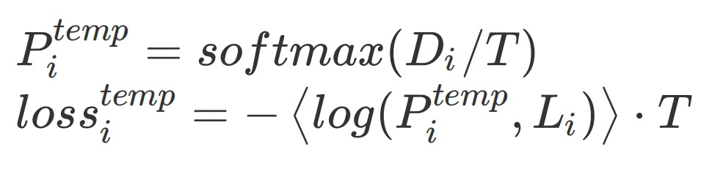
一些技巧：Softmax tempering
旧的计算交叉熵损失的方法：
softmax tempering的计算方法：
Because loss is to be minimized, back-propagation will force the model to generate logits to counter
the smoothing effect of temperature. During decoding with a model trained in this way, the temperature coefficient
is not used and the logits will be such that they yield a sharper softmax distribution compared to those of
a model trained without softmax tempering。
by 《Softmax Tempering for Training Neural Machine Translation Models》

Slide 8
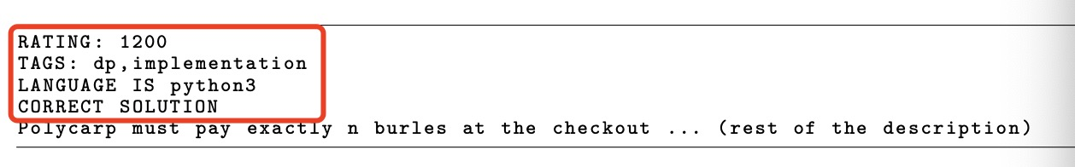
一些技巧：Value conditioning & prediction
区分正确与错误的题解
Value conditioning
prediction(采样阶段)，“solution”都填“正确”，模型就会采样到正确的sample

Slide 9
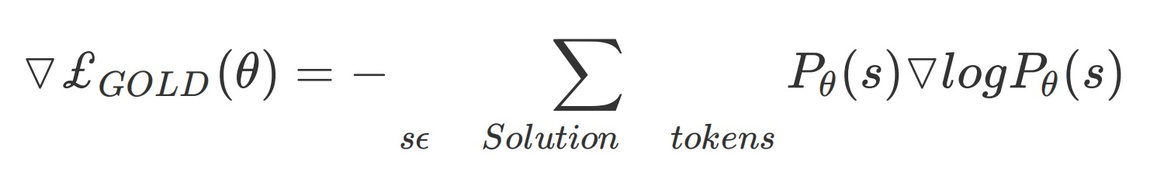
一些技巧：GOLD
目标：尽可能精确的解
对loss求导的改进：
by 《GOLD: Text Generation by Learning from Demonstrations》

Slide 10
预测阶段——1. Large scaling sample
解题代码
transformer_block
transformer_block
transformer_block
encoder
decoder
embedding
token embeded
（1）⽣成Python和C++语⾔的样本各⼀半；
（2）随机组合题⽬的tag和ratings；
（3）使⽤相对⾼的softmax tempering参数
（4）100万个samples
问题的自然语言描述

Slide 11
预测阶段——2. Filtering
100万samples
pass example test?
1000 samples

Slide 12
预测阶段——3. Clustering
1000 samples
test input1
test input2
similary on test ouput ?
问题的自然语言描述
transformer 2
test input3
.....
select one sample one by one
验证时，如果这10个sample中有⼀个通过了所有的hidden test，即为成功解题！
10 samples

