Slide 1
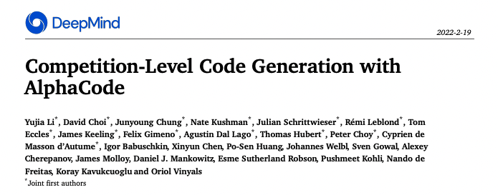
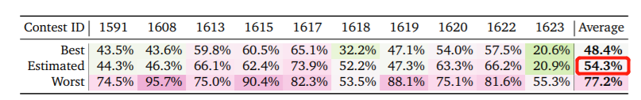
计算机学院-大数据与人工智能 何峙

Slide 2
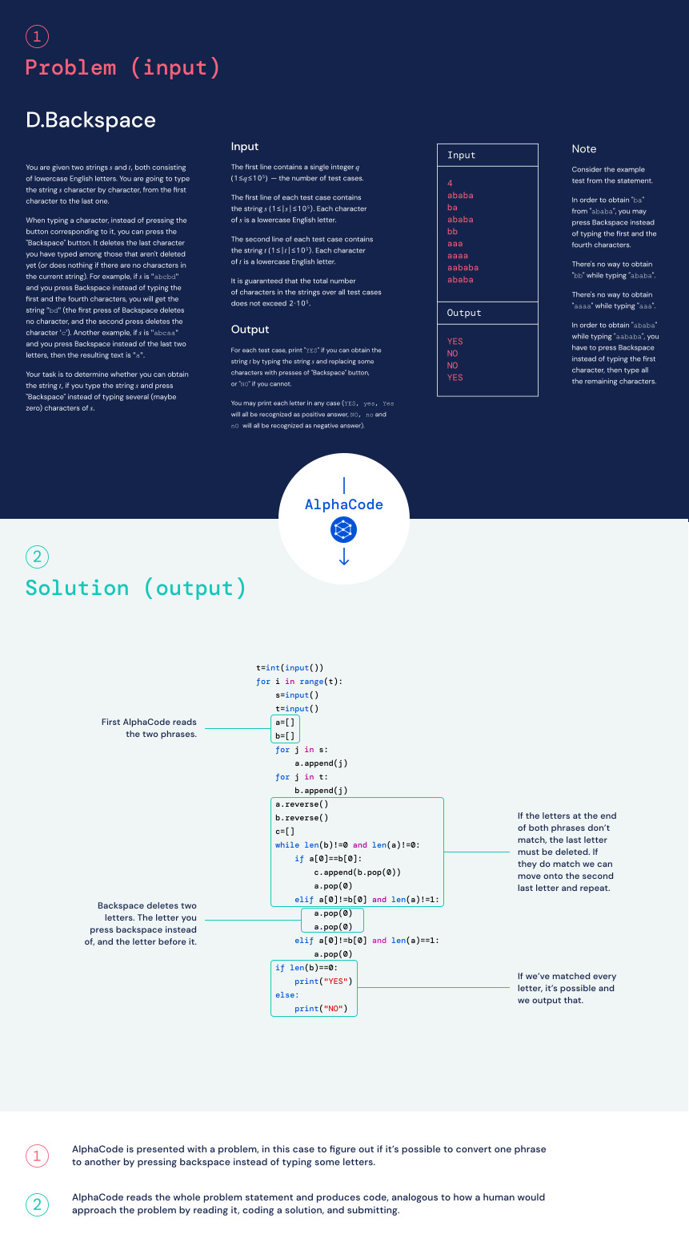

Slide 3
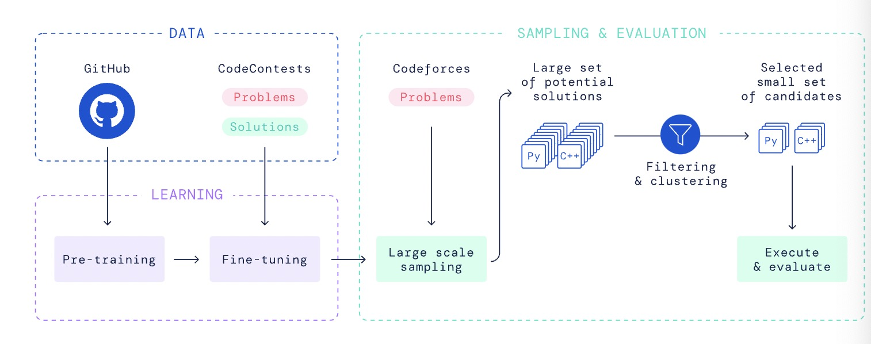
系统架构

Slide 4
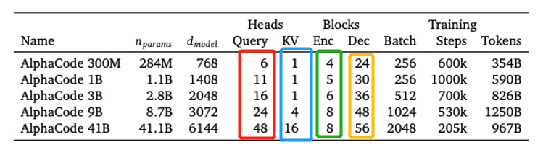
总体基于transformer的seq2seq模型
encoder用的transformer层数比decoder要少得多
“Using a full set of query heads but sharing key and value heads^{[1]} per attention block significantly reduces memory usage and cache update costs...”
[1] 《Fast Transformer Decoding: One Write-Head is All You Need》

Slide 5
Pre-training
代码片段的后半部分
transformer_block
transformer_block
transformer_block
encoder
decoder
embedding
token embeded
代码片段的前半部分
综合使用两个loss:
1. decoder：next-token prediction loss
2. encoder：masked language modeling loss

Slide 6
Fine-tuning
解题代码
transformer_block
transformer_block
transformer_block
encoder
decoder
embedding
token embeded
问题的自然语言描述

Slide 7
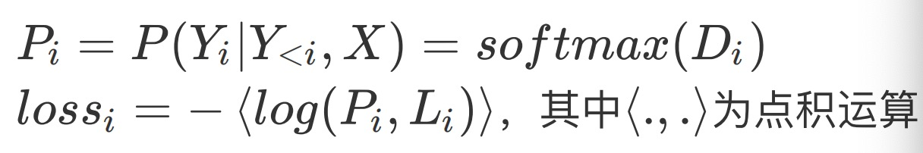
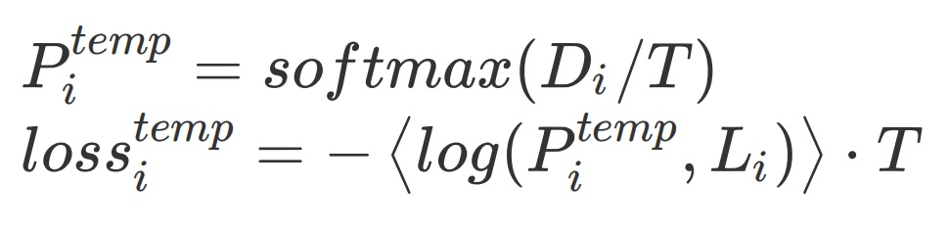
一些技巧：Softmax tempering
旧的计算交叉熵损失的方法：
softmax tempering的计算方法：
“Because loss is to be minimized, back-propagation will force the model to generate logits to counter
the smoothing effect of temperature. During decoding with a model trained in this way, the temperature coefficient
is not used and the logits will be such that they yield a sharper softmax distribution compared to those of
a model trained without softmax tempering。^{[2]}”
[2] 《Softmax Tempering for Training Neural Machine Translation Models》

Slide 8
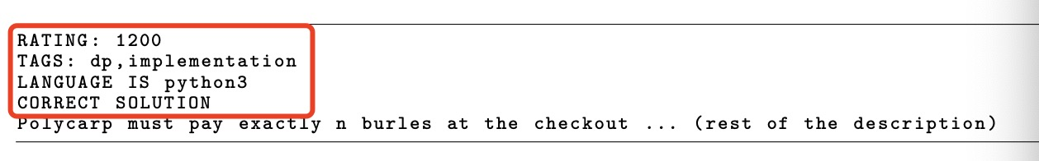
一些技巧：Value conditioning & prediction
区分正确与错误的题解
Value conditioning
prediction(采样阶段)，“solution”都填“正确”，模型就会采样到正确的sample

Slide 9
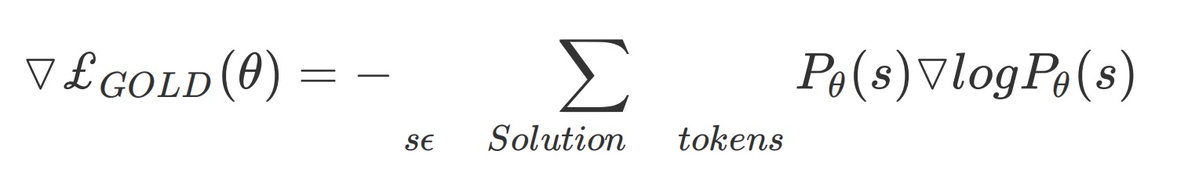
一些技巧：GOLD^{[3]}
目标：尽可能精确的解
对loss求导的改进：
[3] 《GOLD: Text Generation by Learning from Demonstrations》

Slide 10
预测阶段——1. Large scaling sample
解题代码
transformer_block
transformer_block
transformer_block
encoder
decoder
embedding
token embeded
（1）⽣成Python和C++语⾔的样本各⼀半；
（2）随机组合题⽬的tag和ratings；
（3）使⽤相对⾼的softmax tempering参数
（4）100万个samples
问题的自然语言描述

Slide 11
预测阶段——2. Filtering
100万samples
pass example test?
1000 samples

Slide 12
预测阶段——3. Clustering
1000 samples
test input1
test input2
similary on test ouput ?
问题的自然语言描述
transformer 2
test input3
.....
select one sample one by one
验证时，如果这10个sample中有⼀个通过了所有的hidden test，即为成功解题！
10 samples

Slide 13
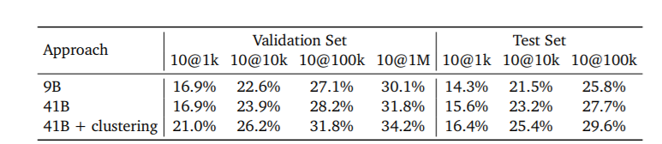
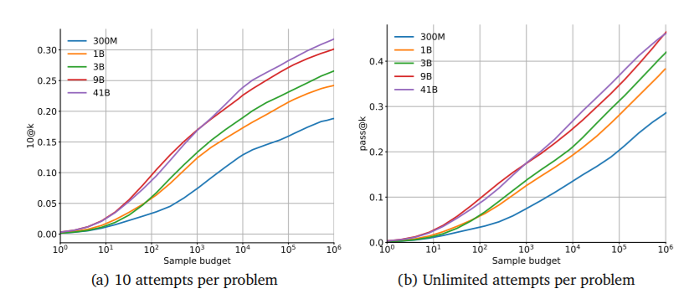
模型效果
解题率：pass@k, n@k

Slide 14
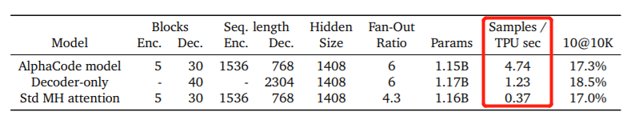
模型效果
采样速度

Slide 15
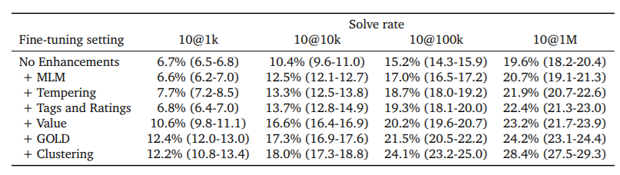
模型效果
各种加buffer

Slide 16
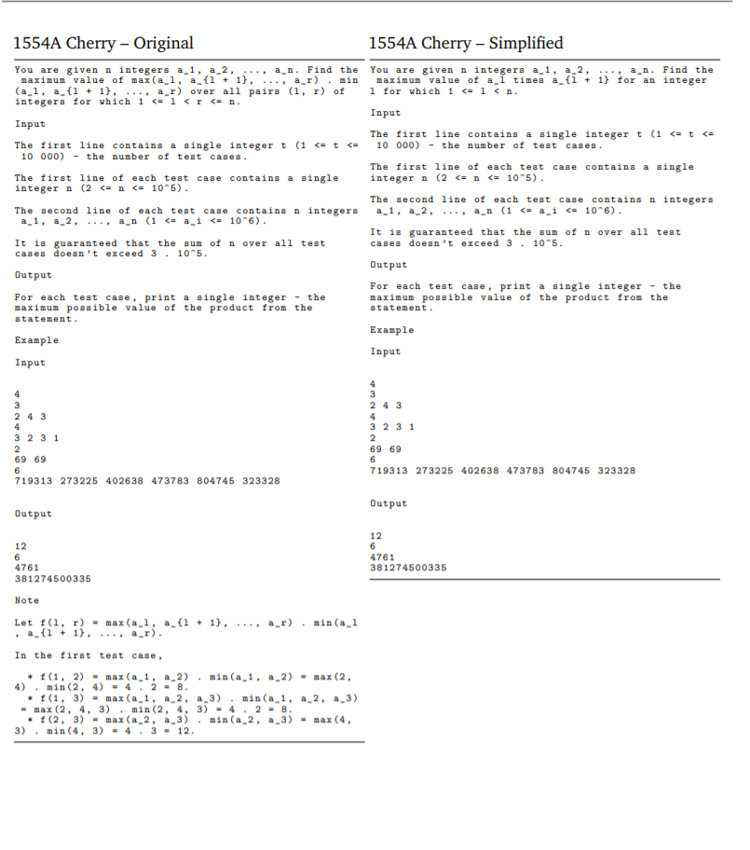
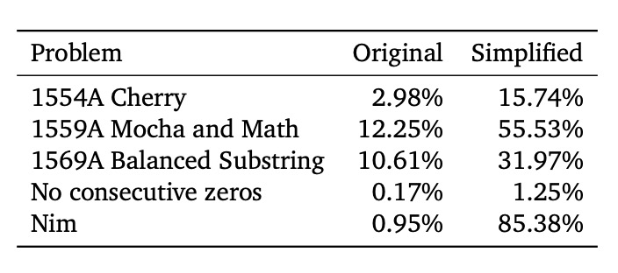
模型效果
问题自然语言描述的精简性影响

Slide 17
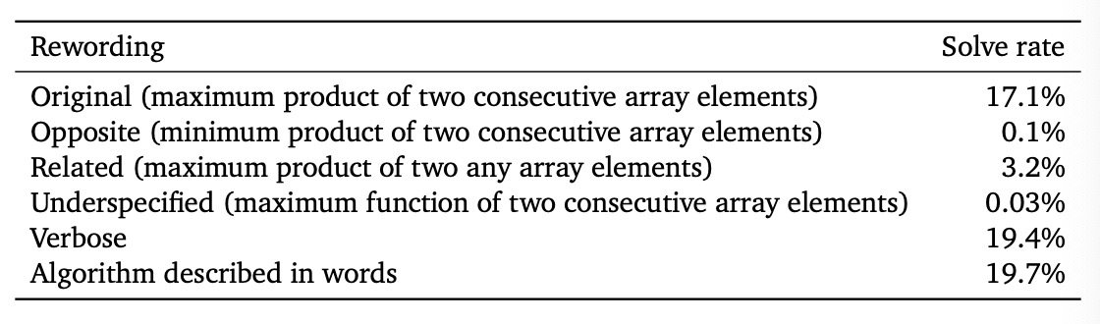
模型效果
“the model acutally does better with more language-heavy descriptions”

Slide 18
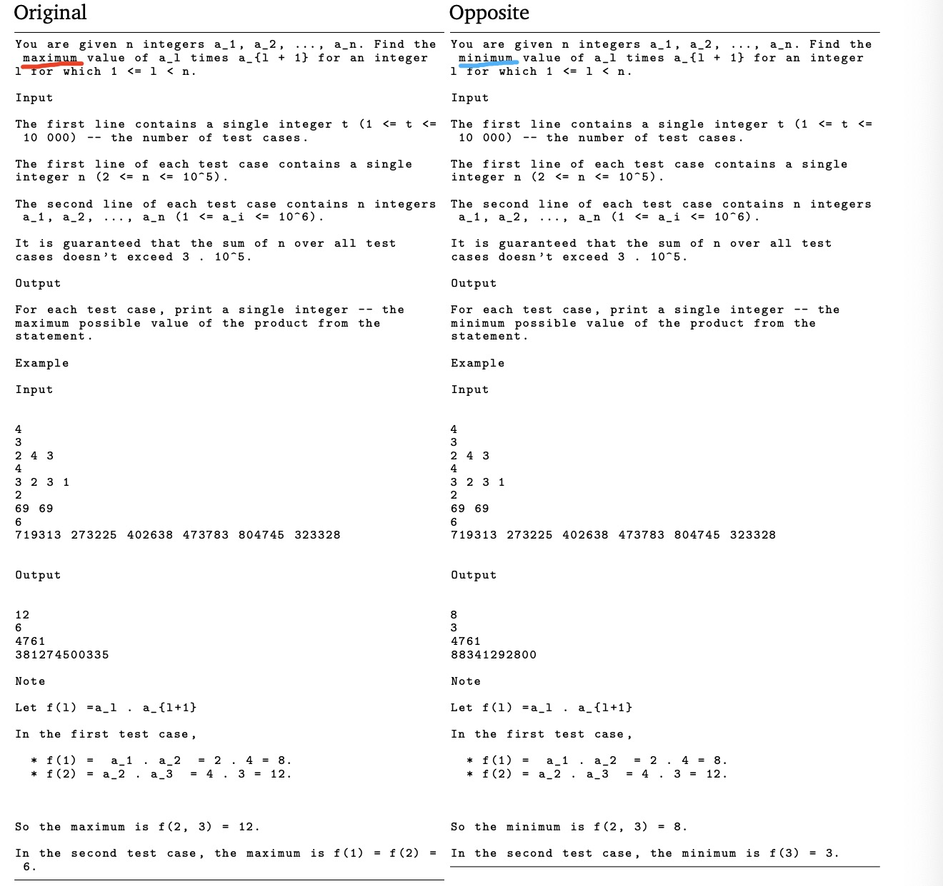
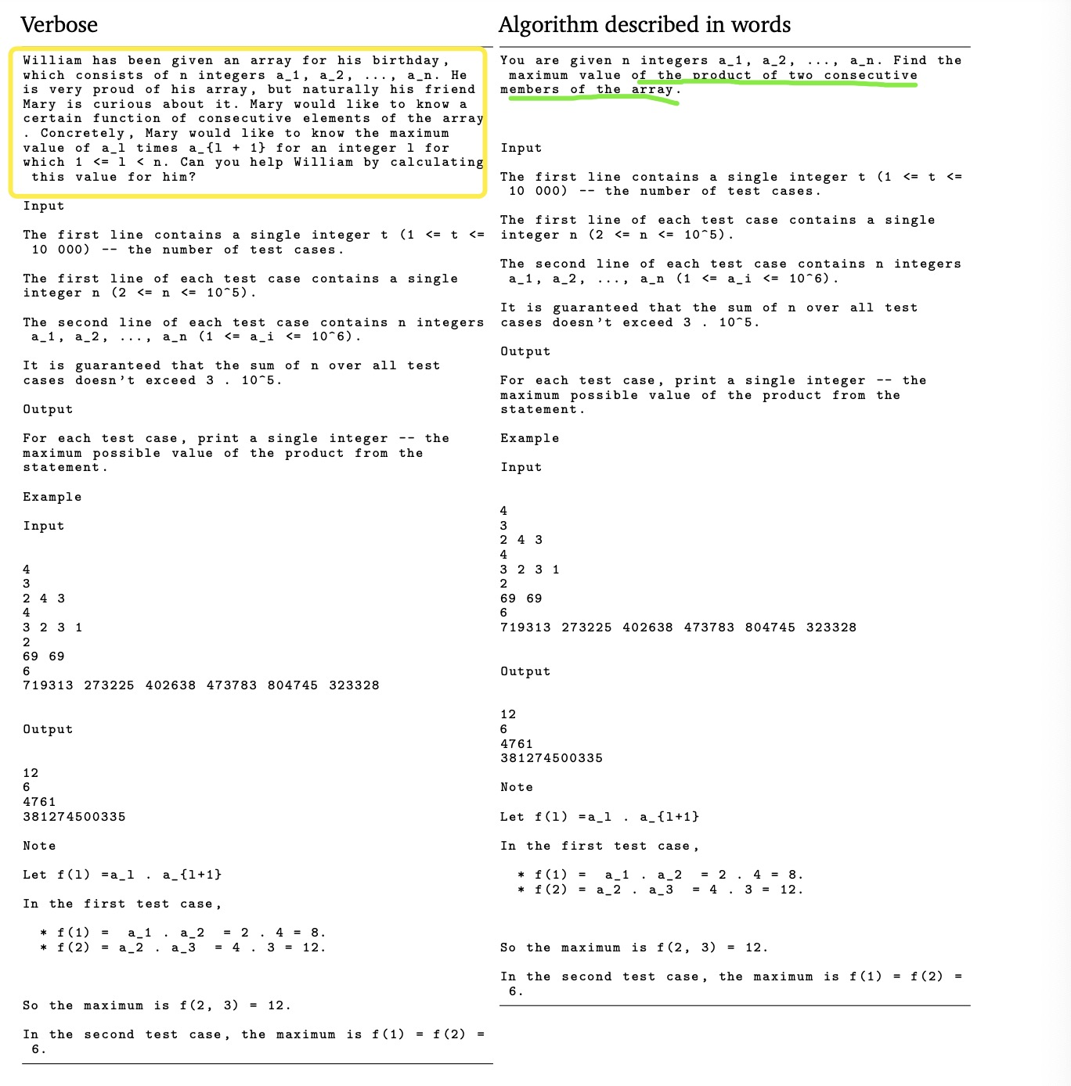

Slide 19
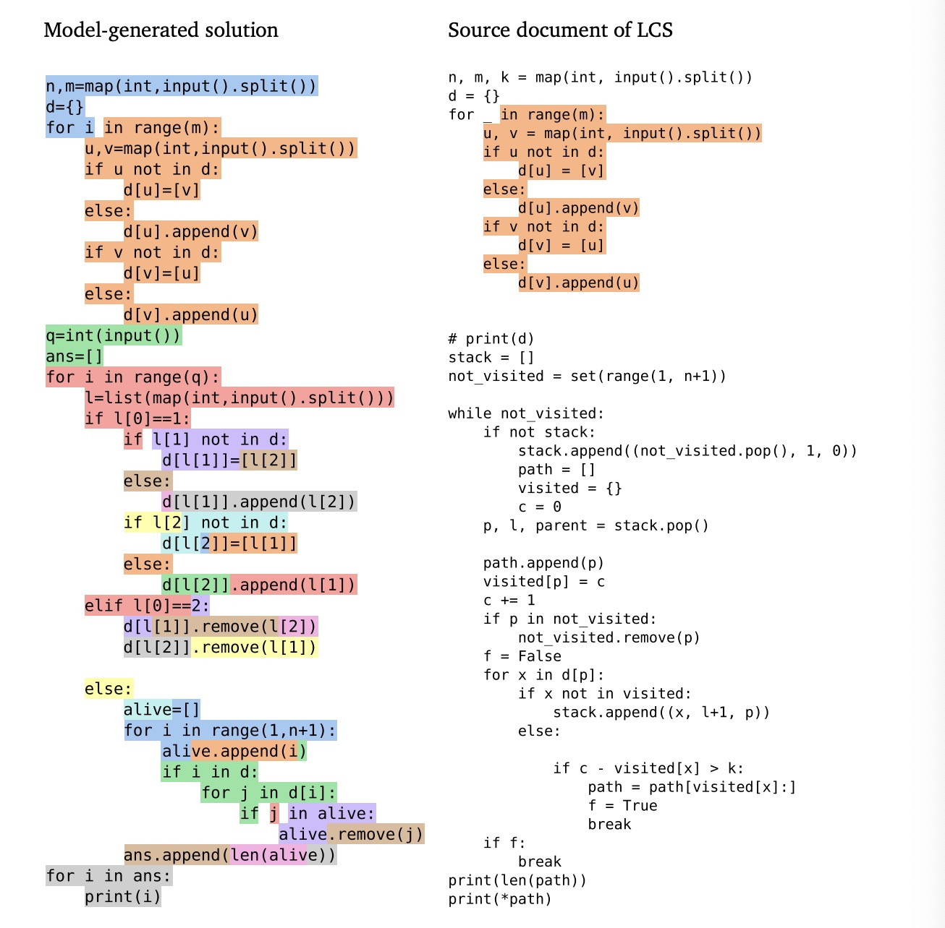

关于训练数据的“泄漏”
* 源于Copilot争议
* 按提交日期划分数据集
*“The common substrings between model solutions and training data mostly contained boilerplate code for reading and parsing the input data format, rather than key logic for solving problems. AlphaCode thus does not seem to solve problems by copying long blocks of code.”

Slide 20
其他
模型加速工具：JAX，Haiku
官方Demo: https://alphacode.deepmind.com/
数据集：
https://github.com/deepmind/code_contests
https://codeforces.com/

