Slide 1
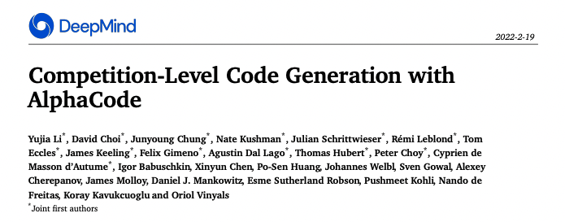
计算机学院-电子信息 何峙

Slide 2
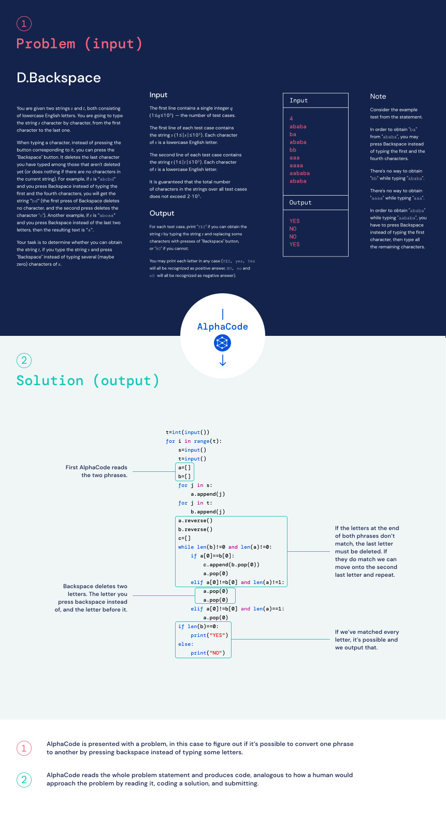

Slide 3
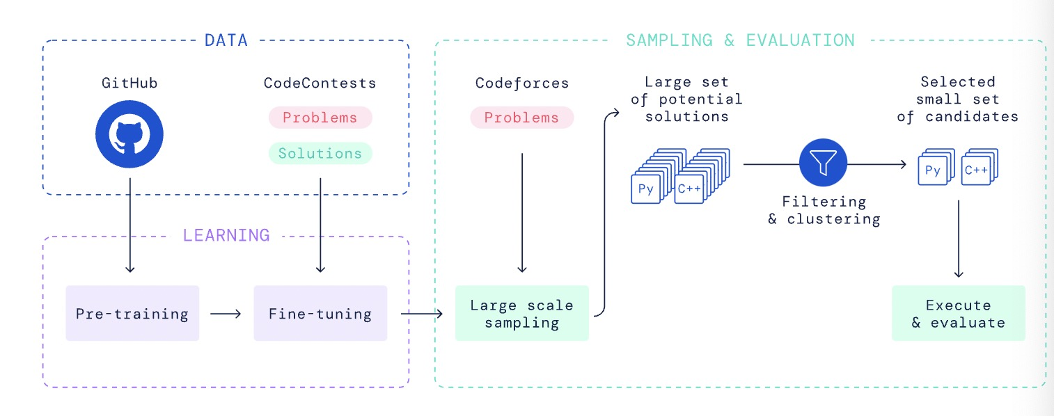
系统架构

Slide 4
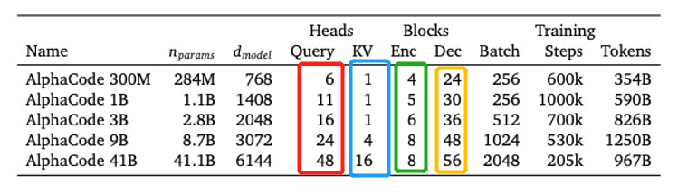
系统架构
总体基于transformer的seq2seq模型
“We further found that using a shallow encoder and a deep decoder significantly improves the efficiency of training without hurting problem solve rate.”
“Using a full set of query heads but sharing key and value heads per attention block significantly reduces memory usage and cache update costs...”

