Slide 1
Do As I Can, Not As I Say: Grounding Language in Robotic Affordance
He Zhi, CSE of SYSU
Email: hezh58@mail2.sysu.edu.cn

Slide 2
LLM has no experience, but has knowledge
Robot has no knowledge, but has experience

Slide 3
LLM Say knowledge
+
Robot Can do experience
=
SayCan
SayCan is to ground large language models through value functions——affordance functions that capture the log likelihood that a particular skill will be able to succeed in the current state.

Slide 4


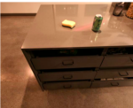
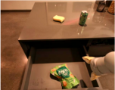
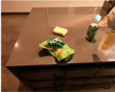
Methodology
i: Instruction
How would you put an apple on the table？
: action in Robot action space
:action natural language description
Find an apple
Find a coke
Pick up the apple
Place the apple
......
s: environment state
Gripper Height
+
Rotation to Go
......
Closure to Go
......

Slide 5

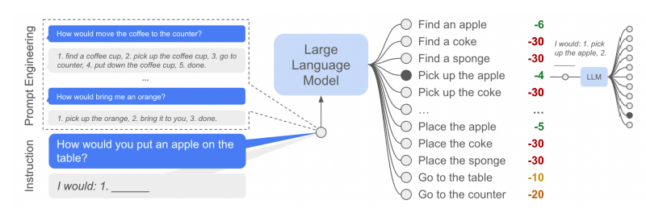
Methodology
LLM provides

Slide 6

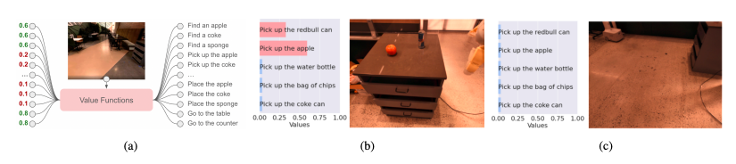
Methodology
Agent (Robot, etc) provides

Slide 7
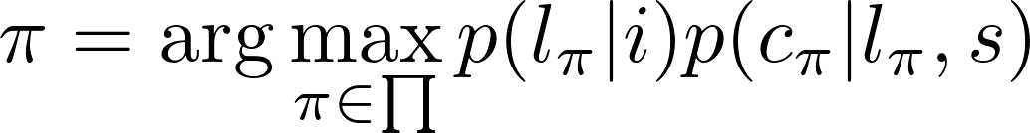
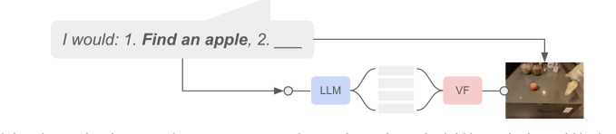
Methodology

Slide 8
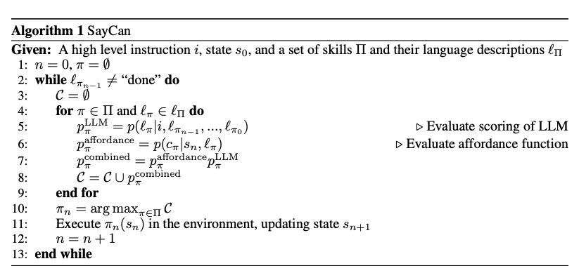
Methodology

Slide 9
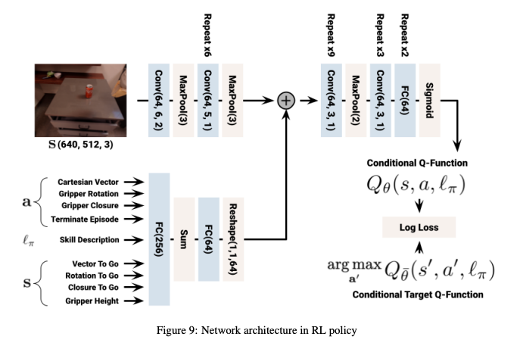
Model architecture——Agent
《Mt-opt: Continuous multi-task robotic reinforcement learning at scale》

Slide 10
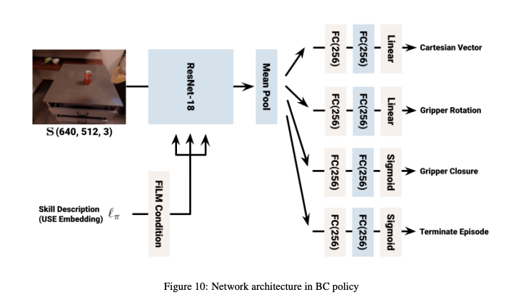
Model architecture——Agent
《Bc-z:Zero-shot task generalization with robotic imitation learning》

Slide 11
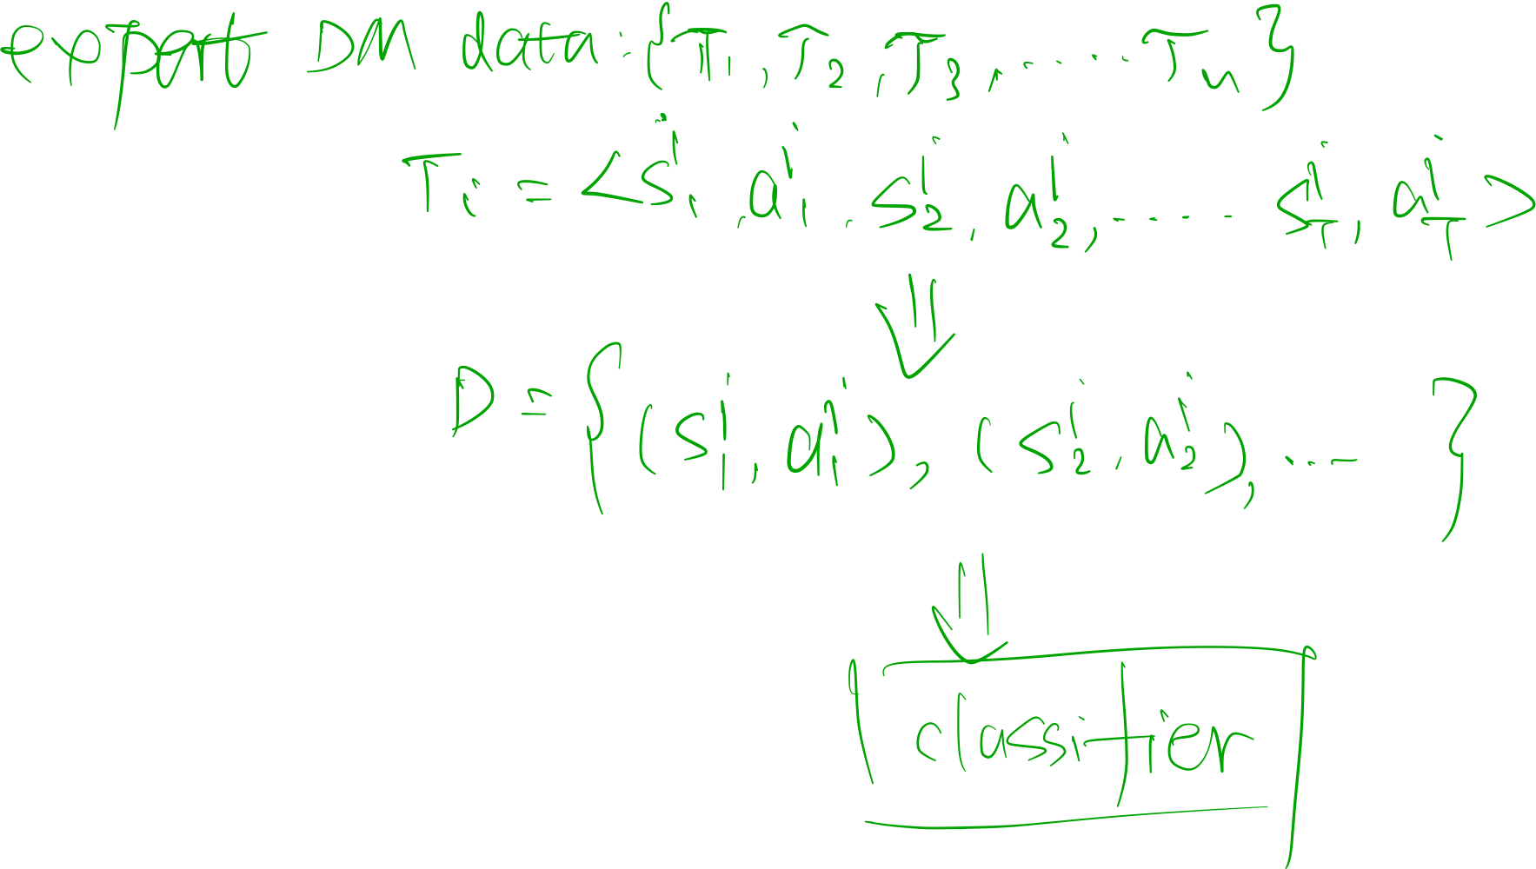
Model architecture——Agent
《Bc-z:Zero-shot task generalization with robotic imitation learning》

Slide 12
Model architecture——LLM
PaLM
《PaLM：Scaling Language Modeling with Pathways》
FLAN
《FINETUNED LANGUAGE MODELS ARE ZERO-SHOT LEARNERS》

Slide 13
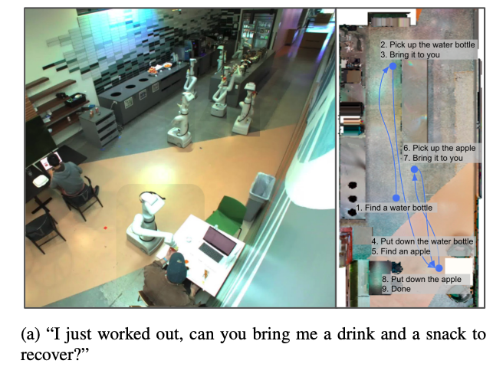
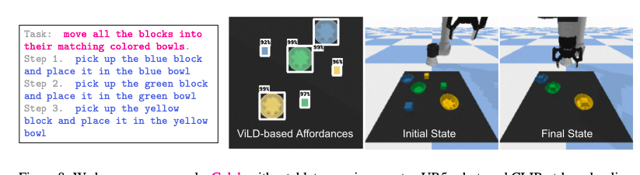
Experiment/Result

Slide 14
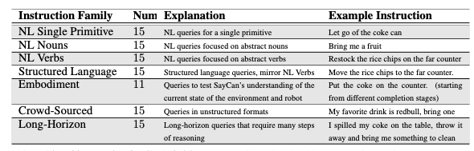
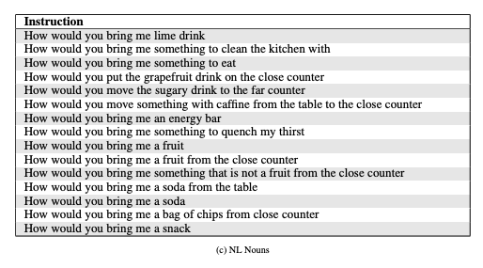
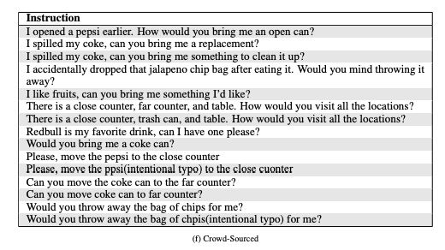
Experiment/Result

Slide 15
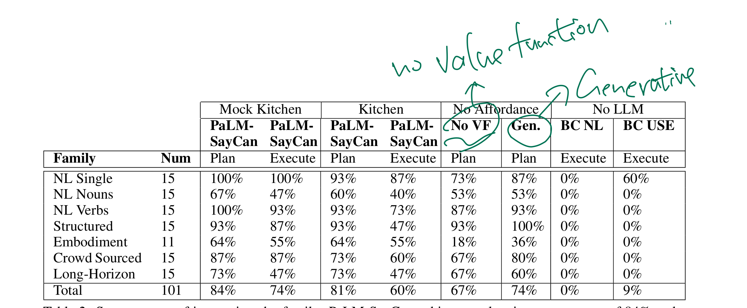
Experiment/Result
plan success rate
execution success rate

Slide 16
What to do next?
Sparse reward!
No middle-step reward!

Slide 17
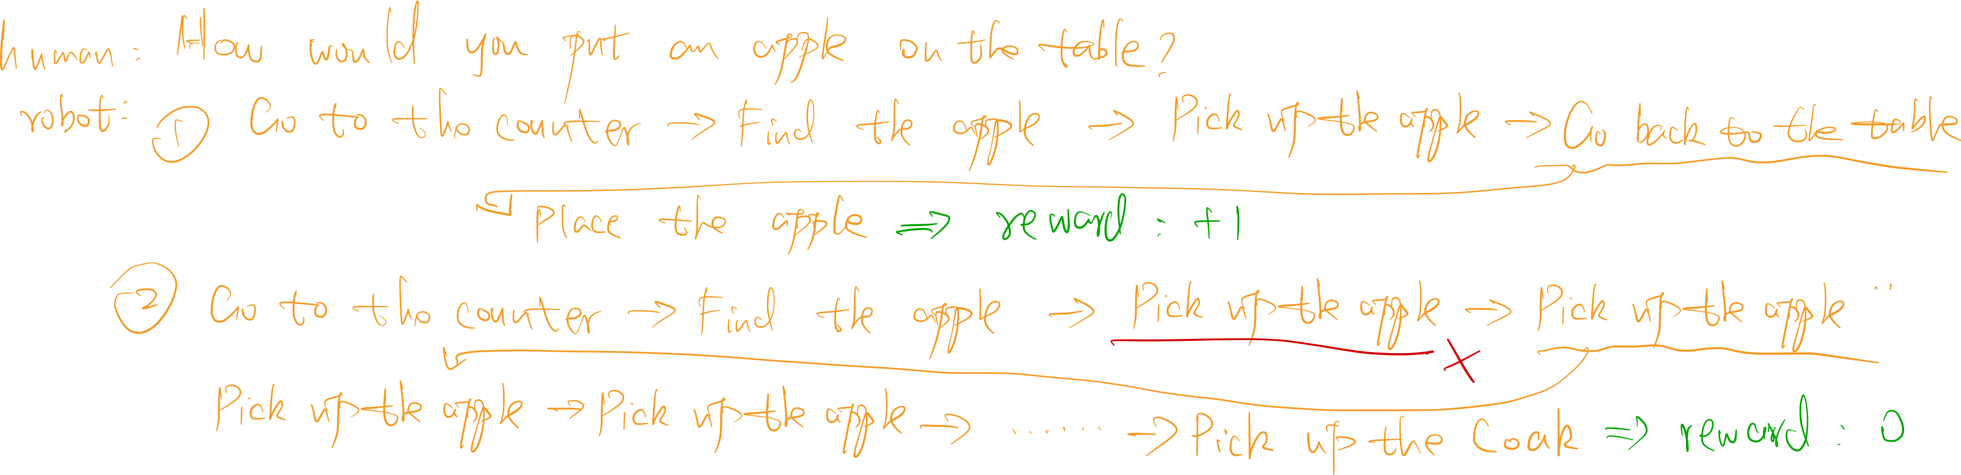
What to do next?
Sparse reward!
No middle-step reward!

Slide 18
Code/Dataset
https://github.com/google-research/google-research/tree/master/saycan
https://github.com/say-can/say-can.github.io/tree/main/data

