Slide 1
CMSC 447, Session 2
Sprint Backlog Review of Interactive Mapping Application
Codepods:
Darrell Laffoon, David Pan, Ian Moskunas, Desiree Mercuree, Kevin Miller, Ben Hazlett
Class Hours: Tuesday/Thursday 5:30-6:45 PM Class Location: Fine Arts 303

Slide 2
Requirements
Requirement 1: The user shall be able to compare crime rates, schools, and average commute time on a map
Feature Points: 2
In progress, 50% complete
Main impediment is linking the backend server with the frontend server
Select different statistics and the map will update the heatmap to reflect the change
Requirement 2: The map shall be interactive with a mouse
Feature Points: 1
Complete, 100% complete
No impediments. Google Maps API handled this
Able move around the map using mouse controls

Slide 3
Requirements
Requirement 3: The user shall be able to select a specific statistic of interest to display a heatmap over the map
Feature Points: 2
In progress, 50% complete
Main impediment is linking the backend server with the frontend server
The user will select a statistic and the heatmap will update to handle reflect this change
Requirement 4: The user be able to switch statistics to compare different statistics on the map
Feature Points: 2
In progress, 50% complete
Main impediment is linking the backend server with the frontend server
The map will be redrawn to reflect the new statistic selected

Slide 4
Requirements
Requirement 5: The data shall be visualized using a heatmap style gradient
Feature Points: 2
In progress, 50% complete
Main impediment is linking the backend server with the frontend server
Red will be worst color, green will be best color
Requirement 6: A data key will be provided explaining the statistic selected
Feature Points: 2
In progress, 50% complete
No impediment
This will be present on the web page to the right of the map

Slide 5
Requirements
Requirement 7: Must be able to be run on Google Chrome, Firefox, and Microsoft Edge browsers
Feature Points: 1
100% complete
No impediment
Requirement 8: Data must be for moving in the state of Maryland
Feature Points: 2
50% complete
Main impediment is linking the backend server with the frontend server
Depending on the data a should is for the 48 contiguous United States

Slide 6
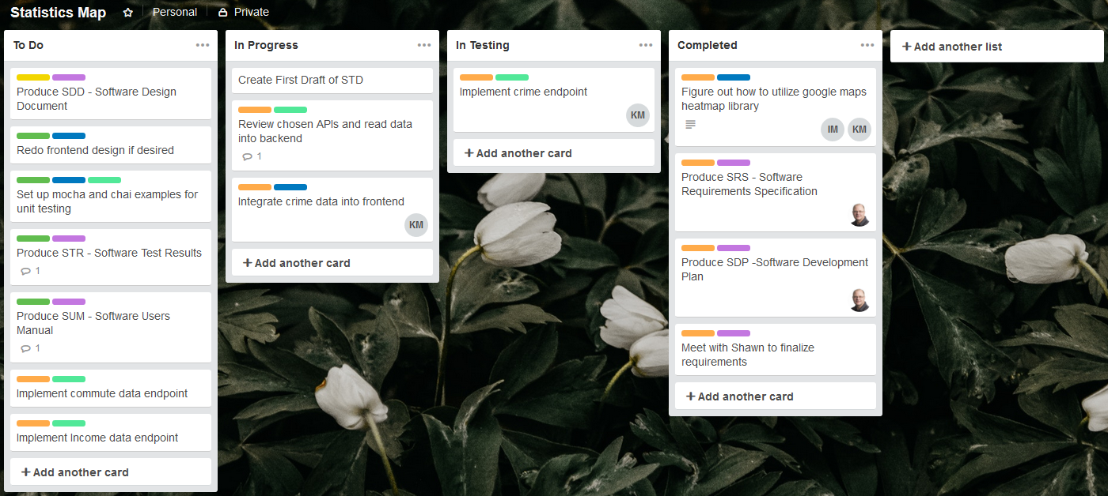

Slide 7
Documentation
System/Software Development Plan (SDP)
Complete, 100% complete, Darrell Laffoon, Kevin Miller, Complete
System/Software Requirements Specification (SRS)
Complete, 100% complete, Darrell Laffon, Kevin Miller, Complete
System/Software Design Document (SDD)
In Progress, 85% complete, Darrell Laffoon, Ben Hazlett, Kevin Miller, May 15th
Software Test Description (STD)
In Progress, 75% complete, Darrell Laffoon, Ben Hazlett, Kevin Miller, May 15th
System/Software Testing Report (STR)
In Progress, 25% complete, Darrell Laffoon, Kevin Miller, May 15th
Software User Manual (SUM)
In Progress, 10% complete, Darrell Laffoon, May 15th

Slide 8
Reviews
System Requirements Review (SRR)
Darrell Laffon, Desiree, David Pan, Kevin, Ian Moskunas, Ben Hazlett, No Issues, Signed Off
Software Specification Review (SSR)
Darrell Laffon, Desiree, David Pan, Ian Moskunas, Kevin Miller, Ben Hazlett, No Issues, Signed Off
System Design Review (SDR)
Desiree, Dave, Kevin, Ben Hazlett, Ian Moskunas, No Issues, Signed Off
Preliminary Design Review (PDR)
Desiree, Dave, Kevin, Ben Hazlett, Ian Moskunas, No Issues, Signed Off
Critical Design Review (CDR)
To be completed
Test Readiness Review (TRR)
To be completed

Slide 9
Summary
Phasesd | Activity | Deadline | Deliverables
Kickoff | Meet with Customer and Gather Business Reqs | ASAP
Prep Environment | Build Environments & Identify Tools | Week of 3/25
Analysis | Identify Requirements | Week of 3/25 | SRS & SDP
Design | Architecture and Design | Week of 4/1 | SDD
Implementation | Develop Application to SDD specifications | 3/25-5/6 | STD
Testing | Testing to plan outlined in STD | 3/25-5/6 | STR
Customer Demo | Present and Demo Project to Customer | 5/10 | SUM & APP
What’s working:
Tracking well to the plan
Good Dev Environment and tool selection
Sound Architectural Plan and design
Documentation is tracking well with Implementation
Data sources identified and back end services nearing completion
Team highly engaged and working well together
Challenges:
Lack of good tracker (JIRA) … moved to Trello, but not maintaining it as good as we could
Hybrid approach of Waterfall with Agile elements - Really shifted to more of a Kanban approach
Took a while to find good data sources
As expected, learning new tools/tech with limited time
Difficulties:

