Slide 1
CMPS 161 Final Project
Graph Visualizations of IMDb Data

Slide 2
Overview of Application
A web application to generate graphs from IMDb actors
Greatly improved generation speed from first prototype
Multiple generation options
Support for multiple roots
Edge cross checking
Simple graph algorithms integrated (BFS, DFS, Min Cut)
Dynamic addition of elements
Animated layouts
Performant at high graph sizes

Slide 3
Basic Statistics
About fifty graphs generated across two sets of roots
All relevant setting permutations tested
The most influential traits of root nodes on a graph are the era of an actor and popular rating
The true random generation produced the widest variety of actors and films but the least film intersections
Choosing the newest films with the highest billing actors resulted in the most film intersections

Slide 4
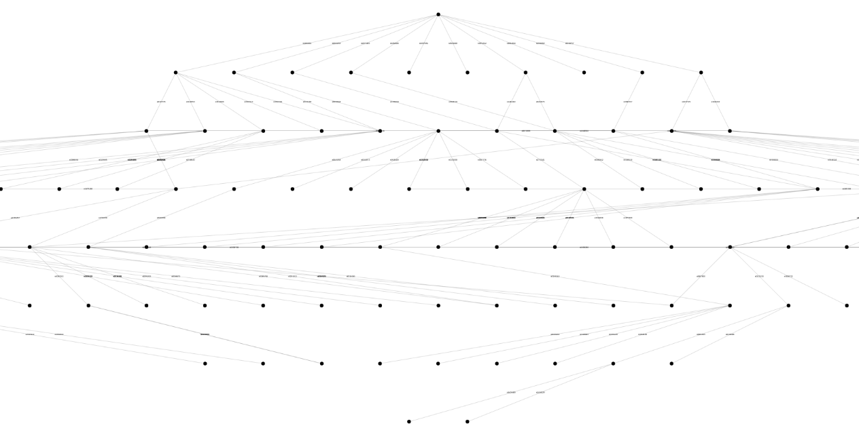
Breadth First Layout Example

Slide 5
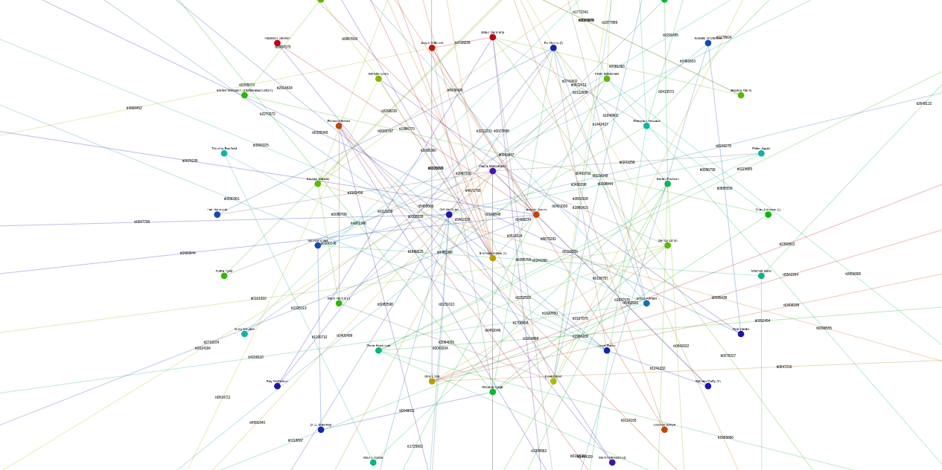
DFS Coloring Example

Slide 6
Demo

