Slide 1
The Adapter Pattern
by Kevin Washington – kwsl@ic.ufal.br

Slide 2
Intent
Convert the interface of a class into another interface clients expect. Adapter lets classes work together that couldn't otherwise because of incompatible interfaces.
Wrap an existing class with a new interface.
Impedance match an old component to a new system

Slide 3
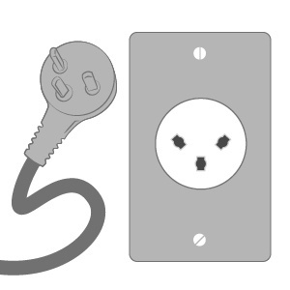
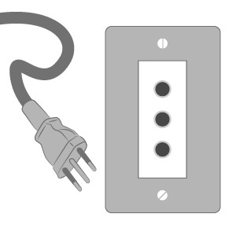
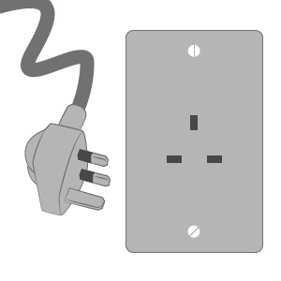
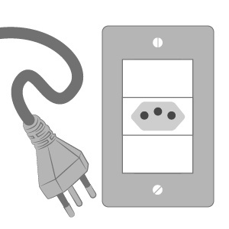
Problem

Slide 4
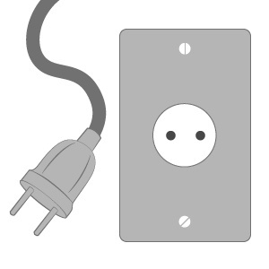
Problem

Slide 5
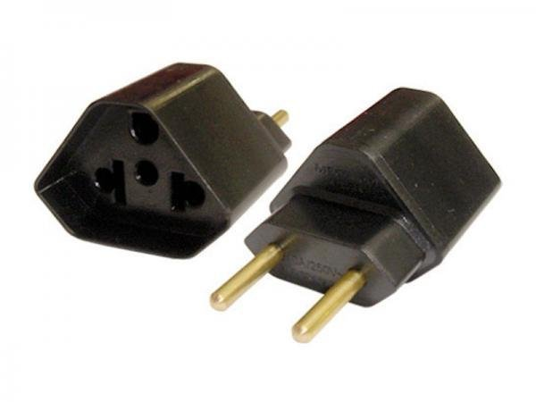
Solution? Adapters

Slide 6
Demo

