Slide 1
Do More Complex GARCH Models Improve Volatility Forecasting?
Applications to Value-at-Risk (VaR)
Fenglei Wu
MS in Financial Engineering Claremont Graduate University
April 2026
Notes:
Hello everyone, today I will present my project on volatility forecasting using GARCH-family models, with a focus on risk management applications.
The key question of this project is simple:
Do more complex GARCH models actually improve out-of-sample volatility forecasting, and can these forecasts be translated into reliable risk measures such as Value-at-Risk?
This question is important because in financial modeling, more complex models often fit historical data better, but may not perform Ill in real-world forecasting.

Slide 2
Workflow of the Analysis
Motivation & Data
Volatility Modeling
01
02
ETF data (SPY, QQQ, DIA)
Volatility clustering
Non-normality & ARCH effects
GARCH (baseline)
EGARCH / GJR (asymmetry)
Forecast Evaluation
Risk Application
03
04
Out-of-sample testing
Loss functions (MSE, MAE, QLIKE)
VaR estimation
Backtesting (Kupiec test)
Notes:
The workflow of this project is straightforward.
First, I analyze stylized facts of financial data to motivate the use of GARCH models.
Second, I estimate different GARCH-family models, including both symmetric and asymmetric specifications.
Third, I evaluate their forecasting performance using a strict out-of-sample framework.
Finally, I translate volatility forecasts into Value-at-Risk and validate them through backtesting.
So overall, this project builds a full pipeline from modeling to real-world risk application.

Slide 3
01 Motivation & Data
“Why GARCH Models for Volatility?”
Research Background
Research Questions
Empirical Observations
Do complex models improve forecasting performance?
Time-varying volatility
Volatility clustering
Implication
Volatility is predictable
Can volatility forecasts be used for reliable VaR?
Modeling Approach
GARCH family models
Notes:
Before building any model, I first examine the key characteristics of financial data.
One important observation is that volatility is time-varying and exhibits clustering.
This means that periods of high volatility tend to be folloId by high volatility, and periods of low volatility tend to persist as Ill.
This is important because it suggests that while returns themselves are difficult to predict, volatility is actually predictable.
This distinction is critical in financial time series modeling.
Therefore, models like GARCH are designed specifically to capture this predictable structure in volatility.

Slide 4



01 Motivation & Data
Data Description
Assets Under Study
Data Specifications
Data Processing Pipeline
SPY (S&P 500)
Large-cap U.S. equities
10-Year Timeframe
Jan 2015 - Jan 2025 Covers multiple market cycles
01. Log Returns Calculation
rₜ = ln(Pₜ / Pₜ₋₁)
QQQ (Nasdaq-100)
Focuses on U.S. tech and growth-oriented companies.
Daily Frequency
Uses official closing prices Adjusted for splits/dividends
02. Realized Volatility Proxy
21-day rolling variance as volatility proxy
DIA (Dow Jones)
Represents 30 blue-chip U.S. industrial stocks.
Reliable Source
Yahoo Finance API Accessed via Python (yfinance)
Notes:
I use three major US equity ETFs: SPY, QQQ, and DIA.
The sample spans from 2015 to 2025, covering different market conditions, including periods of stability and extreme volatility such as the COVID-19 crisis.
I compute daily log returns from adjusted closing prices.
In addition, I use a 21-day rolling variance as a proxy for realized volatility.
This proxy serves as a benchmark when evaluating the accuracy of model-based volatility forecasts.
While this is a simplified measure, it captures local variability in returns and is commonly used in practice.

Slide 5
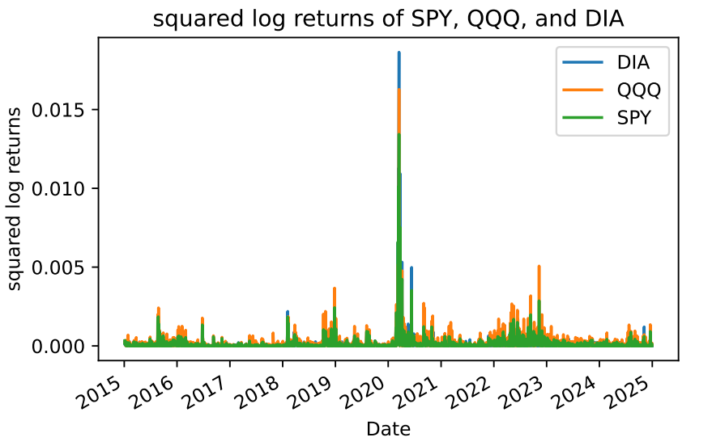
01 Motivation & Data
Stylized Fact: Volatility Clustering in ETF Returns
Key Observation:
Volatility is time-varying
Volatility clustering (persistence)
Extreme events (e.g., 2020)
Figure: Squared Log Returns (Volatility Proxy)
Notes:
Here I visualize volatility clustering using squared returns.
I observe that large movements tend to cluster together over time.
For example, during the COVID period, volatility spikes significantly and remains elevated for a period of time.
This confirms that volatility is not constant, but persistent and time-varying.
This is exactly the type of behavior that GARCH models are designed to capture.
So this provides strong empirical motivation for using conditional volatility models.

Slide 6
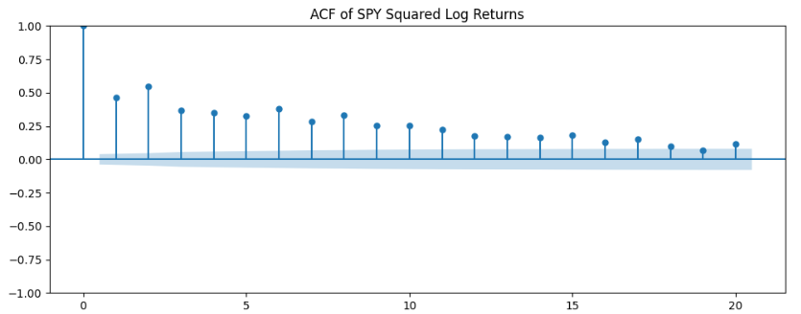
01 Motivation & Data
Stylized Facts: Non-Normality & ARCH Evidence
Evidence of Non-Normality
Evidence of ARCH Effects
Non-Normal Returns:
Negative skewness → downside risk
Excess kurtosis → fat tails
Significant ACF in squared returns → volatility clustering
ARCH-LM test p-values ≈ 0 → confirms conditional heteroskedasticity
Negative Skewness (Downside Risk)
Indicates a higher probability of large negative returns, meaning losses are more severe than gains.
Excess Kurtosis ("Fat Tails")
Extreme market events (crashes/rallies) occur much more frequently than predicted by a normal distribution.
Metric | SPY (S&P500) | QQQ (Nasdaq) | DIA (Dow)
Skewness | -0.8007 | -0.5531 | -0.9835
Kurtosis | ↑↑ | ↑↑ | ↑↑
ACF of Squared Returns (SPY)
Notes:
I also observe that returns are clearly non-normal.
There is negative skewness, indicating higher downside risk, and excess kurtosis(亏偷死s), indicating fat tails. This means extreme events occur more frequently than predicted by a normal distribution.
In addition, I observe strong ARCH effects. The ACF of squared returns shows significant autocorrelation, indicating volatility persistence.
I also perform ARCH-LM tests, which strongly reject the null hypothesis of constant variance.
Together, these results confirm the presence of conditional heteroskedasticity(he-te-ro-ske-das-TI-ci-ty), which justifies the use of GARCH-type models.

Slide 7
02 Volatility Modeling
GARCH Family Models
Symmetric Model
EGARCH (Log-form asymmetry)
GJR-GARCH (Threshold asymmetry)
GARCH(1,1) (Symmetric)
EGARCH (Exponential GARCH)
GJR-GARCH
Model volatility clustering using past shocks and past variance
Model asymmetry and ensures positivity via log variance
Captures the leverage effect (negative shocks increase volatility more)
Captures asymmetric response via an indicator for negative shocks
γ > 0 implies a stronger impact of negative shocks
σₜ² = ω + αεₜ₋₁² + βσₜ₋₁²
ln(σ_t²) = ω + β ln(σ_{t-1}²) + α (|ε_{t-1}| / σ_{t-1} − E|z|) + γ (ε_{t-1} / σ_{t-1})
σ_t² = ω + α ε_{t-1}²
+ γ I_{t-1} ε_{t-1}²
+ β σ_{t-1}²
Based on the stylized facts, I first use GARCH to capture volatility clustering, and then extend to EGARCH and GJR-GARCH to account for asymmetric volatility dynamics.
Notes:
I consider three models in this project.
First, GARCH(1,1) as the baseline model, which captures volatility persistence using past shocks and pas variance.
Second, EGARCH, which models the logarithm of variance and captures asymmetry.
Third, GJR-GARCH, which also captures asymmetric effects using a threshold (帅洗后) mechanism.
The key idea behind the asymmetric models is that negative shocks tend to increase volatility more than positive shocks.
The key question here is whether this additional complexity actually improves forecasting performance.

Slide 8
03 Forecast Evaluation
Out-of-Sample Evaluation Strategy
Model Estimation
Out-of-Sample Forecasting Strategy
Rolling Window Approach (Simulating Real-World Scenarios)
Core Method: MLE
I employ Maximum Likelihood Estimation to estimate the parameters of all models, which is standard in econometric research.
Training Set (In-sample) 2015-01-01 ~ 2022-12-31
Test Set (Out-of-sample) 2023-01-01 ~ 2025-01-01
Distribution Assumption
Iterative Forecasting Process
Residuals are assumed to follow aNormal Distribution, ensuring the validity of statistical inference in our model.
01 Estimate Params w/ Initial Train Set
02 Forecast Volatility for Next Day (t+1)
03 Roll Window Forward Add New Observation
04 Repeat Process Until End of Test
"MLE provides efficient and consistent parameter estimates."
Key Benefit: This strict process eliminates "Look-ahead Bias" by only utilizing past information for prediction.
Notes:
I evaluate all models using a strict out-of-sample framework.
The data is split into a training set and a test set.
I use an expanding window approach, where the model is re-estimated as new data becomes available.This setup is very important.
In financial modeling, in-sample fit can be misleading, because complex models can always fit historical data better.
HoIver, what really matters is out-of-sample performance.
This approach mimics real-world forecasting conditions and completely avoids look-ahead bias.
So it provides a realistic and robust evaluation of model performance.

Slide 9
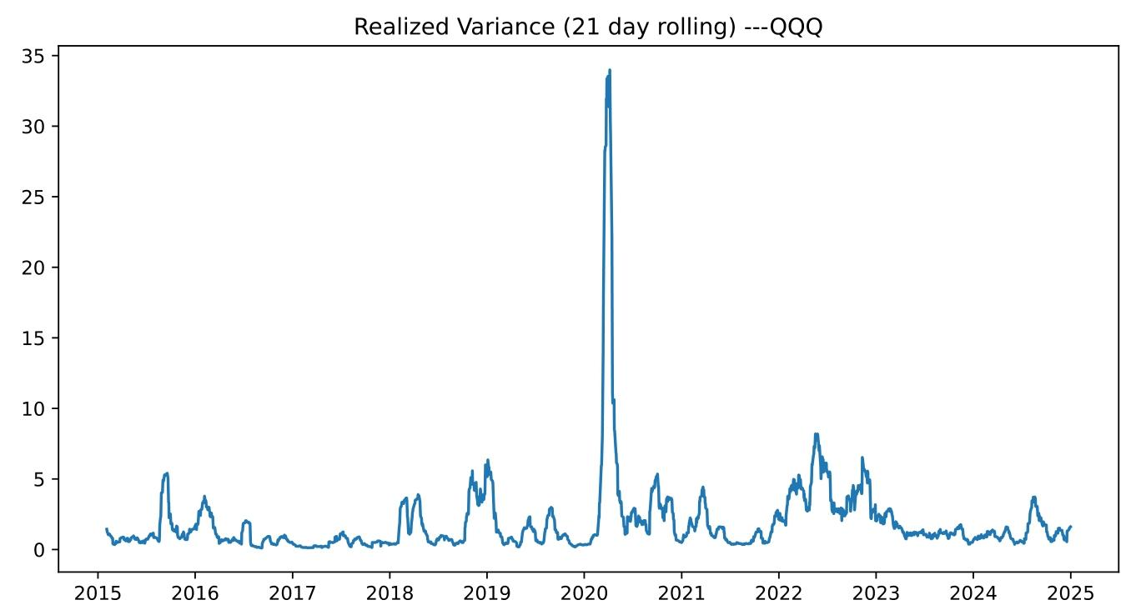
03 Forecast Evaluation
Benchmark: Realized Volatility
Mean Squared Error (MSE)
penalizes large errors
21-day rolling variance as proxy
Represents “true” volatility.
MSE = (1/T) Σ (σₜ² - σ̂ₜ²)²
Mean Absolute Error (MAE)
robust to outliers
MAE = (1/T) Σ |σₜ² - σ̂ₜ²|
QLIKE Loss Function
sensitive to underestimation (important for risk)
Figure 1: QQQ 21-day Rolling Realized Variance
QLIKE = (1/T) Σ [ ln(σ̂ₜ²) + (σₜ² / σ̂ₜ²) ]
LoIr loss = better forecasting performance
Notes:
I evaluate forecasting performance using three loss functions: MSE, MAE, and QLIKE.
Each loss function captures a different aspect of forecast accuracy.
MSE penalizes large errors more heavily.
MAE is more robust to outliers.
QLIKE is particularly important in volatility modeling, because it penalizes underestimation of volatility.
This is critical in risk management, since underestimating volatility can lead to underestimated risk.So using multiple loss functions ensures a more comprehensive evaluation.

Slide 10
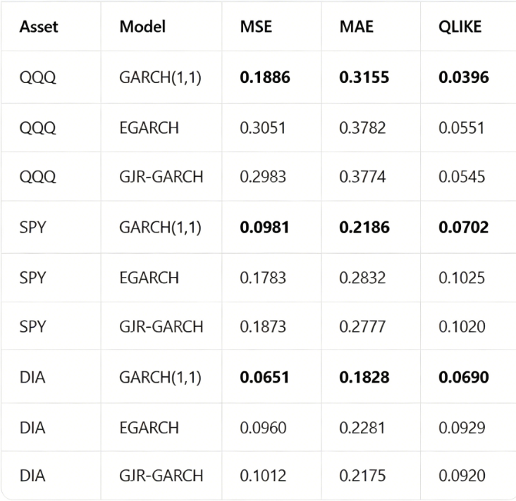
03 Forecast Evaluation
Model Comparison Results
📊 Forecast Metrics Summary (LoIst in Bold)
🔑 Key Finding:
GARCH(1,1) outperforms all models across assets and metrics
💡 Why complex models fail？
Capture asymmetry in-sample
Worse out-of-sample → overfitting
Notes:
The results are very clear.
GARCH(1,1) consistently outperforms all more complex models across all assets and all evaluation metrics.
This is an important finding.
Even though EGARCH and GJR-GARCH provide a better in-sample fit, they do not improve out-of-sample forecasting performance.
This suggests that the additional flexibility may lead to overfitting, and does not generalize Ill to new data.So in this case, a simpler model is actually more robust.
This highlights a key principle in financial modeling: robustness is often more important than complexity.

Slide 11
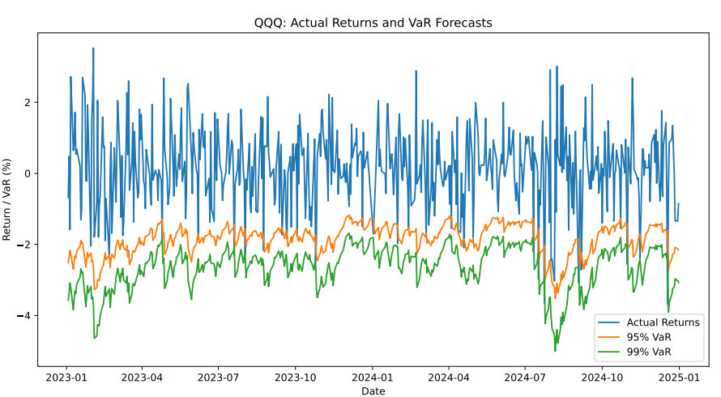
04 Value-at-Risk (VaR) Forecasting
Dynamic VaR Forecast (QQQ)
From Volatility Forecast to Risk Measurement
Volatility forecasts → input for risk models
I convert σ̂ₜ into VaR
Goal: evaluate practical risk usefulness
VaRₜ = μ + zₐ × σ̂ₜ
VaR dynamically adjusts to changing volatility conditions
Notes:
Next, I translate volatility forecasts into Value-at-Risk.
This step is important because it connects statistical modeling with real-world applications.
In practice, institutions are not directly interested in volatility, but in potential losses.
So by converting volatility forecasts into VaR, I can quantify downside risk.
Since volatility is time-varying, VaR also adjusts dynamically with market conditions.

Slide 12
04 VaR Backtesting
VaR model is Ill-calibrated and statistically valid
Failure Rate ≈ Expected Level
Kupiec Test: No Rejection
Close to 5% (95% VaR)
Close to 1% (99% VaR)
A statistical test to formally check if the actual failure rate is significantly different from the expected rate. Null hypothesis: the model is correctly specified.
Asset | Level | Expected | Actual
QQQ | 95% | 5.00% | 5.38%
QQQ | 99% | 1.00% | 1.79%
SPY | 95% | 5.00% | 5.58%
DIA | 95% | 5.00% | 4.78%
Asset | Level | p-value | Conclusion
QQQ | 95% | 0.701 | Not Reject
QQQ | 99% | 0.108 | Not Reject
SPY | 95% | 0.560 | Not Reject
DIA | 95% | 0.821 | Not Reject
VaR forecasts pass statistical backtesting and are reliable for risk management
Notes:
I evaluate the VaR forecasts using violation rates and the Kupiec（库皮克） test.
The idea is simple: if the model is Ill calibrated, the actual violation rate should match the expected level.
In our results, the violation rates are close to the expected levels for both 95% and 99% VaR.
The Kupiec test also fails to reject the null hypothesis.
This indicates that the VaR model is Ill calibrated and statistically reliable.

Slide 13
Risk Management Insights
Dynamic Risk Assessment
Robustness
Time-varying volatility
VaR adapts to market conditions
GARCH(1,1) outperforms
Out-of-sample > model complexity
ES / CVaR
Backtesting
VaR misses tail severity
Use ES / CVaR for full risk view
Validate model reliability
Required before real-world use
Notes:
Based on these results, I can draw several key insights.
First, volatility models enable dynamic risk measurement.
Second, robustness matters more than model complexity.
Third, VaR should be complemented with Expected Shortfall to capture tail risk.
Finally, backtesting is essential before using any model in practice.

Slide 14
Limitations
Model performance is subject to distributional assumptions and data limitations
Distribution Assumption
Risk Measure
Normality underestimates tail risk
Use fat-tailed distributions (e.g. t)
Focus on VaR only
Missing tail severity
Model Stability
Volatility Proxy
Assumes stable volatility dynamics
May fail under regime shifts
Rolling variance is a rough proxy
High-frequency data improves accuracy
Notes:
There are several limitations.
I assume normality, which may underestimate tail risk.
I focus only on VaR, which does not capture the magnitude of extreme losses.
GARCH models assume stable dynamics, which may not hold under regime shifts.
And the volatility proxy is simplified.
So the results should be interpreted with caution, especially during extreme market conditions.

Slide 15
Conclusion
Simple models outperform complex ones and deliver reliable risk estimates
GARCH(1,1) Outperforms
Reliable VaR Measure
Best out-of-sample performance
Robust across assets
Ill-calibrated
Passes backtesting
Practical Implication
Future Research Directions
Simple models work in practice
Robustness > complexity
Fat-tailed distributions
Expected Shortfall (ES)
Regime-switching models
Overall, this project provides a clear case study on selecting and validating an effective risk management tool through rigorous empirical analysis.
Notes:
To conclude,
This project builds a complete pipeline from volatility forecasting to risk validation.
I find that GARCH(1,1) provides the best out-of-sample performance.
Its VaR estimates are Ill calibrated and pass statistical backtesting.
The key takeaway is that in practice, simple models can outperform more complex ones.
Robustness matters more than complexity.

Slide 16
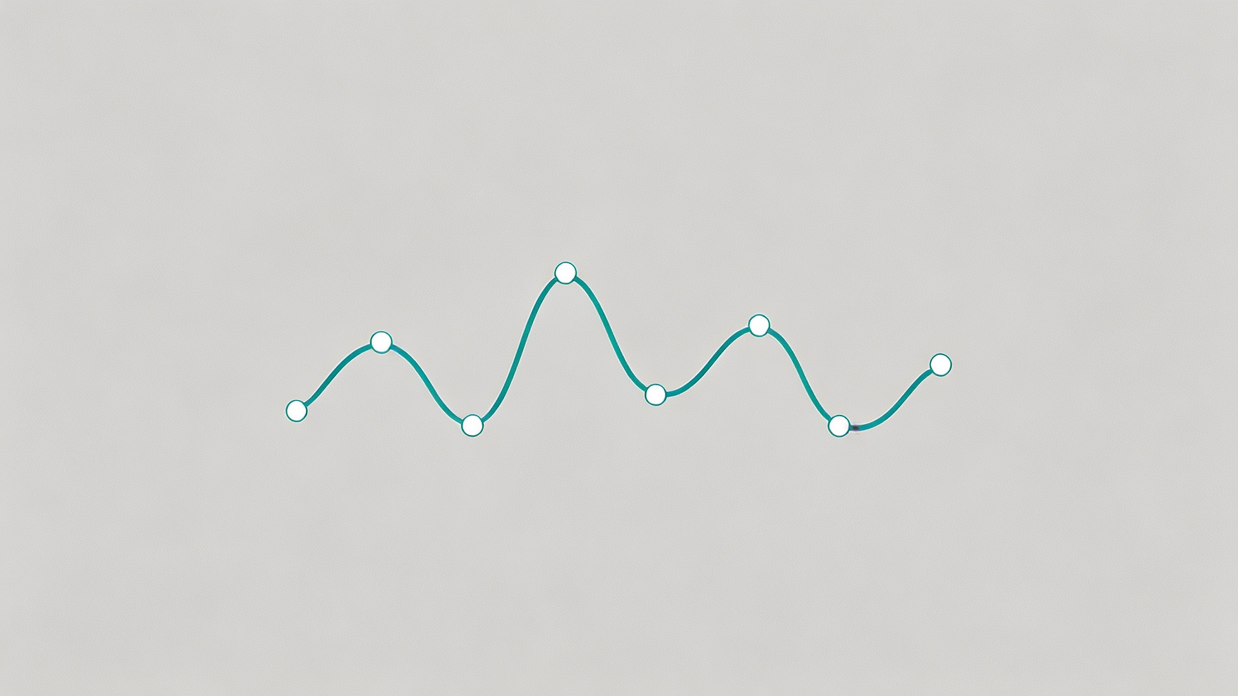
Thank You
Q & A
QUESTIONS & ANSIRS
THANKS FOR YOUR ATTENTION

