Slide 1
Variables and Measurement
SSI II
January 10, 2019

Slide 2
Previously…
Quantitative Data and Measurement
Fall quarter

Slide 3
Essential Questions
What are the different ways we can organize data?
How should we evaluate measures?

Slide 4
Evaluating Measurement
Fall Quarter Review

Slide 5
Reliability
A measure is reliable if it is repeatable or consistent
Does the measure produce the same results on repeated trials?
Survey questions
Content analysis
Indices
Etc.

Slide 6
Validity
How accurately does the measure represent the concept?
Example: What might be wrong with the validity of crime rates?

Slide 7
Checking Validity
Face validity – common sense, reasonableness
Content validity – comprehensiveness of definition
Construct validity – when a measure of a concept is associated with a measure of a different concept that is thought to be theoretically related

Slide 8
Examples of Poor Face Validity
Literacy rate -> proportion of people who have 6 years of formal education
Intelligence -> years of education
Party ID -> ideology

Slide 9
Content Validity
Dahl says democracy is ‘contestation’ and ‘participation’
The Polity IV scores only look at contestation
They are not a great measure of content validity for Dahl’s definition of democracy

Slide 10
Construct Validity
A pretty wide body of evidence shows that as education increases, crime rates decrease
If you measure education levels with a specific test and that is not correlated with crime rates, that suggests a construct validity issue for that test as a measure of education

Slide 11
Reliability and Validity
Both reliability and validity are necessary for hypothesis tests
Unreliable measures -> unreliable tests
Invalid measures -> meaningless tests
Unfortunately (or fortunately), these come in degrees
Many measures are neither perfectly valid nor perfectly reliable

Slide 12
Maximum Information Possible
We also want to get as much information as possible
Without sacrificing validity or reliability
Which types of variables give you the most information?

Slide 13
Types of Variables
More Fall Review

Slide 14
Categorical Variables
Also called nominal variables, qualitative variables, or factor variables
Variables that we cannot rank
Gender, Religion, Country of Nationality, etc.

Slide 15
Dichotomous/Dummy/Binary Variables
Categorical variables with only two categories
Male or Female
Democracy or nondemocracy
Catholic or not Catholic
Student or not student
Any categorical variable can become a series of dichotomous or dummy variables

Slide 16
Dummy Variable Names
Make these meaningful!
You could use “Gender”
What more information do you get by using “Female?”

Slide 17
Ordinal Variables
A few categories, can be ordered/ranked, but the difference between groups may not be consistent
Ideology, religiosity, any survey question with choices of ‘strongly agree’, ‘agree’, etc.

Slide 18
Continuous Variables
Anything you can count or that increases consistently
“variables that have equal unit differences”
Age, GDP, vote share, etc.

Slide 19
Discrete/Count Variables
A variable that can only take whole number values
If there are enough values, it can often be treated as continuous
Which one matters for the types of statistical tests you can do, but this is mostly beyond the scope of the class

Slide 20
Interval Scales
Continuous variables for which:
Zero may not hold a real meaning
Intervals do not have a consistent interpretation throughout
Fahrenheit, Celsius, IQ

Slide 21
Ratio Scales
Continuous variables for which:
Zero does have real meaning
Ratios have consistent meaning at any point on the scale
Kelvin, money, age (?)

Slide 22
Is age always continuous/ratio?
Ordinal
18-24, 25-34, 35-44, etc.
Discrete/Count
# of days “old” at which a seed sprouts
Binary/dichotomous/dummy
Is a first grader 6 or 7?
Is a woman’s youngest child younger or older than 6? Younger or older than 18?

Slide 23
Examples

Slide 24
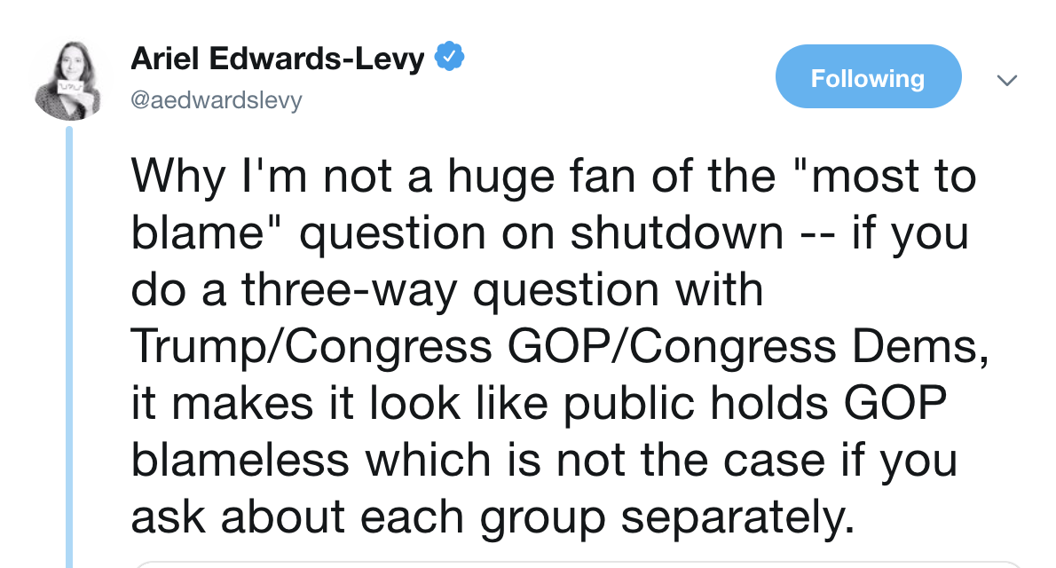

Slide 25
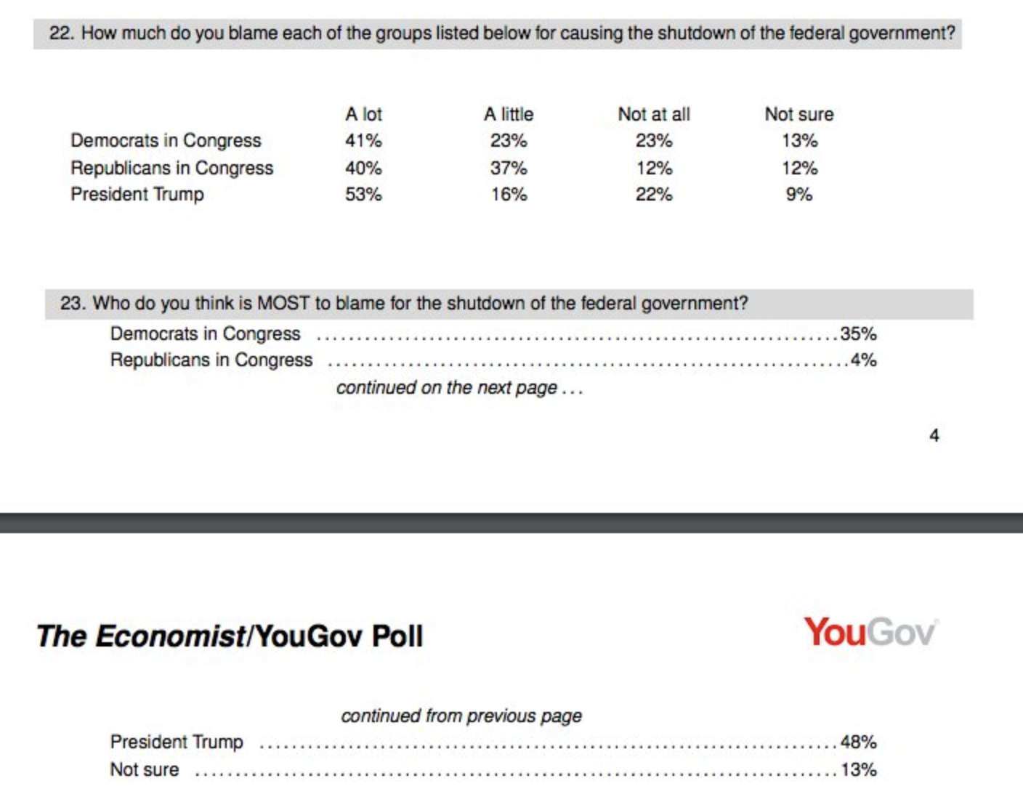

Slide 26
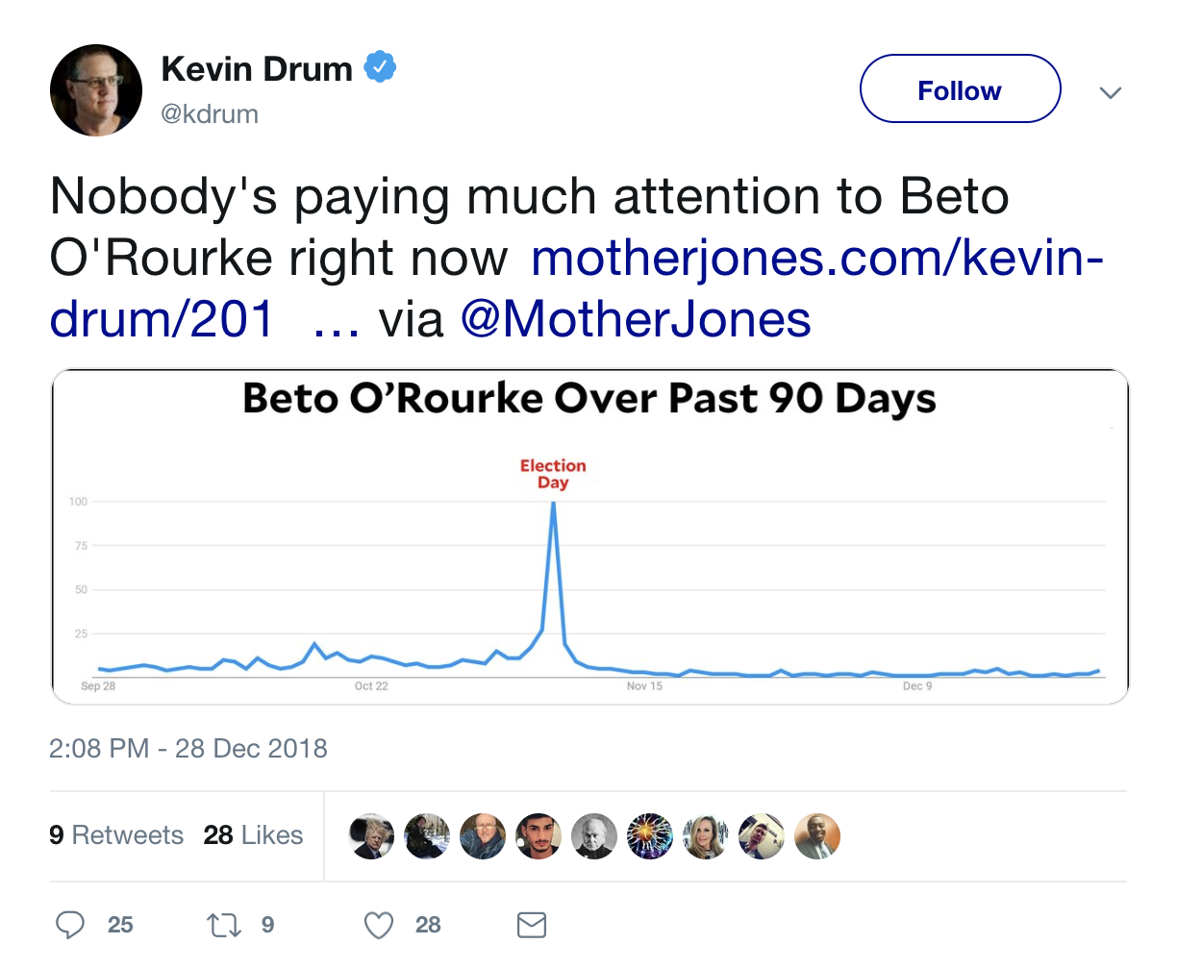

Slide 27
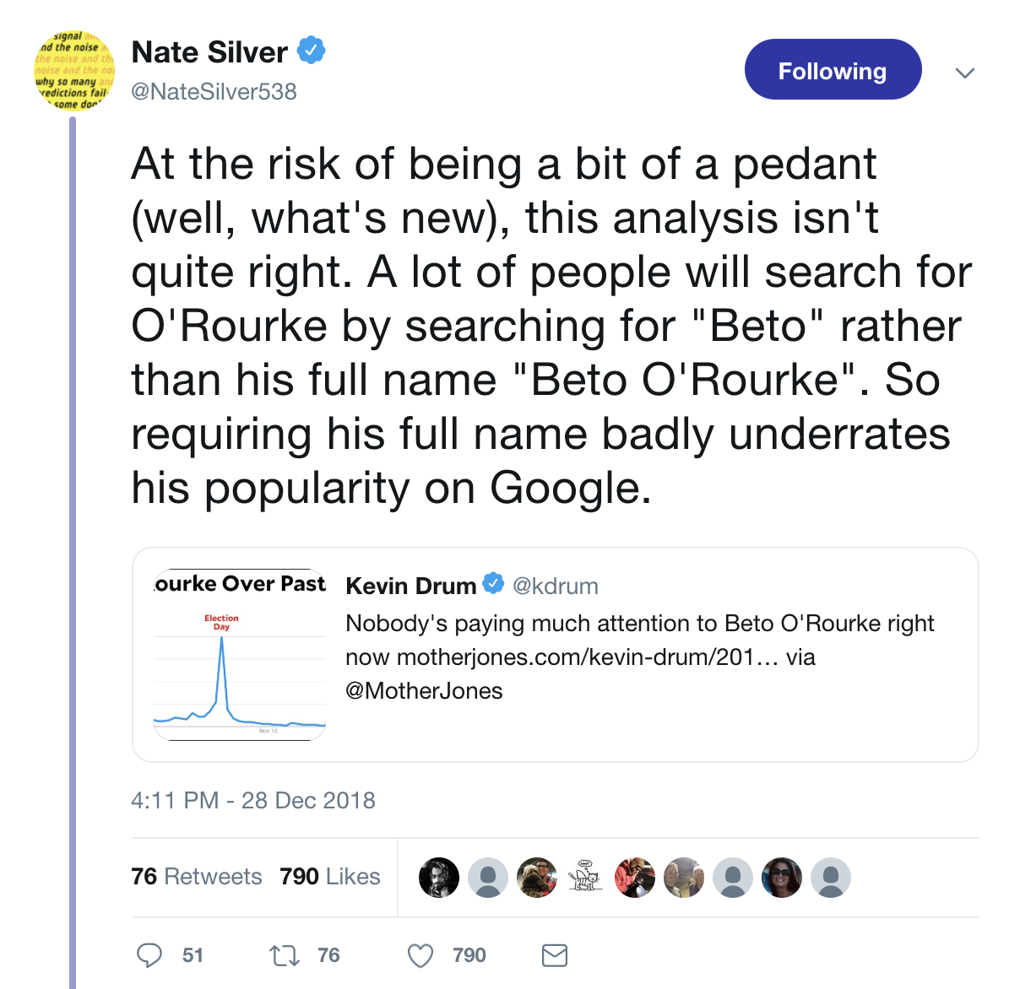

Slide 28
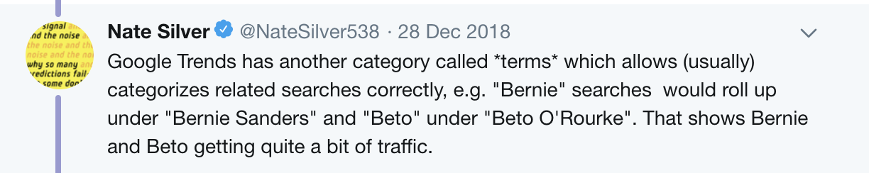

Slide 29
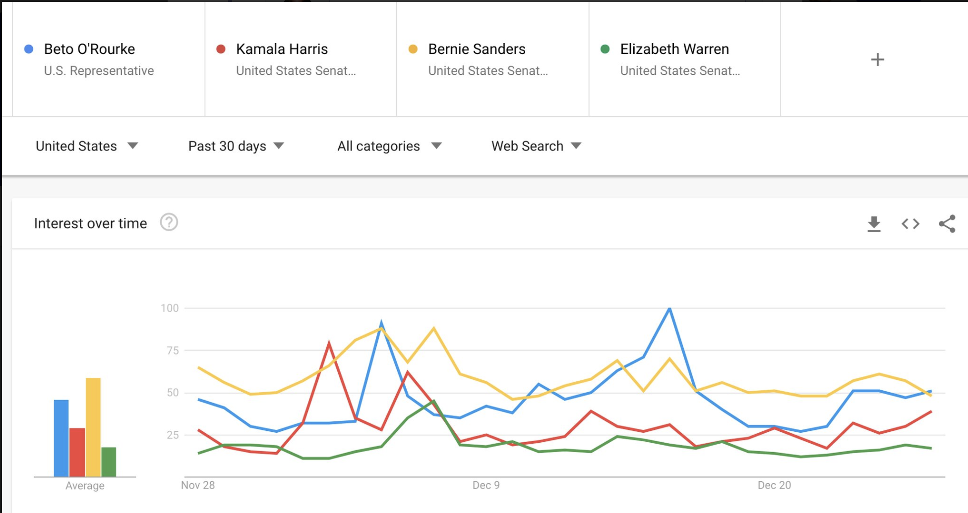

Slide 30
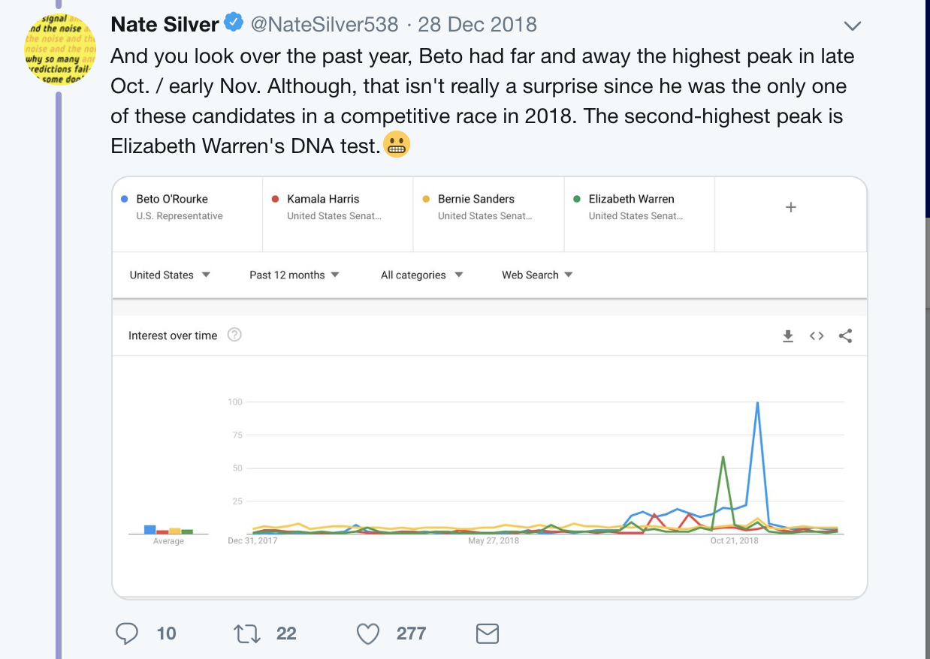

Slide 31
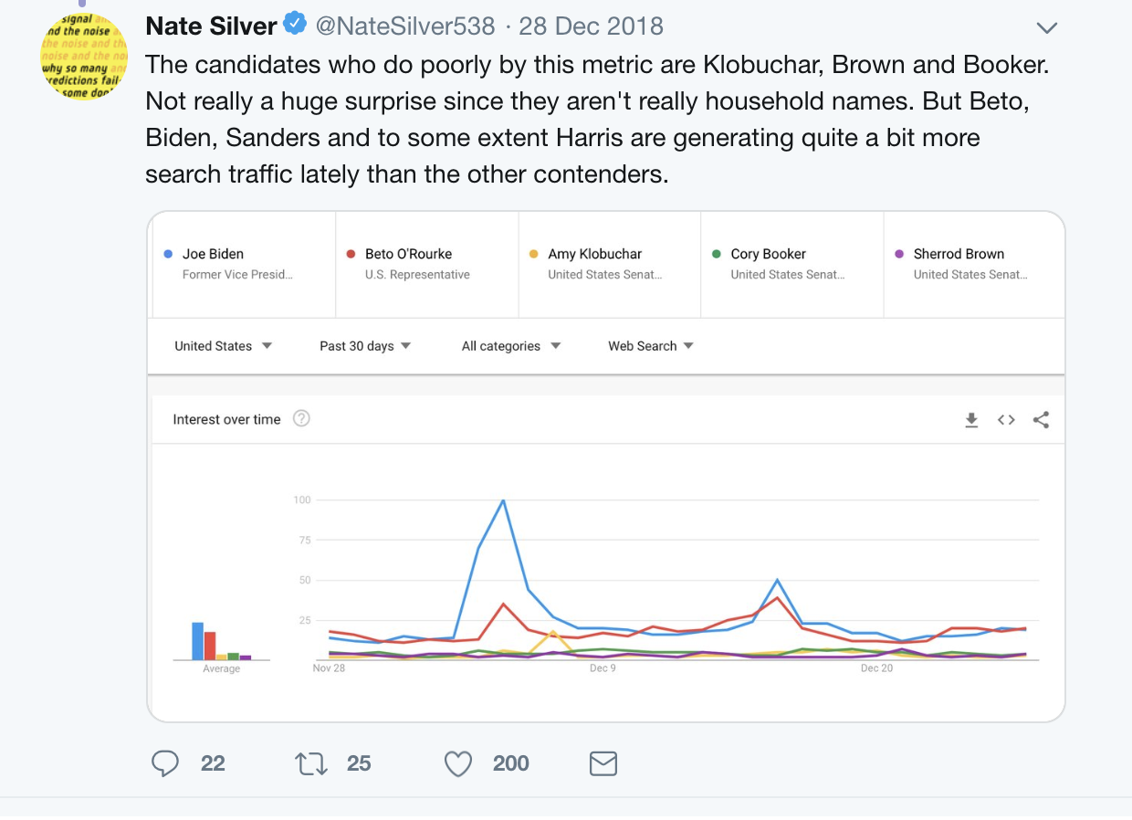

Slide 32
Essential Questions
What are the different ways we can organize data?
How should we evaluate measures?

Slide 33
Next Time…
Visual representations of data
Graphs and Tables
How do these depend on the type of variable?

